Slide 1
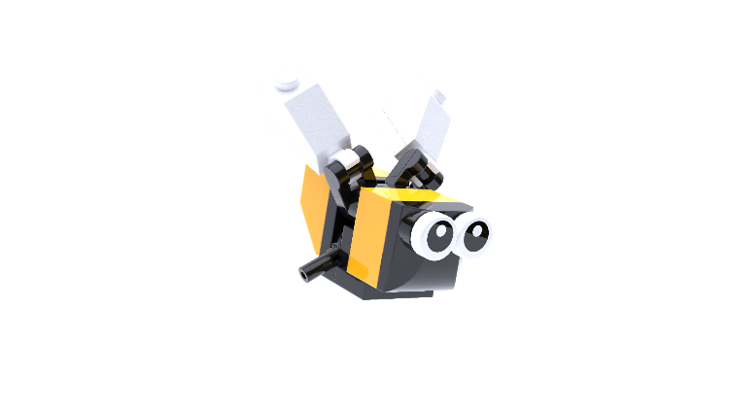

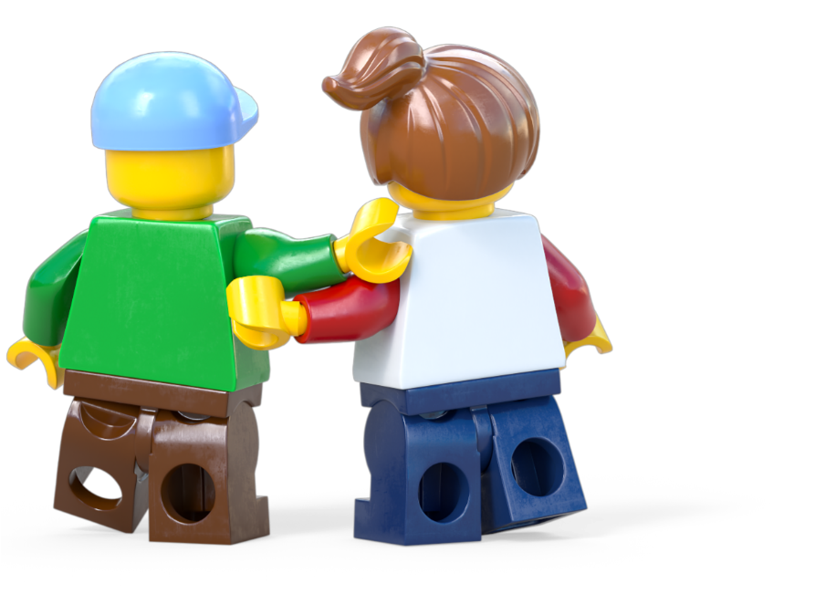
Build for Belonging
Build for Nature Workshop
Ages 7-11
Build the Change is supported by the LEGO Foundation. LEGO, the LEGO logo, the Minifigure and the Brick and Knob configuration are trademarks and copyrights of the LEGO Group. ©2025 The LEGO Group. All rights reserved.

Slide 2
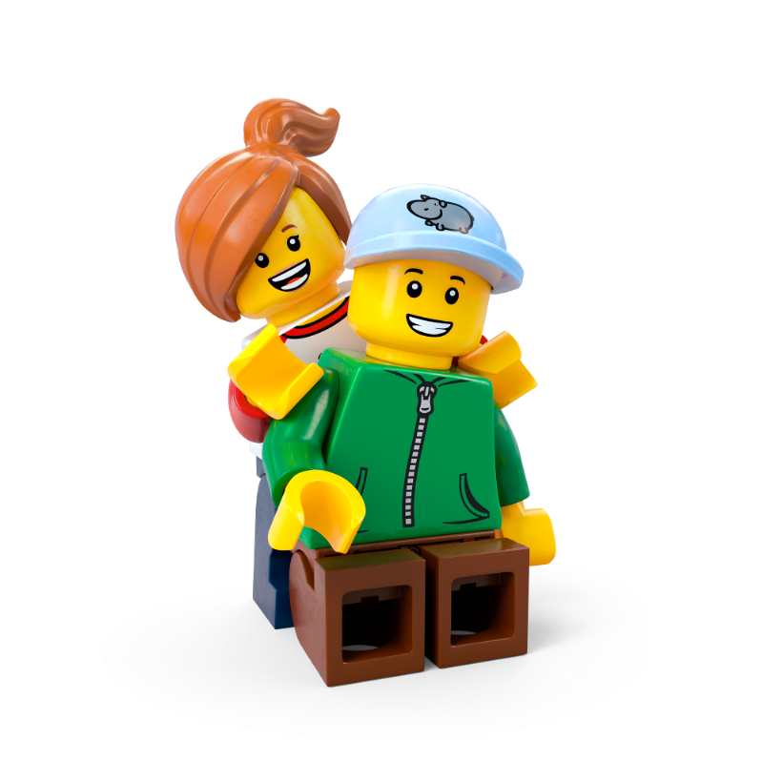
Contents
Workshop 1 Immerse (slides 3-22)
News Detectives Article (slides 12-13)
Planet People Podcast (slides 15-20)
Build for Belonging Design Brief (slides 21-22)
Take Action! Optional Extension (slides 23-26)
Workshop 2 Create and Share (slides 27-39)
Design brief (slides 32-34)
Challenge checklist (slide 35)
Competition Information (slide 37)
Appendix (slides 40-41)
Team roles (slide 41)

Slide 3
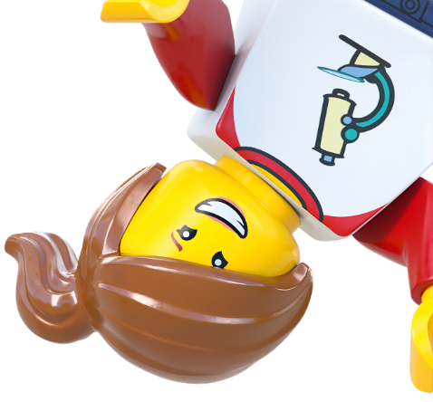



Lesson 1
Immerse

Slide 4



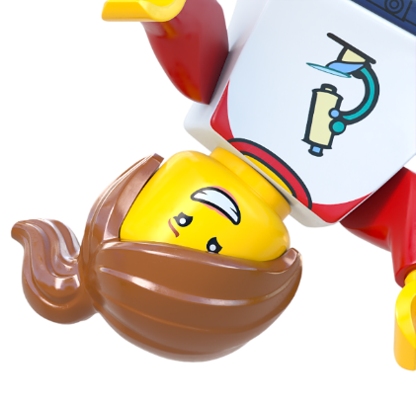
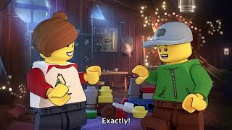

Notes:
Time - 2mins
Play the video to introduce pupils to the LEGO Group’s Build the Change programme.
https://www.youtube.com/watch?v=D7z8iXqjIkE

Slide 5
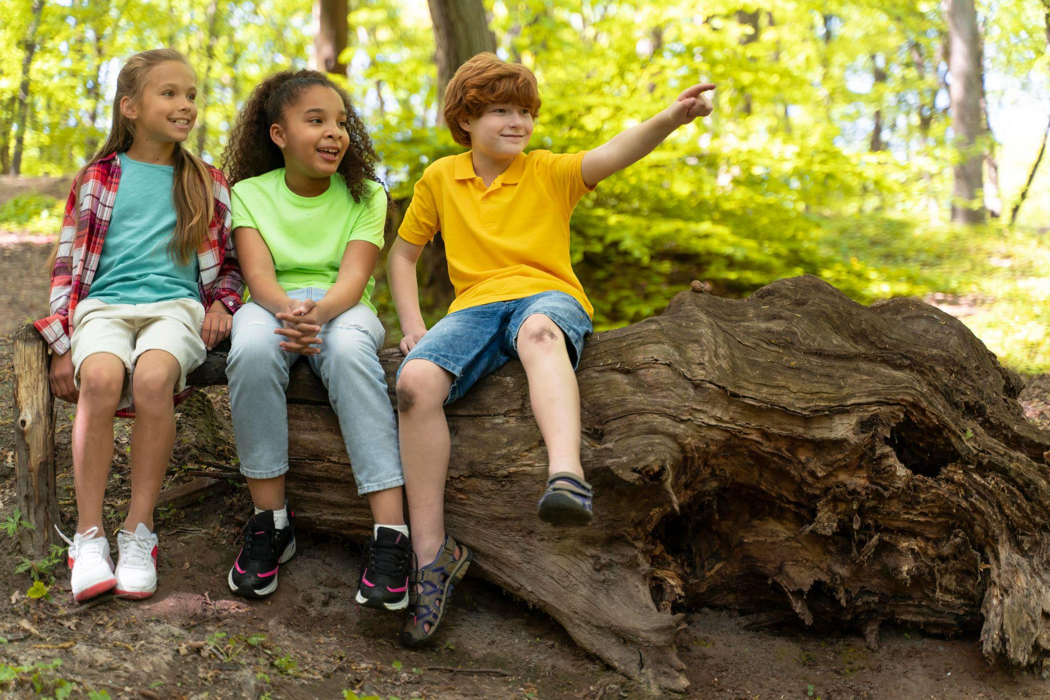
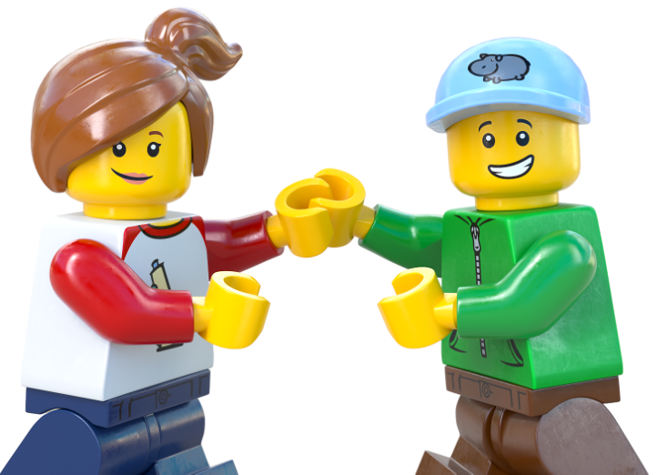

Recreate a happy moment...
In nature.
c Freepik
Notes:
Time - 3 mins
Use our playful activity to introduce the topic. Ask pupils to draw or build a happy moment spent outdoors, with nature.
Encourage pupils to think about a fun time they’ve had outdoors, in nature. Use the creative materials to create, build or draw that moment. It doesn’t have to look exactly like it did – encourage pupils to make it their own! Invite them to picture how they felt in that moment.
What made it special?

Slide 6

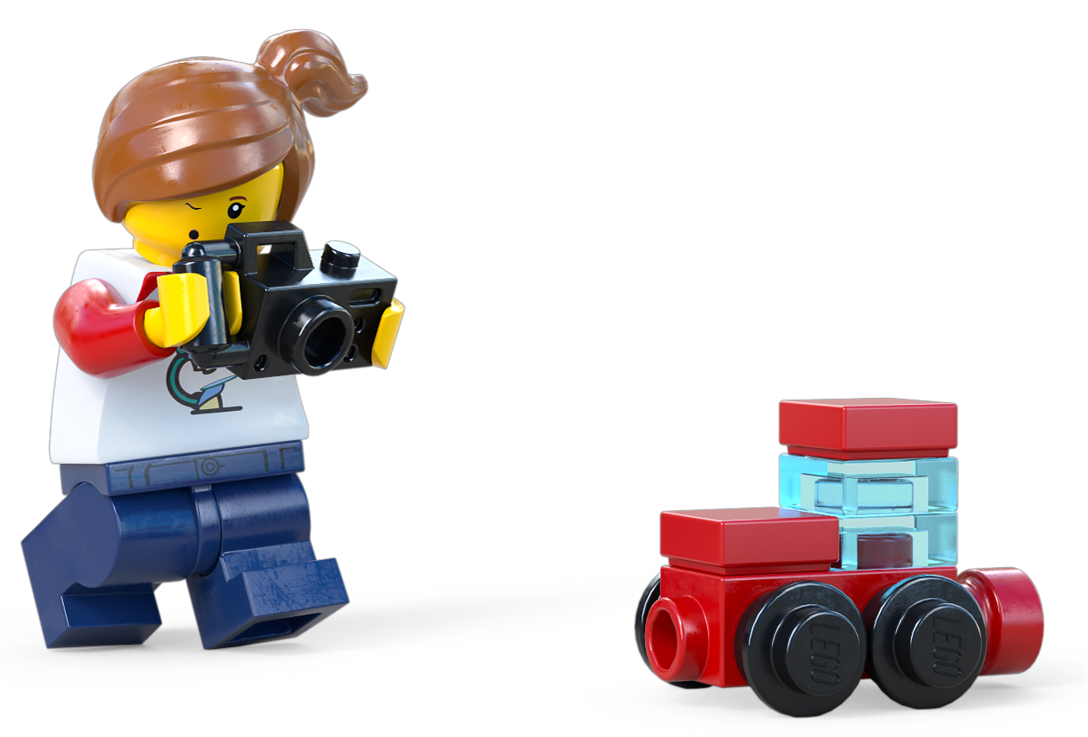
Share your happy moment
Notes:
Time - 2 mins
Encourage them to share memories and feelings in pairs or as a class.
You could ask them:
How did you feel at this time?
What words or feelings come to mind?
Would it have been the same or different if you’d experienced it indoors, away from nature?

Slide 7


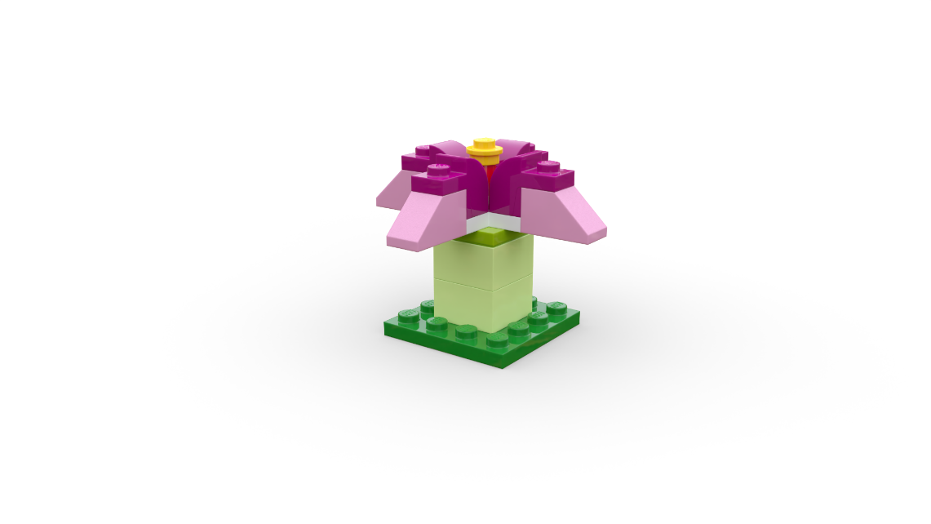
Nature Quiz
If you think the statement is false, sit down.
If you think it’s true, stand up.
Notes:
Time - 6 mins
Use our Nature Quiz to link your pupils' positive personal experiences to the proven benefits of being outside in nature.
Instruct pupils to listen to the following statements. Decide if each one is TRUE or FALSE. Some of these statements sound true, but are they really?
Read out the true or false statements in the slide notes. If pupils think the statement is false, ask them to sit down. If they think it is true, ask them to stand up.
Ask pupils to explain their answers before clicking to reveal the answer.

Slide 8

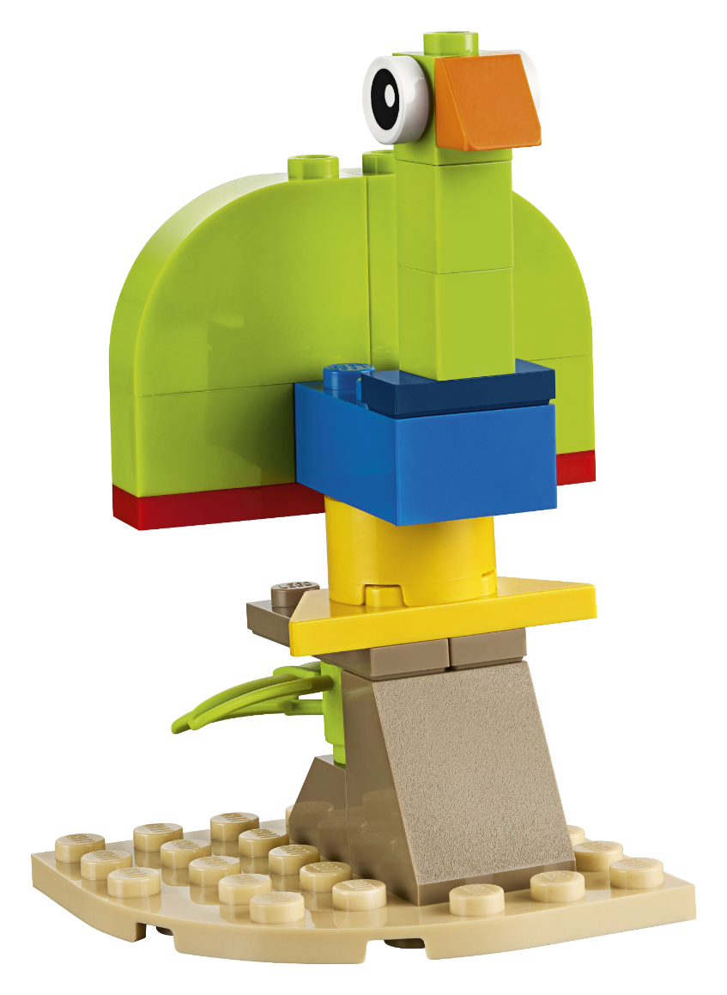
True
or False?
✅ True!
If you think it is
TRUE - stand up
If you think it is
FALSE - sit down
Notes:
Read statement:
Watching animals in nature, like birds or squirrels, can make people feel calmer and happier.
Click to reveal: TRUE
Even short moments of watching nature can make you feel more positive and less worried.

Slide 9
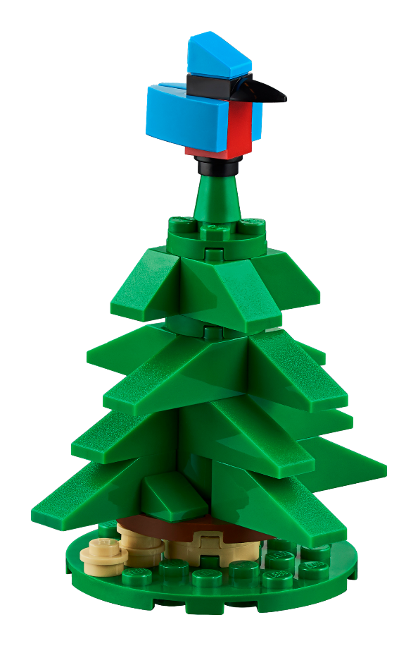
True
or False?
❌ False!
If you think it is
TRUE - stand up
If you think it is
FALSE - sit down
Notes:
Read statement:
Being outside makes you feel more tired, which is why it’s harder to sleep after a Day outdoors.
Click to reveal: FALSE
Fresh air and natural light actually help us sleep better at night.

Slide 10
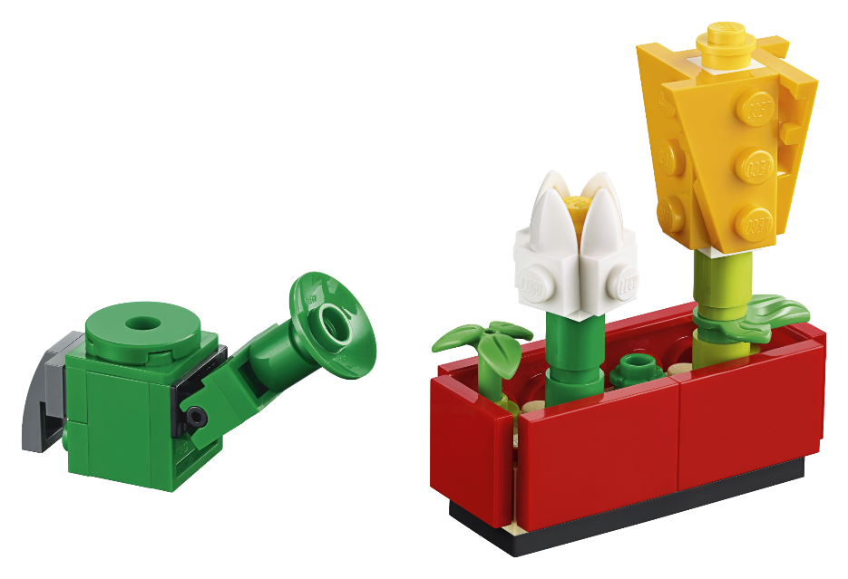
True
or False?
✅ True!
If you think it is
TRUE - stand up
If you think it is
FALSE - sit down
Notes:
Read statement:
Spending time outdoors can help your brain work better and make it easier to focus.
Click to reveal: TRUE
Nature can help people concentrate and feel more refreshed after time outside.

Slide 11
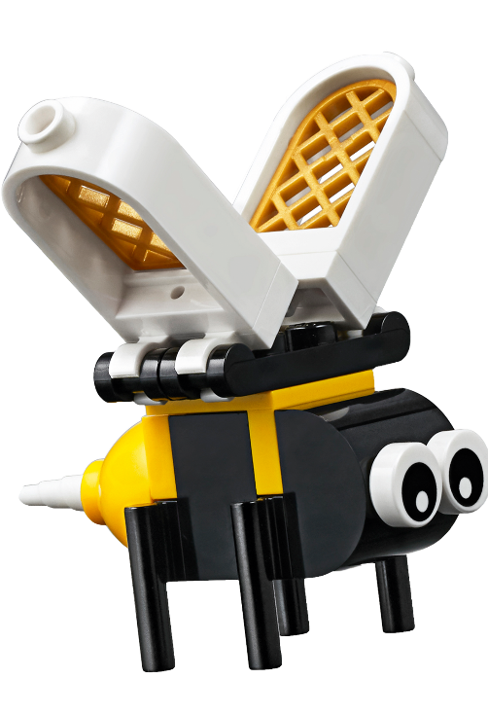
True
or False?
❌ False!
If you think it is
TRUE - stand up
If you think it is
FALSE - sit down
Notes:
Read statement:
The sun is bad for your skin, so it’s better to stay indoors all year round.
Click to reveal: FALSE
The sun gives us vitamin D, which is important for strong bones— don’t forget to wear sunscreen and a sun hat before going outside in sunshine!

Slide 12
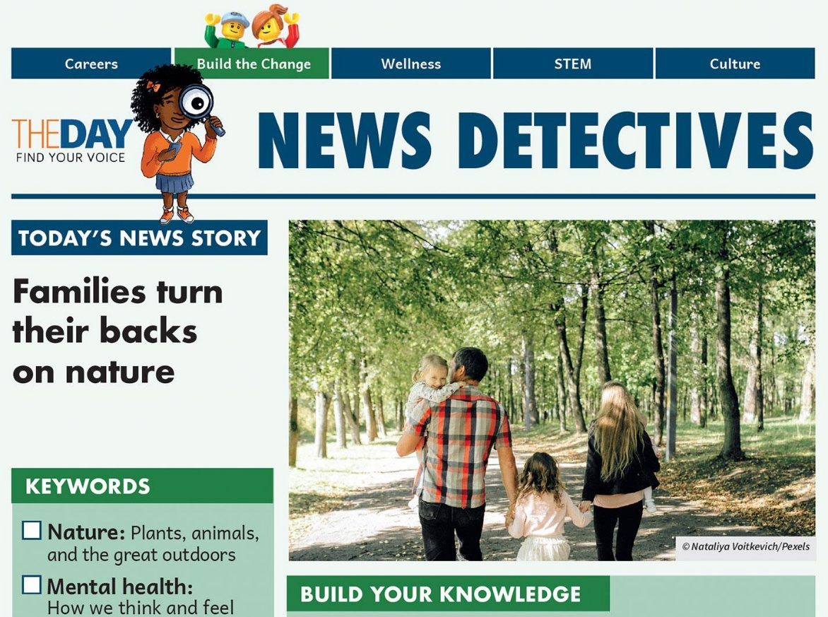
Read all about it!
Fewer People Enjoying Nature’s Magic!
Download the news article here.
Notes:
Time - 9 mins
Read the News Detectives article:
Start by exploring the KEYWORDS, and introduce the WHAT YOU NEED TO KNOW section.
Read TODAY’S NEWS STORY independently, or as a class, depending on your class’ reading ability.
https://buildthechange.theday.co.uk/resources/families-turn-their-backs-on-nature/

Slide 13
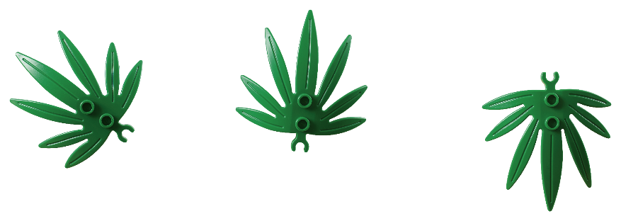
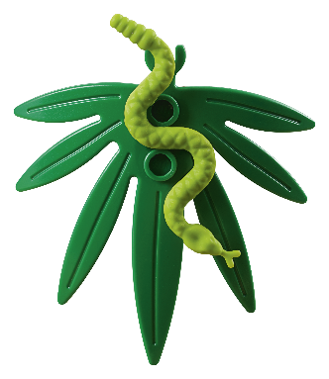
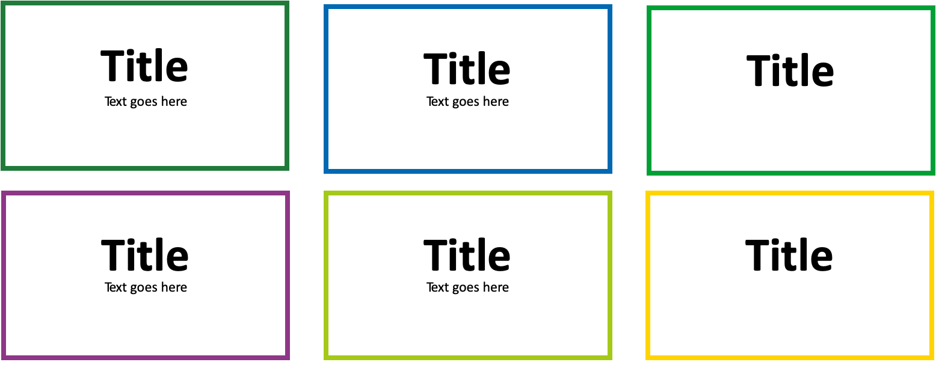
What did we learn?
What
Who
Where
When
Why
How
Notes:
Time - 4 mins
Use the WWWWWH? questions to check their understanding.
What can we improve by being outside?
ANSWER: Our physical and mental health
Who says being in nature makes them feel more alive?
ANSWER: Dom Higgins
Where could people spend more time outside?
The article talks about forests and beaches – but any time outdoors is beneficial - including playing just outside your front door, on a green patch of grass or chilling out on your balcony.
When did people start spending more time outside?
ANSWER: The Covid-19 pandemic
Why are many people getting outside less?
ANSWER: Busy with school or work
How much time spent outdoors can boost our health?
ANSWER: 20 minutes

Slide 14
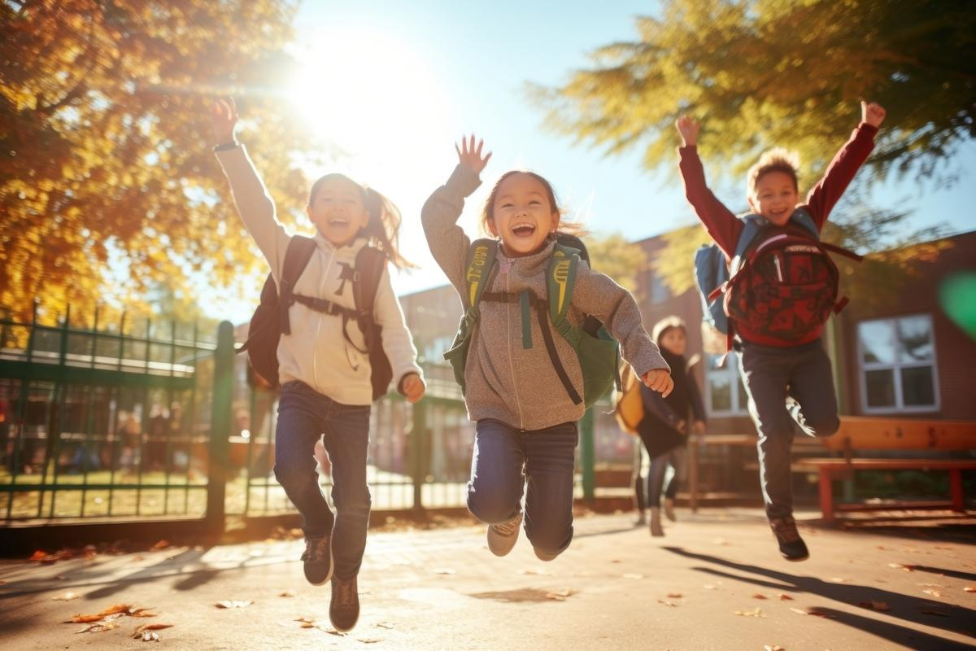

Investigation of The Day
How can we make sure everybody benefits from nature?
c macrovector/Freepik
Notes:
Time - 2 mins
Point pupils to the Investigation of the Day question (also on page 2 of the News Detectives Article): How can we help everybody benefit from nature?
Take some ideas from the class. Tell pupils they are about to explore this question in more depth with a special expert.

Slide 15
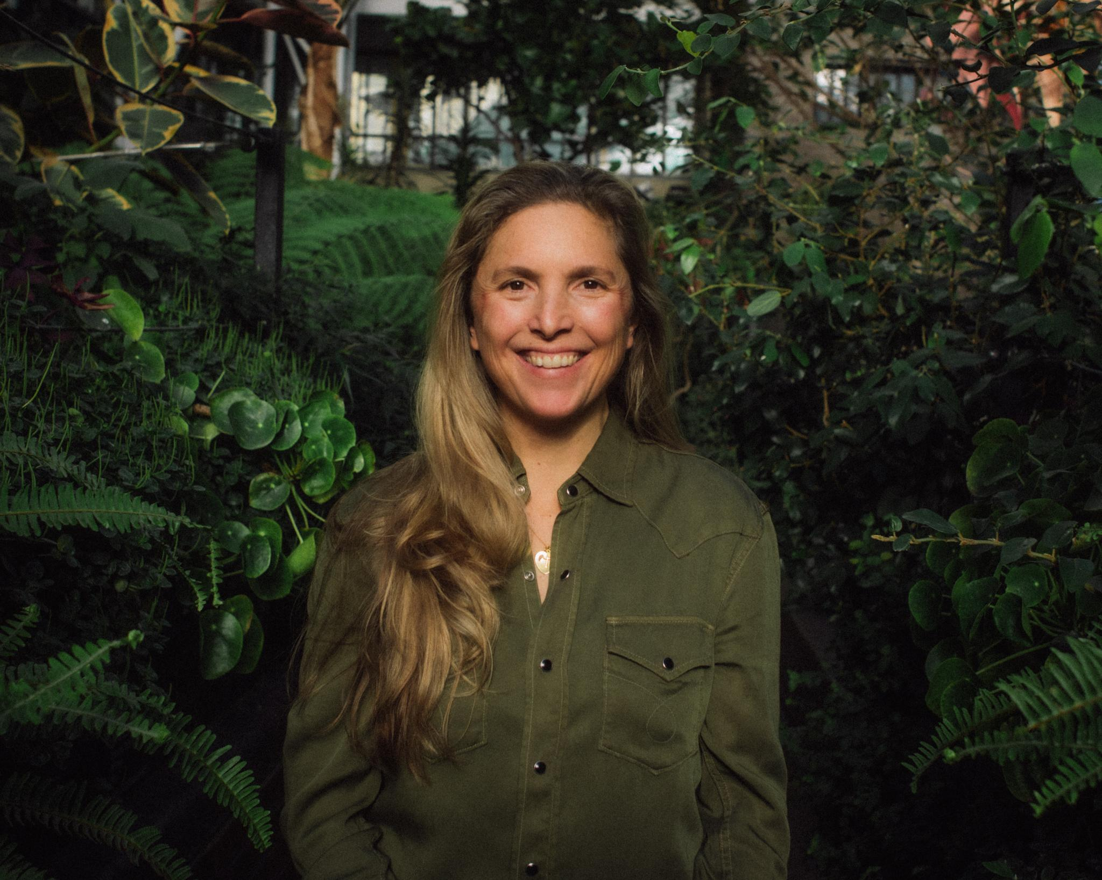
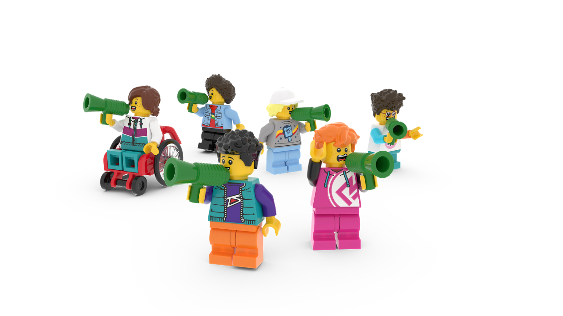
The Planet
People Podcast
Meet our special podcast guest Elise Van Middelem, who leads big nature-based projects and has funded close to 240 pocket forests in 52 cities worldwide!
You’ll hear from her on the Build for Nature podcast episode, up next!
Notes:
Seat pupils in teams around creative materials. Each pupil should have a Competition Worksheet in front of them. Explain that while they listen to the Planet People Podcast, they will be able to build or draw while they listen. They should also remember to keep adding useful information or ideas to the topic Mind Map they started in their Competition Worksheet.

Slide 16
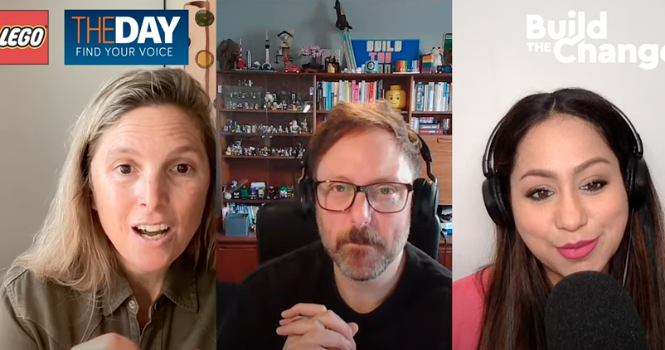
The Planet People Podcast
Part 1
Notes:
Time - 25 mins to listen to the podcast, with pauses. https://www.youtube.com/watch?v=fRagpiO6IF8
Play part 1 of the Planet People Podcast (5 mins), pause at 5.52
In this part, pupils will:
Be introduced to the topic: how to bring the benefits of nature to the places we live, learn and play
Complete a mini-build challenge: build something from nature that you find incredible
Understand a bit about our guest, their job and how they help people and the planet.
2. Pause the podcast at 5.52, (see Podcast Pause 1 Slide 17)

Slide 17
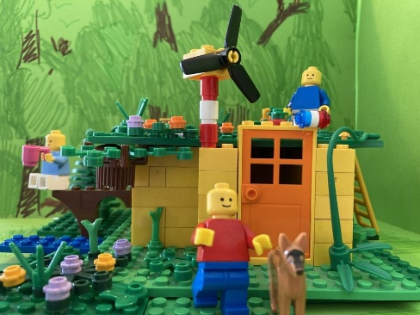
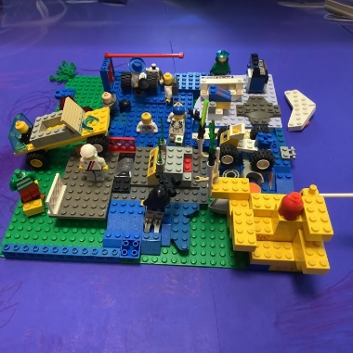
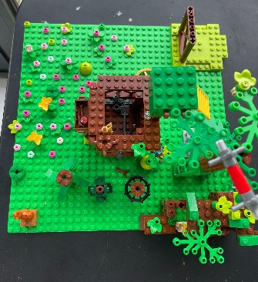
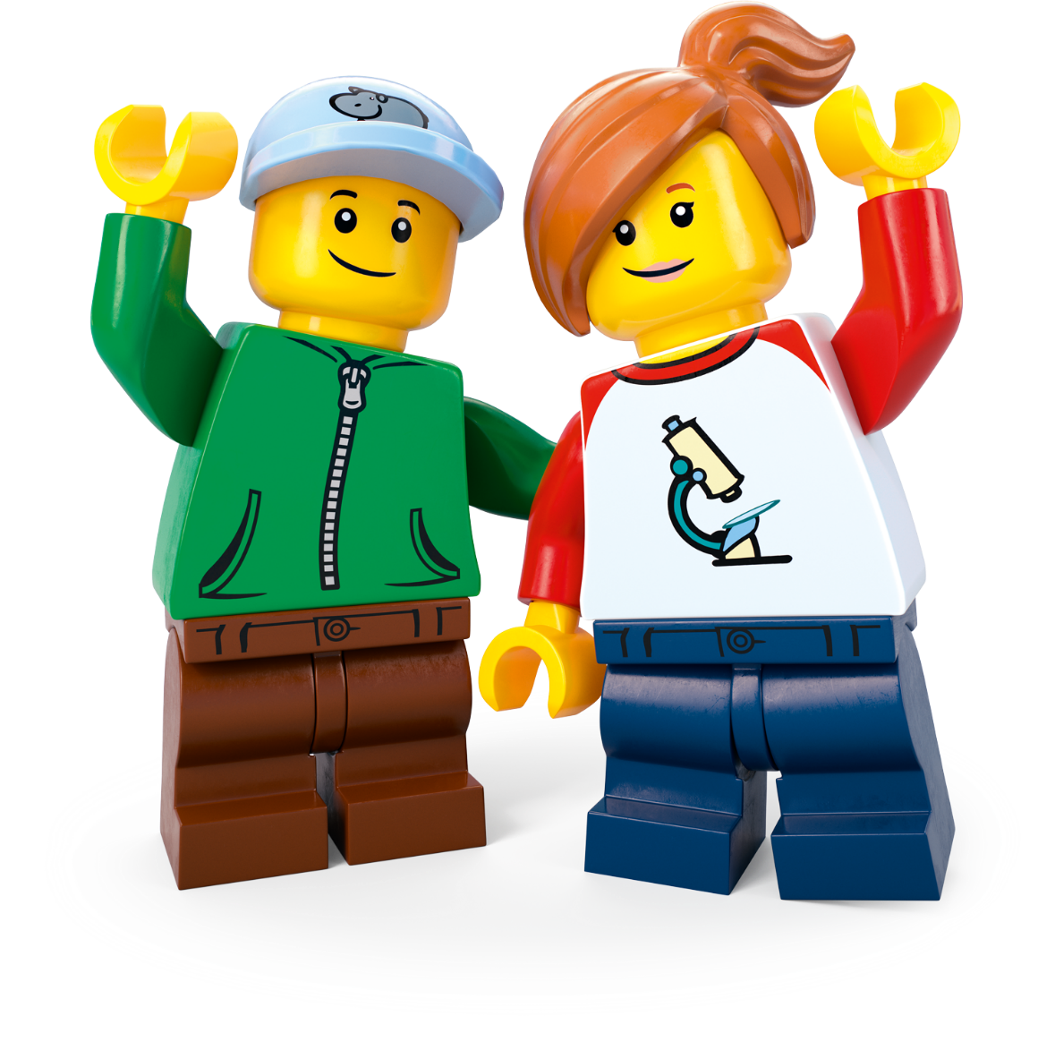
Podcast Pause 1:
Mini Design Challenge
Create something from nature that makes you say WOW.
What did you make?
Notes:
Time - 3 mins for this pause
Allow pupils to finish their mini-build challenge: build something from nature that you find incredible.
Share some ideas.
Direct pupils to their Competition Worksheet.
As they listen to Part 2, next, remind them to add to their topic Mind Map by drawing or writing down interesting or inspiring words or ideas.

Slide 18
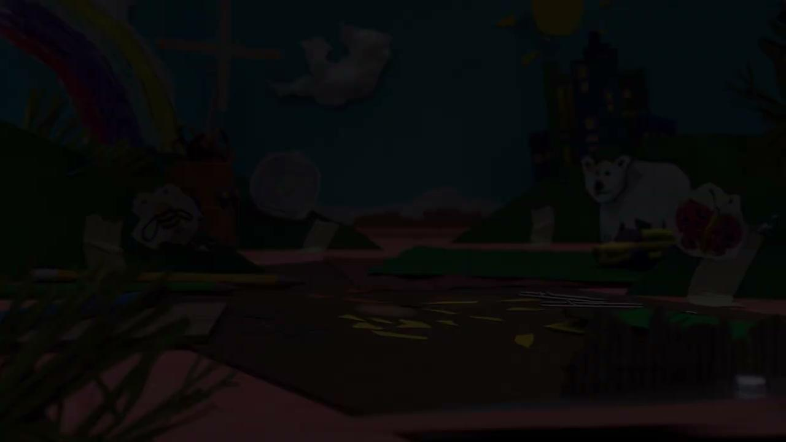
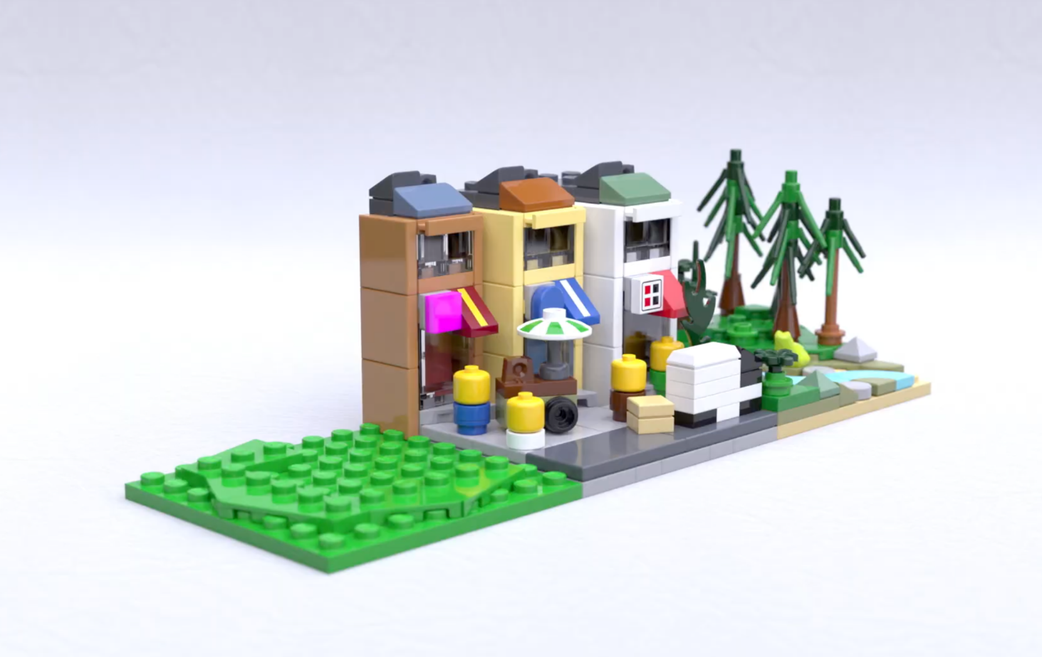
The Planet People Podcast Part 2
.
Notes:
Play part 2 (from 5.52) of the Planet People Podcast (5 mins), pause at 11.16 (if you need the link to the podcast again it’s https://www.youtube.com/watch?v=fRagpiO6IF8).
In this part, pupils will:
Listen to the hosts interview the guest expert using the Investigation of the Day question: How can we make sure everybody benefits from nature?
Pupils create a Mind Map in their Competition Worksheet to record ideas as they listen.
2. Pause the podcast at 11.16, (see Podcast Pause 2 Slide 19)

Slide 19


Podcast Pause 2:
What have
we learned?
Notes:
Time - 5 mins for this pause
Take a moment to encourage pupils to share what they have written down on their worksheet. Use these comprehension questions to check for understanding:
Approximately how big is a small city pocket forest? The same size as a tennis court!
Why is it important to bring nature to our busy spaces and communities? It’s essential to our being – nature connection helps mental wellbeing and it brings people together. It also has lots of environmental benefits like cooler temperatures, cleaner air and healthier soil.
68% of people (or 7 out of 10 people) will be living where by 2050? Cities

Slide 20
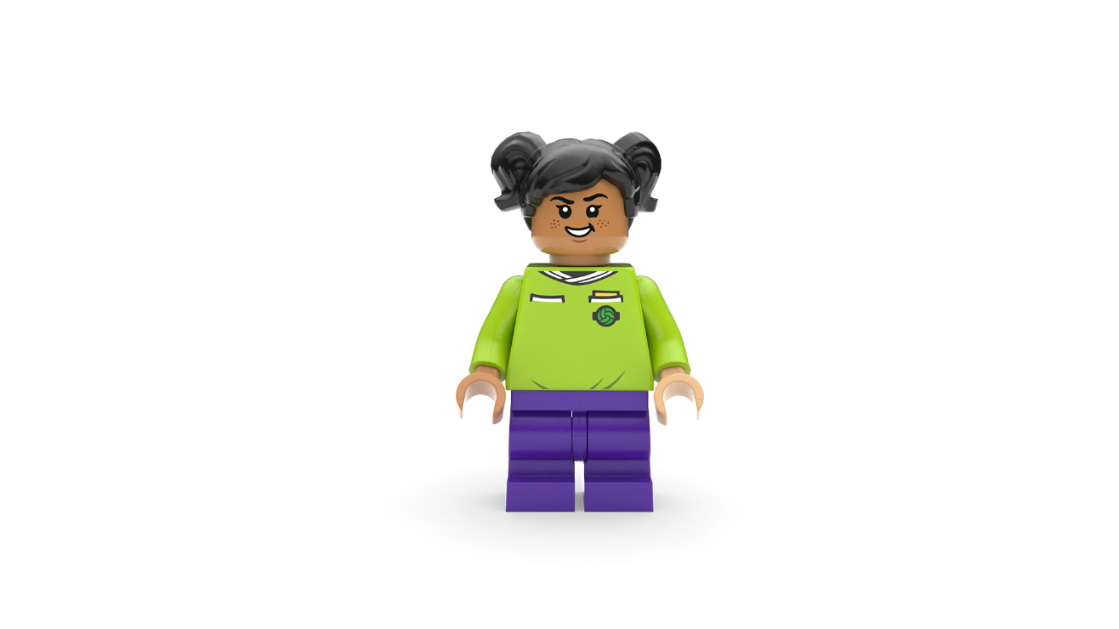
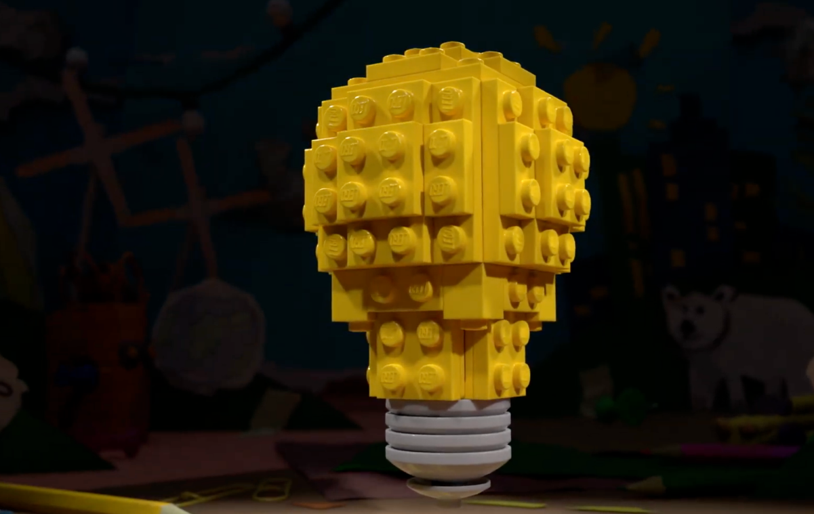
The Planet People Podcast Part 3
Notes:
Play part 3 (from 11.16) of the Planet People Podcast, (7 mins). (if you need the link to the podcast again it’s https://www.youtube.com/watch?v=fRagpiO6IF8).
In this part, pupils will:
Recap on the conversation
Be introduced to the Build the Change design challenge
Record any inspiring ideas on their Competition Worksheet.
Understand how they can enter their ideas into our competition.

Slide 21
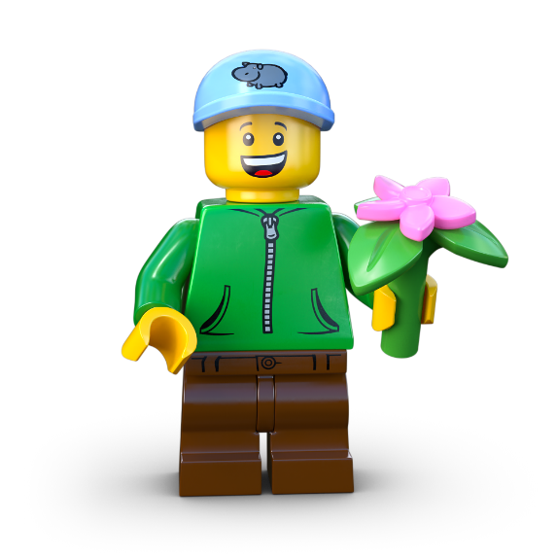
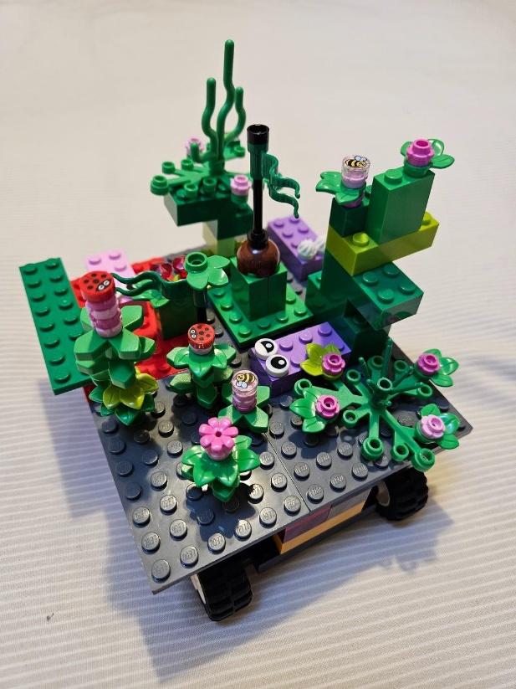
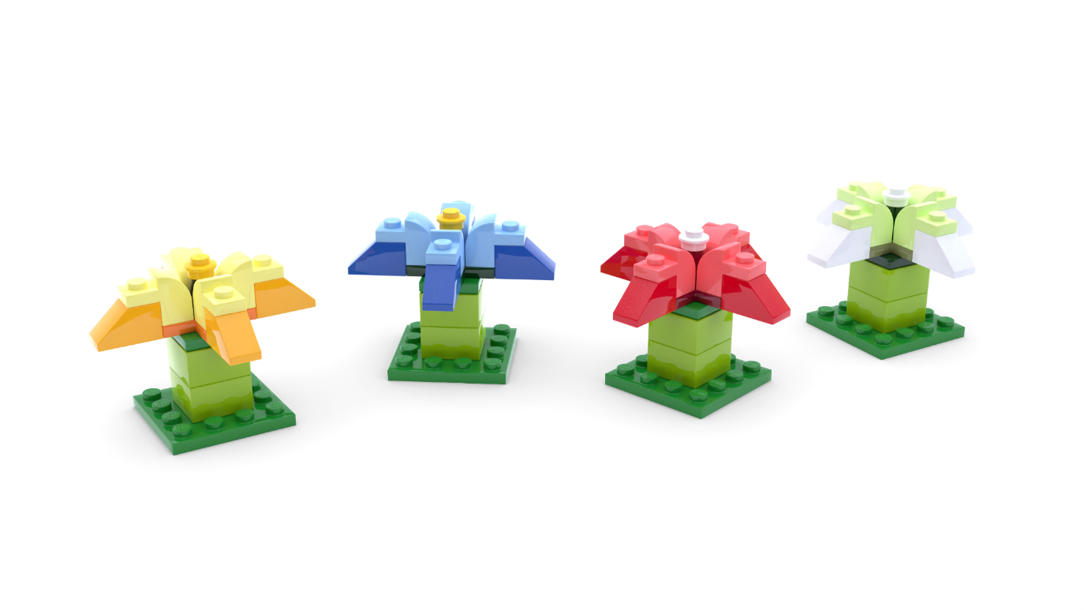
The Build for Belonging Design Challenge
Use your imagination to create something green, awe-some and completely unexpected for
your community!
Notes:
Time - 2 mins
Remind pupils that: when people spend time around trees, flowers, and wildlife, they feel happier and healthier. But many people struggle to find time to reconnect with the magic of nature. What if you could surprise your community with an idea that brings the wonders of nature into busy, everyday life?
Set the Build the Change design challenge using the slide:
Create something green, awe-some and completely unexpected for your community!
Check for understanding.

Slide 22

Reflection
What inspired you?
What intrigued you?
Notes:
Time - 5 mins
Think about the topic, the design challenge and anything else you’ve learned today. Allow pupils time to add final thoughts and ideas to their Mind Map.
You could ask them to:
Draw one thing that has interested or inspired them today
Write down one question they still have about the topic.
You may wish to seek answers to these questions together, or set this as research challenge to be completed at home.

Slide 23
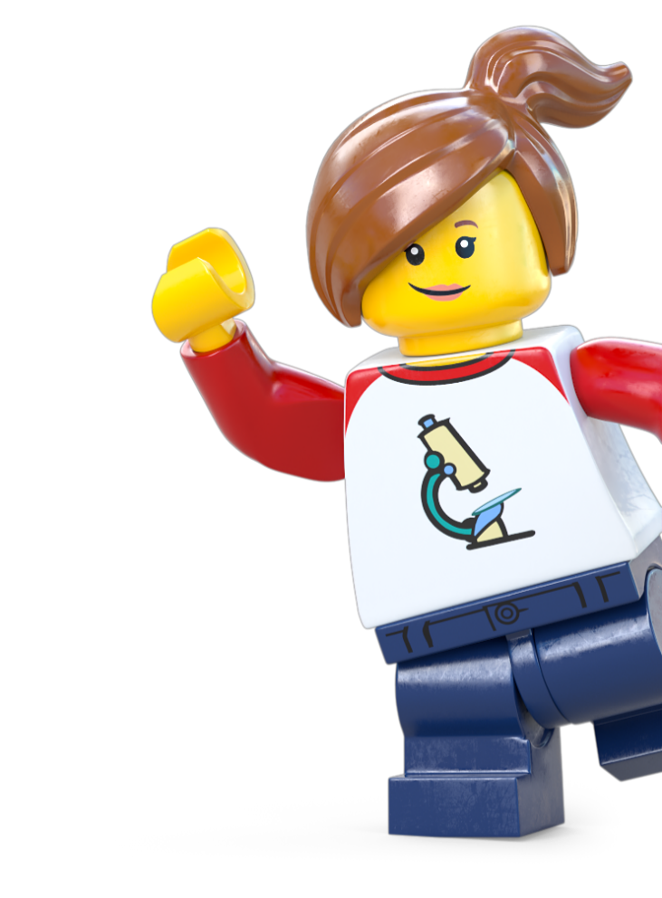
Extension Activity
Take Action!
Notes:
Take Action! Extension activities
The activities in this session are completely optional. You can spend however long you like on these, therefore we haven’t included timings. These activities are designed to be delivered outside. You can deliver some around your school but if possible, consider taking the learning out of school and into the community.

Slide 24
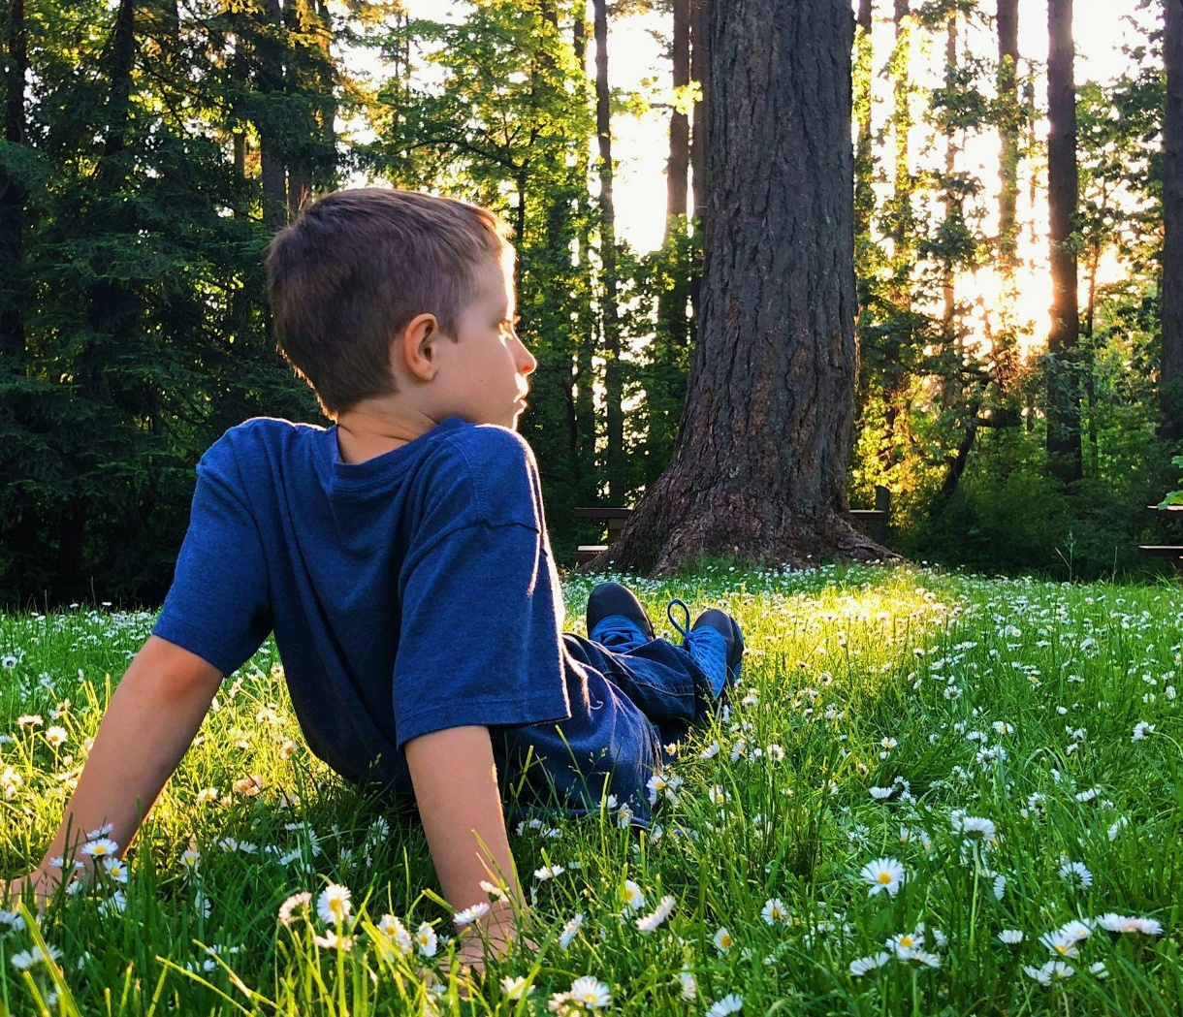
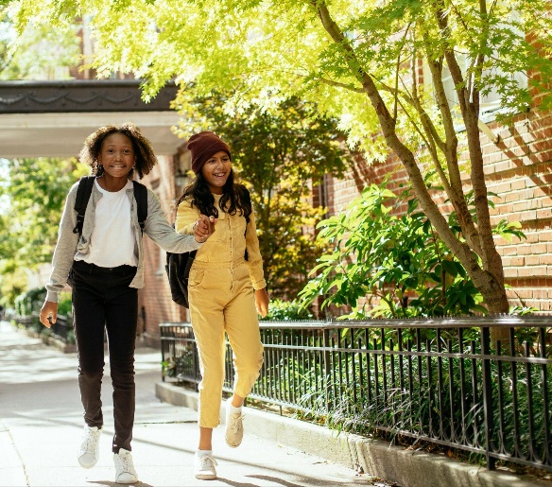

Activity 1:
Explore Nature
& Wellbeing
c Melissa Askew/Unsplash
c Mary Taylor/Pexels
Notes:
Explore the impact of nature in your school grounds or local area with these two simple outdoor activities:
Happy Nature Walk (Well-being & Mindfulness) Go outside and sit or walk in a green space. Close your eyes, listen, and notice how nature makes you feel. Draw or write about it.
Activity: Take pupils outside (if possible) for a short walk or sit in a green space. Ask them to close their eyes, listen, and notice how they feel.
Task: Afterwards, ask them to write or draw about how nature affects their mood.
Discussion: Relate their experience to the earlier learning to reinforce why green spaces are so important for mental health and happiness.
Nature Sounds Vs Man-made Sounds Compare sounds in a green space vs. a busy area. Which felt calmer? How might we bring more natural sounds into cities?
Objective: Compare natural and urban soundscapes to understand how nature influences wellbeing.
Activity: Take pupils to two locations—one with nature (a park, garden, or tree-lined street) and one without (a busy road or built-up area). Have them close their eyes and listen for 30 seconds in each location.
Record the sounds they hear (e.g. birdsong, rustling leaves, traffic, footsteps).
Discuss: Which place felt calmer? How could we bring more natural sounds into busy places?
Reflect: How could you use nature’s sights, sounds & feelings to inspire your ideas?
Link it to the Build the Change Design Challenge: Encourage pupils to think about sensory experiences when designing their green space.

Slide 25
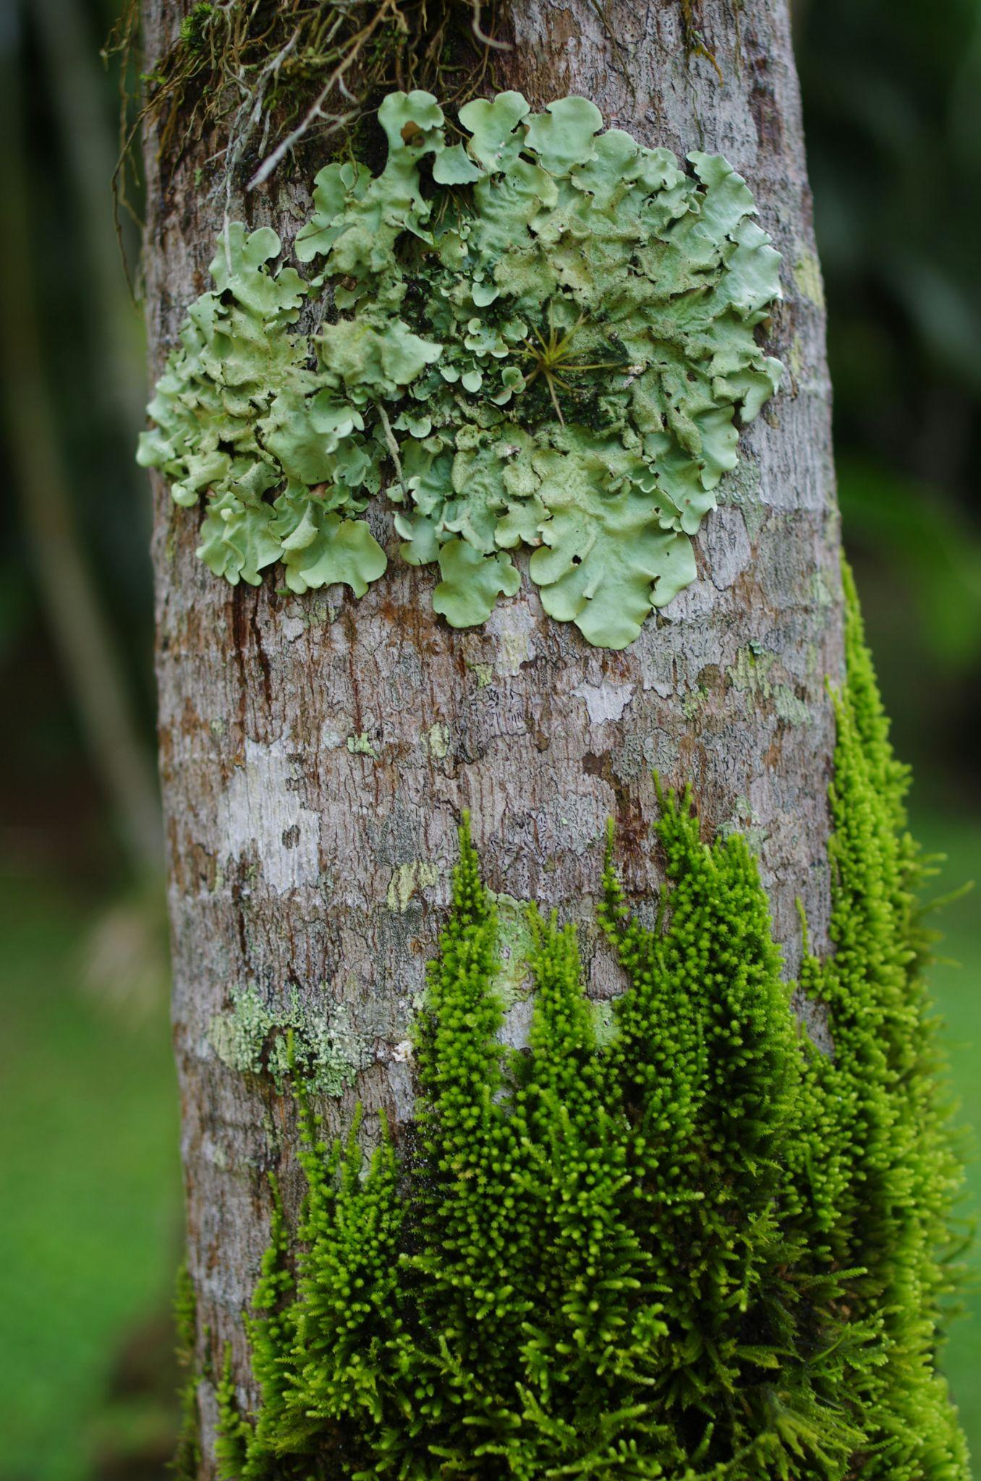
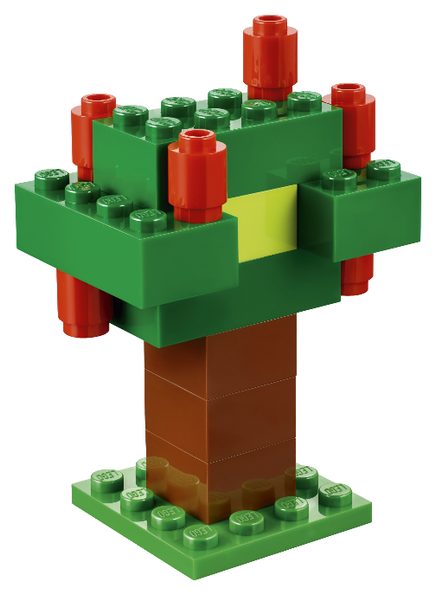
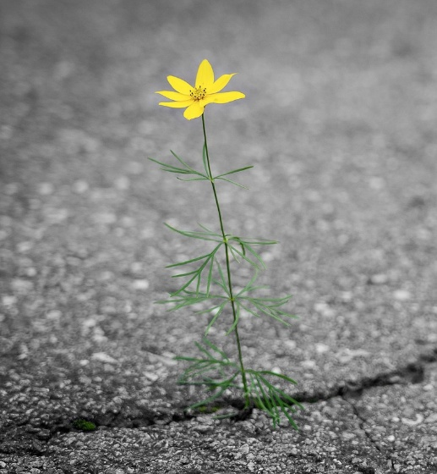
Activity 2:
Nature spotting and mapping
c Rene Schindler/Pixabay
c Mar Nunez/Unsplash
Notes:
Use Geography fieldwork to help pupils get ideas for their response to the challenge.
Nature Spotting & Mapping
Objective: Identify and map existing green spaces and unexpected pockets of nature in the local area.
Activity:
Take pupils on a walk around the school or local area.
Give them clipboards with a simple map and ask them to mark any green spaces they find, including parks, planters, trees, grassy patches, green pathways, wild spaces or weeds growing in pavement cracks.
Ask: Where does nature already exist? Where is it missing? Where is it thriving?
Back in class, create a large class map showing their findings.
Link to Design Challenge: Can pupils use this to identify potential locations for their nature-inspired ideas?

Slide 26
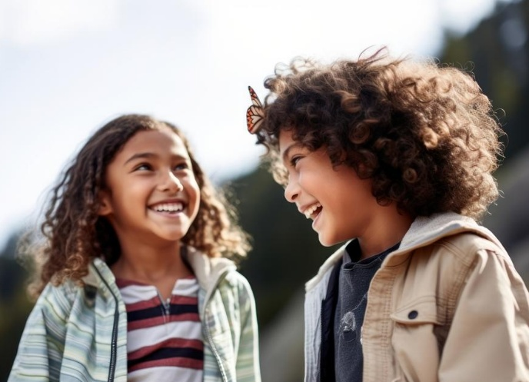
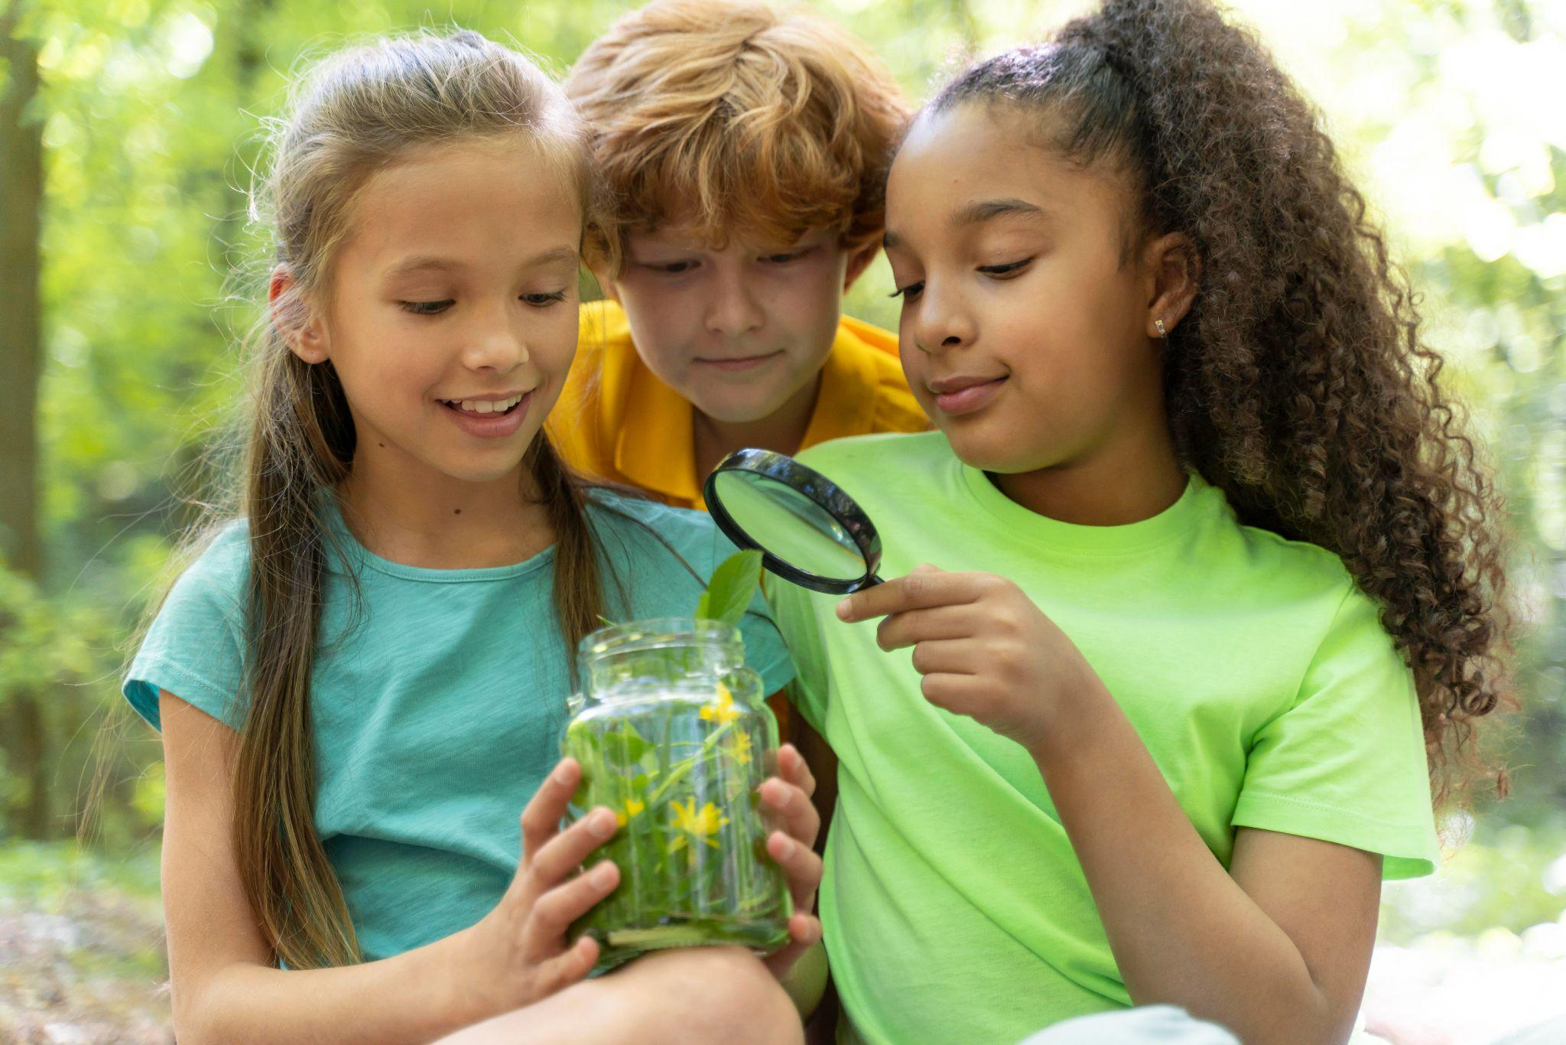

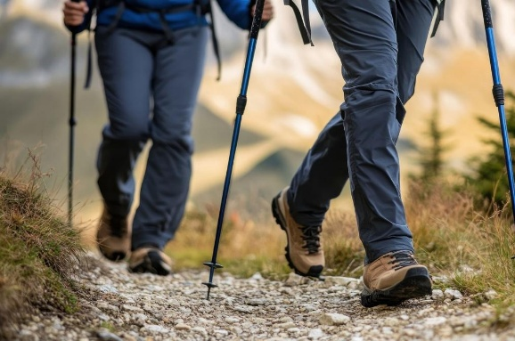

Activity 2:
Who uses nature?
c Freepik
Notes:
Use observation and recording to explore how human and physical geography connect.
Who Uses Nature? Wildlife & People Study
Objective: Observe how people and animals interact with nature.
Activity:
Split the class into two groups: one observes how people use green spaces (playing, relaxing, exercising), the other records signs of wildlife (birds, insects, nests, footprints).
Sketch or take notes about what they see.
Discuss: How does nature support both people and animals? Could we create a space that helps both?
This hands-on activity helps pupils understand the relationship between nature and human activity, linking physical and human geography. It links to the Build the Change Design Challenge, encouraging pupils think about designing for both humans and wildlife.

Slide 27
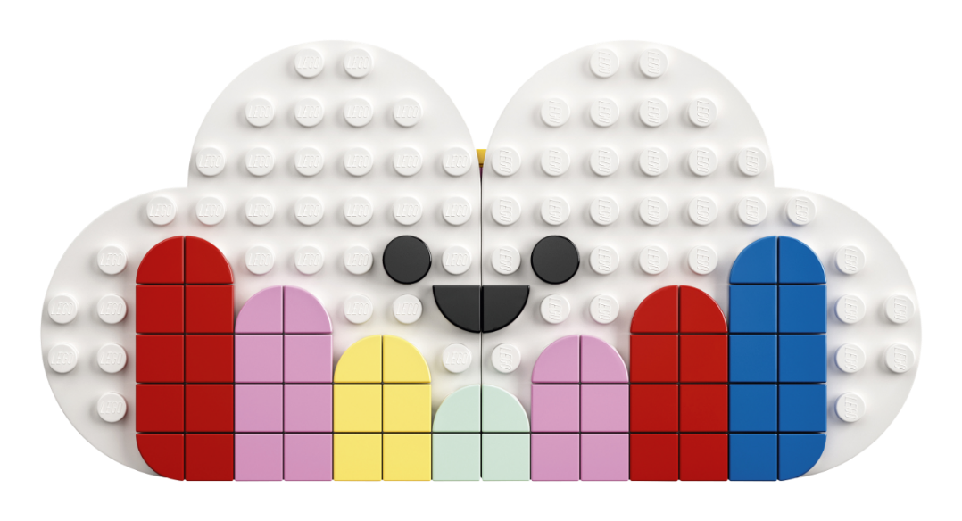
Lesson 2
Create
and Share!

Slide 28
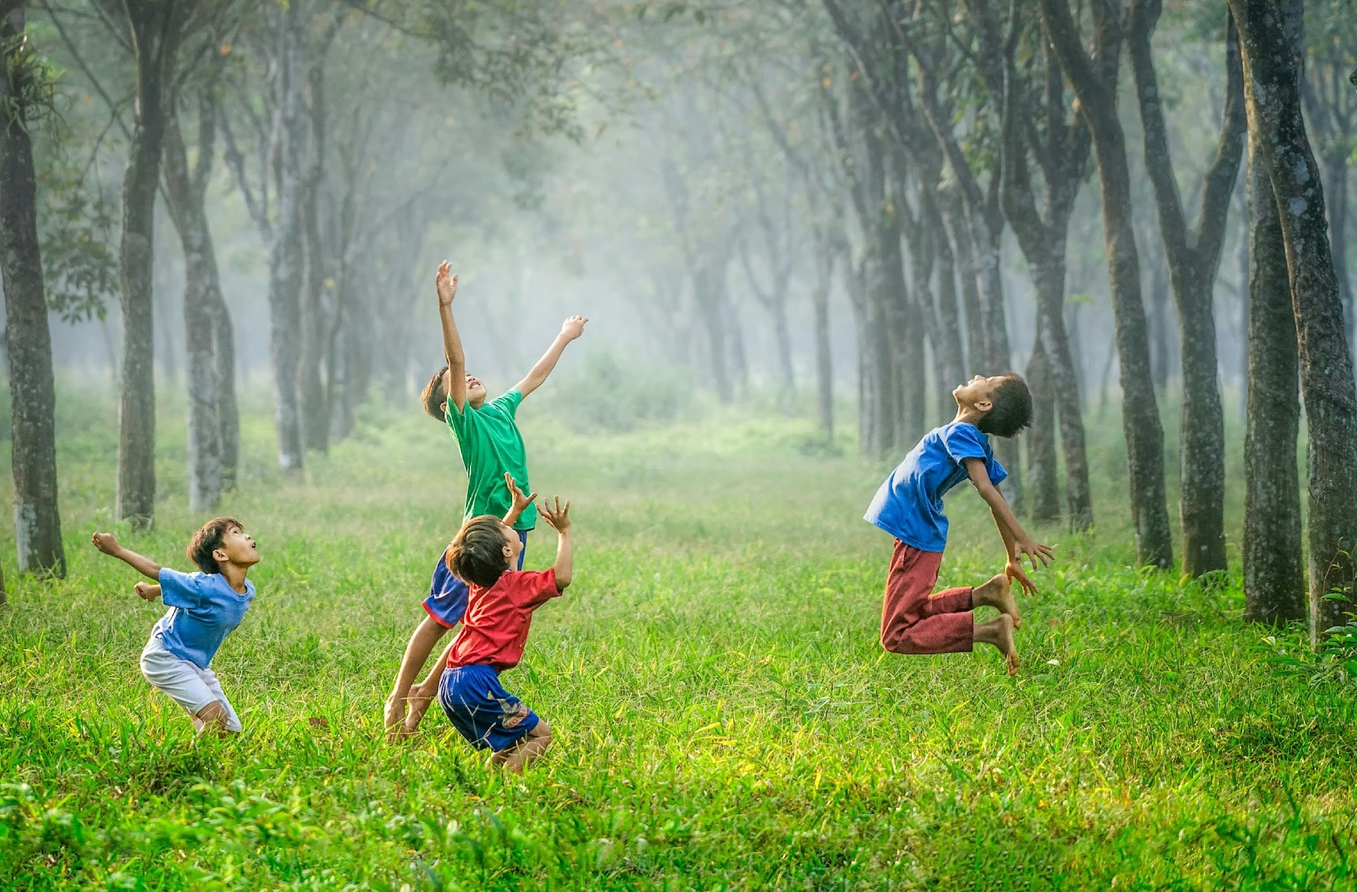
Super
Nature
Notes:
Time - 3 mins
Think, pair, share: Why Should We Spend Time in Nature? Put pupils in pairs and list as many reasons as they can, recalling what they learned in the previous lesson(s).
Share ideas as a class. Compare with the master list on the next slide.

Slide 29











Nature...
Turns us into explorers
Helps us sleep
Brings people together
Needs our help
Is just fun!
Makes us happier
Is the best gym
Cleans our air
Is full of wildlife
Helps us learn
© Artem Kniaz/Unsplash
Notes:
Makes us happier
Fresh air and green spaces help us feel calm and cheerful.
The best gym
Running, climbing, and playing outside keeps us strong and healthy.
Cleans our air
Trees act like giant air filters, giving us fresh oxygen to breathe.
Full of wildlife
Nature is home to birds, butterflies, and so many amazing creatures.
Helps us learn
The outdoors is a giant classroom, full of things to discover!
Turns us into explorers
Build dens, follow animal tracks, or go on an adventure!
Helps us sleep
Sunshine resets our body clock, helping us rest better at night.
Brings people together
Parks and forests are perfect for fun with family and friends.
Needs our help
The more we love nature, the more we want to protect it!
Is just fun!
Splash, climb, roll, and explore - every day outside is an adventure!

Slide 30
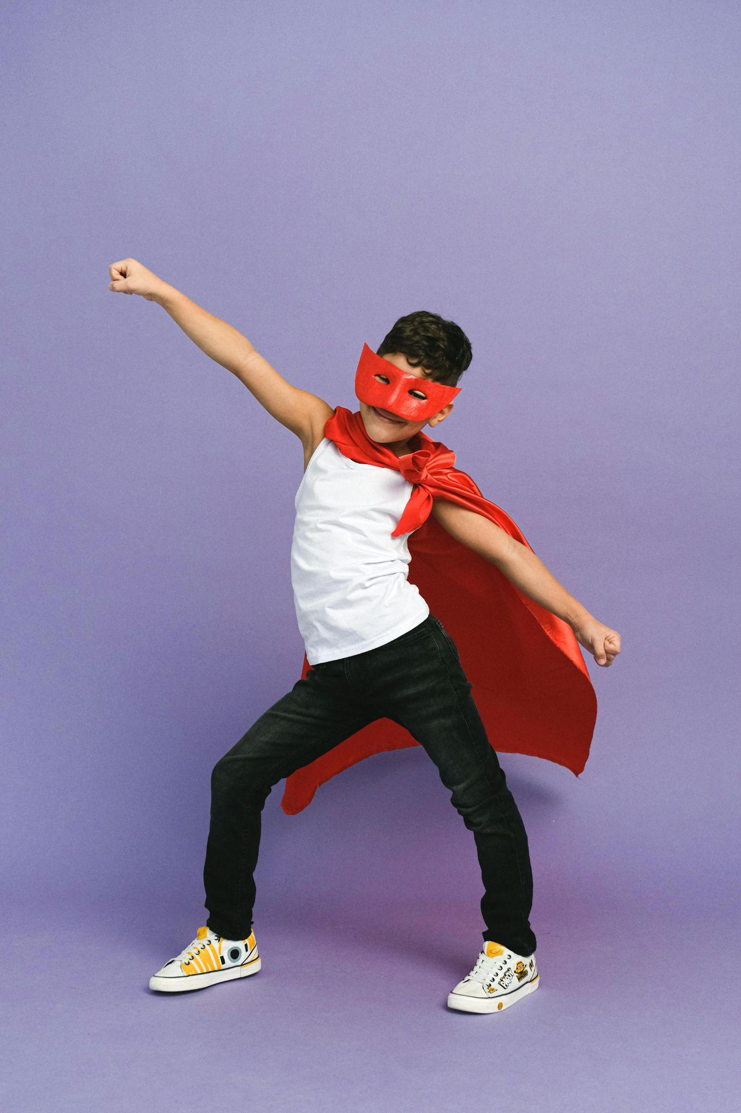

Nature:
The Superhero!
c Anna Shvets/Pexels
Notes:
Time - 10 mins
Still in pairs, ask pupils to imagine nature as a superhero!
What are their superpowers?
How do they help people, animals, or the planet?
What do they look like?
What’s their name?
Then, use their ideas to create a "Nature Superhero" (e.g. "Captain Clean Air" or "The Water Wizard") with a costume and powers based on real natural benefits. They can build, make or draw their hero.

Slide 31








Work together. Create together.
Teamwork Wins
All Ideas Shine
Build It Up
Listen Like a Leader
Kind Words Always
Everyone Belongs
Celebrate Differences
Mistakes Are Magic
Notes:
Time - 2 mins
Use this slide as a checklist to help pupils reflect on the previous team or paired activity. What did they do well? Where could they have improved? Remind them that when we work well together in teams and include everyone we feel a sense of belonging. If you are completing the design challenge in pairs or team, read through the teamwork manifesto together:
Teamwork Wins We work together, help each other, and share the fun.
All Ideas Shine Every idea is welcome – big, small, or even a little wacky!
Build It Up Use each other’s ideas to make something amazing.
Listen Like a Leader Give your teammates your full attention – their ideas matter.
Kind Words Always Speak with kindness and cheer each other on.
Everyone Belongs Include everyone in the group – no one is left out.
Celebrate Differences Our unique ideas make the team stronger and more creative.
Mistakes Are Magic Mistakes help us learn and grow – celebrate them!
If you are running this challenge as a pair or team activity, these rules will help pupils build a sense of belonging as they tackle the creative challenge. If you have more time, you could pass a copy round for everyone to sign or even create your own.

Slide 32
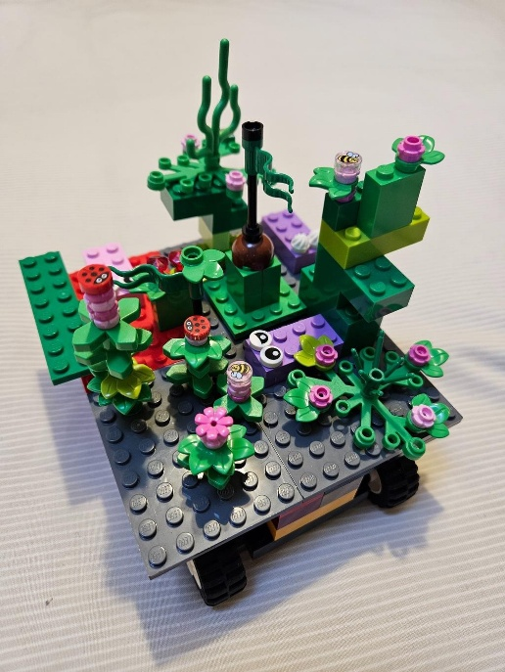
The Build for Belonging Design Challenge
Use your imagination to create
something green, awe-some and completely unexpected for your community!
Notes:
Time - 5 mins (for next 3 slides)
Bring pupils back to the design challenge that was introduced in lesson 1: Use your imagination to create something green, awe-some and completely unexpected for your community!
Remind them that when people spend time around trees, flowers, and wildlife, they feel happier and healthier. But many people struggle to find time to reconnect with the magic of nature. Imagine: What if you could surprise your community with an amazing idea that brings the wonders of nature into busy, everyday life?
Check for understanding.

Slide 33
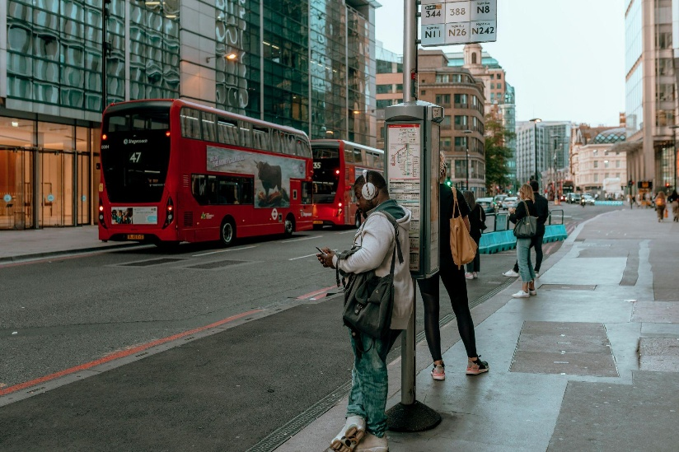
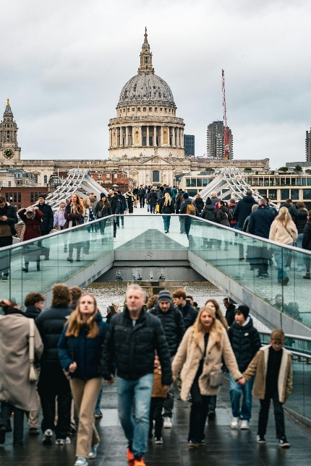
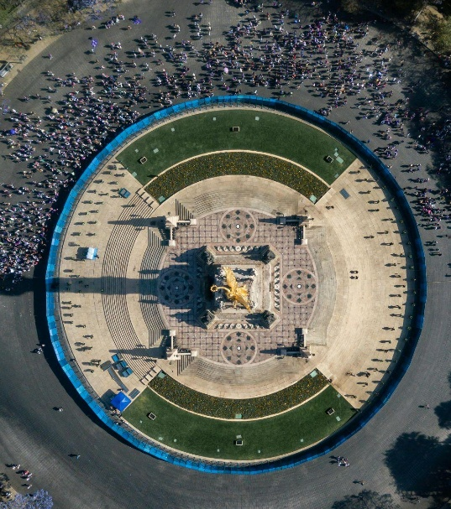
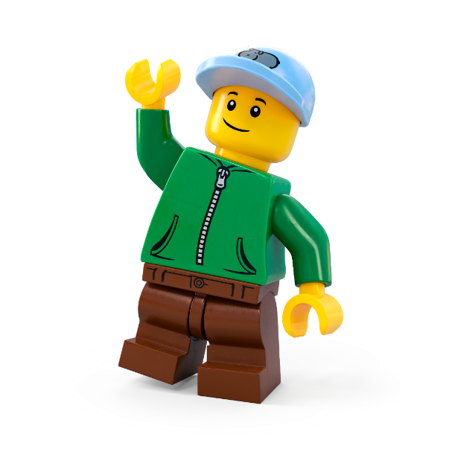

A busy place
c Pexels
Notes:
Time - 5 mins (for 3 slides)
Ask them to think of a busy place in your local area. A place where there’s lots of people but not much nature. Their mission is to bring a bit of nature magic into these spaces.
Use the images on the slide to help pupils pick an area they’d like to rewild.
Remind pupils about the real-world examples of unexpected nature pockets, explored in the Planet People Podcast.

Slide 34




What if?
c Li-Ling Chang, Victor Ballesteros, Elizabeth Vilallta, Jackie Watt/Unsplash
Notes:
Time - 5 mins (for 3 slides)
Now, ask them to imagine THE MOST unusual place where nature could grow!
How could they use nature to make busy people stop and stare?
How could they create a sense of wonder and awe?
How could they give the gift of nature to your community?
Push pupils creative thinking by using the images and encouraging them to think of the most unexpected places they could plant nature.
What if your street had tiny pocket forests, buzzing with wildlife and hidden homes for animals?
What if your high street had a magical trail of flowers and plants, leading people on exciting adventures?
What if you could borrow books from a treehouse library, a cosy reading nook nestled in the treetops?
What if your bus stop was a wild nature haven, where you could listen to birds and smell fresh flowers while you wait?
Get some ideas, the wackier the better.
Share some of these ideas before getting pupils working on the task. Encourage them to write all ideas on their Mind Maps.

Slide 35


Let’s Build the Change!
Brainstorm ideas
Design your space
Create a model
Write a description
Share your solution
Enter our competition
Notes:
Time - 20 mins
Use this slide to explain all the jobs that need to be done before setting pupils off on their own.
Brainstorm ideas
Look at your mind maps. As a team, write down as many ideas as possible – the sillier, the better! Choose two or three of the best ideas to make even better. Decide on one idea as your solution.
Design your space
Draw your brilliant solution in the Competition Worksheet.
Build a model
Create a model of your solution using all the cool materials available.
Present your solution
Share your ideas with the rest of the class
Enter the Build for Belonging competition
Make sure your ideas, designs and descriptions are included in your Competition Worksheet. Teams should submit one worksheet per team to the competition. Teachers can take a photo of the build to enter it into our competition.
Remember: You can run the challenge as an individual challenge, in pairs or small groups of up to 4. You can allocate team roles using the Team Roles on slide 43, in the appendix.

Slide 36

Individual or Pairs -
Final Checklist
Have you:
Labelled your final design?
Written a description of your solution
Got your model ready for its photo?
Prepared your presentation?
Notes:
Time - 10 mins
Allow some time for pupils to finalise their models and get ready to share their ideas with the class.
If you’re running the challenge with pairs or teams, use this list to remind each team member what they are responsible for:
Designer: Time to show off your artistic skills! Label your final drawing to highlight all the awesome features of your design.
Writer: Get your writing hat on! Write a cool description of your amazing solution so everyone knows how it works.
Builder: Your job is to get our model ready for its close-up! Make sure it's looking perfect for its big moment in the spotlight.
Presenter: You’re the star presenter! Get ready to wow the class with your awesome solution and explain how it works.

Slide 37



buildthechange.theday.co.uk/competition
https://youtube.com/shorts/xiEDBb2cHlU?feature=shared
Notes:
Ask pupils to stop working and place their models around the room for everyone to see. Here is the link to a video from Abby Cook: https://youtube.com/shorts/xiEDBb2cHlU?feature=shared
If you are entering your class’ ideas into our Build for Belonging Competition, show this slide to get pupils excited!
Enter by 30th June at www.buildthechange.theday.co.uk/competition

Slide 38

Share your ideas
Notes:
Time - 10 mins
Ask pupils to take it in turns to present their solution to the class. Encourage others to give positive and constructive feedback.
You could ask them: What went well? What could be even better?
Celebrate all their awesome ideas!

Slide 39





Share it with the world
Missed the competition deadline?
Don’t worry, your kids’ awesome ideas can also be published on the LEGO.com website! Simply upload photos with a 200-character max description of your children’s creations to our Build the Change photo gallery, for the whole world to see!
They might even be our next Builder of the Week!
Scan the QR code with a camera to start uploading.
Notes:
Don’t forget to upload your learner’s awesome ideas to help us show everyone how awesome kids’ ideas are!
You can upload photos and descriptions of your children’s creations to our Build the Change Tuesday gallery. They might even be our next Builder of the Week! Scan the QR code with a camera to start uploading or visit: https://www.lego.com/en-gb/sustainability/buildthechange/challenges/theday/upload?CMP=EMC-LCE.

Slide 40

Appendix

Slide 41

Team roles
Presenter
The presenter gets to show off
the team's amazing work to
the class.
Writer
The writer explains the team's ideas
in the best words possible.
Designer
The designer creates and improves the team's awesome drawings.
Builder
The builder brings the design to life
with a cool model.
Notes:
Use this slide if you are asking students to work in groups. Please note: Students can enter the competition individually, in pairs or in teams of up to 4 people.
Explain the roles. Ask students to take on team roles according to their strengths.
You could even print out the slide or give them badges as a reminder.

