Slide 1
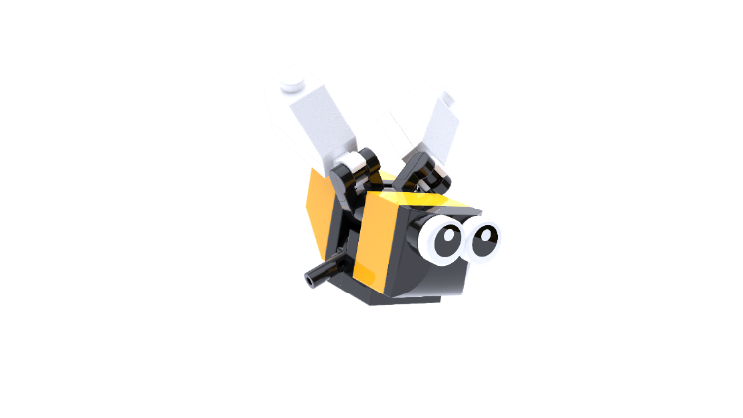
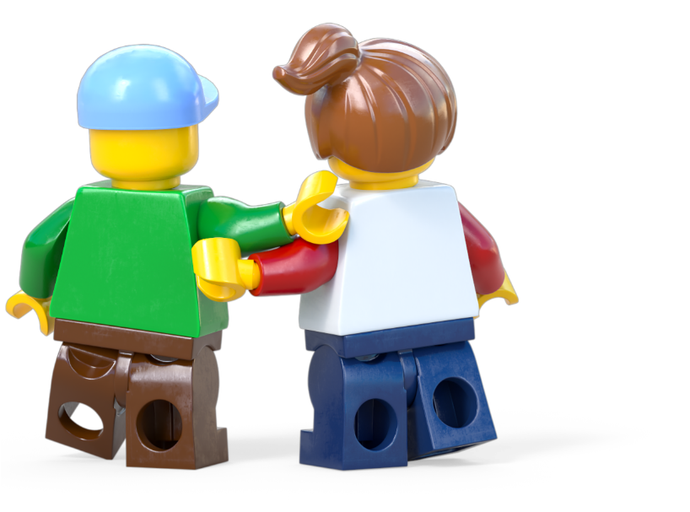
Build for Belonging
Design with Empathy Workshop
Age 7-11
Build the Change is supported by the LEGO Foundation. LEGO, the LEGO logo, the Minifigure and the Brick and Knob configuration are trademarks and copyrights of the LEGO Group. ©2025 The LEGO Group. All rights reserved.

Slide 2
Contents
Workshop 1 Immerse
News Detectives Article
Planet People Podcast
Build for Belonging Design Brief
Take Action -Optional Extension
Workshop 2 Create
Design brief
Challenge checklist
Competition Information
Workshop 2 Share
Appendix
Place Cards
People Cards
Team roles
Slides 3-19
Slides 10-12
Slides 13-18
Slides 19-20
Slides 21-24
Slides 25-45
Slides 32-35
Slide 36-37
Slides 38
Slides 39-40
Slides 41-45
Slides 42
Slides 43-44
Slides 45

Slide 3
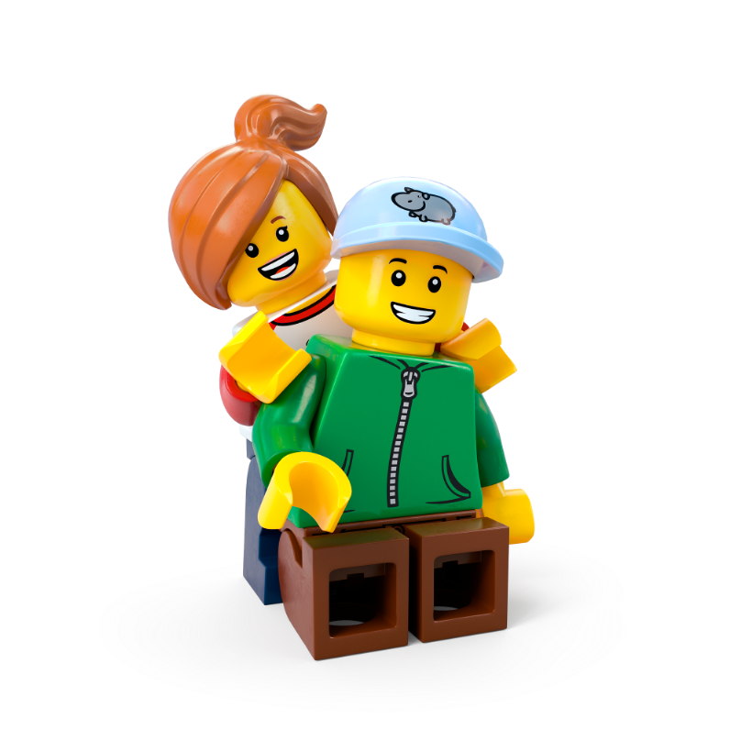
Lesson 1
Immerse

Slide 4
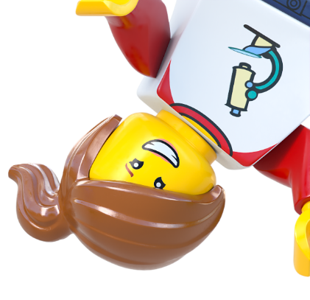
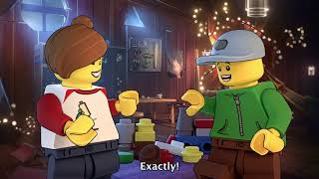
Notes:
Time - 2 mins
Play the video to introduce pupils to the LEGO Group’s Build the Change programme.
https://www.youtube.com/watch?v=D7z8iXqjIkE

Slide 5
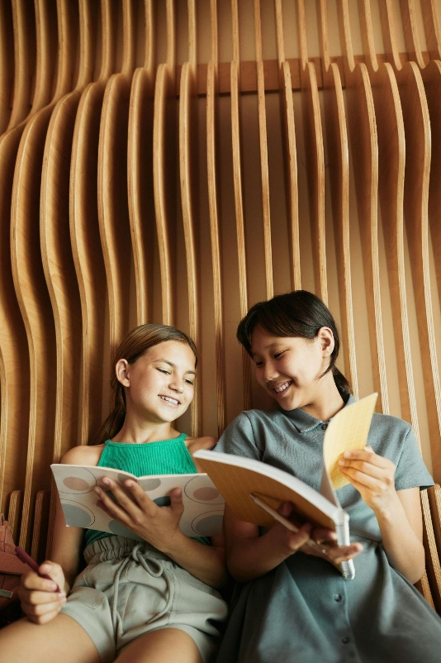
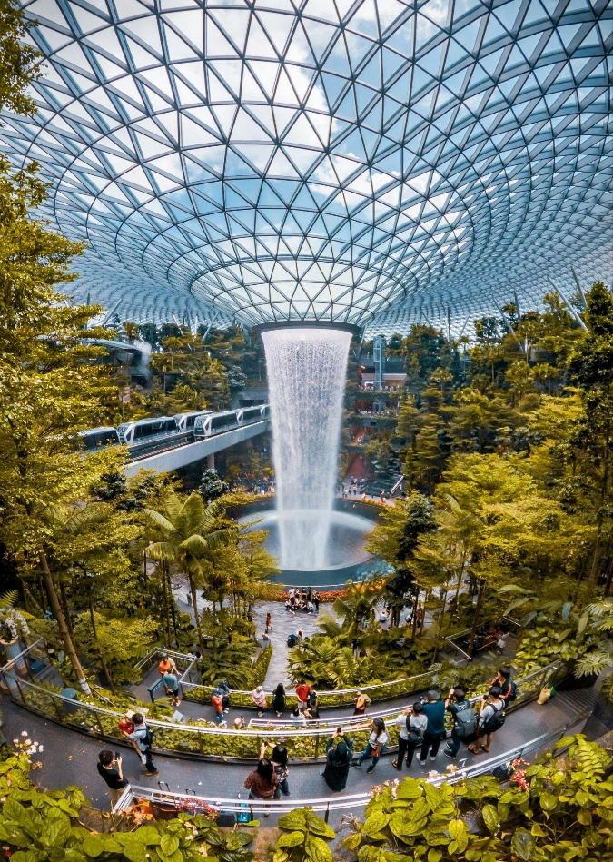
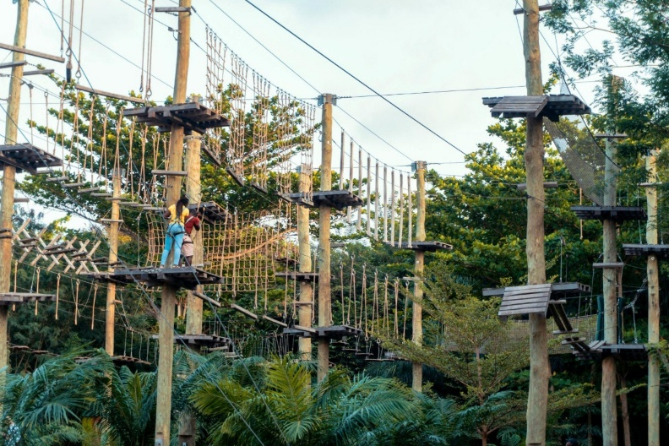
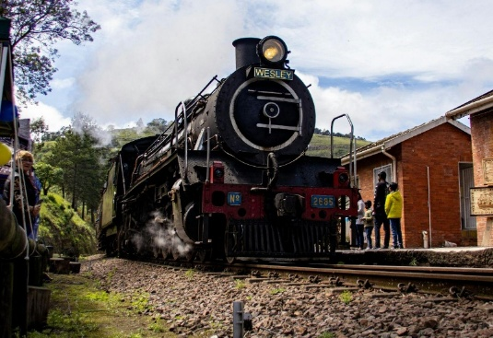
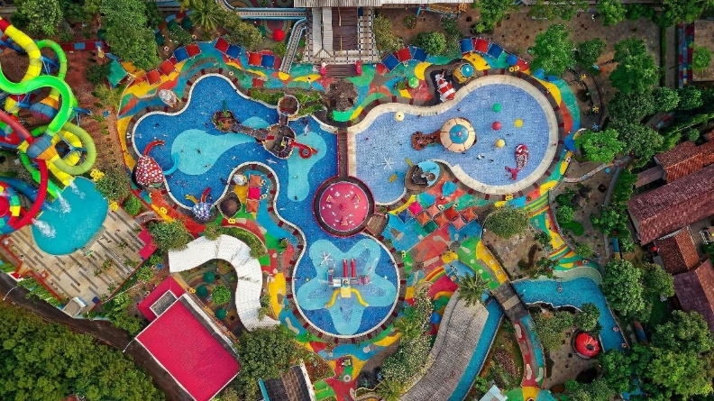
Build your happy place
c Pexels
Notes:
Time - 3 mins
Use our playful activity to introduce the topic.
Ask pupils: Where is your favourite public place in the world? You can use the images on the next slide if they need some inspiration.
Once they’ve picked it, you could ask them to close their eyes and visualise the space. Can they imagine themselves in that space? What so they see, hear or smell? Are there any tastes or textures that spring to mind? E.g. a beach may make them remember the feeling of sand between their toes, the feel of wind on their face, the smell of the salty air etc.
Invite them to use the creative materials in front of them to recreate it! Reassure them that it doesn’t have to look exactly like it does in real life – they should make it their own!
While they build or draw, ask them: How do you feel when you are in that space? What makes it special to you?

Slide 6
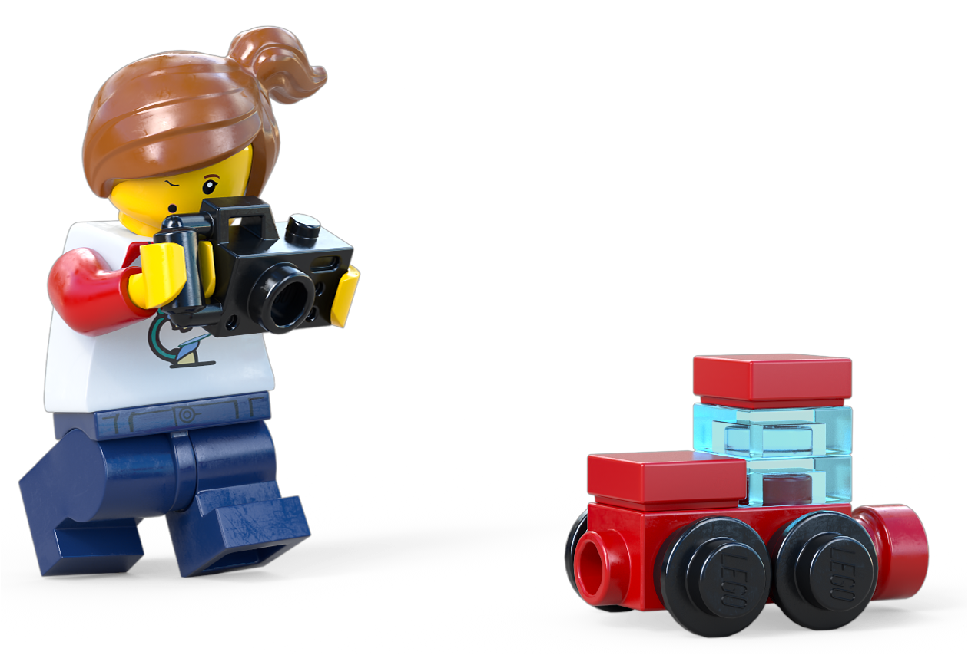
Share your happy place
What makes it special for you?
Notes:
Time - 3 mins
In pairs, encourage them to share their favourite place, along with any feelings they have about that place.
Then, ask each pair to share their favourite places and any words or phrases that spring to mind with the class. What makes their place different, special or fun to be in? Have they ever been in that place or is it somewhere they want to go to one day in the future?
Make a class list of words and phrases that help describe the emotional impact of welcoming spaces.
Some words that may crop up:
Welcoming, happy, exciting, comfortable, easy, friendly, fun, relaxing, enjoyable, interesting, stimulating, epic etc.

Slide 7
Notes:
OPTIONAL:
AWESOME WORDS
Depending on the age and ability of your class, you may want to spend some time introducing the class to some key words we’ll be using in this session. Ask them: which of these words do they recognize? Can they try telling everyone what they mean?
Design -------------------------------
At its most simple, to design something means to make a detailed plan for something. Designers decide things like what that “something” will look like, how it’s made, how it will work, and what it is going to be used for.
Questions: Have you ever designed something? What kinds of design can you think of? Or what comes to mind when you think of things that
are designed? Explain that the word “design” covers many different things.
Possible answers: Architecture, Graphic design, Art, Mechanical engineering, Cars, Fashion & clothes, Products, Toys, Buildings
Built space ---------------------------------
A built space is simply a place that is built by people, like a building or a park.
Question: Can you think of any public spaces that aren’t built?
Possible answers: This will usually be natural areas like woods, sea, the beach etc. although lots of these locations have built elements like visitors centres, picnic benches, toilets, cafe, beach bars, washing facilities etc.
Use ---------------------------------------
Every built space is built to be used for a certain thing. This is called its use. For example, a gym is designed to be used for exercising, and a park is designed to be used for relaxing and enjoying nature.
Question: Can you think of any other built spaces that are used for different things?
Possible answers: School, Museum, Train Station, Airport, Stadium, Restaurant
To make sure a built space can be used by everyone, designers need to think about different people and their wants and needs. These include disabilities like difficulties walking, seeing or hearing.,
Experience ---------------------------------------
An experience is something that happens to you. It happens in a certain place and has a beginning and an end. The same things happening might feel like a different experience to different people. We all use our senses differently, understand things differently, and like and dislike different things.So depending on who you are, the same experience can be happy or sad, boring or interesting
An experience is something that happens to you. It happens in a certain place and has a beginning and an end. The same things happening might feel like a different experience to different people. We all use our senses differently, understand things differently, and like and dislike different things. So depending on who you are, the same experience can be happy or sad, boring or interesting.

Slide 8
Notes:
https://www.lego.com/cdn/cs/sustainability/assets/bltb1946d8ff9fbc92f/DPFP_Intro_part1.mp4
Time - 3 mins
Encourage pupils to start a Mind Map in their Competition Worksheet. From this point, pupils should be capturing ideas and information about the topic in this.
Remind pupils about their favourite places. Explain that these spaces have created by designers. When we have a good experience in a place, it’s usually because a designer has paid close attention to the needs of the users.
Play the video to give children more understanding of the role designers play in designing the places we all enjoy.

Slide 9
Notes:
Time - 1 min
Ask the children to share what stood out for them. Did they realise that so much thinking about people’s needs and wants goes into designing buildings and outdoor places?
Quick reflection questions:
What did you think about the video?
Did any of the examples look familiar? Have you seen similar things?
Did anything surprise you?

Slide 10
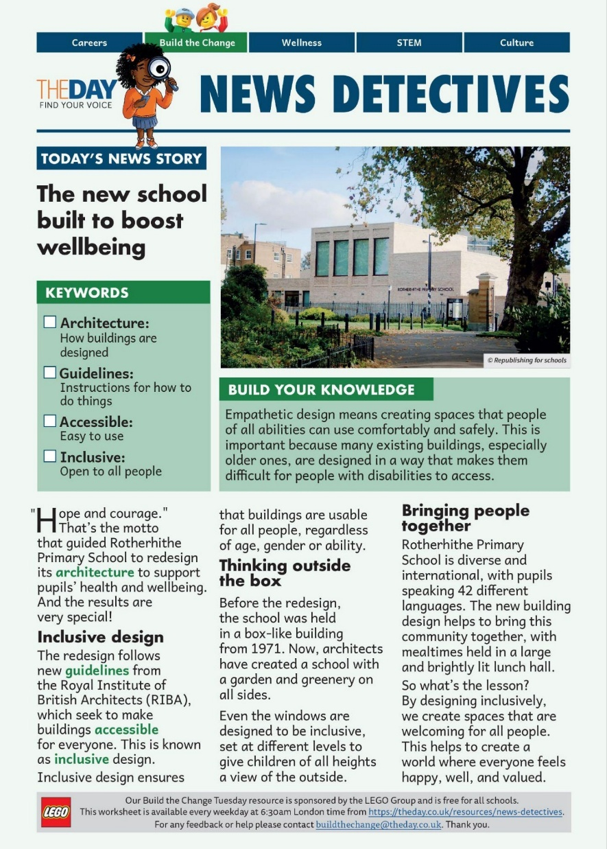
Read all about it!
The new school
built to boost
wellbeing
Download the news article here.
Notes:
Time - 9 mins
Read the News Detectives article:
Start by exploring the KEYWORDS, and introduce the WHAT YOU NEED TO KNOW section.
Read TODAY’S NEWS STORY independently, or as a class, depending on your class’ reading ability.

Slide 11
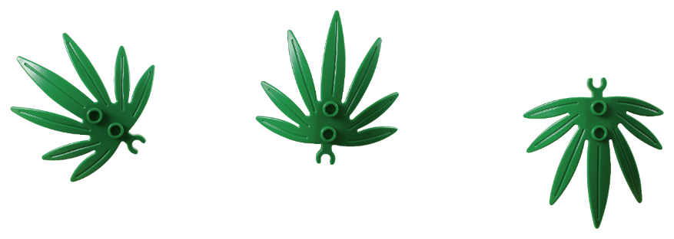
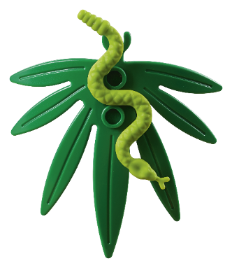
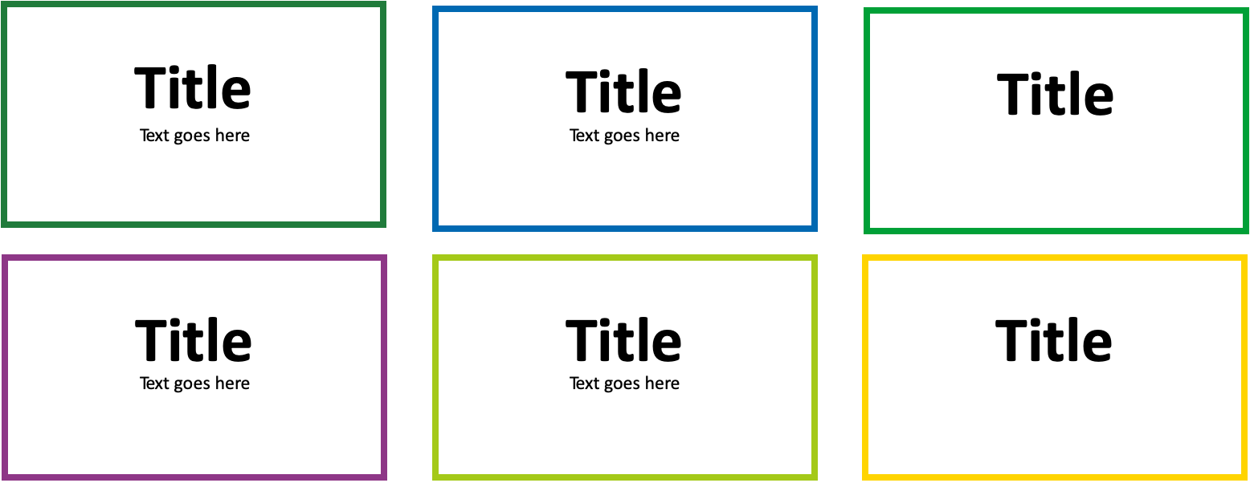
What did we learn?
What
is the school’s motto?
Why
did the school choose this redesign?
Who
has issued new building guidelines?
When
was the old building constructed?
How
many languages are spoken at the school?
Where
are the school’s pupils brought together?
Notes:
Time - 4 mins
Use the WWWWWH? questions to check their understanding.
Answers:
What is the school’s motto? Hope and courage
Why did the school choose this redesign? To support pupils’ health and wellbeing
Who has issued new building guidelines? The Royal Institute of British Architects
When was the old building constructed? 1971
How many languages are spoken at the school? 42
Where are the school’s pupils brought together? The lunch hall

Slide 12
mutual
request
needs
heart
hear
listening
empathy
meeting
understand
dialogue
hearing
compassionate
Investigation of The Day
What is empathetic design, and why is it important for everybody?
feelings
consciousness
connect
compassion
communication
emotion
present
Notes:
Time - 2 mins
Point pupils to the Investigation of the Day question (also on page 2 of the News Detectives Article):
Tell pupils they are about to explore this question in more depth with an expert. Ask if anyone can take a guess at what empathetic design might be. Can they guess using the word cloud?
What is Empathy? Empathy means understanding how someone else feels and caring about their feelings. It’s like putting yourself in their shoes! For example, if your friend falls and hurts their knee, you imagine how painful that must feel and help them up. Or if someone is feeling left out, you notice and invite them to play.
If you think your class would benefit, you could explain the difference between inclusive design and empathetic design (which they will explore further in the podcast). If not just emphasise how empathy is an important skills for everyone, but especially for designers as they are about to find out in the podcast.
What is Inclusive Space Design?
Inclusive design means making a space that everyone can use, no matter who they are or what they need. It’s about making sure nobody is left out!
🔹 Example: A school has ramps AND stairs so both wheelchair users and people who can walk can get inside.
🔹 Example: A playground has swings with back support so children who need extra help can still play.
👉 Inclusive design is about making sure everyone can take part!
What is Empathetic Space Design?
Empathetic design goes one step further—it’s about really understanding people’s feelings and designing spaces that make them feel comfortable, happy, and valued.
🔹 Example: A library has a quiet, cozy area for kids who find noisy places overwhelming.
🔹 Example: A classroom has a choice of bright or dim lighting so children who get headaches from bright lights can still focus.
🔹 Example: A park has benches at different heights so both children and grandparents can sit comfortably.
👉 Empathetic design is about thinking deeply about how people feel in a space, not just if they can use it!
The Difference in a Nutshell:
Inclusive design = Making sure everyone can use a space.
Empathetic design = Making sure everyone feels good in a space.
Great designers use both to create spaces that are fair, welcoming, and comfortable for everyone! 😊

Slide 13
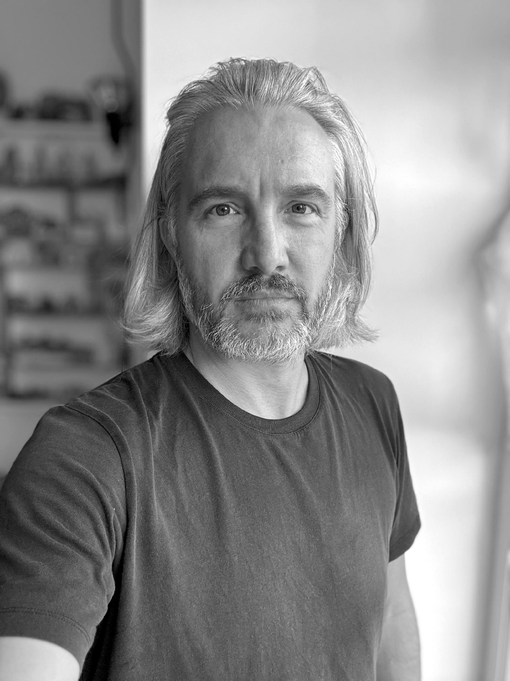
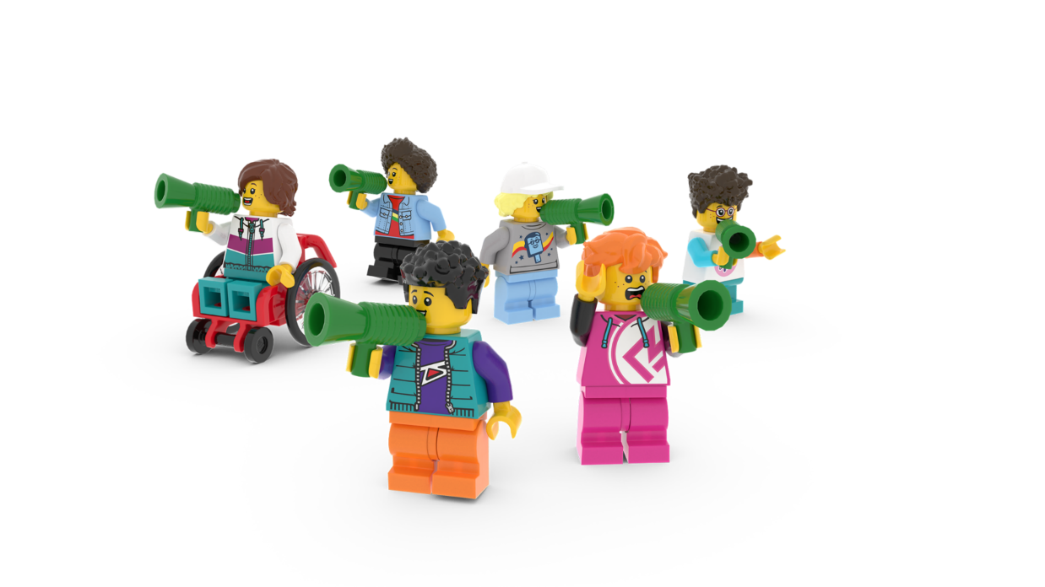
The Planet People Podcast
Meet Oliver Marlow, a designer, artist, author and speaker. He is an expert on designing creative spaces.
You’ll hear from him on the Build with Empathy podcast episode, up next!
Notes:
Seat pupils in teams around creative materials. Each pupil should have a Competition Worksheet in front of them. Explain that while they listen to the Planet People Podcast, they will be able to build or draw while they listen. They should also remember to keep adding useful information or ideas to their Mind Map on their Competition Worksheet.

Slide 14
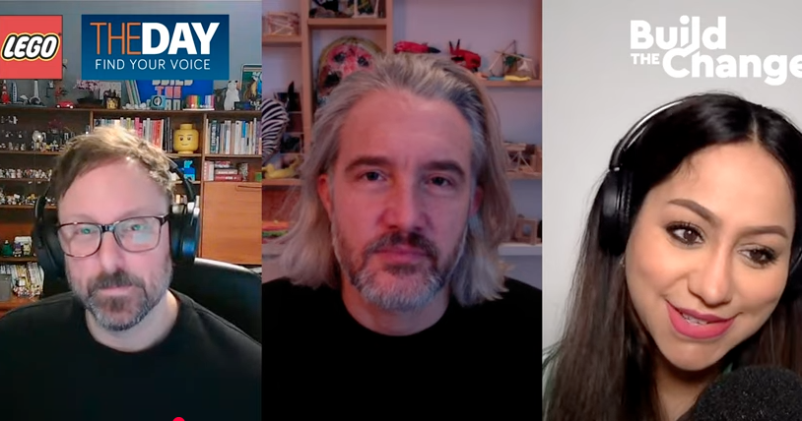
The Planet People Podcast
Part 1
Notes:
Time - 25 mins to listen to the podcast, with pauses. https://www.youtube.com/watch?v=BCWO3cDUkuU
Play part 1 of the Planet People Podcast (5 mins), pause at 4:10
In this part, pupils will:
Be introduced to the topic: human centred empathetic design
Complete a mini-build challenge: build a space for someone you know really well
Understand a bit about our guest, their job and how they help people and the planet.
2. Pause the podcast at 4:10, (see Podcast Pause 1 Slide 15)

Slide 15
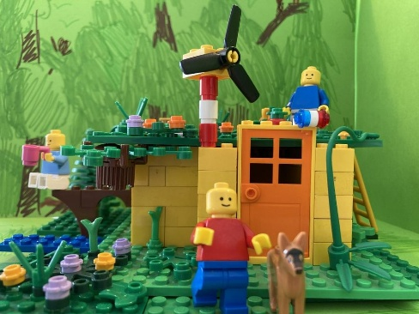
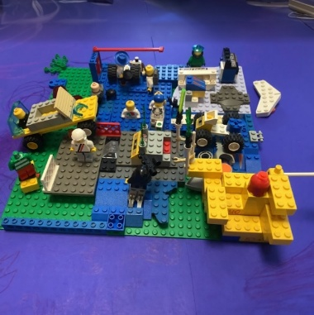
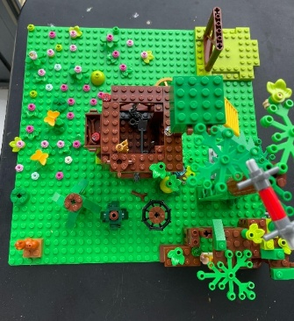
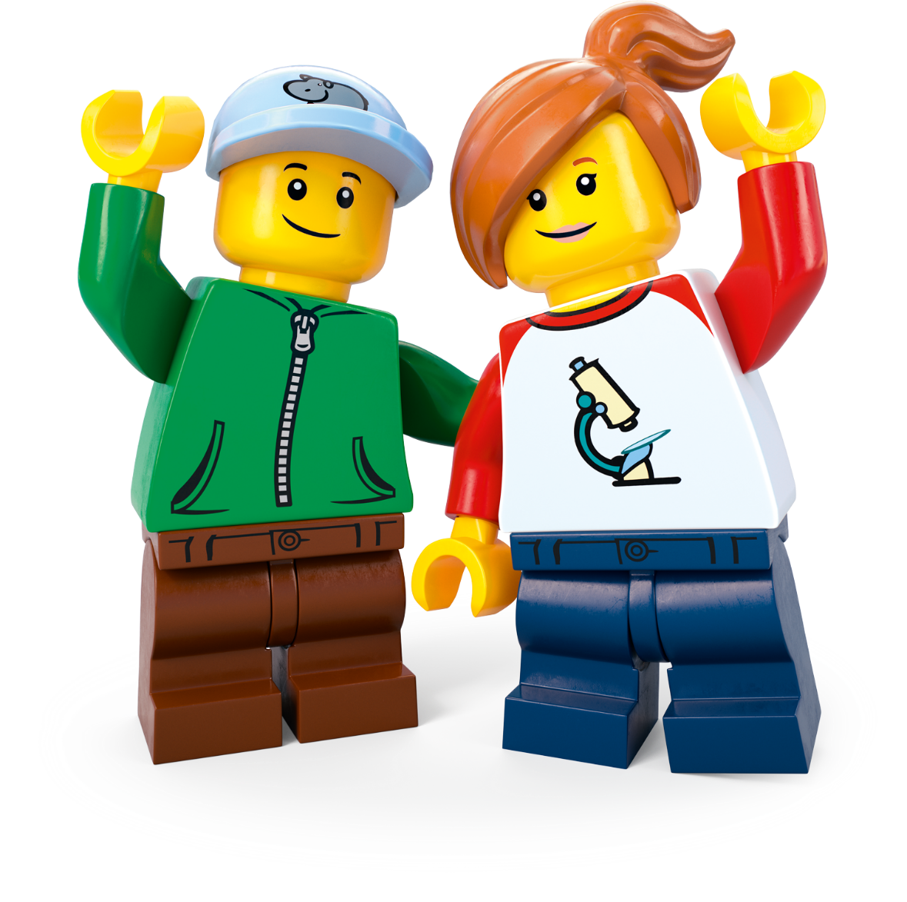
Podcast Pause 1: Mini Design Challenge
Build a space that’s perfect for someone you know well. What did you make?
Notes:
Time - 5 mins for this pause
Allow pupils to finish their mini-build challenge: build a space for someone you know really well.
Share some ideas.
Direct pupils to their Competition Worksheet.
As they listen to Part 2, next, remind them to add to their topic Mind Map by drawing or writing down interesting or inspiring words or ideas.

Slide 16
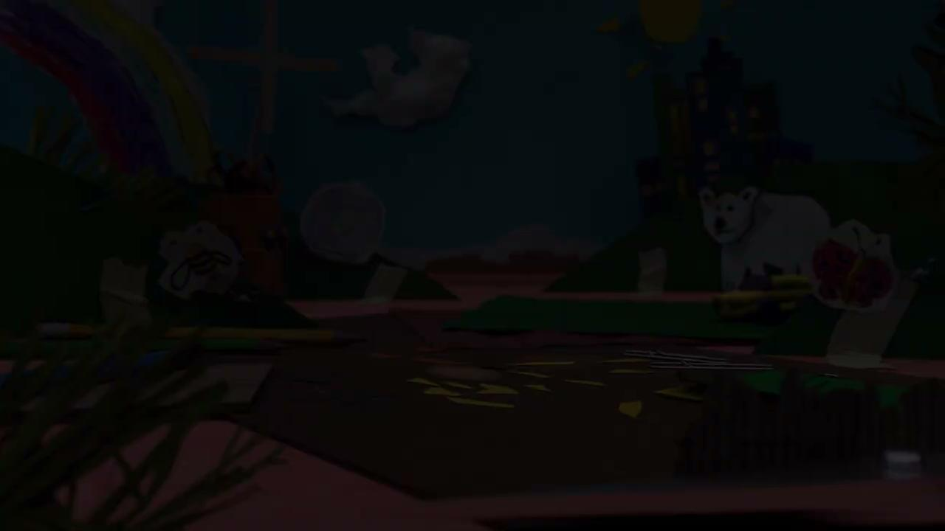
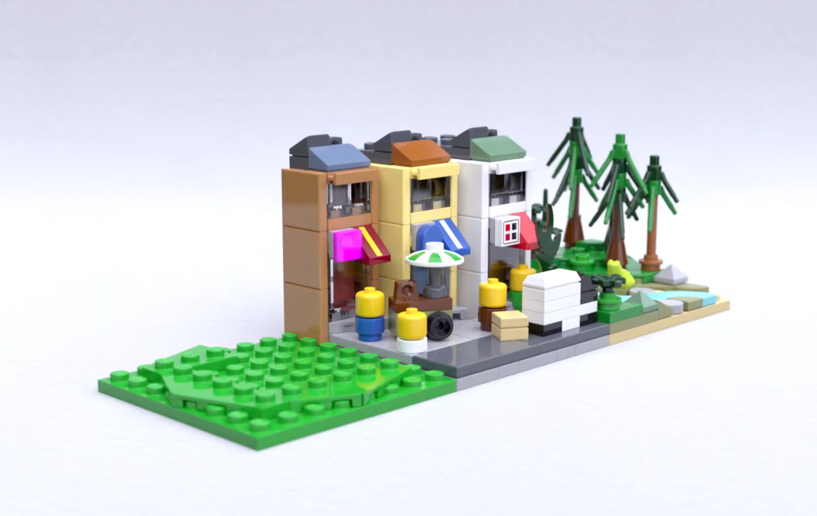
The Planet People Podcast Part 2
.
Notes:
Play part 2 (from 4:10) of the Planet People Podcast (5 mins), pause at 8:15 (if you need the link to the podcast again it’s https://www.youtube.com/watch?v=BCWO3cDUkuU).
In this part, pupils will:
Listen to the hosts interview the guest expert using the Investigation of the Day question: What is empathetic, human-centered design, and why is it important for everybody?
Pupils create a Mind Map in their Competition Worksheet to record ideas as they listen.
2. Pause the podcast at 8:15, (see Podcast Pause 2 Slide 17)

Slide 17
Podcast Pause 2: What have
we learned?
Notes:
Time - 5 mins for this pause
Take a moment to encourage pupils to share what they have written down on their worksheet. Use these comprehension questions to check for understanding.
What is empathetic, human-centred design? Using our empathy to create something that works for everyone. Empathy means imagining what something feels like, for someone else. Empathetic design means walking in lots of different people’s shoes to understand lots of different needs. Human-centred means putting people at the centre of what you are making. Always thinking, will this feel for the people using it?
How does Ollie recommend designing a space that feels welcoming for everyone? The most important thing is to understand who the space is for. Who will be using it?
What spaces make us feel a sense of belonging? Places that include things that people enjoy usually make us feel like we belong. Cultural places and places that reflect who we are and what we like. Music, art, sports and religion can be good examples of this.

Slide 18
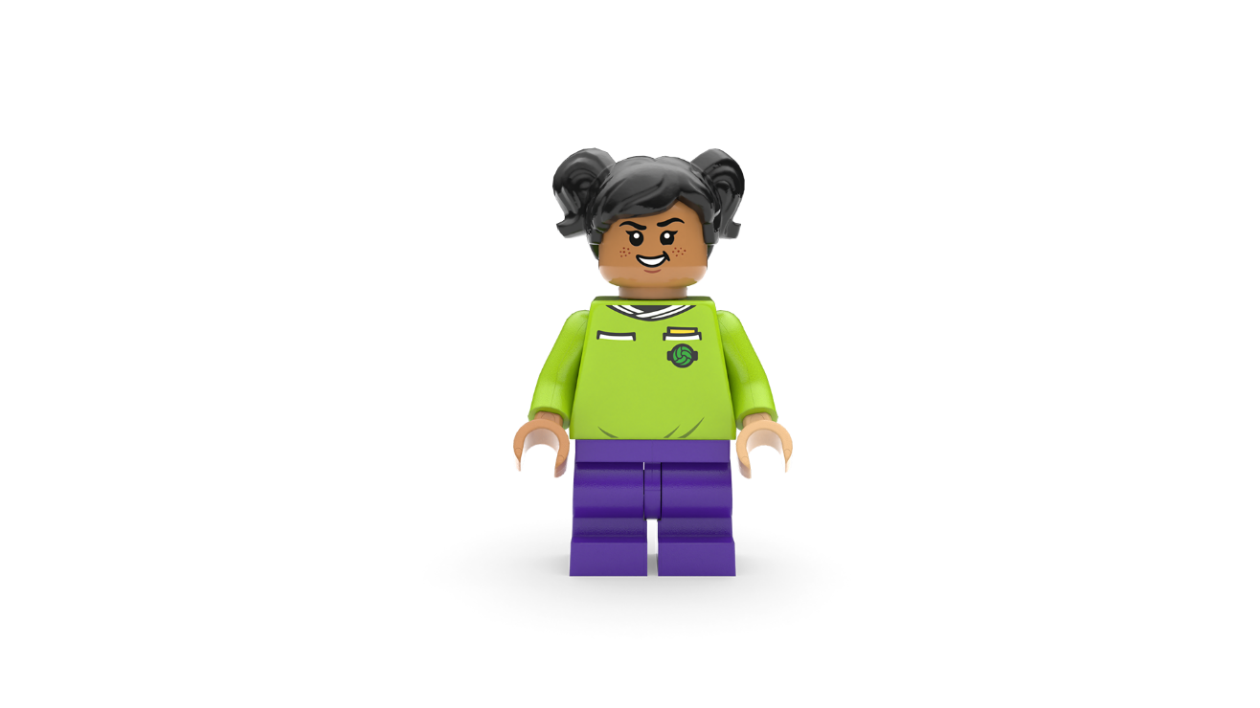
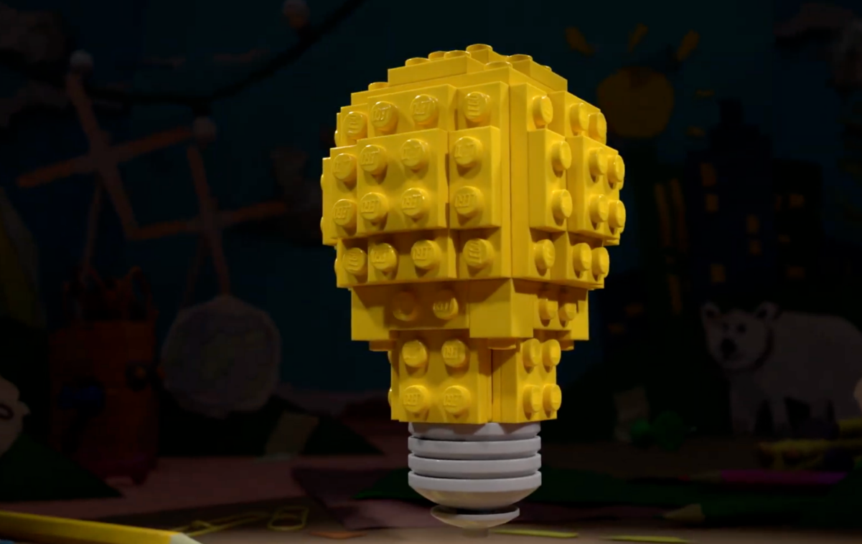
The Planet People Podcast Part 3
Notes:
Play part 3 (from 8:15) of the Planet People Podcast, (5 mins). (if you need the link to the podcast again it’s https://www.youtube.com/watch?v=BCWO3cDUkuU).
In this part, pupils will:
Recap on the conversation
Be introduced to the Build the Change design challenge
Record any inspiring ideas on their Competition Worksheet.
Understand how they can enter their ideas into our competition.

Slide 19
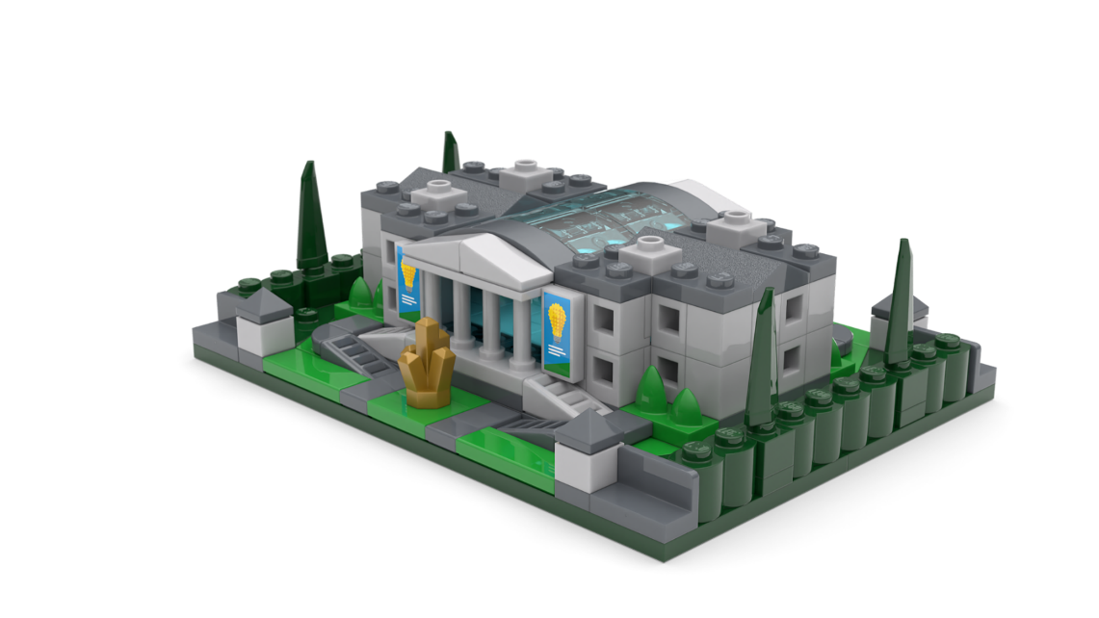
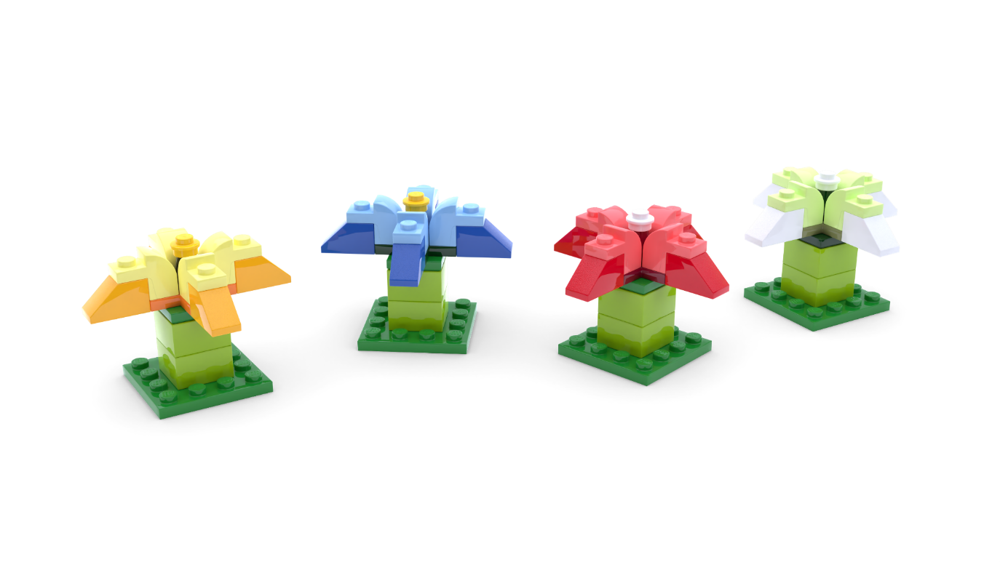
The Build for Belonging Design Challenge
Use your imagination and empathy to redesign a space in your community so it works for everyone.
Notes:
Time - 3 mins
Set the Build the Change challenge:
Empathy is the superpower that helps us create spaces that work for everyone. When we take time to understand the needs and feelings of others, we can build
a world that celebrates differences and brings people closer together.
What if you could create a space that makes everyone feel seen, heard, and valued? A place where people from all walks of life feel they truly belong?
We’d like you to redesign a space in your community so it works for everyone.
Check for understanding.

Slide 20
Reflection
What inspired you?
What intrigued you?
Notes:
Time - 5 mins
Think about the topic, the design challenge and anything else you’ve learned today. Allow pupils time to add final thoughts and ideas to their Mind Map.
You could ask them to:
Draw one thing that has interested or inspired them today
Write down one question they still have about the topic.
You may wish to seek answers to these questions together, or set this as research challenge to be completed at home.

Slide 21
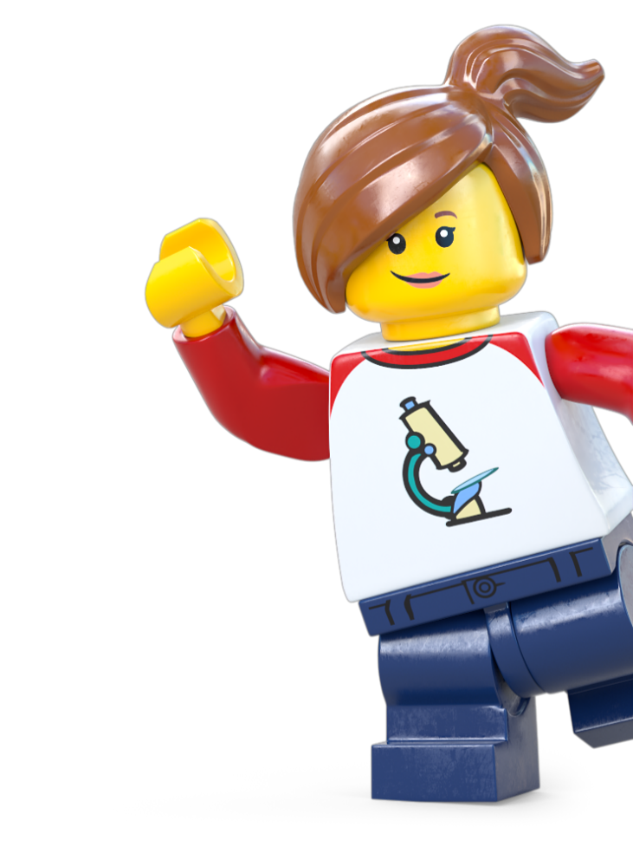
Optional Extension
Take Action!
Notes:
Take Action! Extension activities
The activities in this session are completely optional. You can spend however long you like on these and pick and choose the ones that would work for your class.

Slide 22
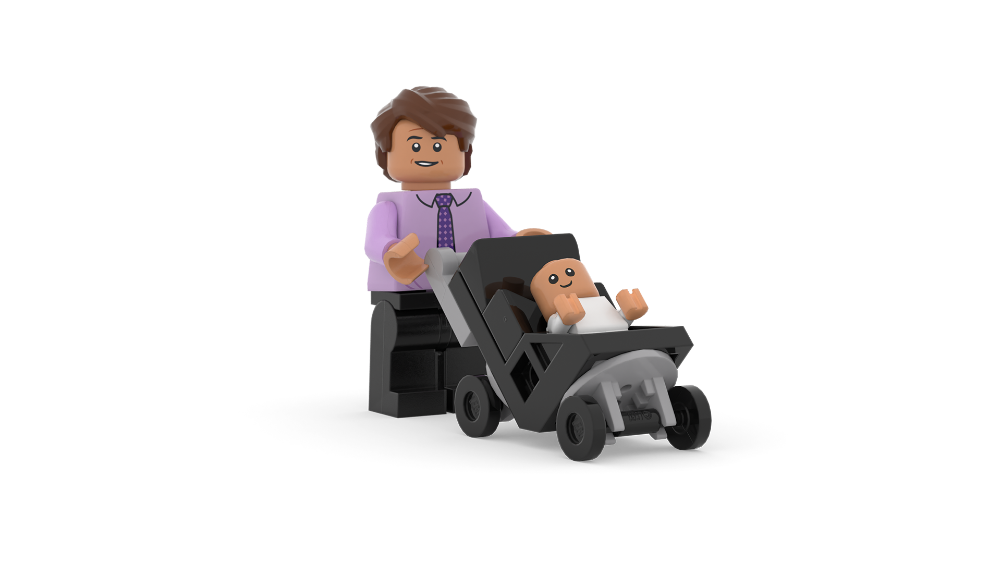
Activity 1: Step Into Their Shoes
Walk in someone’s shoes
How did it feel?
Design your solution
Notes:
Objective: Students will develop empathy for users with different abilities by experiencing physical challenges and designing solutions for accessibility.
Approx Time: 45 minutes Materials: Blindfolds, headphones or earmuffs, gloves, small objects, drawing materials.
Instructions:
Set the Scene (5 min)
Explain: Good design works for everyone! Today, we’ll explore barriers some people face in everyday spaces.
Activity: Step Into Their Shoes (15 min)
In pairs or small groups, students complete tasks while simulating different physical challenges (e.g., navigating a space blindfolded, buttoning a shirt with gloves).
Encourage active observation – what’s hard? What could help?
Discussion (10 min)
Ask guiding questions:
"What was difficult or surprising?"
"How do people adapt to these challenges?"
"Where do you see barriers in real-life spaces?"
Design Challenge (15 min)
Students brainstorm and sketch an inclusive design feature based on their experiences i.e. a solution that would help make things easier.
Examples: ramps, sensory-friendly signs, textured floor paths.
Encourage creative thinking and relate to the challenge – how might a space be improved for everyone?
Key Takeaways: Empathy is essential for human-centered design. Good design removes barriers and creates inclusive spaces. Small changes can make big differences!

Slide 23
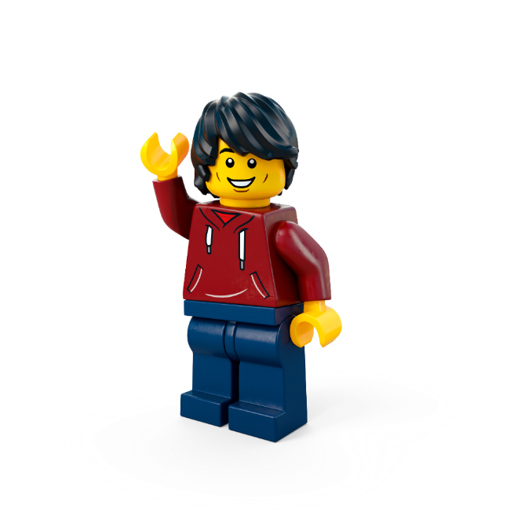
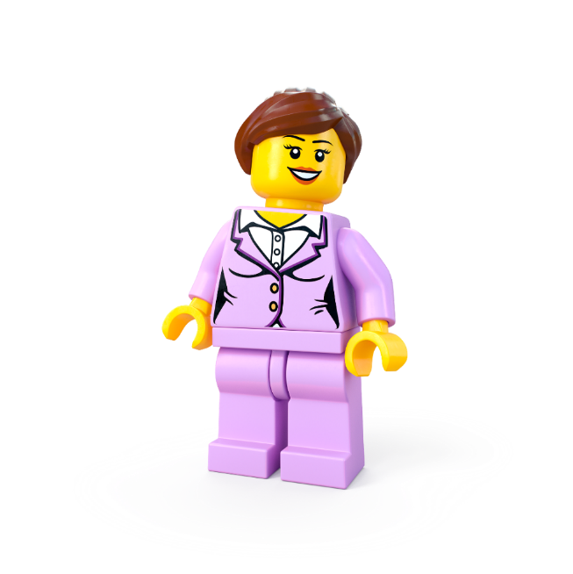
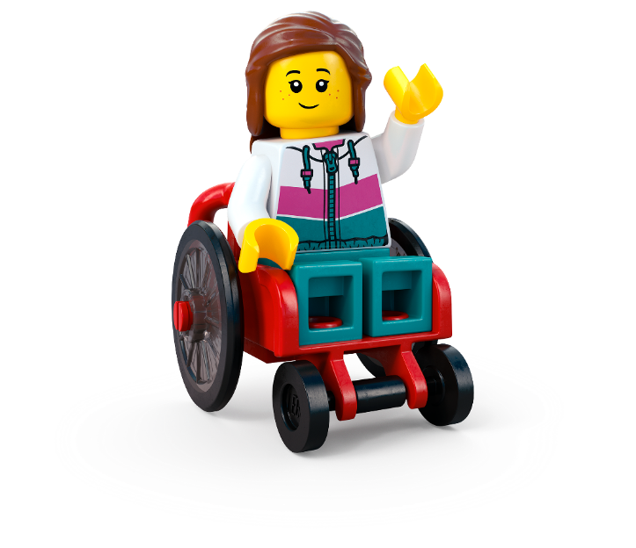
Activity 2: Design Detectives: Empathy Interviews
Your Mission: Investigate how different people experience spaces.
Step 1: Write a question
Step 2: Find people to interview
Step 3: Interview people
Step 4: Find insights
Step 5: Share & discuss
Notes:
Objective: Students will conduct empathy interviews to gather real-world insights on how different users experience spaces, helping them understand human-centered design.
Alternative shorter activity - Fix That Space! - suggested on slide 24.
Approx Time: 60 minutes Materials: Clipboards, notebooks, pencils/tablets, optional voice recorder
1. Set the Scene (10 min)
Explain: Good design starts with understanding people. Today, we will interview real users to learn about their experiences in different spaces.
Ask: What makes a space welcoming or unwelcoming? Who might find certain spaces difficult?
2. Identify Users & Plan Interviews (15 min)
In small teams, students choose a user group to interview:
In teams, interview real users of your school:
Younger students (playground/classroom experience)
Teachers/staff (challenges they notice)
Elderly visitors (navigation difficulties)
People with accessibility needs (barriers they face)
Guide students to create three to four open-ended questions (or provide a question list). Suggest empathetic, open-ended questions such as:
Can you describe a space where you feel comfortable?
What’s a space you find challenging? Why?
If you could change one thing about a space, what would it be?
3. Conduct Interviews (20 min)
Students conduct real or role-played interviews, using clipboards or tablets to record insights.
Encourage active listening and note-taking.
4. Gather & Analyse Insights (10 min)
In teams, sort findings into key categories on a User Needs Map:
Challenges (barriers people face e.g., too noisy, hard to reach things)
Needs (what people wish they had e.g., quiet zones, adjustable seating)
Ideas (possible solutions and ideas based on real feedback)
5. Share & Reflect (10 min)
Teams present findings to the class.
What patterns did they notice?
How can they use these insights to design better spaces around our school?
Key Takeaways:
Empathy is essential for human-centered design
Good design is based on real user needs, not assumptions
Active listening and observation improve problem-solving skills

Slide 24
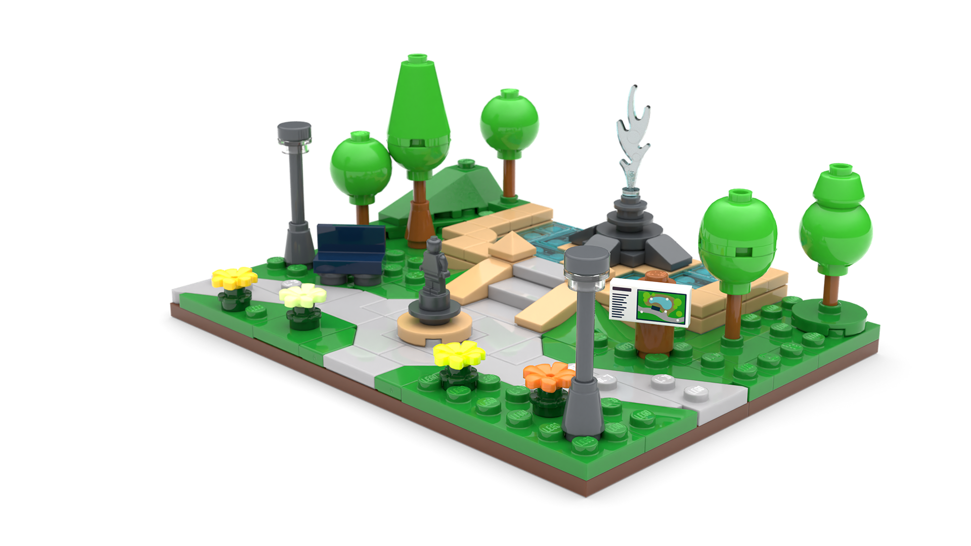
Activity 3: Fix That Space!
Your Mission: Improve a real-world space using observation and creativity!
Step 1: Identify problems
Step 2: Create solutions
Notes:
Objective: Students will observe a real-world space, identify challenges different users might face, and design improvements.
Time: Approx 30 minutes Materials: Clipboards, paper, cameras/tablets (optional).
1. Set the Scene (5 min)
Explain: “Spaces should work for everyone! Today, we’ll explore how to improve a real-world space to make it more inclusive.”
Ask: “What makes a space welcoming? What makes it difficult for some people?”
2. Explore & Observe (15 min)
Take students to a space (e.g., playground, cafeteria, library).
Have them observe and record:
Who is using the space?
What works well?
What challenges do people face? (e.g., Hard to reach? Uncomfortable?)
3. Group Brainstorming (10 min)
Back in class, students discuss observations in teams.
Prompt: “How could we make this space better?”
Encourage small, realistic improvements (e.g., adding signs, quieter zones, different seating).

Slide 25
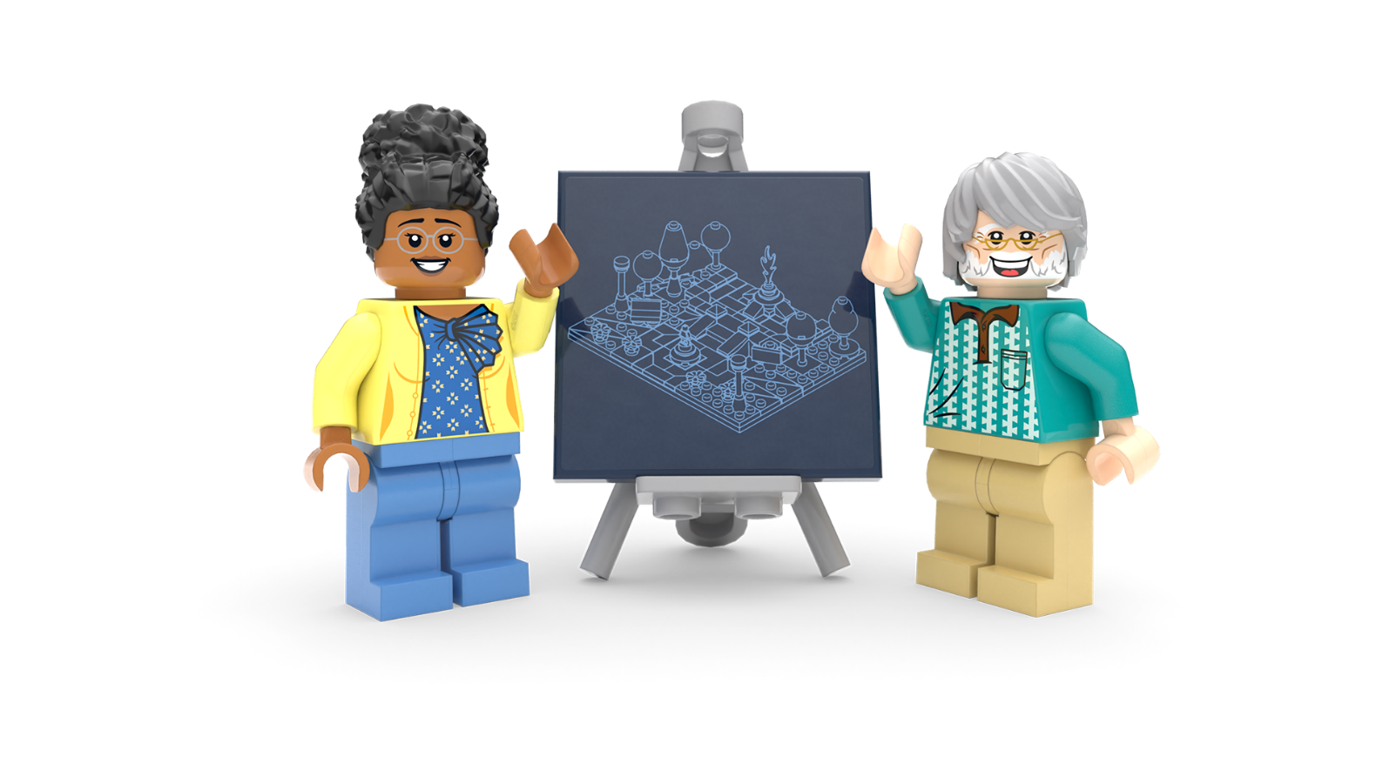
Lesson 2
Create and Share!

Slide 26
Notes:
Time - 2 min
Ask pupils to look at the empty room. What would they need to add to make it a birthday party? Encourage the children to share the things they would love to see at a birthday party.
Possible answers:
Guests, a cake, Balloons, Presents, Wall decorations, Food, Games, Music
When they’ve finished, go to the next slide.

Slide 27
Notes:
Time - 2 min
By adding these things, what kind of experience did you create? Is it fun? Silly? Loud? Exciting?
Explain that this is how we see birthday parties as a group, but is this right for everybody?
Put pupils into pairs or small groups and explain that they have just set up their own party planning business. Explain that they are about to meet some potential customers. Explain that they all have different interests and different needs. They will need to read their profile carefully to design a party that’s perfect for them.

Slide 28
Plan the perfect party for your person!
Notes:
Time - 5 mins
Let pupils pick a character to throw a party for. Then, they should plan the perfect birthday party, based on the profile.
You might like to ask pupils to point out any important information on the profiles. Highlight that Milo is autistic. Ask pupils to think about how this might affect the type of party he might like. Point out that Eva will need a wheelchair friendly location but that this shouldn’t mean the experience is any less awesome.
Encourage pupils to be creative! They should think about where the party could be and what they would need at the party to make it epic. It can be ANYTHING, money is no object!
Party on the moon? Why not! Party underwater? Sure! Anything is possible!
Grab some creative materials and create, create,
create!
NOTES TO EDUCATORS ON THE CHALLENGE:
Encourage the group to express their ideas using any creative materials available.
You can tweak the brief by getting kids to invent their own characters, or by printing out our set of People Cards and letting children choose one (see appendix slides 43-44).

Slide 29
Work together. Create together.
Teamwork Wins
All Ideas Shine
Build It Up
Listen Like a Leader
Kind Words Always
Everyone Belongs
Celebrate Differences
Mistakes Are Magic
Notes:
Time - 2 mins
Use this slide as a checklist to help pupils reflect on the previous team or paired activity. What did they do well? Where could they have improved? Remind them that when we work well together in teams and include everyone we feel a sense of belonging. If you are completing the design challenge in pairs or team, read through the teamwork manifesto together:
Teamwork Wins We work together, help each other, and share the fun.
All Ideas Shine Every idea is welcome – big, small, or even a little wacky!
Build It Up Use each other’s ideas to make something amazing.
Listen Like a Leader Give your teammates your full attention – their ideas matter.
Kind Words Always Speak with kindness and cheer each other on.
Everyone Belongs Include everyone in the group – no one is left out.
Celebrate Differences Our unique ideas make the team stronger and more creative.
Mistakes Are Magic Mistakes help us learn and grow – celebrate them!
If you are running this challenge as a pair or team activity, these rules will help pupils build a sense of belonging as they tackle the creative challenge. If you have more time, you could pass a copy round for everyone to sign or even create your own.

Slide 30
Notes:
https://www.lego.com/cdn/cs/sustainability/assets/blt3eb77b9554899ea1/DPFP_Intro_part2.mp4
3 mins
Explain that so far in this lesson, pupils have designed spaces for themselves and for others. They’ve used empathy to think of experiences that might appeal to another person. They’ve seen how everyone is different and understood that everyone experiences the world around them in different ways.
Now they are going to hear about some more specific ways designers use empathy to create places that work for everyone, not just one person.

Slide 31
Notes:
1 min
Ask pupils what they thought about the video? Relate it to their lived experiences. Can they think of anything they have seen that’s been designed to give people a better experience or make them feel more comfortable? Does they know anybody who needs cool designs to help them?

Slide 32
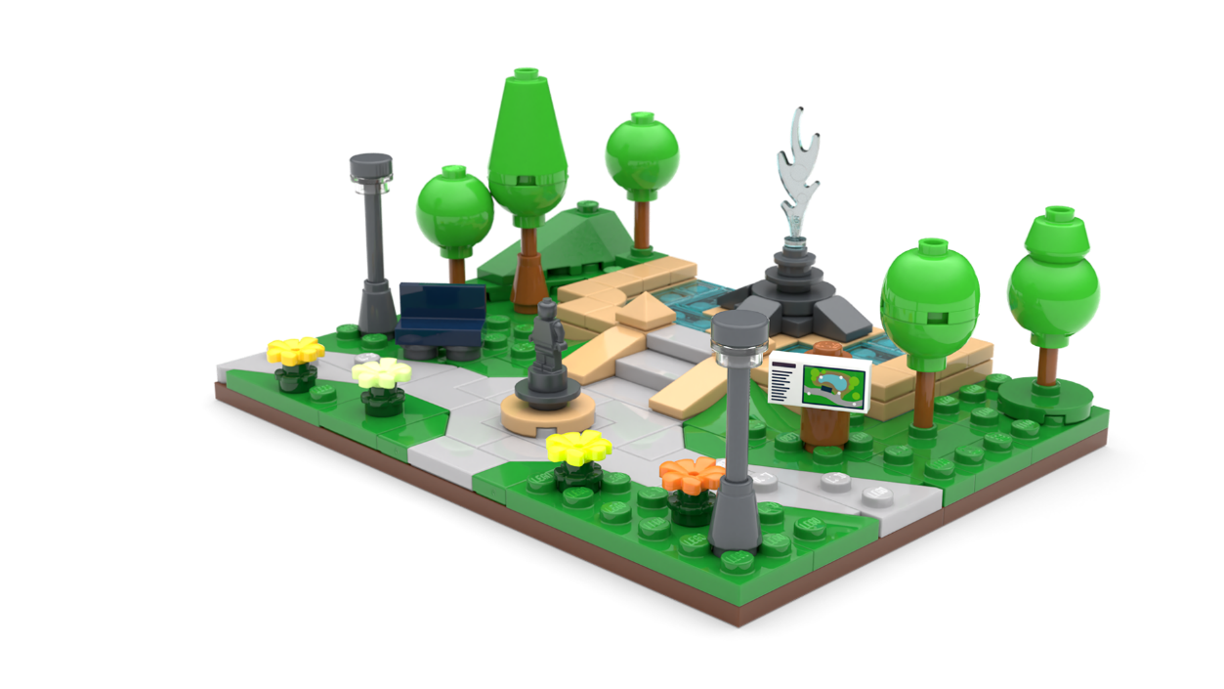
The Build for Belonging Design Challenge
Use your imagination and empathy to redesign a space in your community so it works for everyone.
Notes:
Time - 5 mins (for next 3 slides)
Bring pupils back to the design challenge that was introduced in lesson 1: Use your imagination and empathy to redesign a space in your community so it works for everyone.
Remind them that empathy is a superpower that helps us create spaces that work for everyone. When we take time to understand the needs and feelings of others, we can build a world that celebrates differences and brings people closer together.
Check for understanding of the challenge and what’s expected of them. You can use the following slides to reinforce the brief, so they understand the challenge.

Slide 33
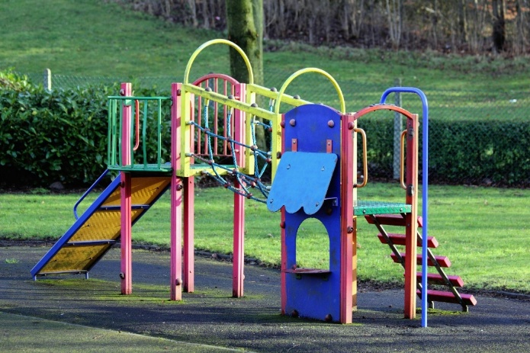
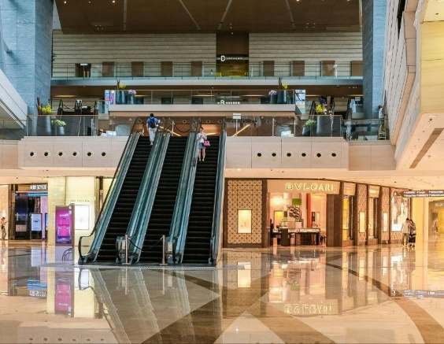
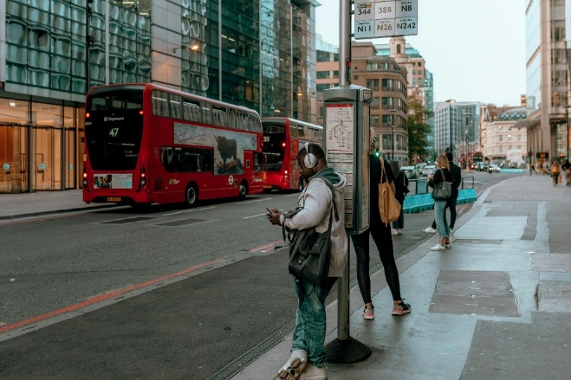
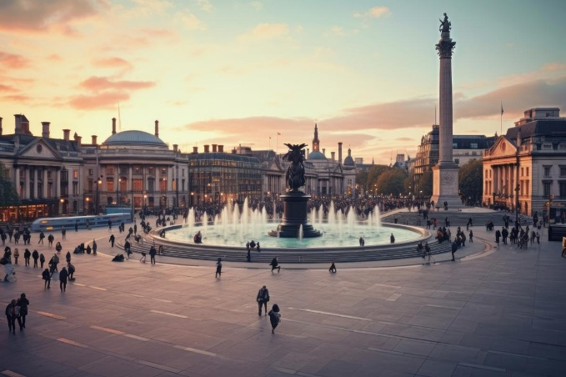
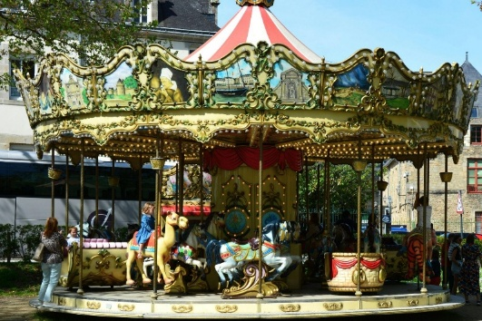
What will you redesign?
c Pexels
Notes:
Use this slide to help pupils pick a public space they’d like to reimagine.
Using the images as inspiration, encourage pupils to think about some of the busiest places in your community. Which ones are used by lots of people? Like a park, a school, a museum, a housing estate, or even a bus stop. You may even want to use some images from your local area here.
They can write ideas for places on their Mind Maps.
You could also use the place cards, on slide 42 of the appendix, if pupils are stuck for ideas.
Once pupils have decided on a place, ask them to imagine how different people experience that space:
What’s easy or fun for some people but difficult for others?
How might someone who uses a wheelchair, pushchair, or walking stick feel here?
Would people from different cultures and backgrounds feel welcome?
Put yourself in their shoes. Can you spot ways to make the space better for everyone?
You may wish to use the People Cards in the appendix, slides 43-44, to help them with this.

Slide 34
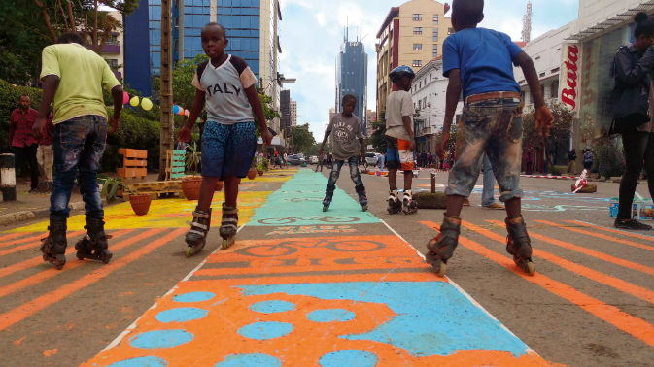
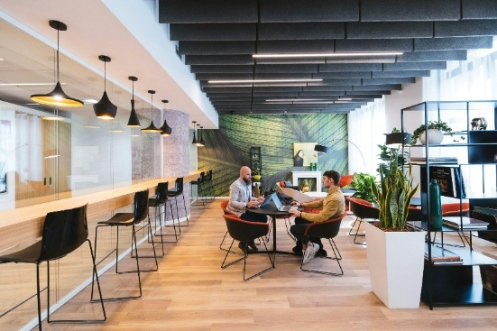
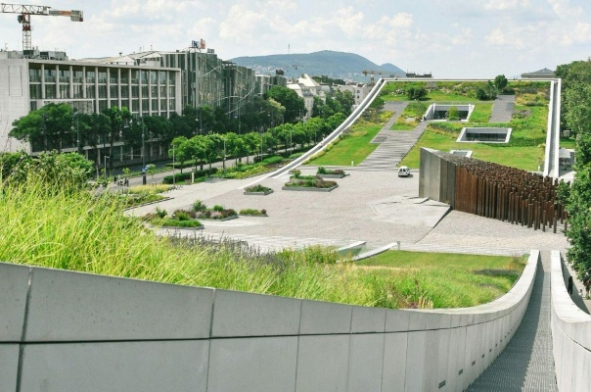
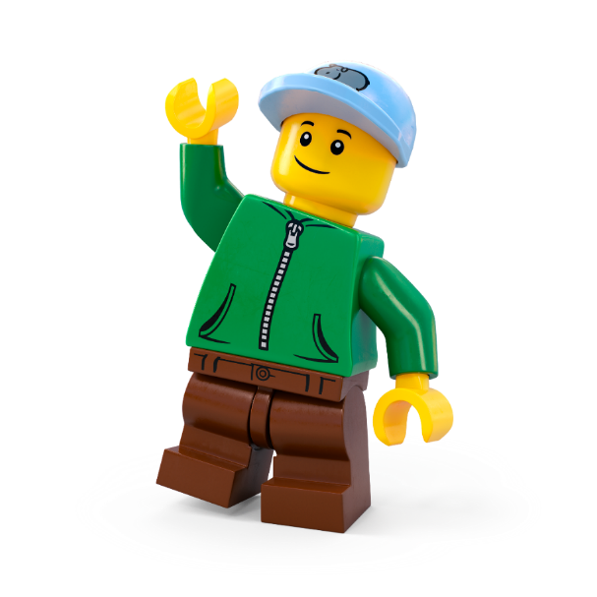
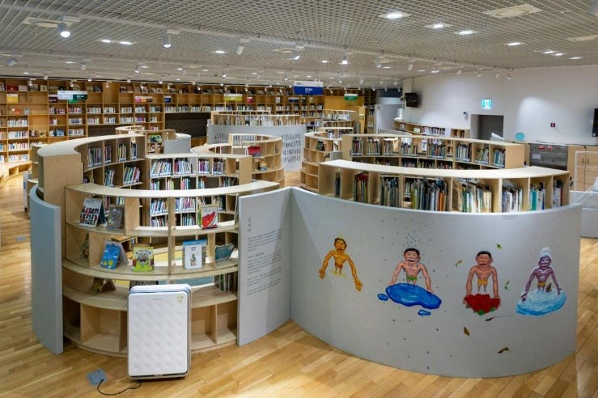
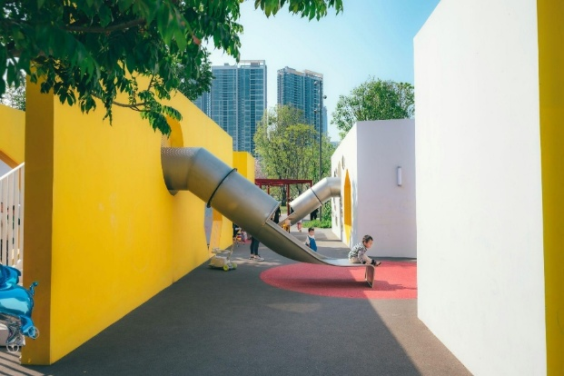
How will you reimagine it?
c Keszthelyi Timi /Unsplash
c Copernico/Unsplash
c UN Habitat, republishing for schools
c Wang Binghua/Unsplash
c Asian Culture Centre/Unsplash
Notes:
Use this slide to inspire pupils with some ways they might reimagine a community spaces. Use the images and the prompts below to inspire pupils.
What if…
A park had pathways wide enough for wheelchairs and pushchairs, scooters and bikes, with places to rest, eat picnics and play?
A library had a storytelling corner where people of all ages could share their culture and traditions?
A busy bus stop had bright murals and comfy seating that made waiting more enjoyable for all?
A playground had sensory spaces for kids who prefer quiet time as well as areas for big, exciting adventures?
Your mission is to reimagine a space that’s more than just practical—it’s welcoming, joyful, and inclusive.

Slide 35
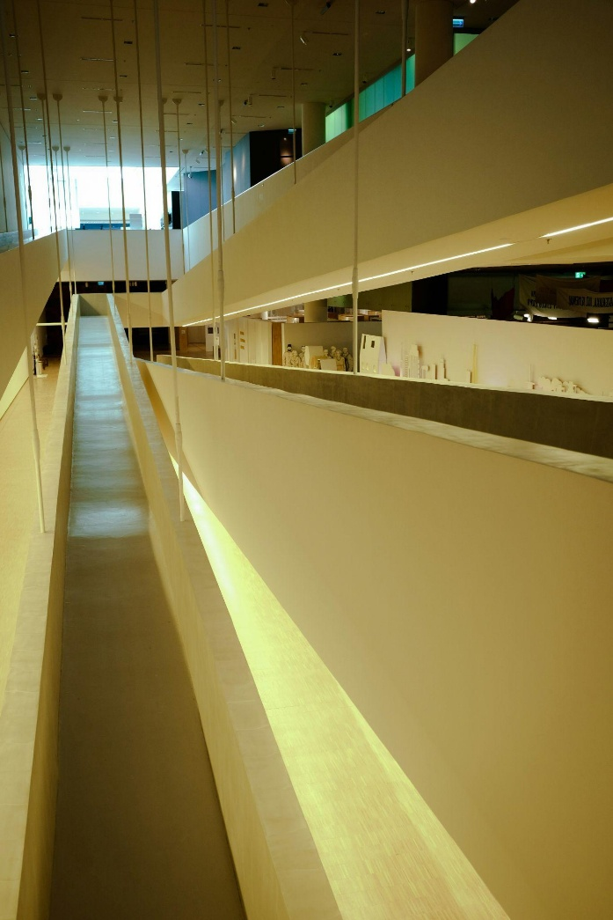
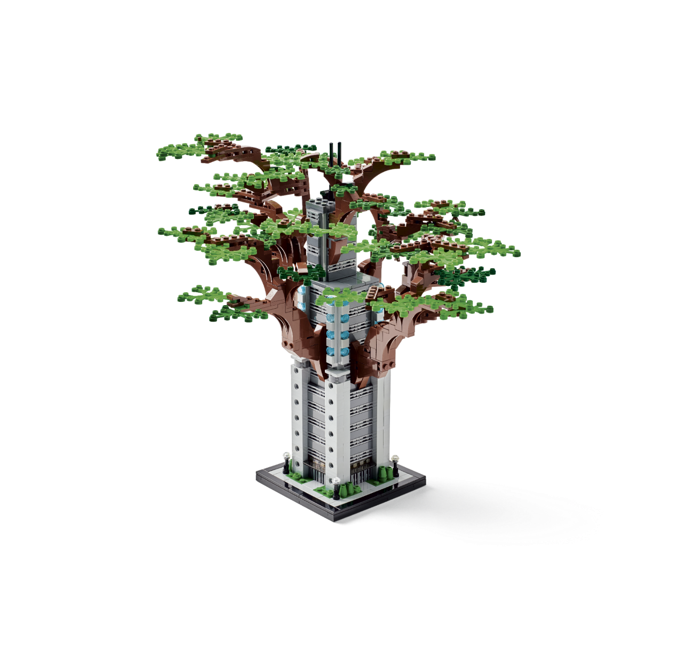
How will you make sure it is…
inclusive?
easy to use?
welcoming?
good for your community?
Credit: Anastasia Saldatava/Unsplash
Notes:
Finally, use this slide to remind pupils they will need to redesign the space so it work for everyone.
Remind them that empathy helps us create spaces where everyone feels welcome. When we understand people’s needs and feelings, we can design places that bring us together.
Use these questions to help them think about the space as it is and how it could be improved.
Inclusivity. How can your space make everyone feel included?
Accessibility. How can it be easy to use for all abilities?
Community. How can it reflect different cultures and stories?
Connection. How can it bring people together?
You may wish to give pupils a selection of People Cards (slides 43-44) to help them design with different users in mind.

Slide 36
Let’s Build the Change!
Brainstorm ideas
Design your space
Create a model
Write a description
Share your solution
Enter our competition
Notes:
Time - 20 mins
Use this slide to explain all the jobs that need to be done before setting pupils off on their own.
Brainstorm ideas
Look at your mind maps. As a team, write down as many ideas as possible – the sillier, the better! Choose two or three of the best ideas to make even better. Decide on one idea as your solution.
Design your space
Draw your brilliant solution in the Competition Worksheet.
Build a model
Create a model of your solution using all the cool materials available.
Present your solution
Share your ideas with the rest of the class
Enter the Build for Belonging competition
Make sure your ideas, designs and descriptions are included in your Competition Worksheet. Teams should submit one worksheet per team to the competition. Teachers can take a photo of the build to enter it into our competition.
Remember: You can run the challenge as an individual challenge, in pairs or small groups of up to 4. You can allocate team roles using the Team Roles on slide 45, in the appendix.

Slide 37
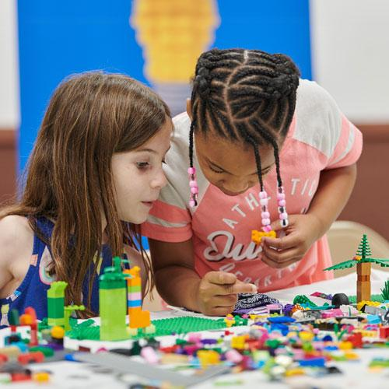
Individual or Pairs - Final Checklist
Have you:
Labelled your final design?
Written a description of your solution?
Got your model ready its photo?
Prepared your presentation?
Notes:
Time - 10 mins
Allow some time for pupils to finalise their models and get ready to share their ideas with the class.
If you’re running the challenge with pairs or teams, use this list to remind each team member what they are responsible for:
Designer: Time to show off your artistic skills! Label your final drawing to highlight all the awesome features of your design.
Writer: Get your writing hat on! Write a cool description of your amazing solution so everyone knows how it works.
Builder: Your job is to get our model ready for its close-up! Make sure it's looking perfect for its big moment in the spotlight.
Presenter: You’re the star presenter! Get ready to wow the class with your awesome solution and explain how it works.

Slide 38
buildthechange.theday.co.uk/competition
Notes:
Ask pupils to stop working and place their models around the room for everyone to see.
If you are entering your class’ ideas into our Build for Belonging Competition, show this slide to get pupils excited!
Enter by 30th June at www.buildthechange.theday.co.uk/competition

Slide 39
Share your ideas
Notes:
Time - 10 mins
Ask pupils to take it in turns to present their solution to the class. Encourage others to give positive and constructive feedback.
You could ask them: What went well? What could be even better?
Celebrate all their awesome ideas!

Slide 40
Share it with the world
Missed the competition deadline?
Don’t worry, your kids’ awesome ideas can also be published on the LEGO.com website! Simply upload photos with a 200 character max description of your children’s creations to our Build the Change photo gallery, for the whole world to see!
They might even be our next Builder of the Week!
Scan the QR code with a camera to start uploading.
Notes:
Don’t forget to upload your learner’s awesome ideas to help us show everyone how awesome kids’ ideas are!
You can upload photos and descriptions of your children’s creations to our Build the Change Tuesday gallery. They might even be our next Builder of the Week! Scan the QR code with a camera to start uploading, or visit: https://www.lego.com/en-gb/sustainability/buildthechange/challenges/theday/upload?CMP=EMC-LCE.

Slide 41
Appendix

Slide 42
Notes:
https://www.lego.com/cdn/cs/sustainability/assets/bltb0153159ab030e5b/DPFP_People_and_Places_cards.pdf
Use these Place Cards if pupils are struggling to think of a space to redesign.

Slide 43
Notes:
Use these People Cards to help pupils make sure they are using empathy to design a space that works for different users.

Slide 44
Notes:
Use these People Cards to help pupils make sure they are using empathy to design a space that works for different users.

Slide 45
Team roles
Presenter The presenter gets to show off the team's amazing work to the class.
Writer The writer explains the team's ideas in the best words possible.
Designer The designer creates and improves the team's awesome drawings.
Builder The builder brings the design to life with a cool model.
Notes:
Use this slide if you are asking students to work in groups. Please note: Students can enter the competition individually, in pairs or in teams of up to 4 people.
Explain the roles. Ask students to take on team roles according to their strengths.
You could even print out the slide or give them badges as a reminder.

