Slide 1
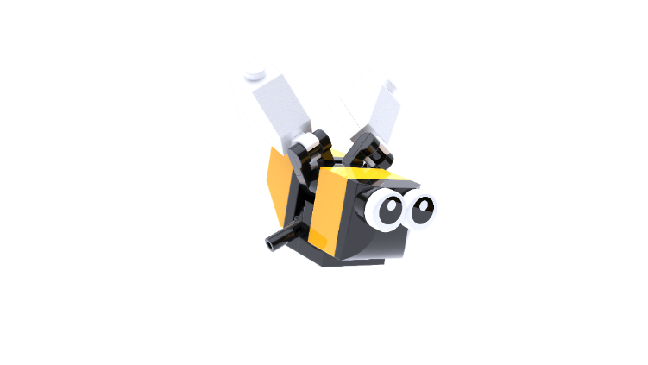
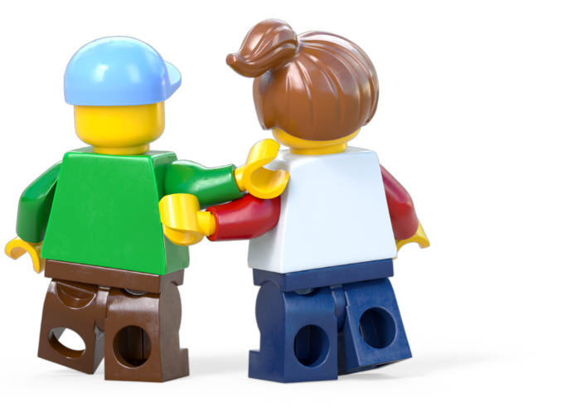
Build for Belonging
BUILD FOR COMMUNITY
WORKSHOP
Ages 7-11
Build the Change is supported by the LEGO Foundation. LEGO, the LEGO logo, the Minifigure and the Brick and Knob configuration are trademarks and copyrights of the LEGO Group. ©2025 The LEGO Group. All rights reserved.

Slide 2
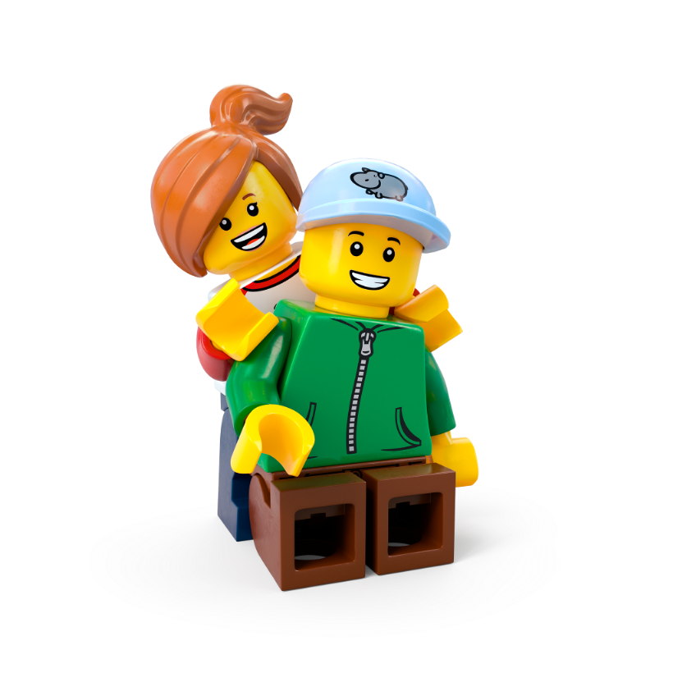
Contents
Workshop 1 Immerse – Slides 3-20
News Detectives Article – Slides 9-11
Planet People Podcast – Slides 13-18
Build for Belonging Design Brief – Slide 19
Take Action! Optional Extension – Slides 21-24
Workshop 2 Create & Share – Slide 25-35
Design brief – Slide 30 - 31
Challenge checklist – Slide 32
Competition Information – Slide 34
Appendix – Slides 37-38
Team roles – Slide 38

Slide 3
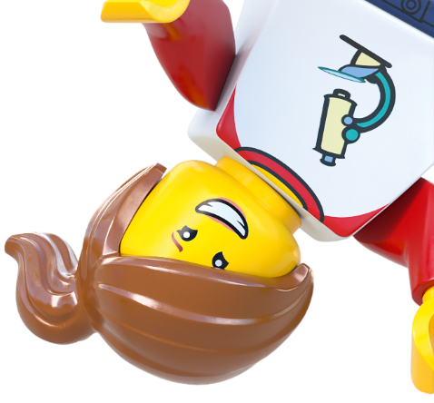
Lesson 1
Immerse

Slide 4
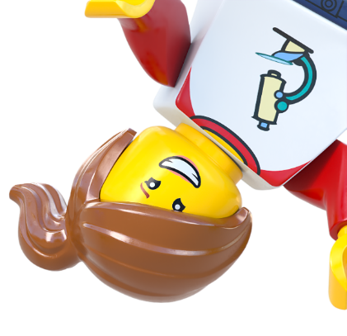
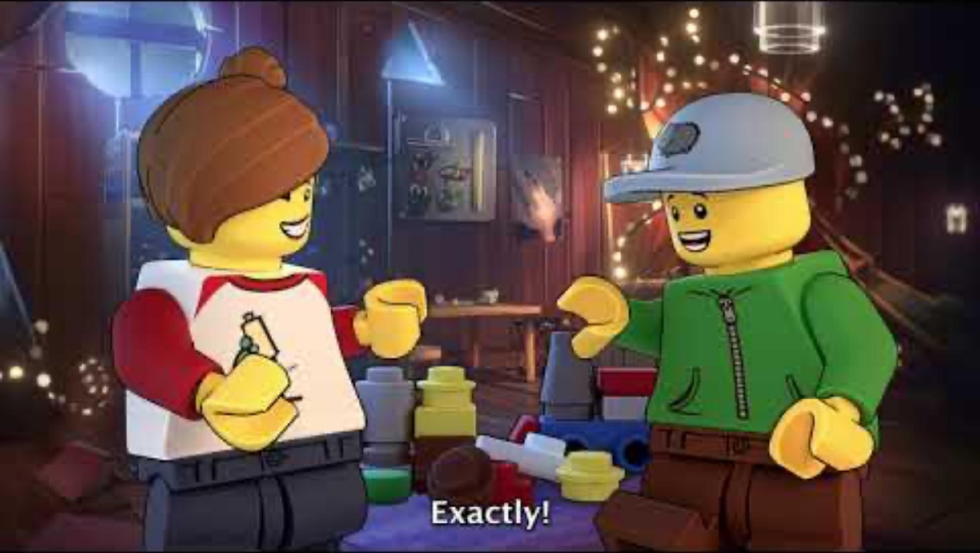
Notes:
Time - 2mins
Play the video to introduce pupils to the LEGO Group’s Build the Change programme.
https://www.youtube.com/watch?v=D7z8iXqjIkE&t=1s

Slide 5
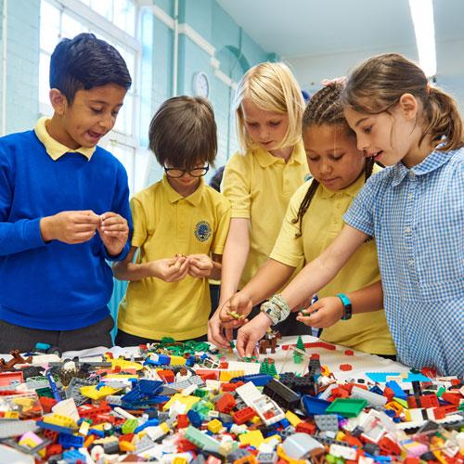
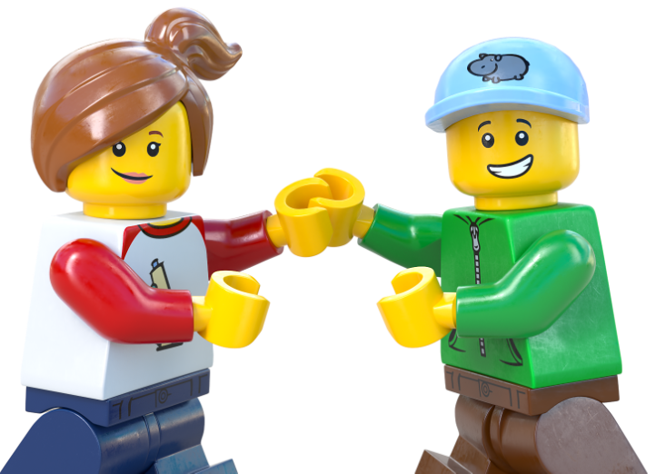
Recreate a happy moment...
With others.
Notes:
Time - 3 mins
Use our playful activity to introduce the topic of belonging. Use this script to introduce the activity:
Think about a fun time you’ve had with friends or family recently. Now, use the creative materials in front of you to build or draw that moment! It doesn’t have to look exactly like it did – make it your own!
As you draw or build, remember how you felt during that moment. What made it special?
Ask pupils to draw, make or build a happy memory with some of their favourite people.

Slide 6
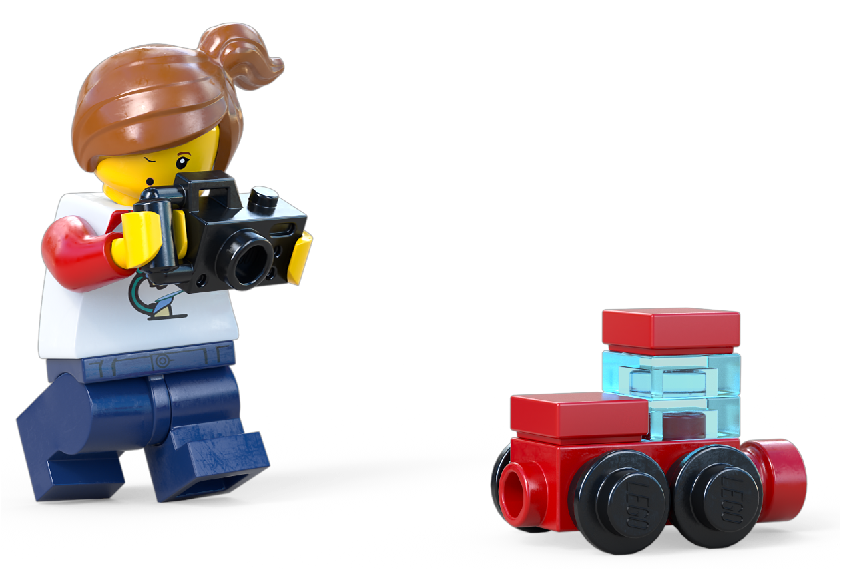
Share your happy moment
Notes:
Time - 2 mins
Encourage them to share memories and feelings in pairs or as a class.
You could ask them: How did you feel at this time? What words or feelings come to mind? Would it have been the same or different if you’d experienced it alone?

Slide 7
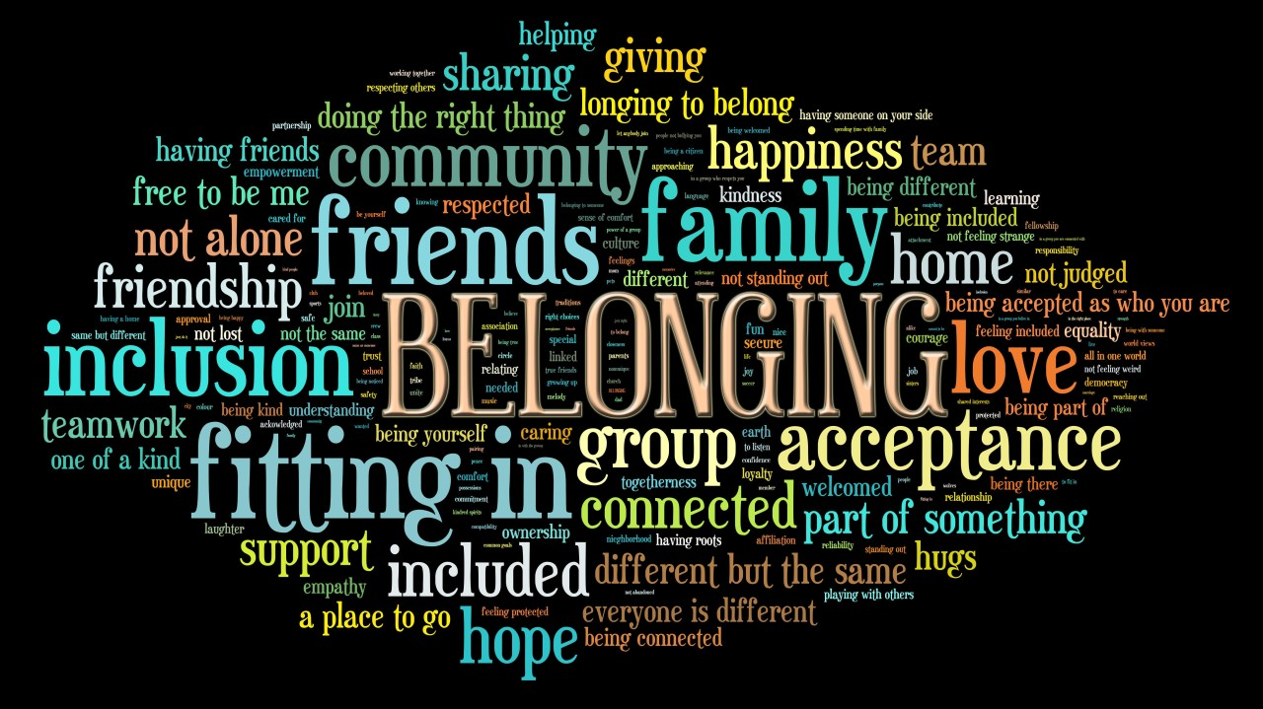
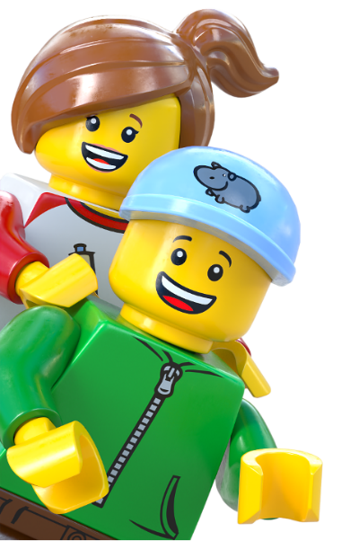
Notes:
Time - 1 min 30 secs
Link your pupils’ personal experiences to this lesson’s topic of belonging.
Explain that today you will be thinking about belonging. Ask pupils if they can look at the word cloud and think about the memory they just shared and answer this question: What is Belonging?
You can use this script to explain belonging:
Belonging means feeling like you’re part of something, whether it’s a group of friends, a team, or your community.
Belonging is like when you find a group of friends who invite you to play and laugh with them. It feels warm and happy, like you’re part of a team where everyone is glad you’re there.
Belonging is important because humans are social creatures—we thrive when we connect with others. When we feel like we belong, it makes us happier, healthier, and more confident.
Ask pupils if this feeling of belonging is how they felt in their memory? Was the moment better because it was shared with others? Would it have been as special if it was experienced alone?
Explain that they’ll explore belonging in more detail later.

Slide 8
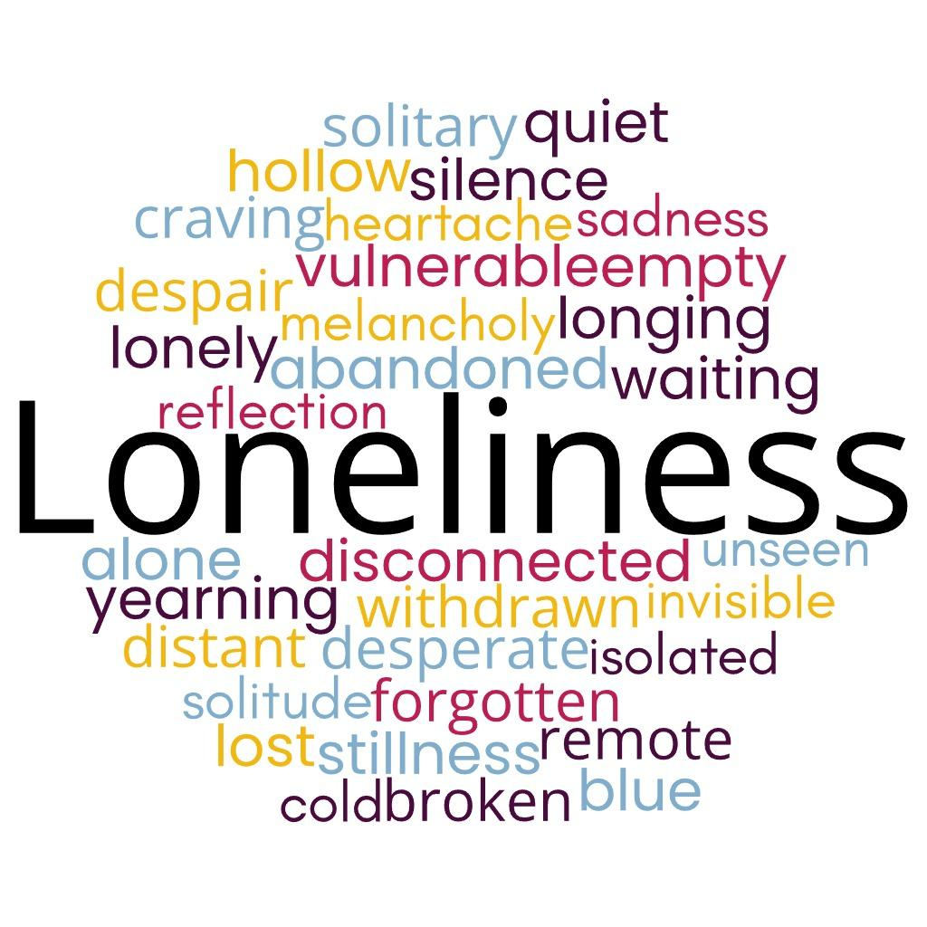
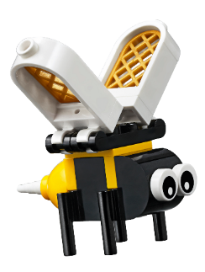
Notes:
Time - 1 min 30 secs
Now that pupils have explore the feeling of belonging, ask them what is loneliness? Use the word cloud for prompts. Highlight how these words are often the opposite of the words associated with belonging.
Use this script to explain loneliness to your class:
Loneliness is like when you’re playing on the playground, and you look around, but there’s no one to play with or talk to. It can feel quiet and a little sad, like you’re all by yourself even if there are people around.
Loneliness is a normal part of being human. This is because long ago, people lived in groups to stay safe and share food. If someone wandered off or got left out, they might be in danger, like from wild animals. So, their brain would make them feel lonely, like a little alarm saying, 'Hey, you need to go back to your friends!'
Even today, when we don’t have enough people to talk to or play with, that same alarm makes us feel lonely. It’s like our heart saying, 'I need some company!' It’s a reminder to spend time with others who care about us.
Make sure pupils understand that loneliness is a natural feeling that can guide us toward finding connection and friendship.
Explain that we’ll explore loneliness in more detail now.

Slide 9
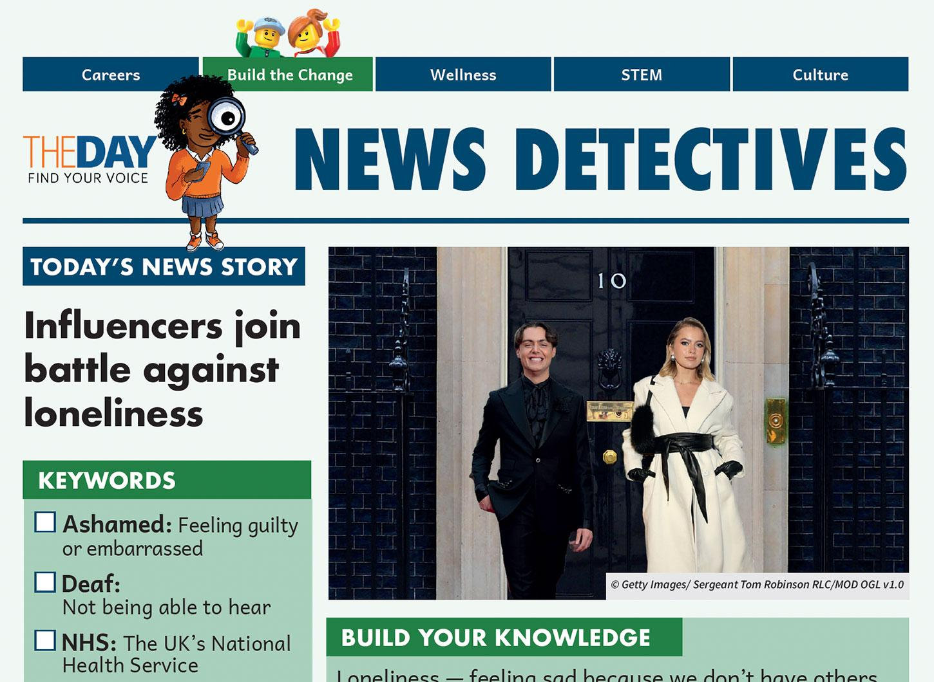
Read all about it!
Download the news article here.
Notes:
Time - 7 mins
Read the News Detectives article:
Start by exploring the KEYWORDS, and introduce the WHAT YOU NEED TO KNOW section.
Read TODAY’S NEWS STORY independently, or as a class, depending on your class’ reading ability.
https://buildthechange.theday.co.uk/resources/influencers-join-battle-against-loneliness/

Slide 10
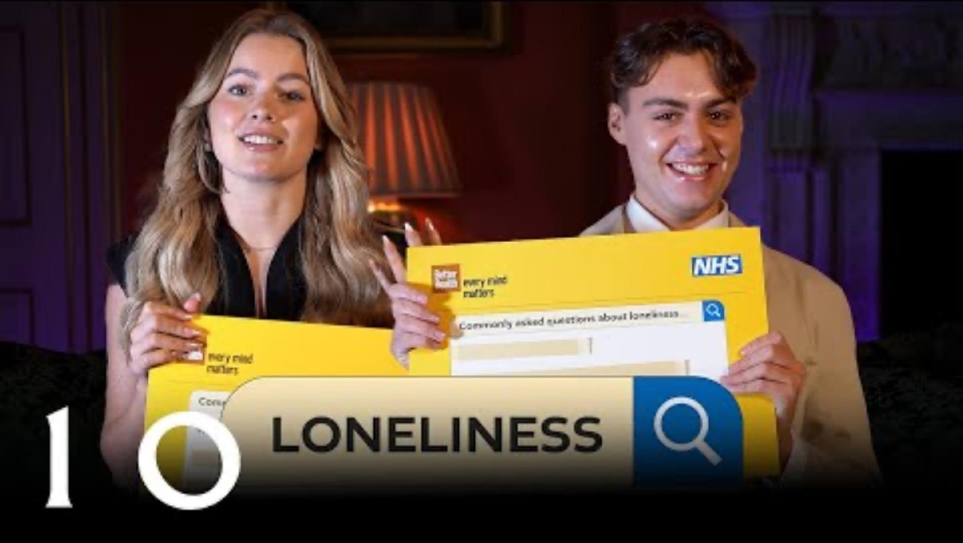
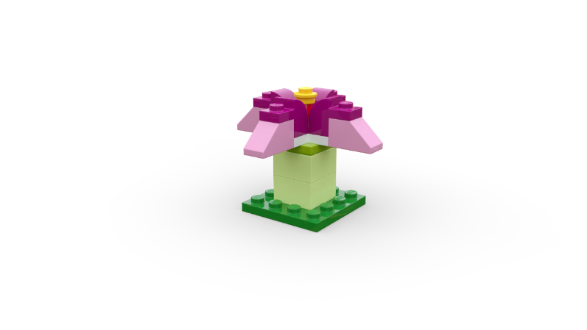
Solutions to loneliness
Talking Loneliness in Downing Street' video from 10 Downing Street's Youtube channel
Notes:
Time - 6 mins
Watch the video as a class: https://www.youtube.com/watch?v=nS-mVlBZzQ0.
While pupils watch the video, ask them to listen out for solutions to loneliness and add them to their Mind Map on their Competition Worksheet.

Slide 11
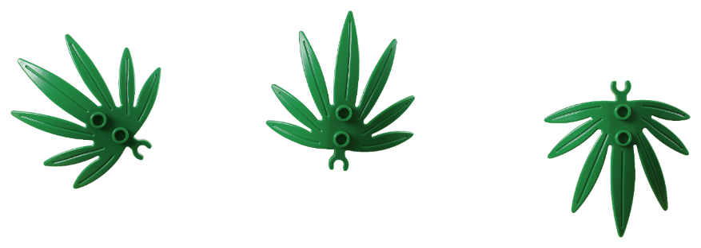
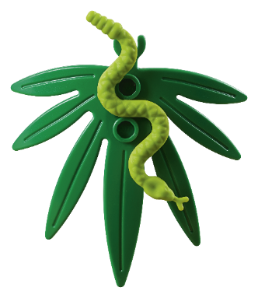
What did we learn?
What
is loneliness?
Why
do people feel lonely?
Who
feels lonely?
When
are we likely to feel lonely?
How
can we overcome loneliness?
Where
can we find help if we’re struggling with loneliness?
Notes:
Time - 3 mins
Use the WWWWWH? questions to check their understanding.
WHAT does Stuart Andrew advise? ANSWER: Talking about feelings of loneliness
WHY do many people hide their feelings of loneliness? ANSWER: They feel embarrassed/ ashamed
WHO says she felt lonely at school? ANSWER: Tasha Ghouri
WHEN was the survey conducted? ANSWER: 2024
HOW do some people in Japan deal with loneliness? ANSWER: Robots
WHERE can people find support? ANSWER: NHS website

Slide 12
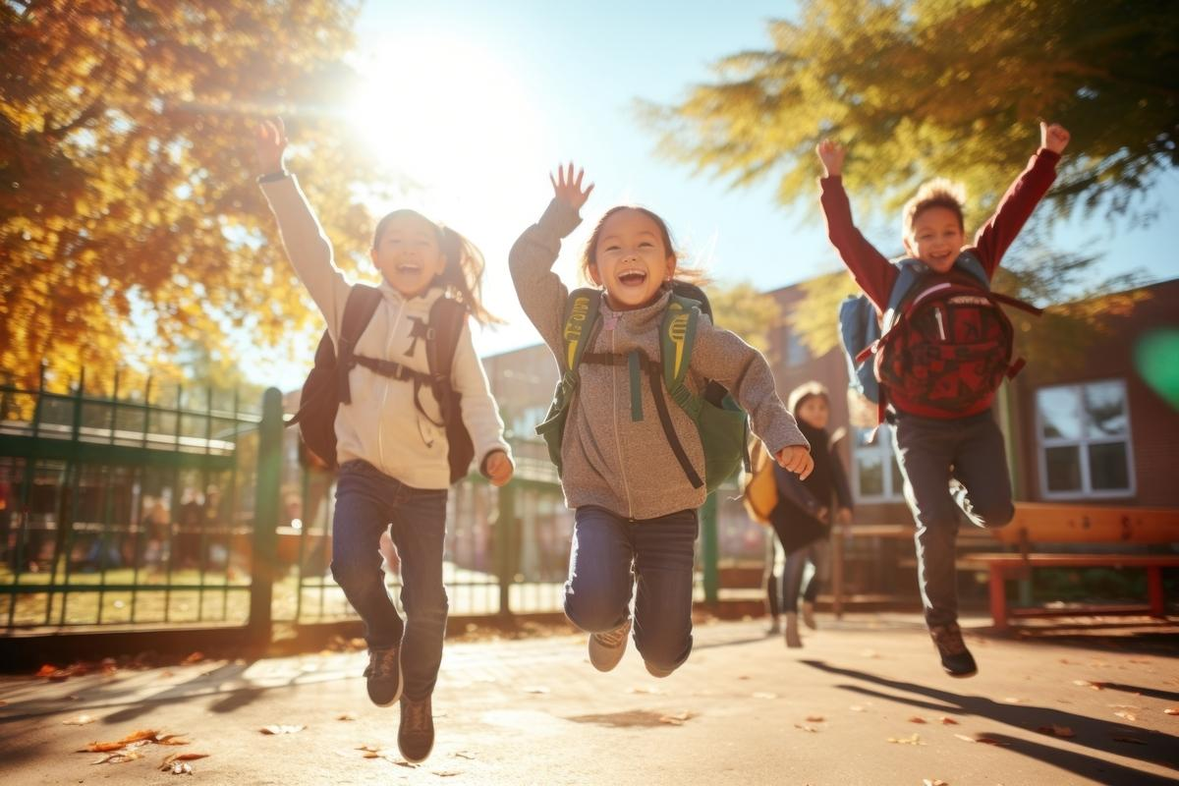
Investigation of The Day
Why is belonging so important for people and our planet?
Notes:
Time - 2 mins
Point pupils to the Investigation of the Day question (also on page 2 of the News Detectives Article): Why is belonging so important for people and the planet?
Can pupils remember what belonging means? Belonging means feeling like you’re part of a group, community, or place where you are accepted and valued. It’s the warm feeling you get when you know you’re welcome and that you matter to the people around you.
Remind pupils that humans are social creatures and in cave times, being alone meant you wouldn’t survive, which is why our brains have evolved to crave human connection.
Tell pupils they are about to explore this question in more depth with an expert on loneliness and belonging.

Slide 13
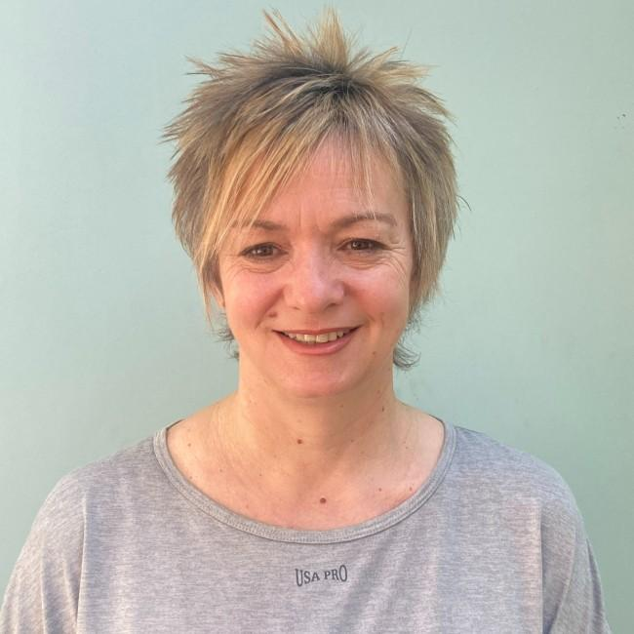
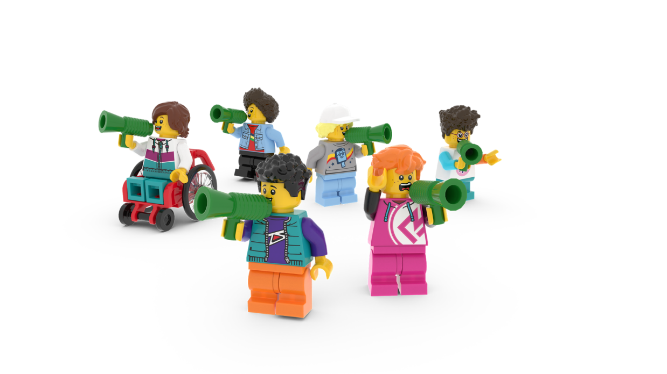
The Planet People Podcast
Meet Andrea Wigfield, a leading researcher on loneliness and social isolation at Sheffield Hallam University!
You’ll hear from her on the Build for Community podcast episode, up next!
Notes:
Seat pupils in teams around creative materials. Each pupil should have a Competition Worksheet in front of them. Explain that while they listen to the Planet People Podcast, they will be able to build or draw while they listen. They should also remember to keep adding useful information or ideas to their Mind Map on their Competition Worksheet.

Slide 14
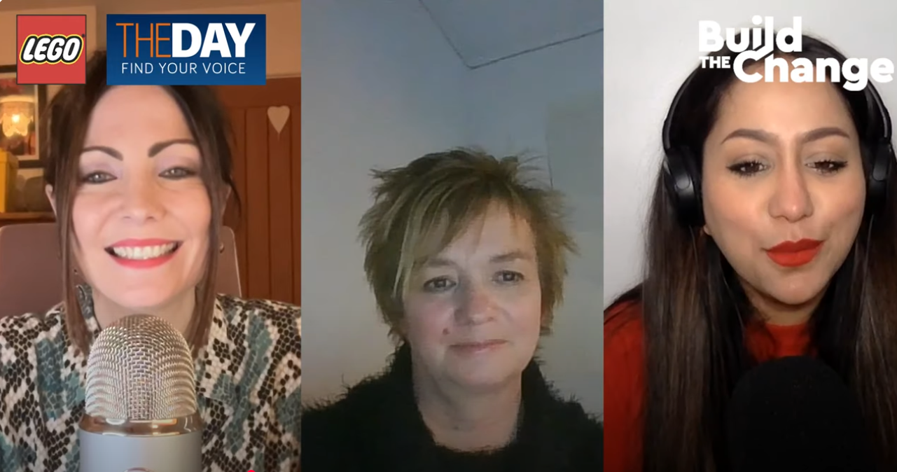
The Planet People Podcast
Part 1
Notes:
Time - 25 mins to listen to the podcast, with pauses.
https://www.youtube.com/watch?v=4r0TgO6pFC8
Play part 1 of the Planet People Podcast (5 mins), pause at 5:10
In this part, pupils will:
Be introduced to the topic: loneliness and belonging
Complete a mini-build challenge: Build or draw an object or place that brings people together.
Understand a bit about our guest, their job and how they help people and the planet.
2. Pause the podcast at 5:10, (see Podcast Pause 1 Slide 15)

Slide 15
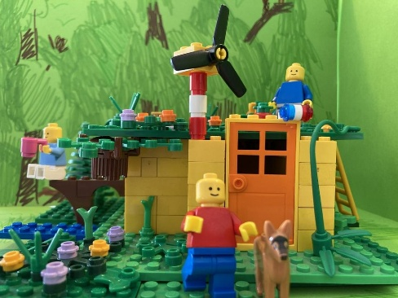
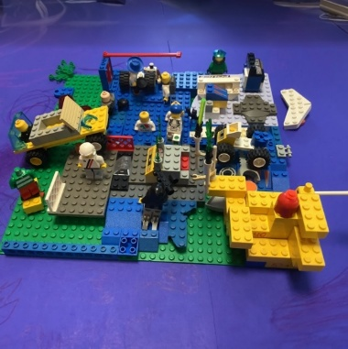
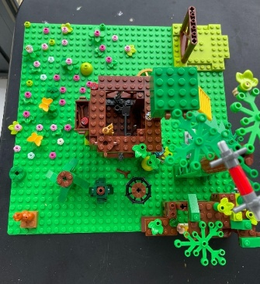
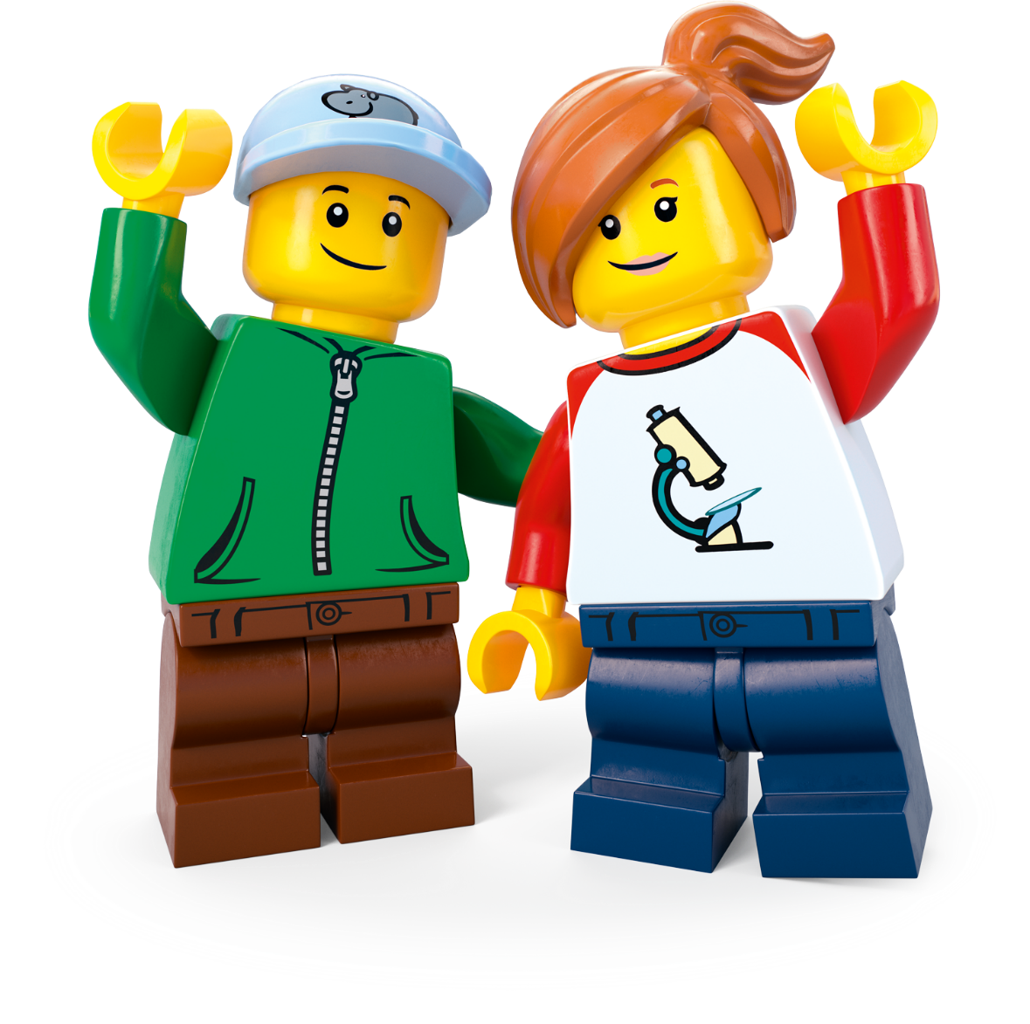
Podcast Pause 1: Mini Design Challenge
Create an object or place that brings people together. What did you make?
Notes:
Time - 4 mins for this pause
Allow pupils to finish their mini-build challenge: Create an object or place that brings people together.
Share some ideas.
Direct pupils to their Competition Worksheet.
As they listen to Part 2, next, remind them to add to their topic Mind Map by drawing or writing down interesting or inspiring words or ideas.

Slide 16
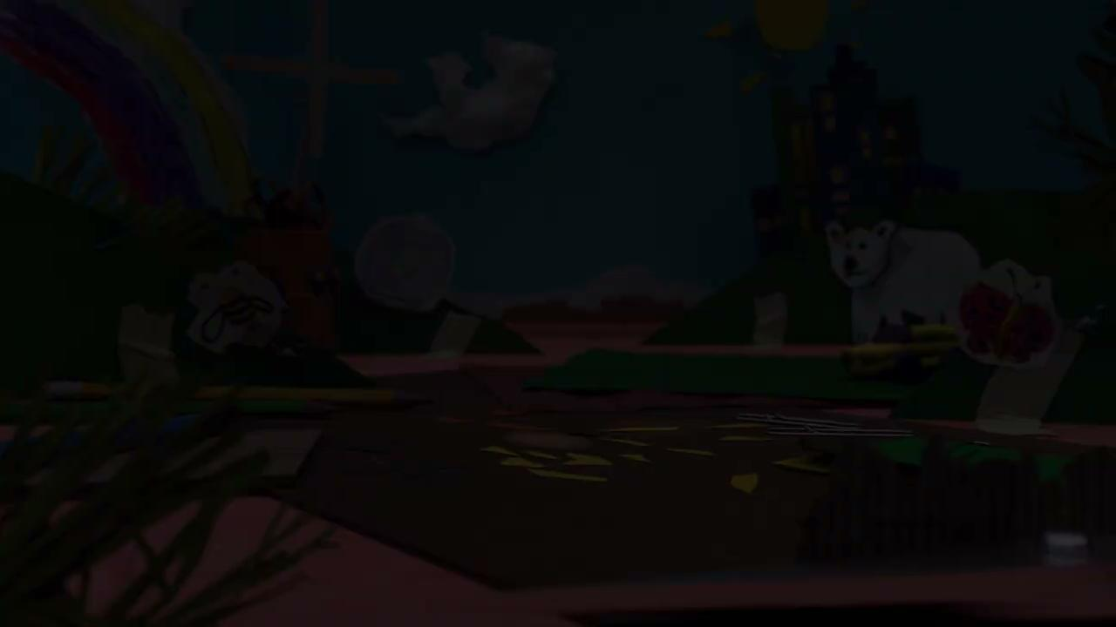
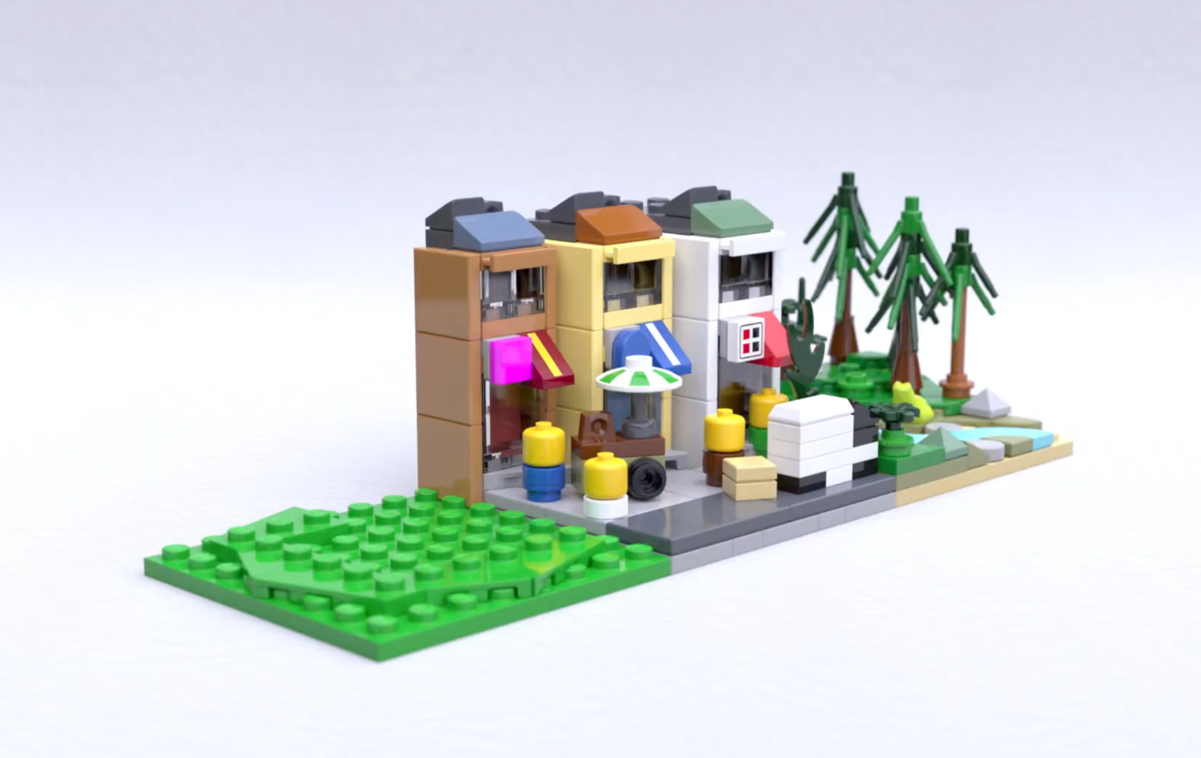
The Planet People Podcast Part 2
.
Notes:
Play part 2 (from 5:10) of the Planet People Podcast (6 mins), pause at 11:08 (if you need the link to the podcast again it’s https://www.youtube.com/watch?v=4r0TgO6pFC8).
In this part, pupils will:
Listen to the hosts interview the guest expert using the Investigation of the Day question: Why belonging so important for people and the planet?
Pupils create a Mind Map in their Competition Worksheet to record ideas as they listen.
2. Pause the podcast at 11:08, (see Podcast Pause 2 Slide 17)

Slide 17
Podcast Pause 2: What have
we learned?
Notes:
Time - 2 mins for this pause
Take a moment to encourage pupils to share what they have written down on their worksheet. Use these comprehension questions to check for understanding:
What is the Centre for Loneliness Studies and what does it do? It’s part of Sheffield Hallum University and they research all kind of things around loneliness, how it affects people and what we can do about it. This includes:
Why do people feel lonely?
What kinds of people are more likely to feel lonely and why?
What events in our lives make us feel lonelier?
How does where we live either make us feel lonely or connected.
How can we help people feel less lonely and more connected?
What are some good examples of projects successfully tackling loneliness?
Intergenerational living – where young people and older people live side-by-side
Intergenerational creative projects like making music, songwriting and art together
Social robots are like pets or friends that can help a lonely person with companionship, daily support and connect them to the outside world.
Friendly benches surrounded by nature which provide spaces where people in a communities can rest, get to know each other and connect with nature all at once.
We live in a world full of people. Why do we still feel lonely? Often this is because we don’t have meaningful relationships. These are the types of relationships where we share the same interests, think similar things or want similar things out of life. We all feel lonely sometimes – its part of being human. Some people are more likely to feel lonely. Age can cause us to feel lonely as well big life events like losing someone or something you love (grief), changing school, works or moving house. These are usually temporary and go away as we make new connections.

Slide 18
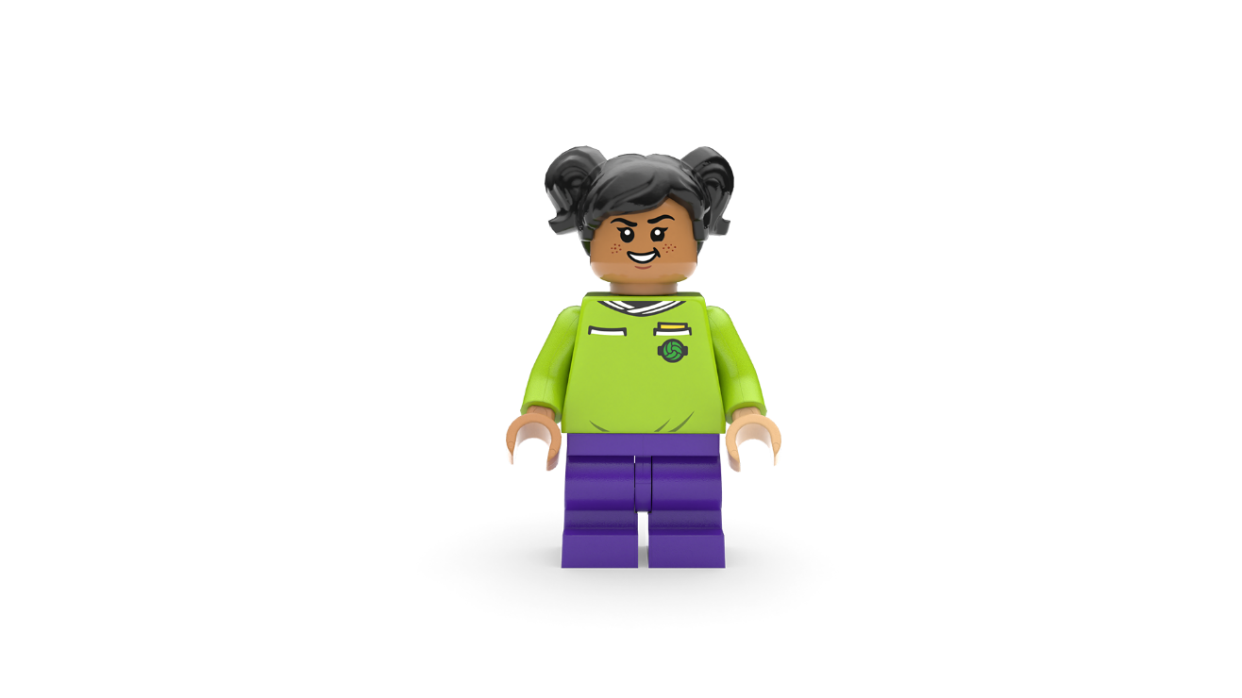
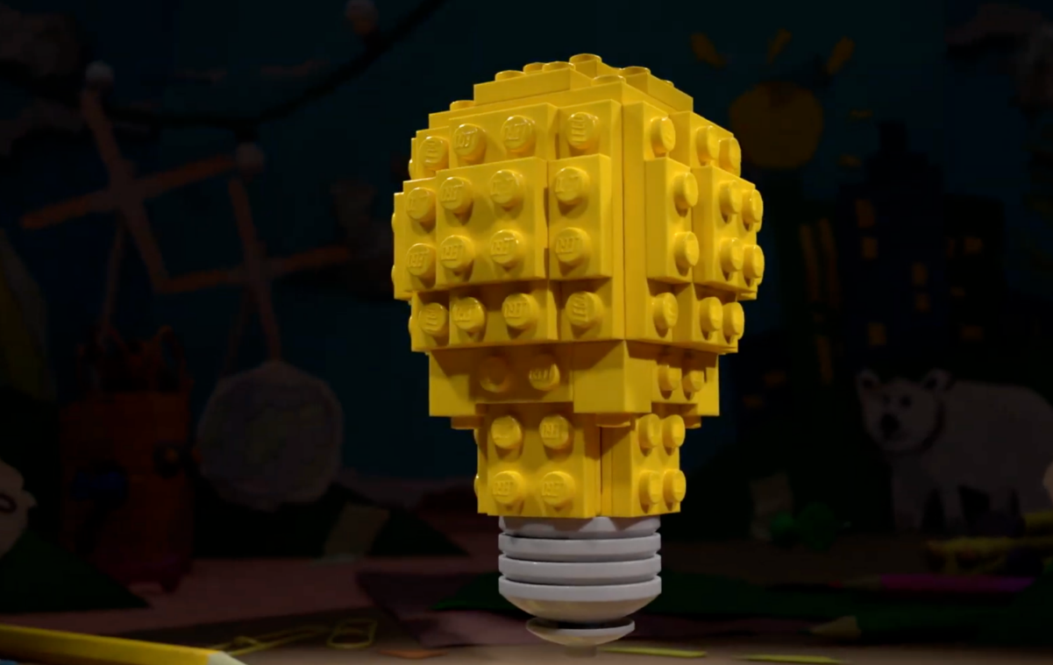
The Planet People Podcast Part 3
Notes:
Play part 3 (from 11:08) of the Planet People Podcast, until the end (8 mins). (if you need the link to the podcast again it’s https://www.youtube.com/watch?v=4r0TgO6pFC8).
In this part, pupils will:
Recap on the conversation
Be introduced to the Build the Change design challenge
Record any inspiring ideas on their Competition Worksheet.
Understand how they can enter their ideas into our competition.

Slide 19
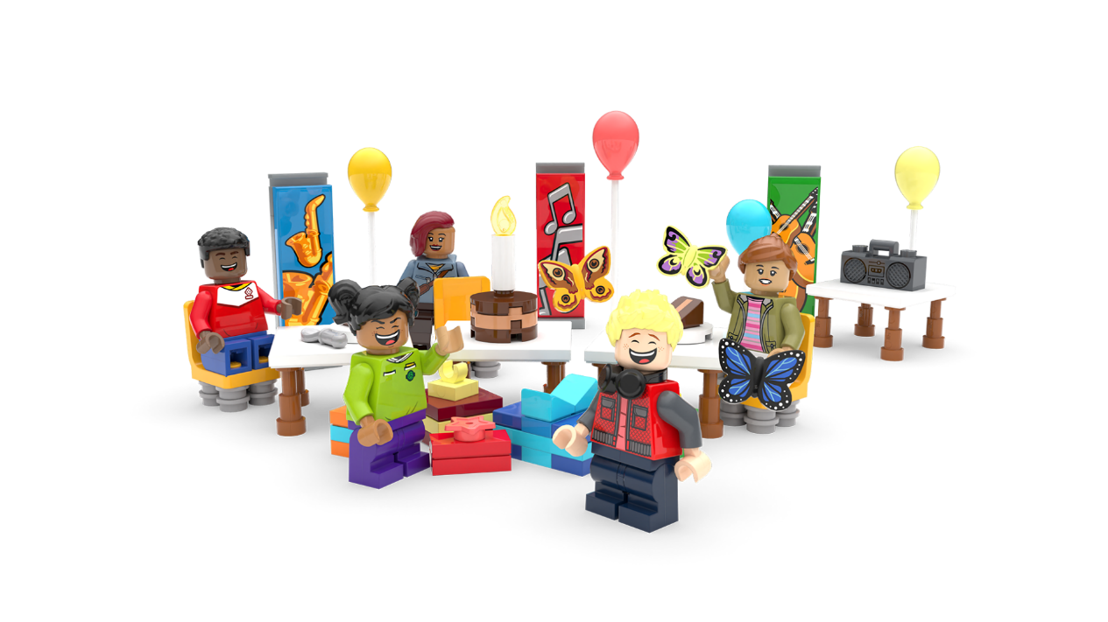
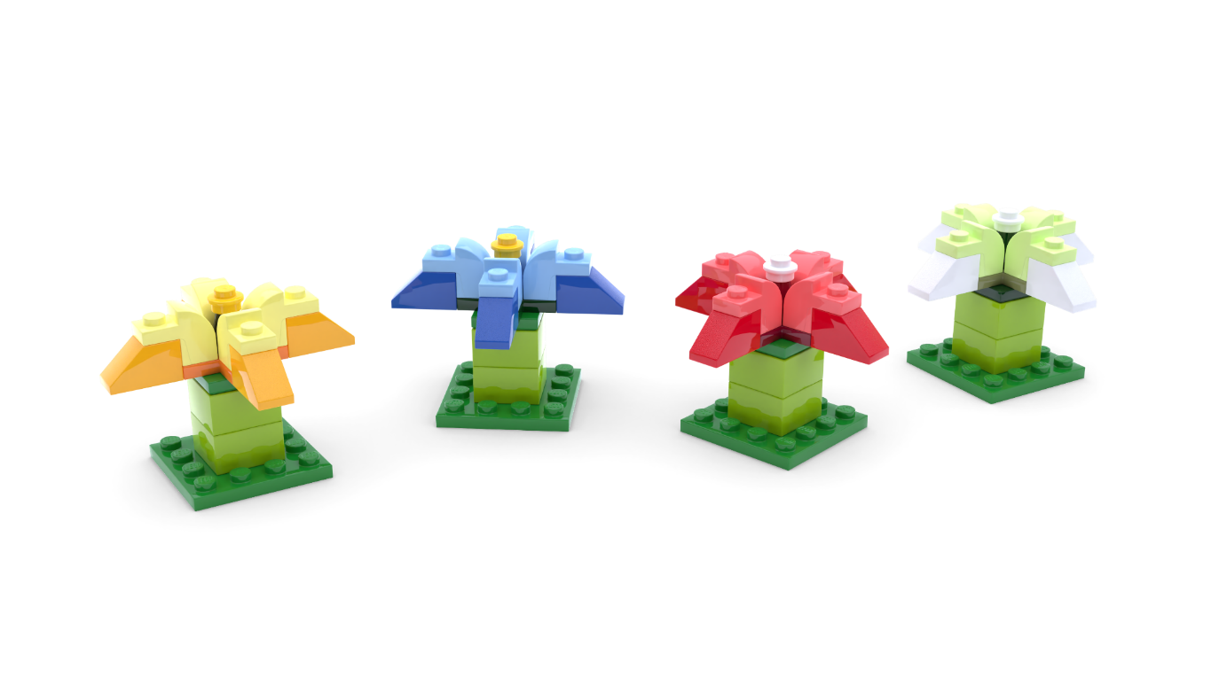
The Build for Belonging Design Challenge
Create something that tackles loneliness and helps local people feel connected.
Notes:
Time - 2 mins
Remind pupils that: Feeling lonely sometimes is part of being human. All humans want to feel like they belong and feel connected to others. What if you could create something amazing to help everyone in your community feel happier and more connected to others? This is your chance to design a brilliant solution to bring people together!
Set the Build the Change challenge using the slide:
Create something that tackles loneliness and helps local people feel connected.
Check for understanding.

Slide 20
Reflection
What inspired you?
What intrigued you?
Notes:
Time - 5 mins
Think about the topic, the design challenge and anything else you’ve learned today. Allow pupils time to add final thoughts and ideas to their Mind Map.
You could ask them to:
Draw one thing that has interested or inspired them today
Write down one question they still have about the topic.
You may wish to seek answers to these questions together, or set this as research challenge to be completed at home.

Slide 21
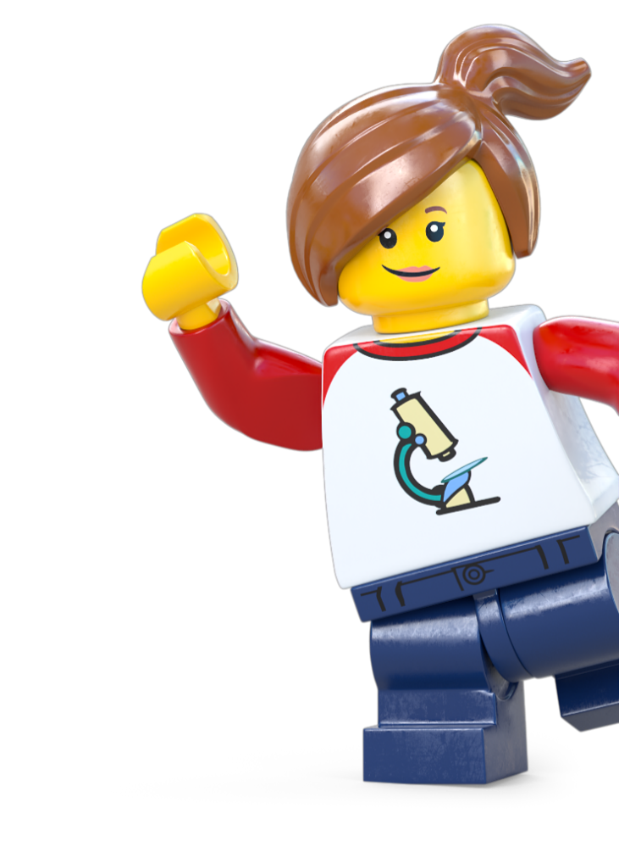
Optional Extension
Take Action!
Notes:
Take Action! Optional Extension activities
The activities in this session are completely optional. You can spend however long you like on these, therefore we haven’t included timings. You may even wish to take the learning out of school and into the community.

Slide 22
Notes:
Explore community using the slide.
Community: A community is a group of people who care about each other and work together. It can be big or small, like your family, your class at school, your neighbourhood, or even a sports team you play on.
In a community:
People help each other, like neighbours sharing tools or classmates helping with homework.
They include everyone, so no one feels left out.
They share things, like toys, ideas, or snacks.
For example:
Your class is a community because you learn and play together.
A sports team is a community because everyone works together to score goals and win games.
A group of friends is a community because you care about and support each other.
Communities are special because they make people feel like they belong!

Slide 23
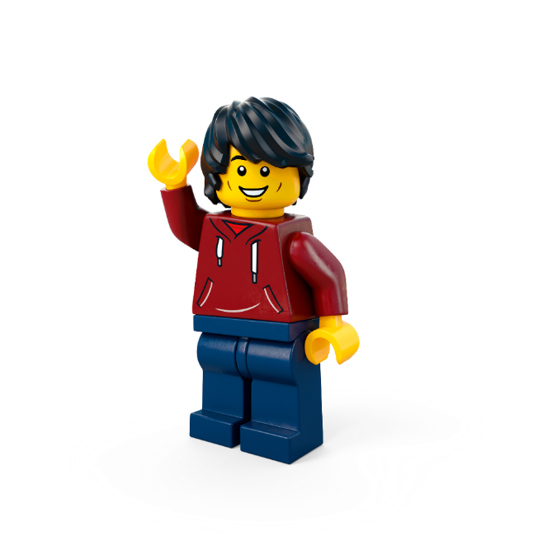
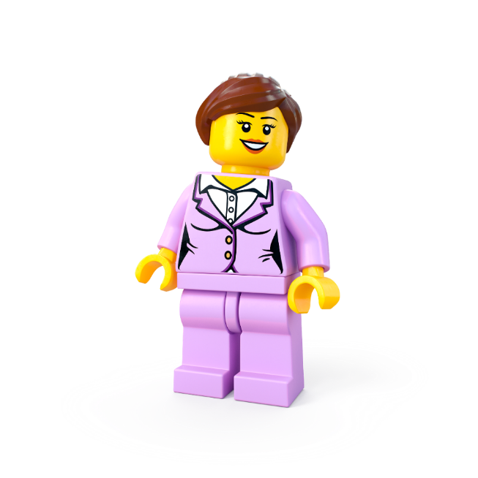
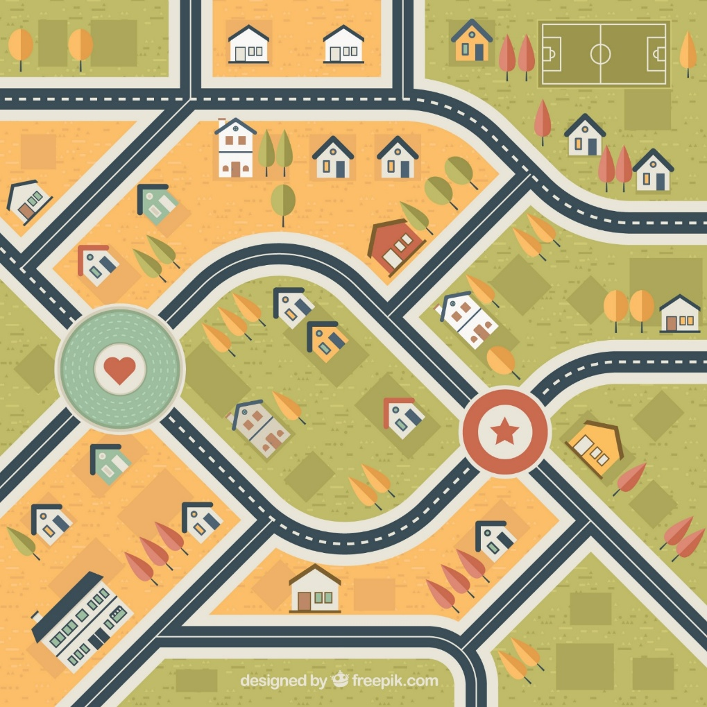
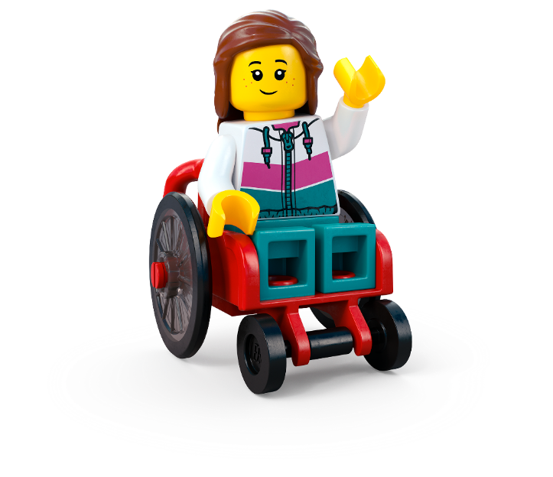
Activity 1: Community map
c Freepik
Notes:
Encourage pupils to think about your wider local community. You could take your class out into the community to observe people and get ideas.
Objective: Identify the groups that make up our community Think about all the different people who live and work in our community. Who helps make it a great place to live?
Compile a list of the different groups of people that make up your community.
Then you could:
Build, make or draw a community map or a collage that visually shows all the different types of people in our community.
Build, make, draw or write some of the ways each group contributes towards your community.

Slide 24
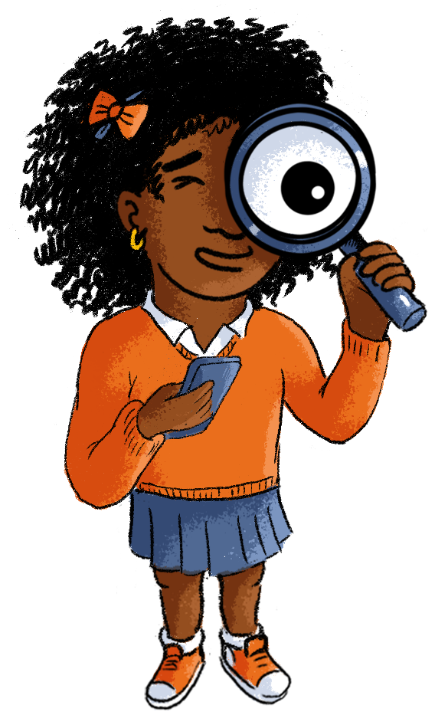
Activity 2: Investigating loneliness
Notes:
This could also be done out in the community, around the school or set as a home learning task.
Objective: How can we make our community feel more connected? Investigate ways to help people feel less lonely or left out.
Design a questionnaire to ask family, neighbours or community figures how you could make your community more inclusive.
Ask each team to write lots of questions.
Take one question from each team to create a class questionnaire.
Ask pupils to use the questionnaire to gather data. This could be at home, around the school or you could take them out into the community.

Slide 25
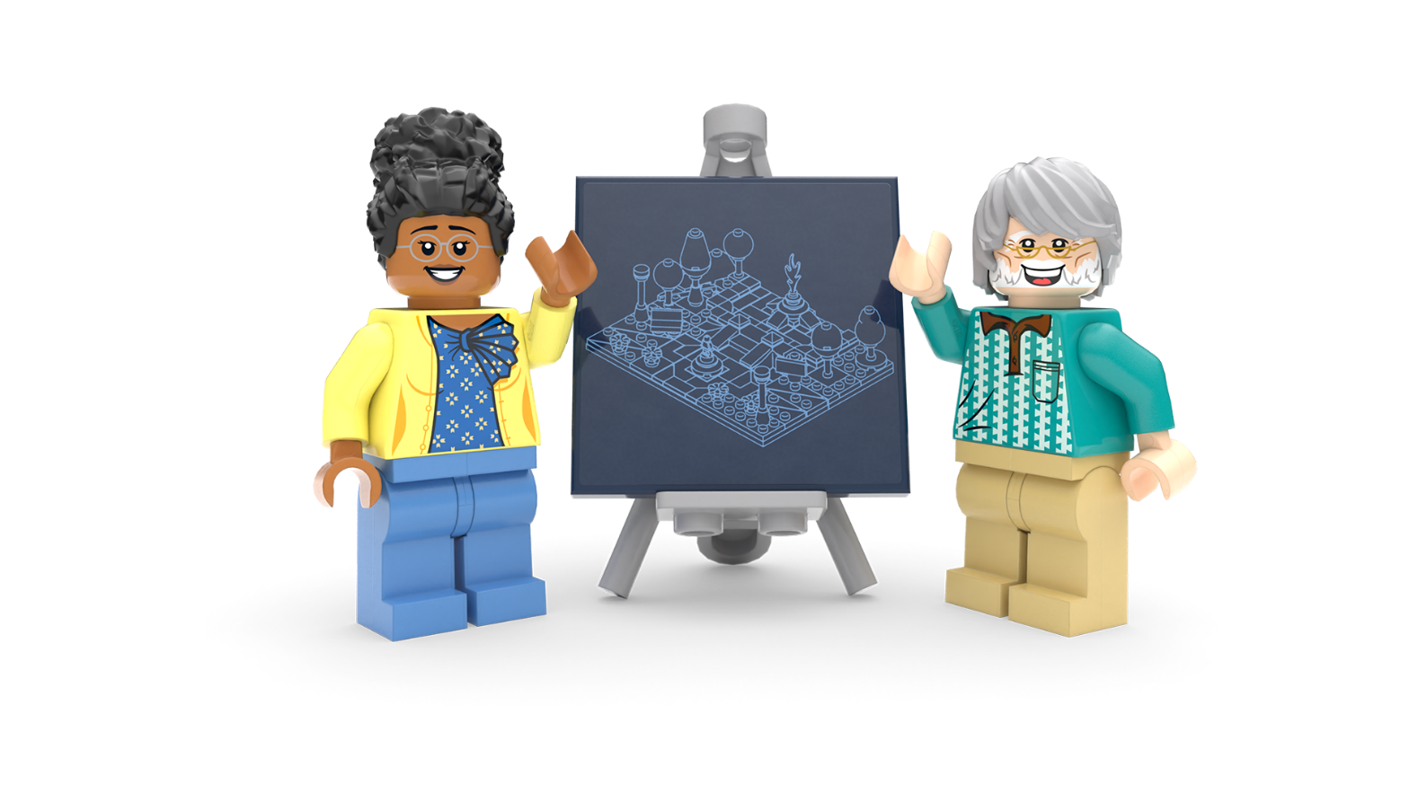
Lesson 2
Create and Share!

Slide 26
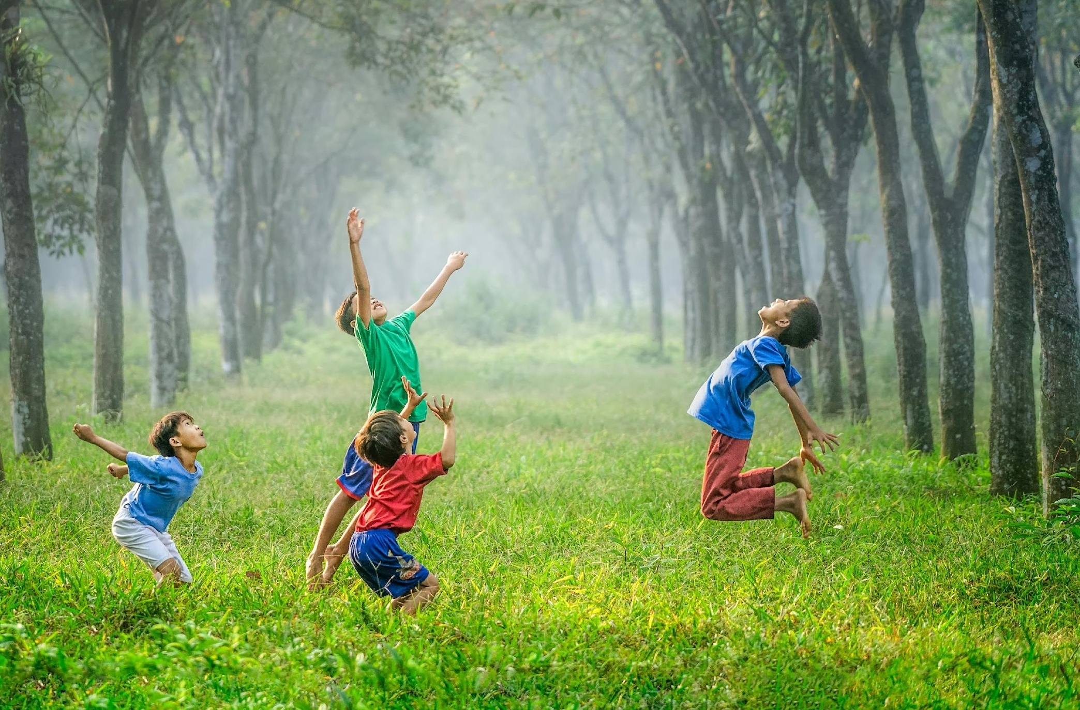
Super Squads
Notes:
Time - 3 mins
Put pupils into teams of 5, seated around the creative materials of your choice. Give them 2 mins to complete this task.
Ask pupils:
What’s one thing that makes you, you?
It could be a cool talent, a hobby you love, or a special personality trait! Maybe it’s something about your background or family. Whatever it is, share it with your team.

Slide 27
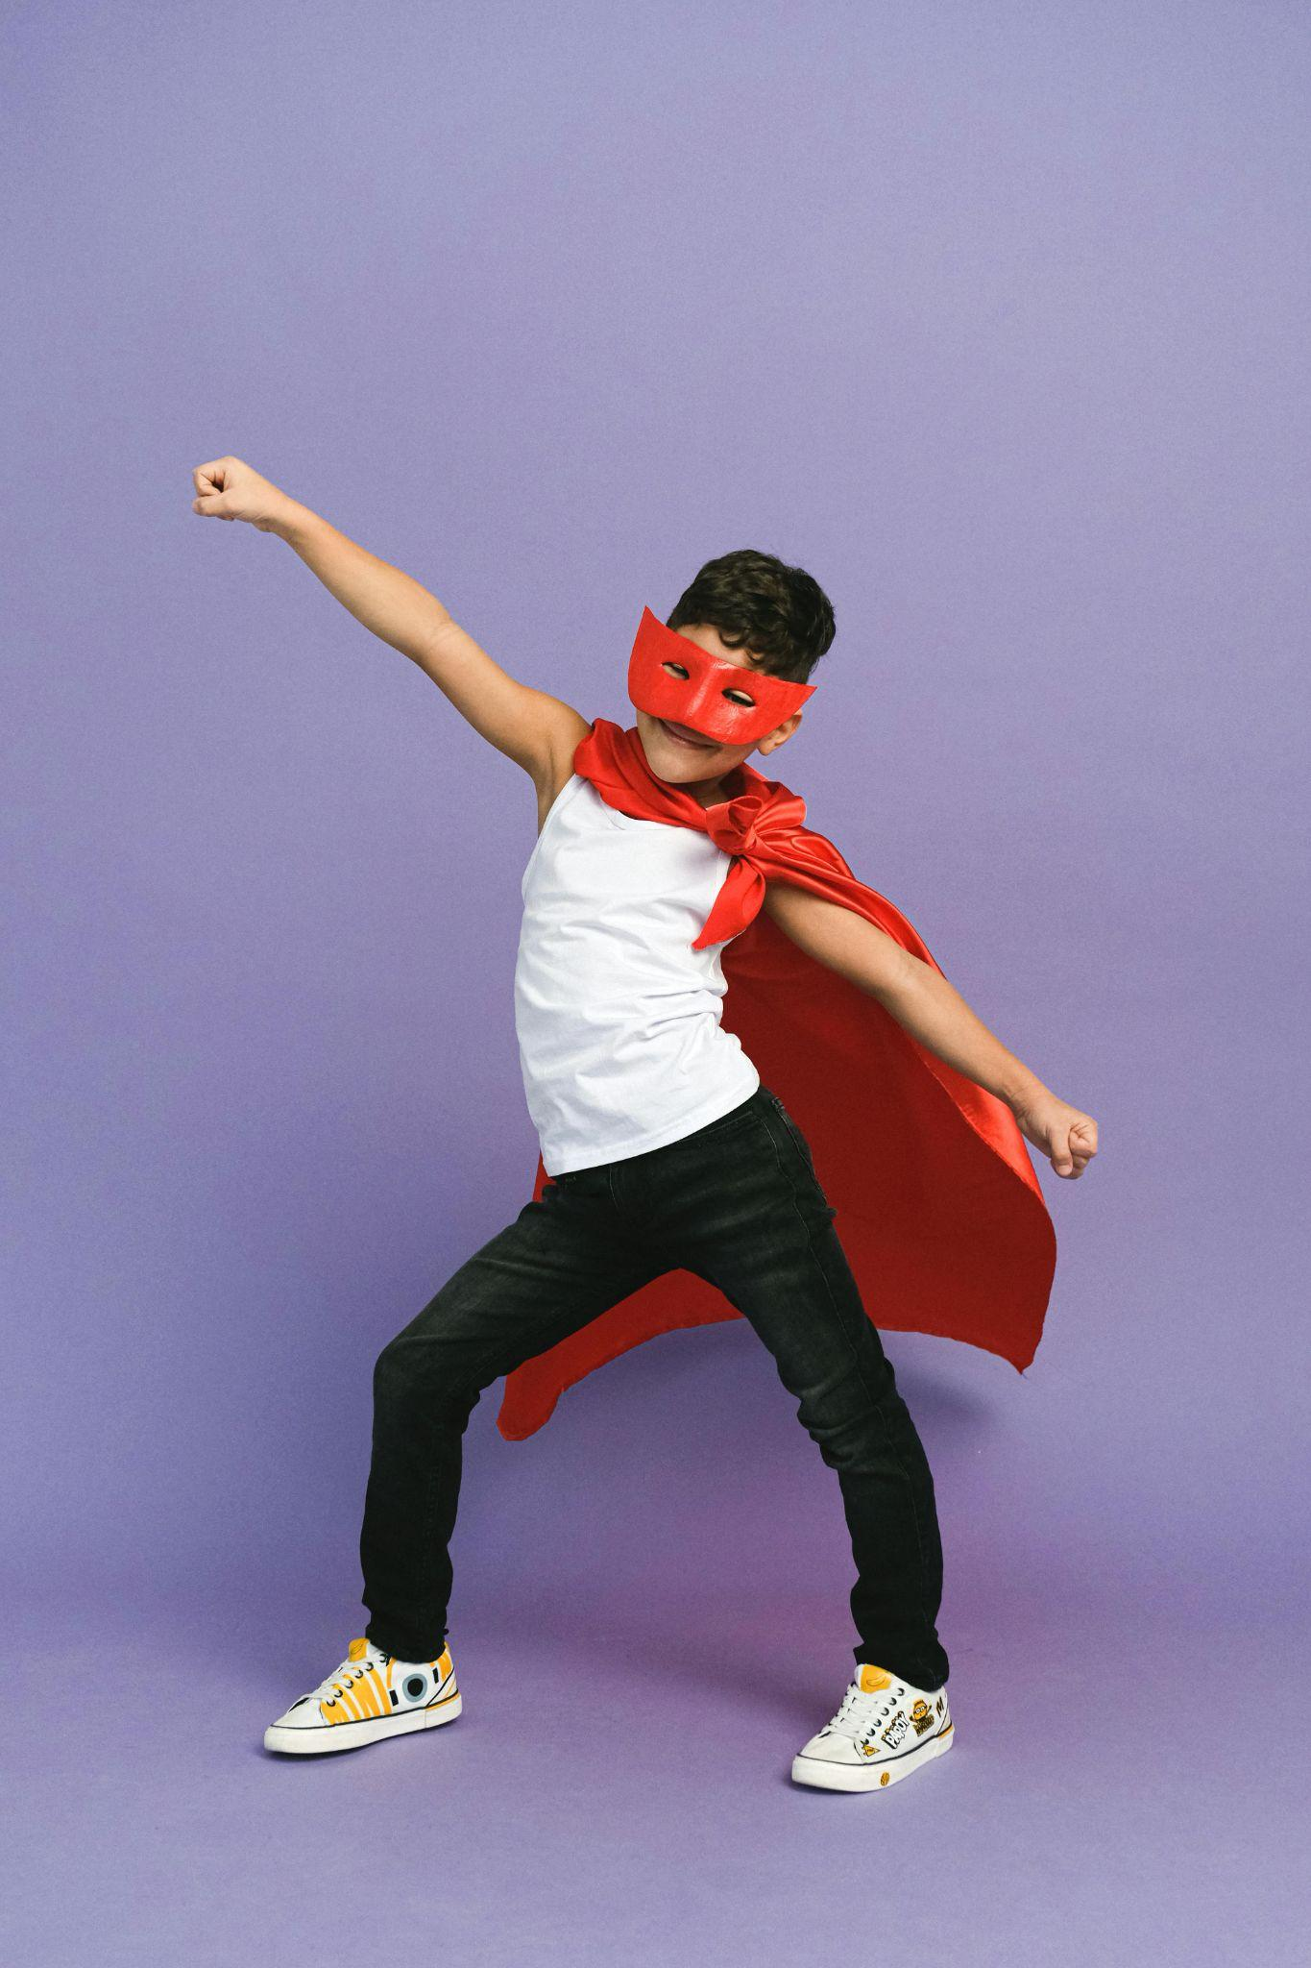
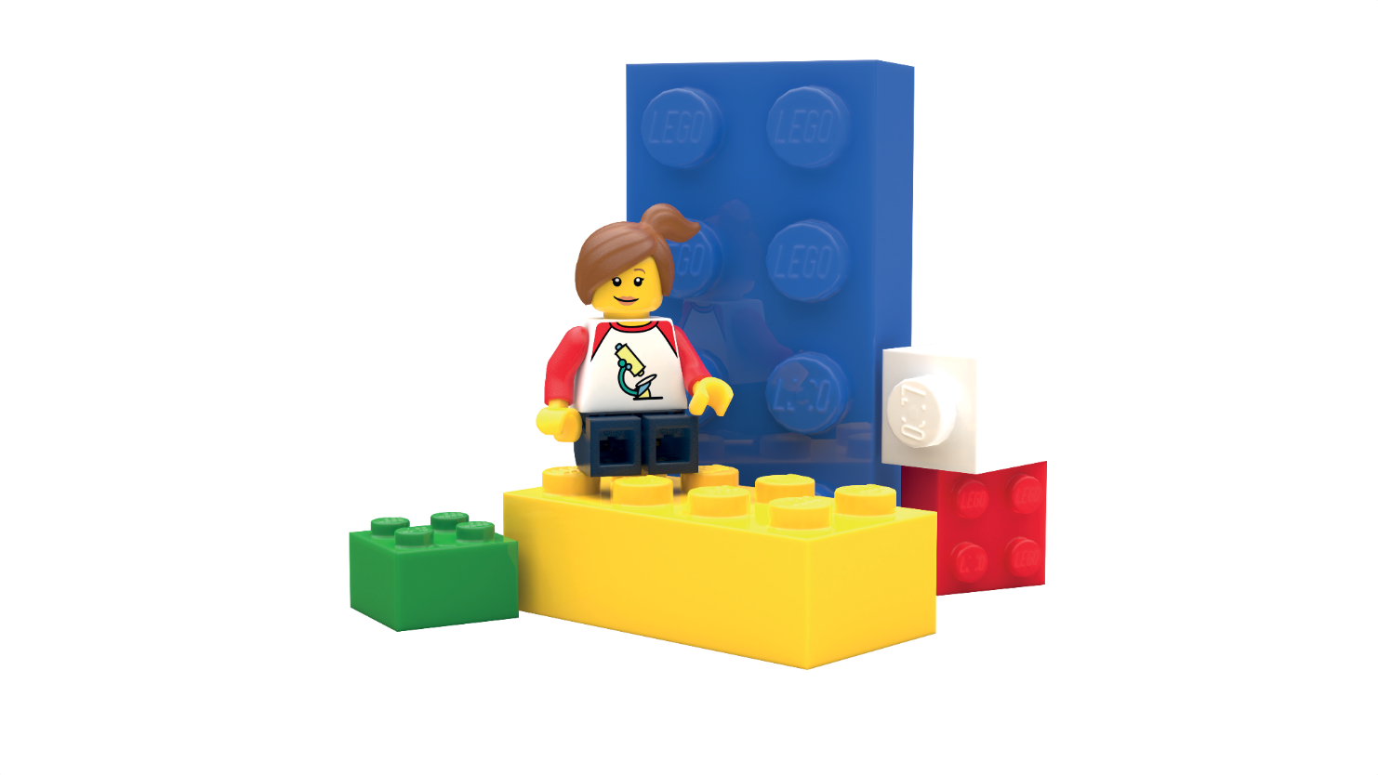
Super Squads
c Anna Shvets/Pexels
Notes:
Time - 7 mins
Challenge teams to create a super character (this can be anything!) that combines their special qualities. They can draw or build this, depending on time, resources and your class.
Use this script to explain the activity:
Time to get creative! Use the materials in front of you to make a super character that combines all your special qualities. Give your character a name – this will be your team’s name for today!
Share characters and celebrate how each teams' special individual qualities are more powerful when combined.

Slide 28
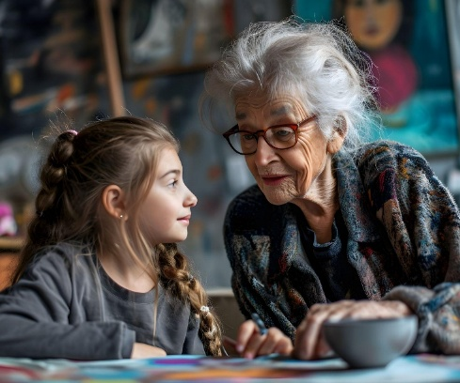
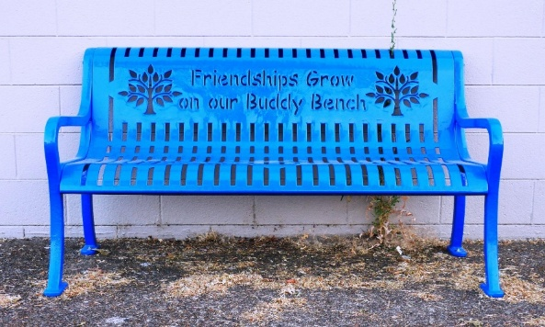
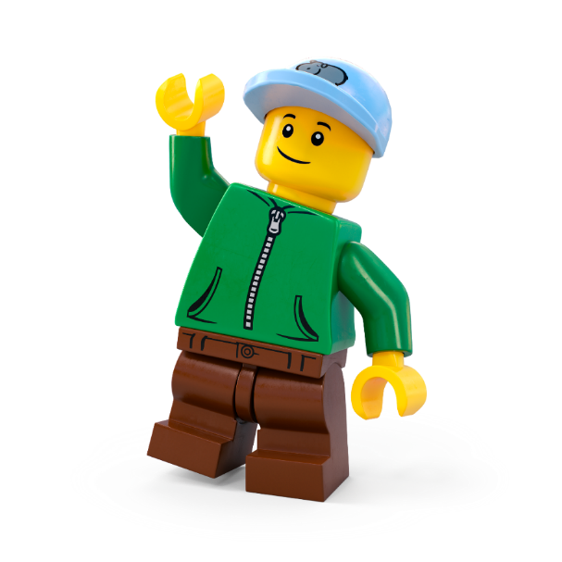
Solutions to loneliness
1
3
Credit: Freepik
1 is your team’s favourite solution
3 is your team’s least favourite solution
Credit: Rick Obst/CC by 2.0
Notes:
Time - 6 mins
Remind pupils about the real-world solutions to loneliness, explored in the Planet People Podcast.
Challenge them to rank the 3 solutions as a team, from 1 - 3. They must all reach an agreement on their final decision.
They must agree on their favourite and explain why. What makes them so successful?
Encourage groups to share why they made their decision.

Slide 29
Work together. Create together.
Teamwork Wins
All Ideas Shine
Build It Up
Listen Like a Leader
Kind Words Always
Everyone Belongs
Celebrate Differences
Mistakes Are Magic
Notes:
Time - 2 mins
Use this slide as a checklist to help pupils reflect on the previous two team or paired activities. What did they do well? Where could they have improved?
Remind them that when we work well together in teams and include everyone we feel a sense of belonging. If you are completing the design challenge in pairs or team, read through the teamwork manifesto together:
Teamwork Wins We work together, help each other, and share the fun.
All Ideas Shine Every idea is welcome – big, small, or even a little wacky!
Build It Up Use each other’s ideas to make something amazing.
Listen Like a Leader Give your teammates your full attention – their ideas matter.
Kind Words Always Speak with kindness and cheer each other on.
Everyone Belongs Include everyone in the group – no one is left out.
Celebrate Differences Our unique ideas make the team stronger and more creative.
Mistakes Are Magic Mistakes help us learn and grow – celebrate them!
If you are running this challenge as a pair or team activity, these rules will help pupils build a sense of belonging as they tackle the creative challenge. If you have more time, you could pass a copy round for everyone to sign or even create your own.

Slide 30
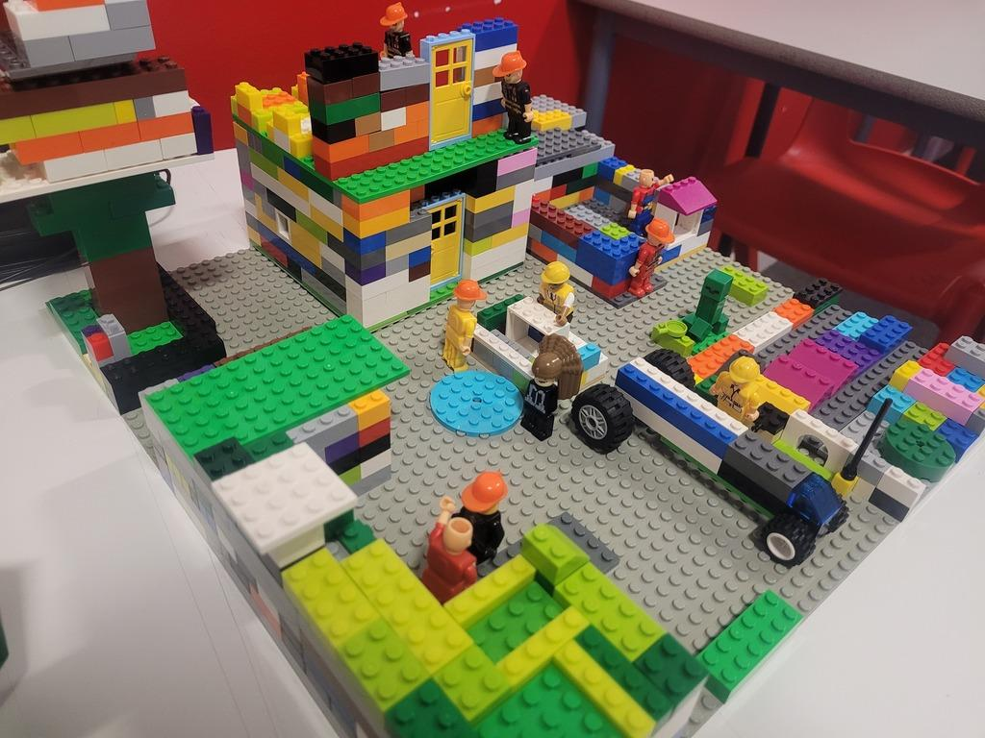
The Build for Belonging Design Challenge
Create something that tackles loneliness and helps local people feel connected.
Notes:
Time - 2 mins
Bring pupils back to the design challenge that was introduced in lesson 1: Create something that tackles loneliness and helps local people feel connected.
Remind pupils that: Feeling lonely sometimes is part of being human. All humans want to feel like they belong and feel connected to others. What if you could create something amazing to help everyone in your community feel happier and more connected to others? This is your chance to design a brilliant solution to bring people together!
Check for understanding.

Slide 31
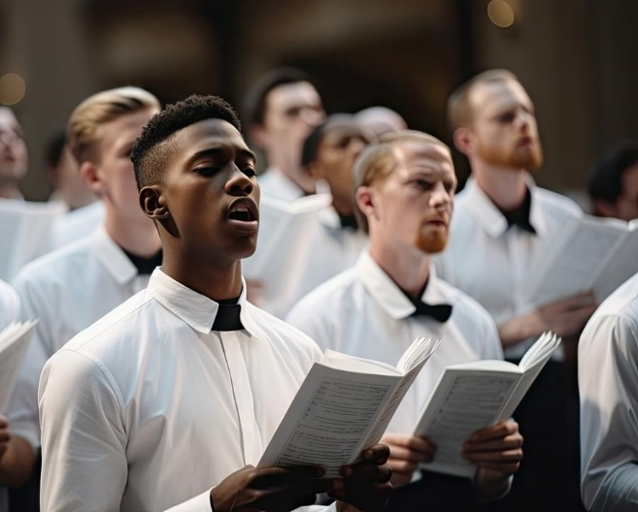
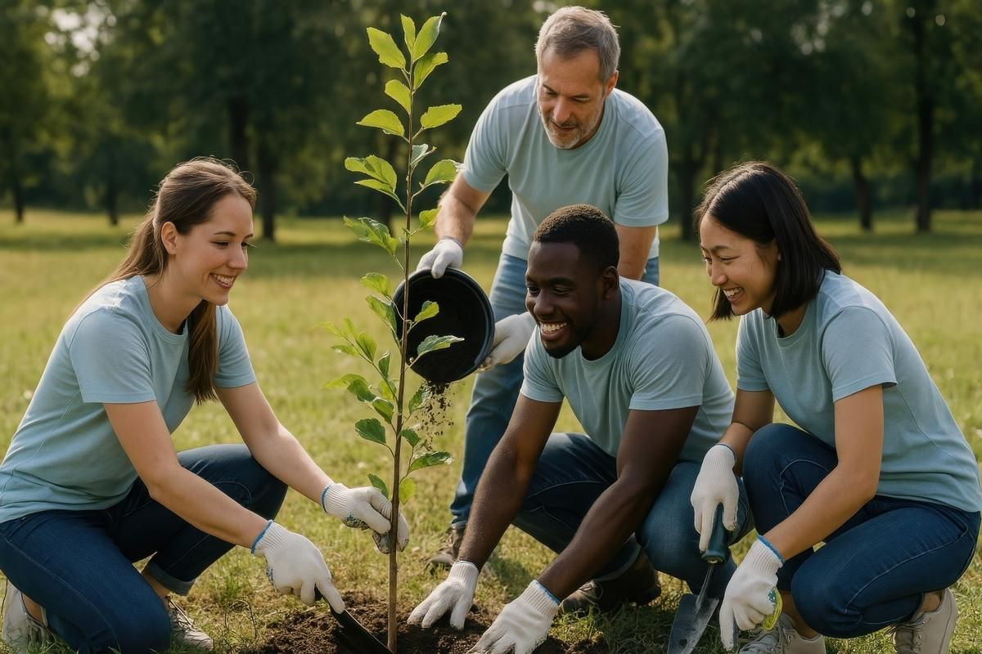
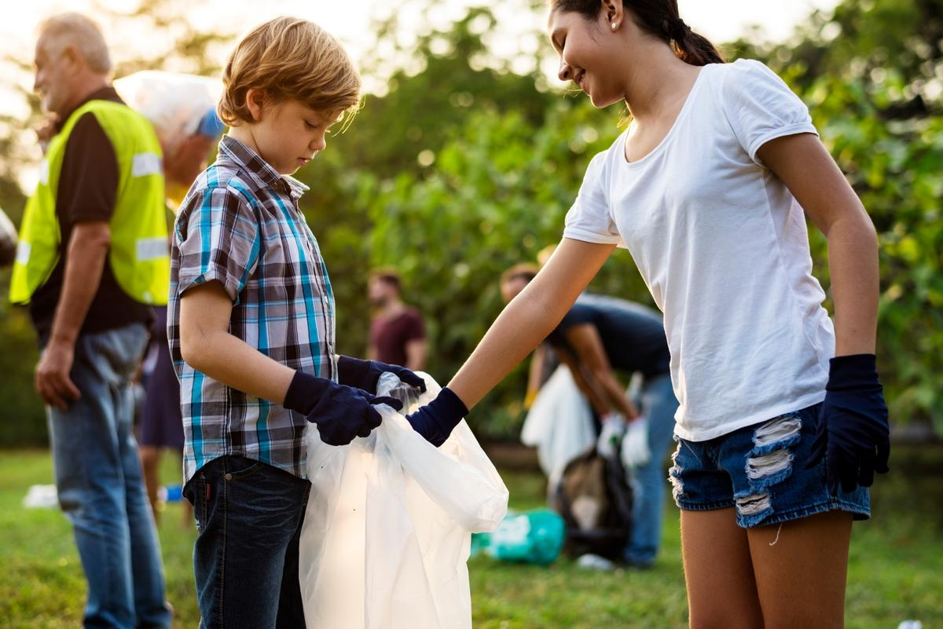
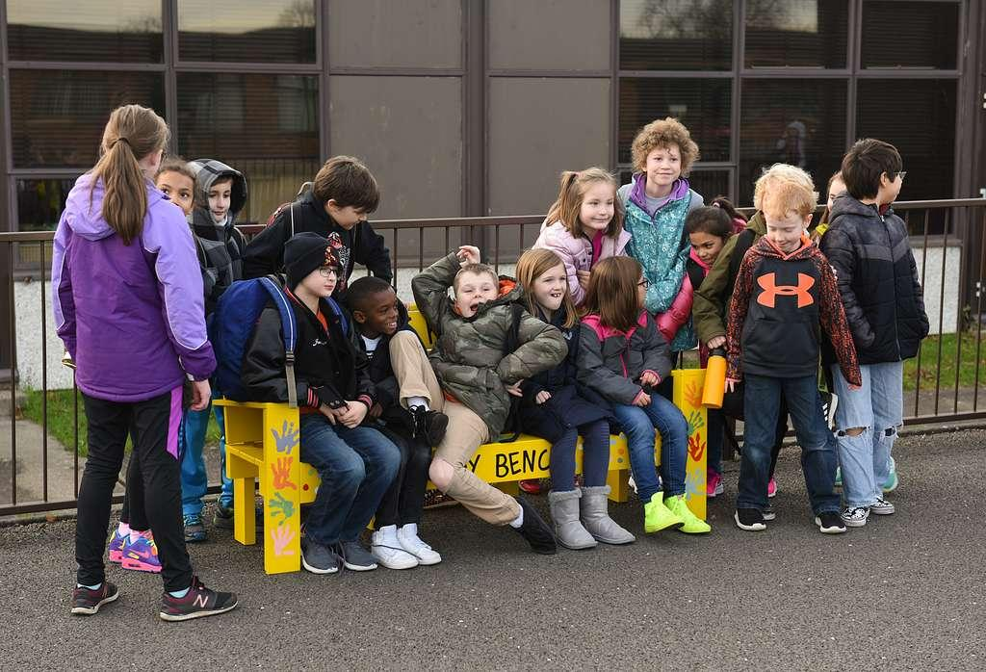
Design Challenge Inspiration

Slide 32
Let’s Build the Change!
Brainstorm ideas
Design your space
Create a model
Write a description
Share your solution
Enter our competition
Notes:
Time - 20 mins
Use this slide to explain all the jobs that need to be done before setting pupils off on their own.
Brainstorm ideas
Look at your mind maps. As a team, write down as many ideas as possible – the sillier, the better! Choose two or three of the best ideas to make even better. Decide on one idea as your solution.
Design your space
Draw your brilliant solution in the Competition Worksheet.
Build a model
Create a model of your solution using all the cool materials available.
Present your solution
Share your ideas with the rest of the class
Enter the Build for Belonging competition
Make sure your ideas, designs and descriptions are included in your Competition Worksheet. Teams should submit one worksheet per team to the competition. Teachers can take a photo of the build to enter it into our competition.
Remember: You can run the challenge as an individual challenge, in pairs or small groups of up to 4. You can allocate team roles using the Team Roles on slide 45, in the appendix.

Slide 33
Individual or Pairs - Final Checklist
Have you:
Labelled your final design?
Written a description of your solution
Got your model ready for its photo?
Prepared your presentation?
Notes:
Time - 10 mins
Allow some time for pupils to finalise their models and get ready to share their ideas with the class.
If you’re running the challenge with pairs or teams, use this list to remind each team member what they are responsible for:
Designer: Time to show off your artistic skills! Label your final drawing to highlight all the awesome features of your design.
Writer: Get your writing hat on! Write a cool description of your amazing solution so everyone knows how it works.
Builder: Your job is to get our model ready for its close-up! Make sure it's looking perfect for its big moment in the spotlight.
Presenter: You’re the star presenter! Get ready to wow the class with your awesome solution and explain how it works.

Slide 34
buildthechange.theday.co.uk/competition
Notes:
Ask pupils to stop working and place their models around the room for everyone to see.
If you are entering your class’ ideas into our Build for Belonging Competition, show this slide to get pupils excited!
Enter by 30th June at www.buildthechange.theday.co.uk/competition

Slide 35
Share your ideas
Notes:
Time - 10 mins
Ask pupils to take it in turns to present their solution to the class. Encourage others to give positive and constructive feedback.
You could ask them: What went well? What could be even better?
Celebrate all their awesome ideas!

Slide 36
Share it with the world
Missed the competition deadline?
Don’t worry, your kids’ awesome ideas can be published on the LEGO.com website year-round! Simply upload photos with a 200-character max description of your children’s creations to our Build the Change photo gallery, for the whole world to see!
They might even be our next Builder of the Week!
Scan the QR code with a camera to start uploading.
Notes:
Don’t forget to upload your learner’s awesome ideas to help us show everyone how awesome kids’ ideas are!
You can upload photos and descriptions of your children’s creations to our Build the Change Tuesday gallery. They might even be our next Builder of the Week! Scan the QR code with a camera to start uploading, or visit: https://www.lego.com/en-gb/sustainability/buildthechange/challenges/theday/upload?CMP=EMC-LCE.

Slide 37
Appendix

Slide 38
Team roles
Presenter The presenter gets to show off the team's amazing work to the class.
Writer The writer explains the team's ideas in the best words possible.
Designer The designer creates and improves the team's awesome drawings.
Builder The builder brings the design to life with a cool model.
Notes:
Use this slide if you are asking students to work in groups. Please note: Students can enter the competition individually, in pairs or in teams of up to 4 people.
Explain the roles. Ask students to take on team roles according to their strengths.
You could even print out the slide or give them badges as a reminder.

