Slide 1
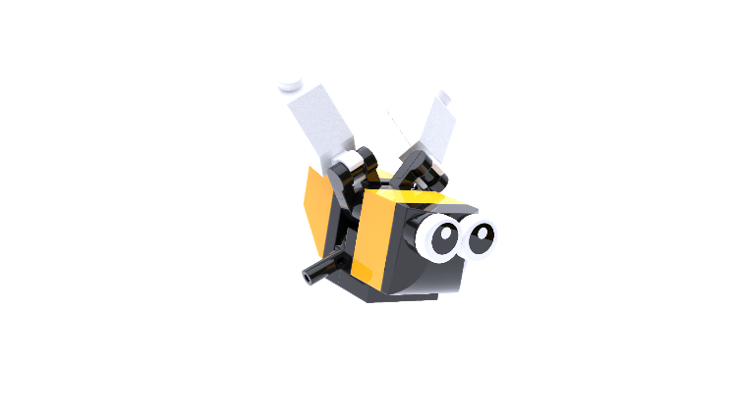
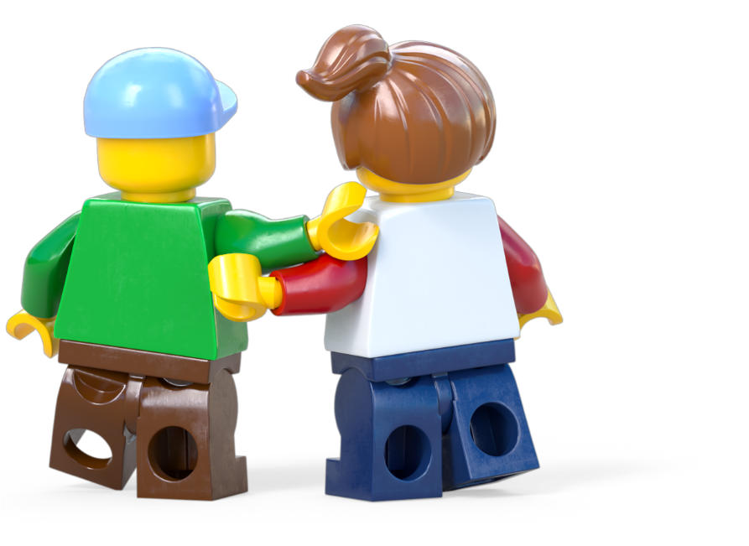
Build for Belonging
BUILD FOR NATURE
WORKSHOP Ages 11-14
Build the Change is supported by the LEGO Foundation. LEGO, the LEGO logo, the Minifigure and the Brick and Knob configuration are trademarks and copyrights of the LEGO Group. ©2025 The LEGO Group. All rights reserved.

Slide 2
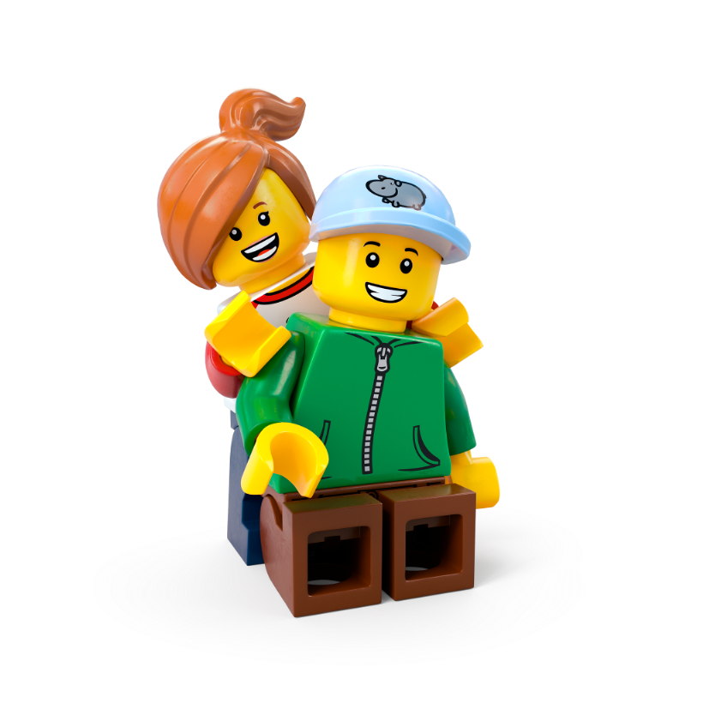
Contents
Workshop 1 Immerse (slides 3-21)
News Detectives Article (slides 12-13)
Planet People Podcast (slides 14-19)
Build for Belonging Design Brief (slides 20-21)
Take Action! Optional Extension (slides 22-25)
Workshop 2 Create and Share (slides 26-38)
Design brief (slides 31-32)
Challenge checklist (slide 33)
Competition Information (slide 36)
Appendix (39-42)
Audience cards (slides 40-41)
Team roles (slide 42)

Slide 3
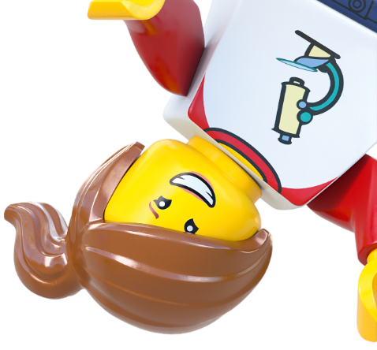
Lesson 1
Immerse

Slide 4
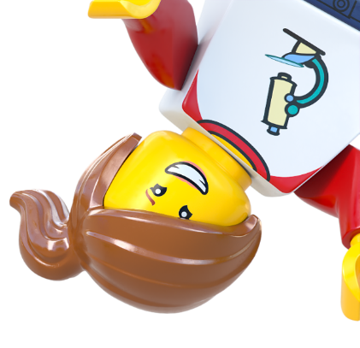
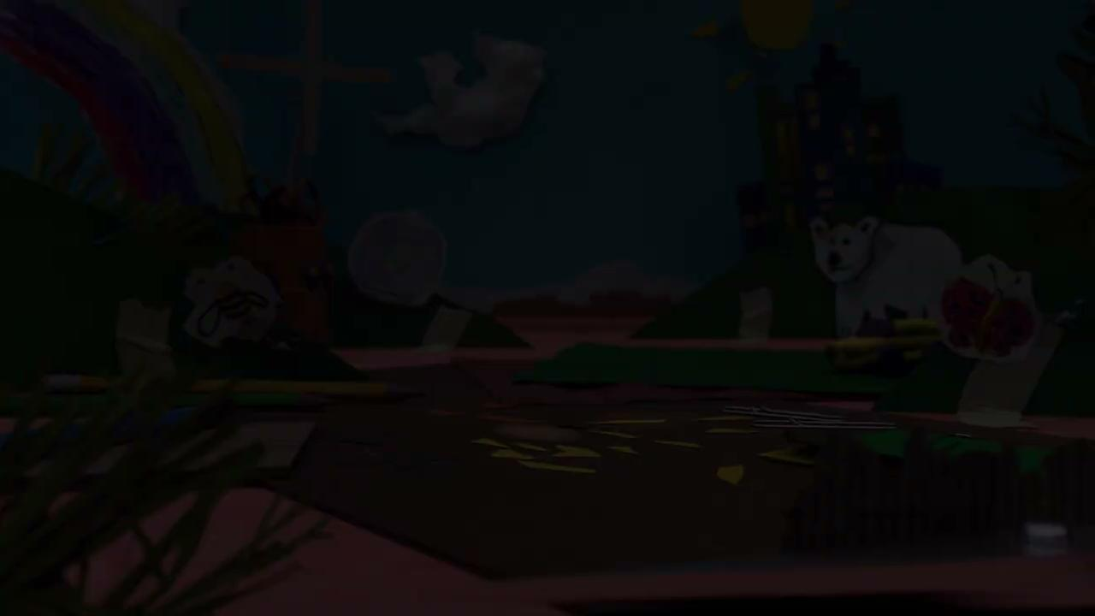
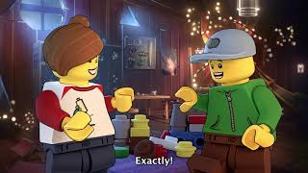
Notes:
Time - 1 min
Play the video to introduce students to the LEGO Group’s Build the Change programme.
https://www.youtube.com/watch?v=D7z8iXqjIkE

Slide 5
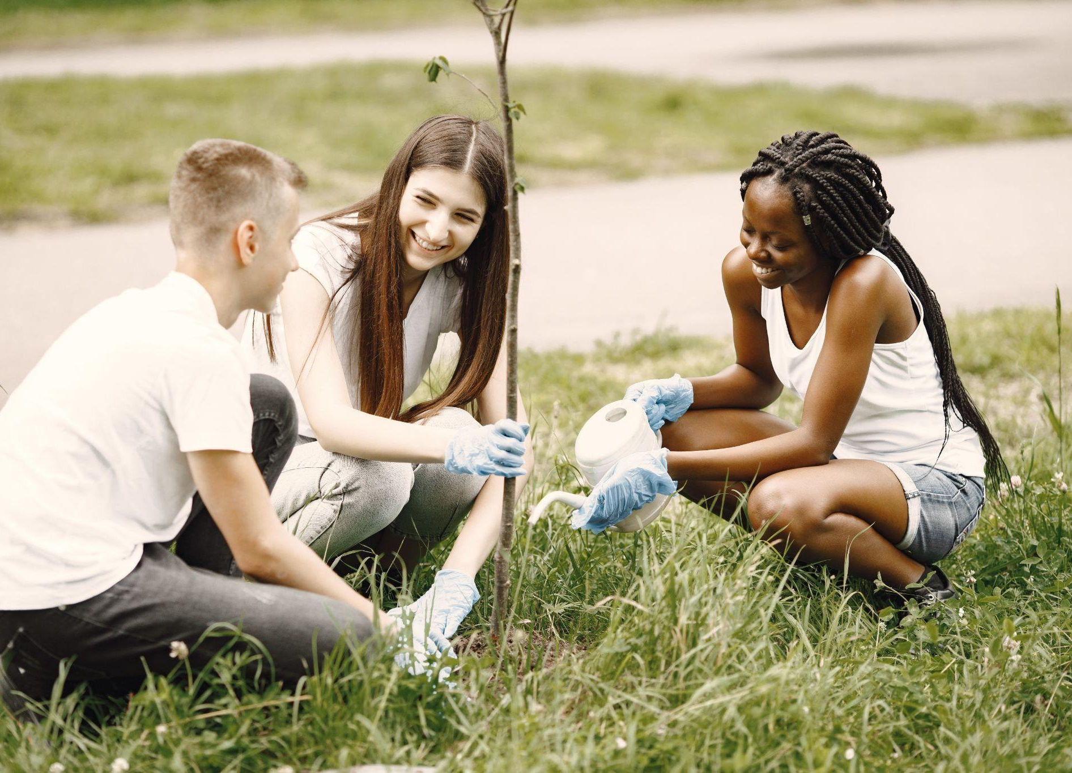
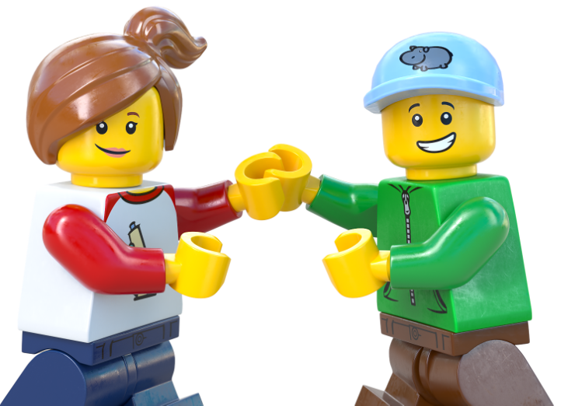
Recreate a happy moment
Notes:
Time - 3 mins
Use our playful activity to introduce the topic. Ask students to draw or build a happy moment spent outdoors, with nature.
Encourage students to think about a good time they’ve had outdoors, in nature. Use the creative materials to create, build or draw that moment. It doesn’t have to look exactly like it did – encourage students to make it their own! Invite them to picture how they felt in that moment. What made it special?

Slide 6
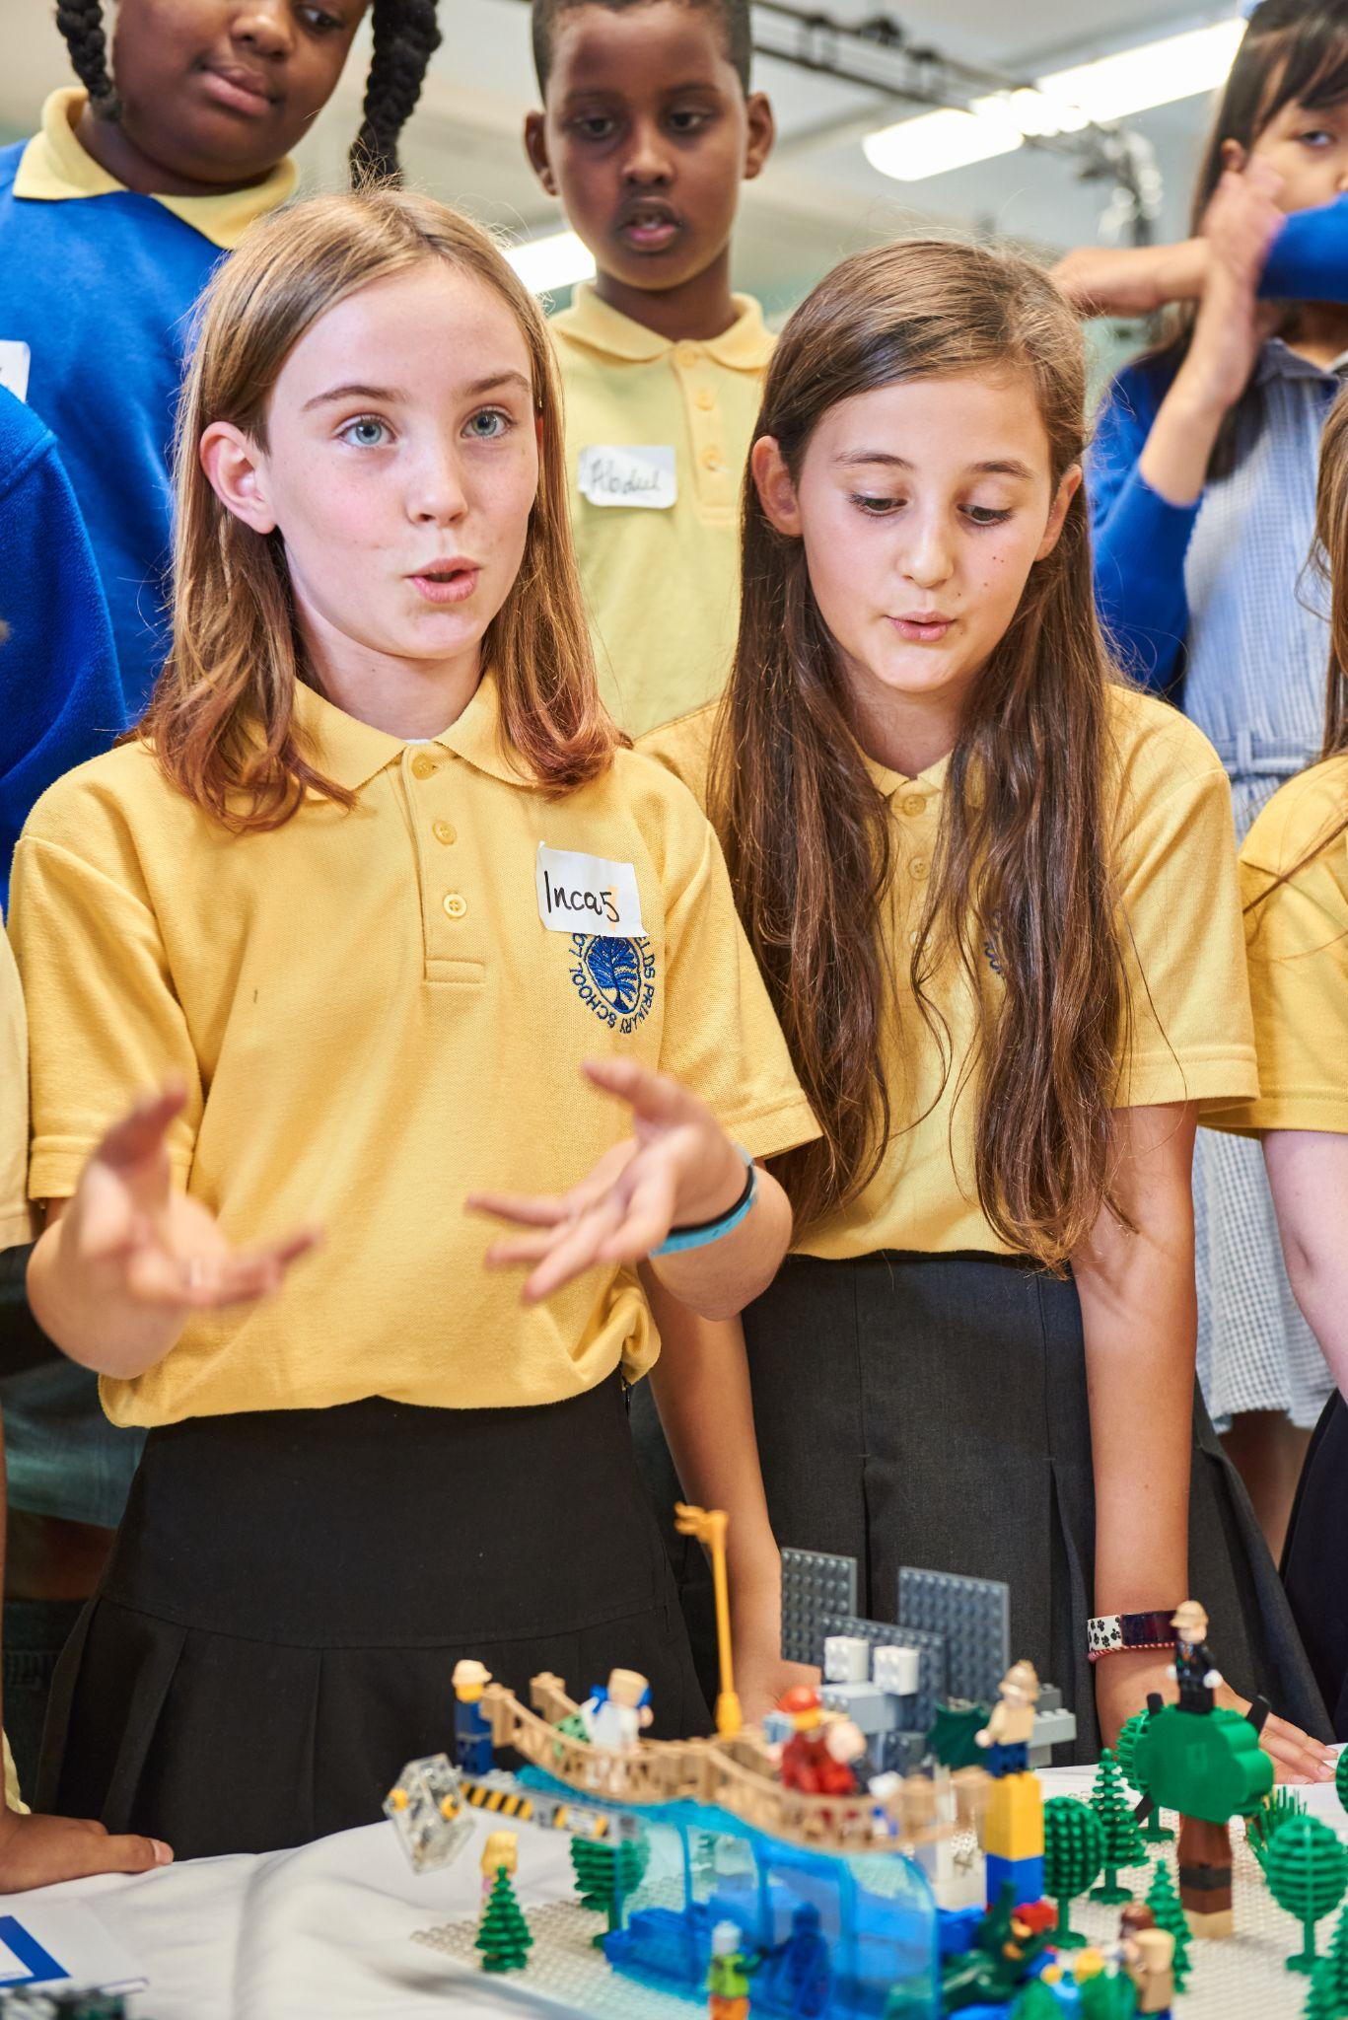
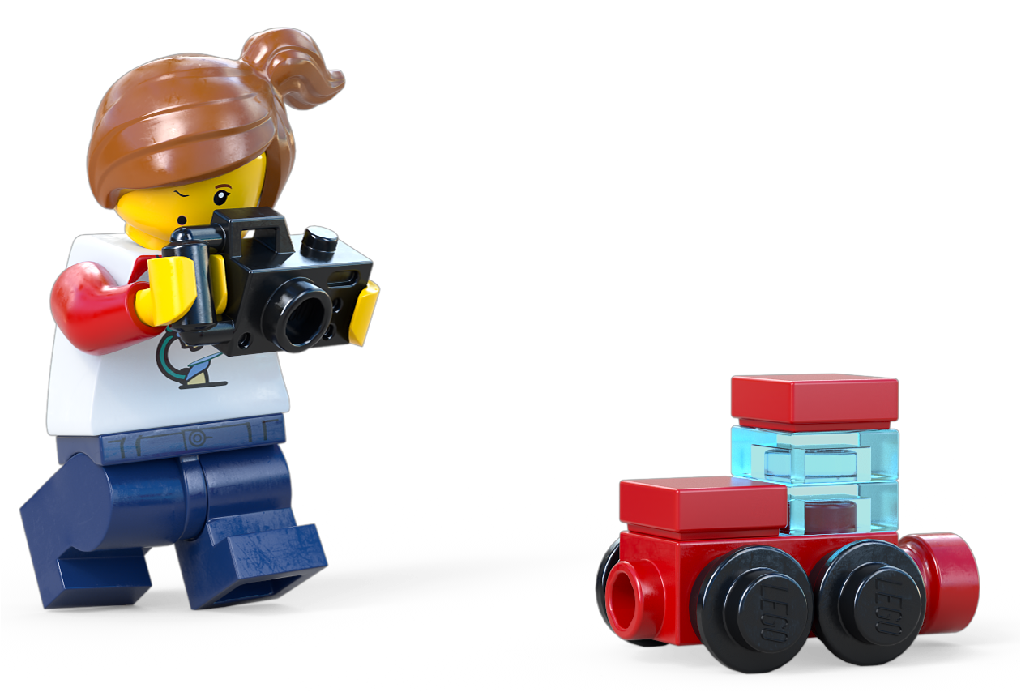
Share your happy moment
Notes:
Time - 2 mins
Encourage them to share memories and feelings in pairs or as a class.
You could ask them: How did you feel at this time? What words or feelings come to mind? Would it have been the same or different if you’d experienced it indoors, away from nature?

Slide 7
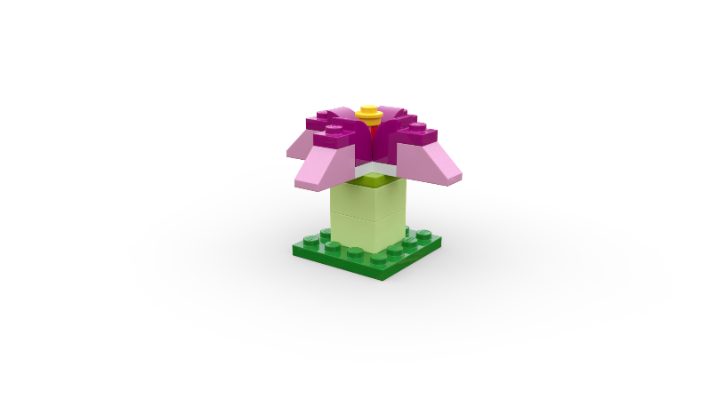
Nature Quiz
If you think the statement is false, sit down.
If you think it’s true, stand up.
Notes:
Time - 6 mins
Use our Nature Quiz to link your students' positive personal experiences to the proven benefits of being outside in nature.
Instruct students to listen to the following statements. Decide if each one is TRUE or FALSE. Some of these statements sound true, but are they really?
Read out the true or false statements in the slide notes. If students think the statement is false, ask them to sit down. If they think it is true, ask them to stand up.
Ask students to explain their answers before clicking to reveal the answer.

Slide 8
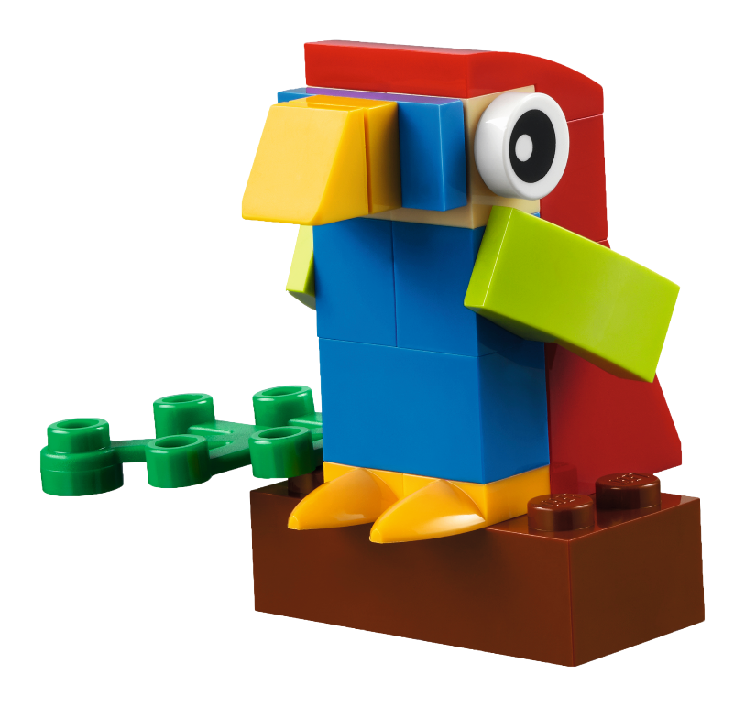
True or False?
✅ True!
If you think it is TRUE - stand up
If you think it is
FALSE - sit down
Notes:
Read statement:
Studies show that nature sounds can have a calming effect on the body and mind.
Click to reveal: TRUE
Listening to natural sounds like birdsong or running water can help lower blood pressure and reduce feelings of stress.

Slide 9
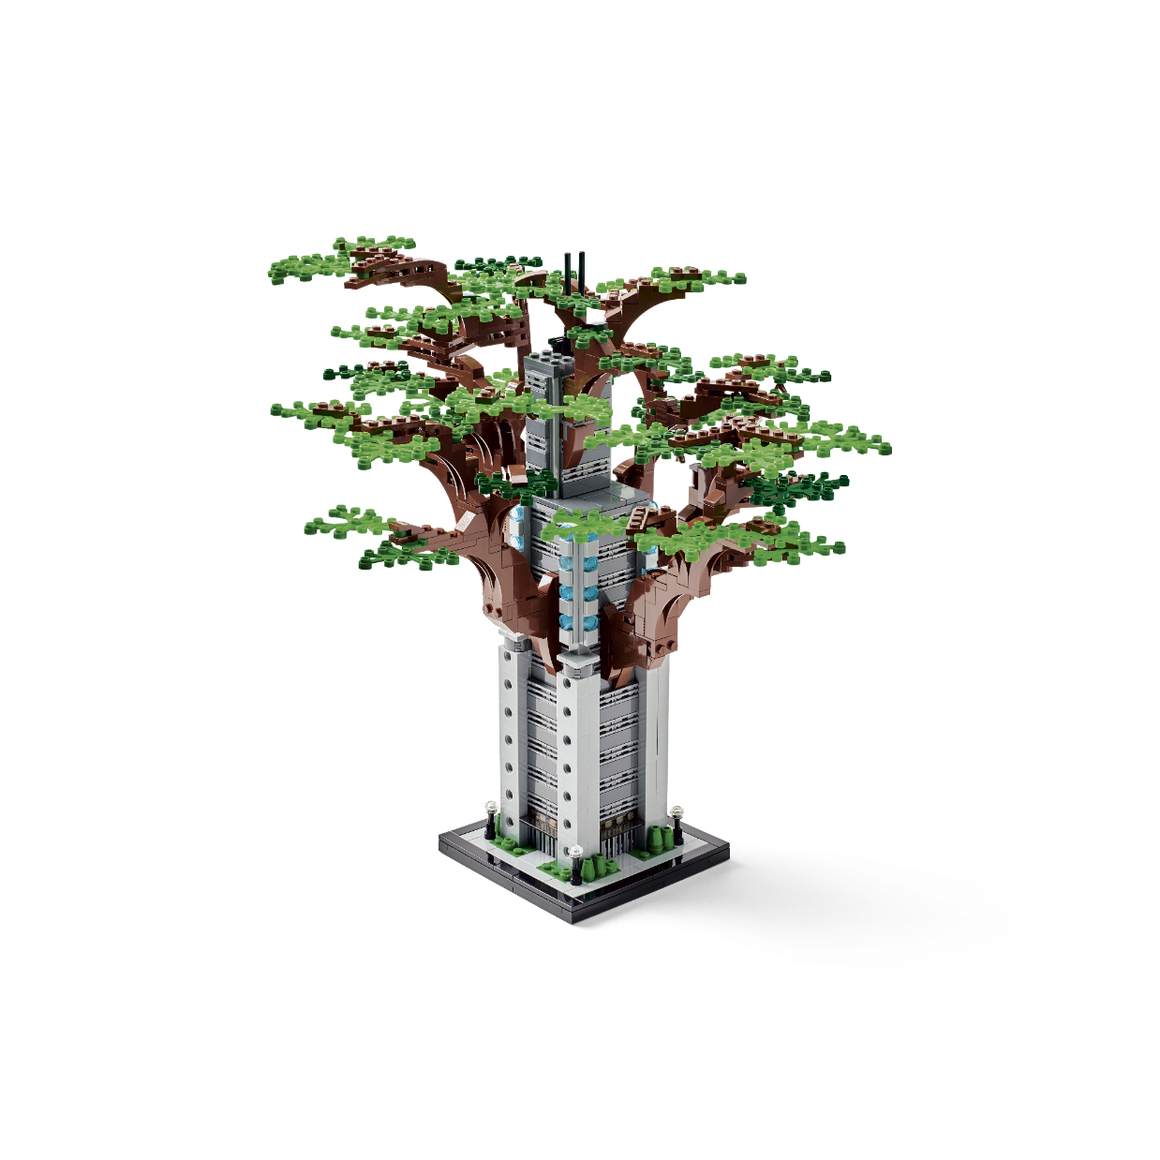
True or False?
❌ False!
If you think it is TRUE - stand up
If you think it is
FALSE - sit down
Notes:
Read statement:
City air is always more polluted than countryside air, so there’s no benefit to going outside if you live in an urban area.
Click to reveal: FALSE
While cities can have more pollution, parks and green spaces still improve air quality and offer mental health benefits

Slide 10
True or False?
If you think it is TRUE - stand up
If you think it is
FALSE - sit down
✅ True!
Notes:
Read statement:
If you’re feeling tired, a walk outside is more likely to boost your energy than a sugary snack.
Click to reveal: TRUE
Fresh air, sunlight, and movement wake up your body more naturally than sugar, which can cause an energy crash.

Slide 11
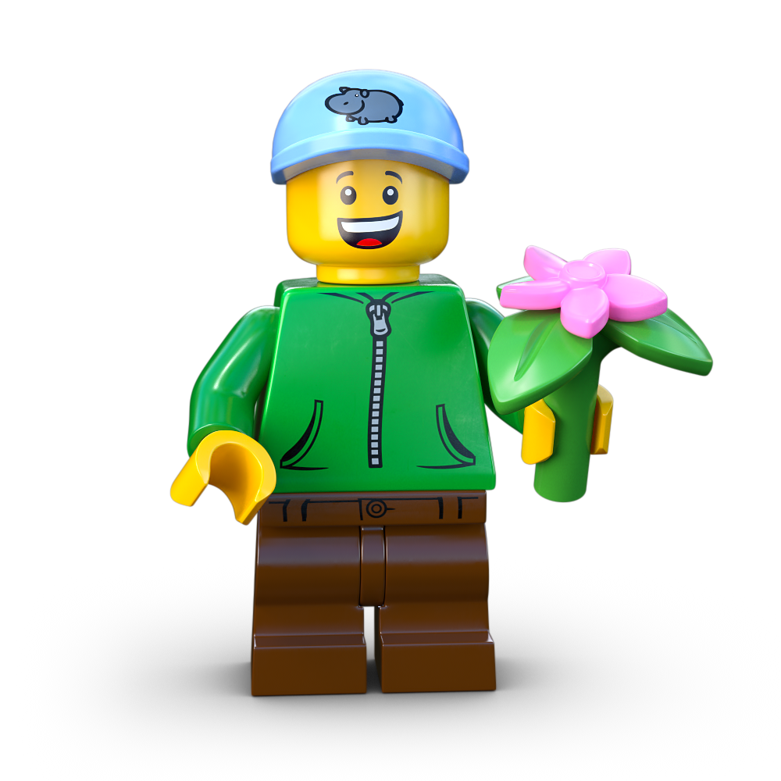
True or False?
✅ True!
If you think it is TRUE - stand up
If you think it is
FALSE - sit down
Notes:
Read statement:
Research shows that nature helps with focus, creativity, and brain function.
Click to reveal: TRUE
Being outside can improve concentration and memory, making it easier to study.

Slide 12
Read all about it!
Fewer People Enjoying Nature’s Magic!
Download the news article here.
Notes:
Time - 4 mins
Read the News Detectives article:
Read TODAY’S NEWS STORY independently, or as a class, depending on your class’ reading ability.
You could read the article on page 3 if you would like to increase the challenge for your class.
https://buildthechange.theday.co.uk/resources/families-turn-their-backs-on-nature/

Slide 13
News Detectives
Connect
Wonder
Investigate
Construct
Express
Reflect
Notes:
Time - 10 mins
Put students into teams of 5 or 6 students. Give them some time to discuss these questions:
Connect - - How do you feel about this story? Have you ever experienced any physical or mental benefits of being outside in nature?
Wonder - - What questions do you have about this story? For example: How do they estimate the cost to the NHS?
Investigate - - What are the facts? What are the opinions?
Construct - - Should the Government do more to encourage busy people back to nature?
Express - - Do people your age appreciate nature? How could you make them more aware of these benefits?
Reflect - - How might you convince your best friend to ditch their screens and get outside with you?
You could give them 5 minutes to discuss the questions and then spend some time reviewing and sharing responses when they’ve worked through all six.
Alternatively, you could give each group a question to focus on in more detail and then share ideas as a class.
Encourage them to add any interesting ideas or useful information to their Mind Map, in their Competition Worksheet.

Slide 14
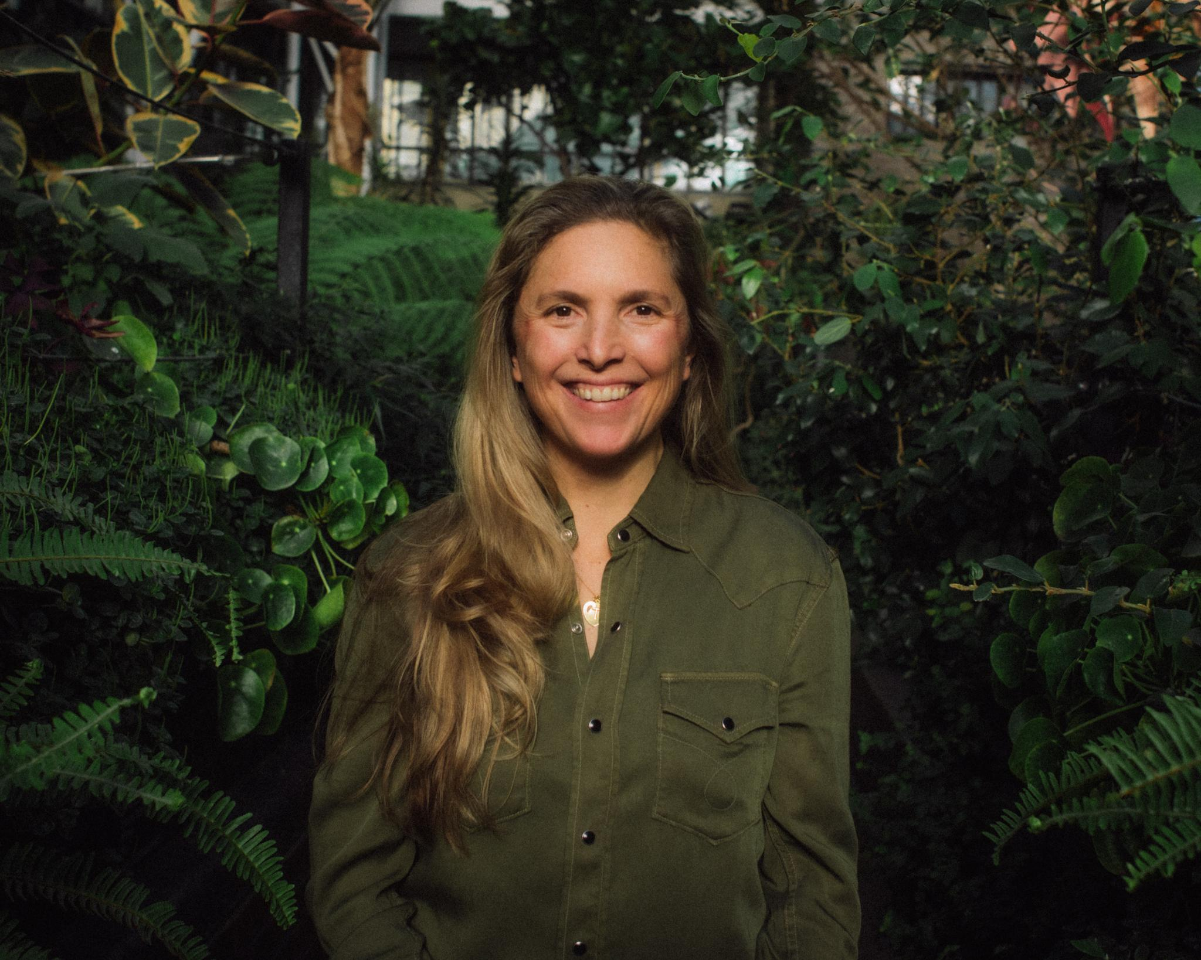
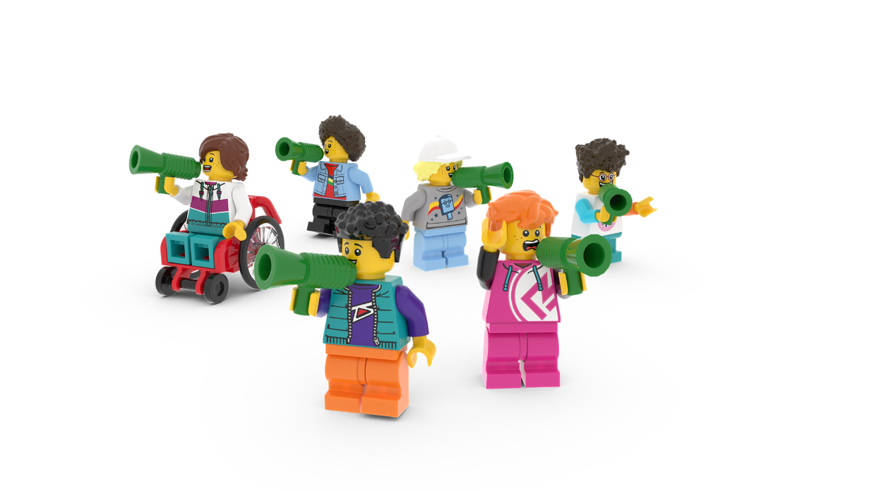
The Planet People Podcast
Meet our special podcast guest Elise Van Middelem, who leads big nature-based projects and has funded close to 240 pocket forests in 52 cities worldwide!
You’ll hear from her on the Build for Nature podcast episode, up next!
Notes:
Time - 2 mins
Seat students around creative materials. This can be for drawing, building or making.
Each student should have a Competition Worksheet in front of them.
Explain that they are going to listen to the LEGO Build the Change Planet People Podcast, which will explore how we can help everybody benefit from nature, with an expert on the subject.
Inform them that they will be able to build or draw while they listen. They will be quizzed too so they should listen while they create.
They should also remember to keep adding useful information or ideas to the topic Mind Map they started in their Competition Worksheet.

Slide 15
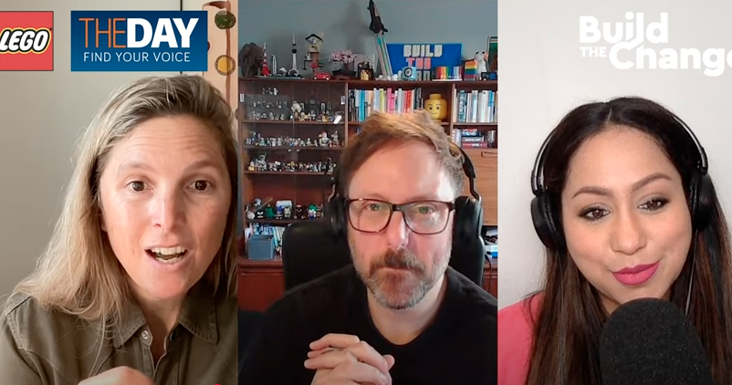
The Planet People Podcast
Notes:
Time - 25 mins to listen to the podcast, with pauses. https://www.youtube.com/watch?v=fRagpiO6IF8
Play part 1 of the Planet People Podcast (5 mins), pause at 5.52
In this part, pupils will:
Be introduced to the topic: how to bring the benefits of nature to the places we live, learn and play
Complete a mini-build challenge: build something from nature that you find incredible
Understand a bit about our guest, their job and how they help people and the planet.
2. Pause the podcast at 5.52, (see Podcast Pause 1 Slide 16)

Slide 16
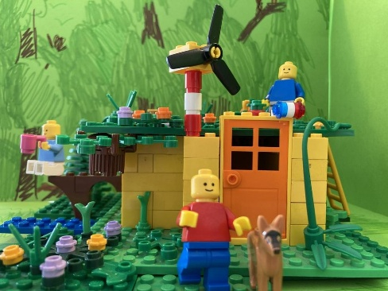
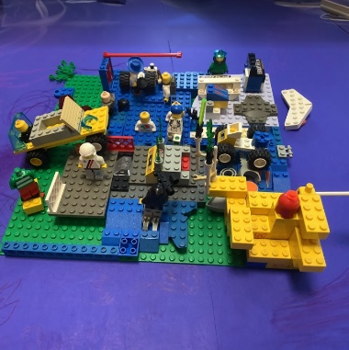
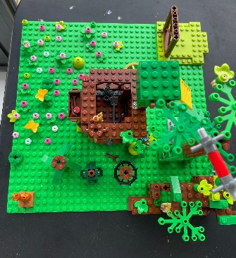
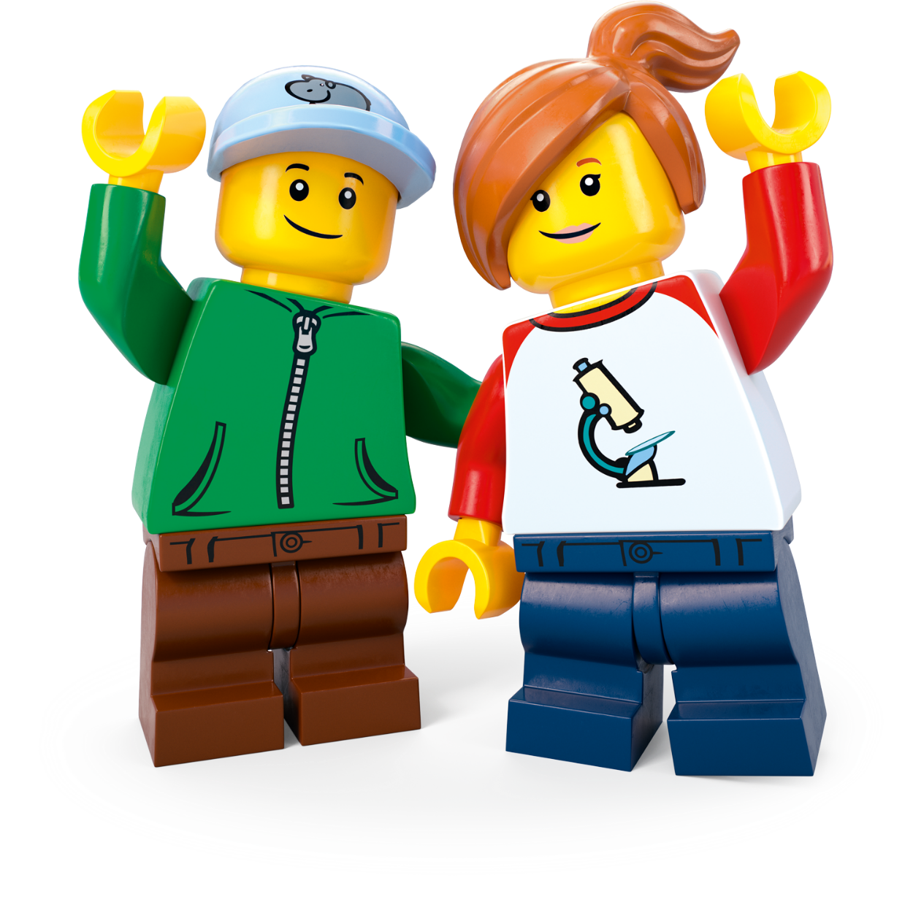
Podcast Pause 1: Mini Design Challenge
Build or draw something magical in nature. What did you make?
Notes:
Time - 3 mins for this pause
Allow students to finish their mini-build challenge: build something from nature that you find incredible.
Share some ideas.
Direct students to their Competition Worksheet.
As they listen to Part 2, next, remind them to add to their topic Mind Map by drawing or writing down interesting or inspiring words or ideas.

Slide 17
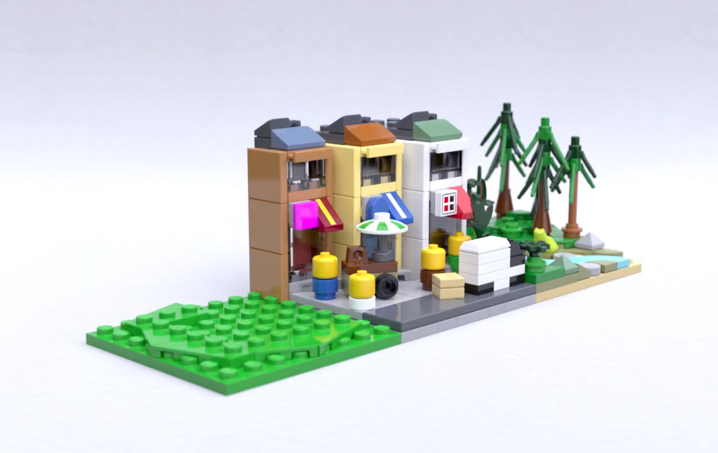
The Planet People Podcast Part 2
.
Notes:
Play part 2 (from 5.52) of the Planet People Podcast (5 mins), pause at 11.16 (if you need the link to the podcast again it’s https://www.youtube.com/watch?v=fRagpiO6IF8).
In this part, students will:
Listen to the hosts interview the guest expert using the Investigation of the Day question: How can we make sure everybody benefits from nature?
Students create a Mind Map in their Competition Worksheet to record ideas as they listen.
2. Pause the podcast at 11.16, (see Podcast Pause 2 Slide 18)

Slide 18
Podcast Pause 2: What have
we learned?
Notes:
Time - 5 mins for this pause
Take a moment to encourage students to share what they have written down on their worksheet. Use these comprehension questions to check for understanding.
Approximately how big is a small city pocket forest? The same size as a tennis court!
Why is it important to bring nature to our busy spaces and communities? It’s essential to our being – nature connection helps mental wellbeing and it brings people together. It also has lots of environmental benefits like cooler temperatures, cleaner air and healthier soil.
68% of people (or 7 out of 10 people) will be living where by 2050? Cities

Slide 19
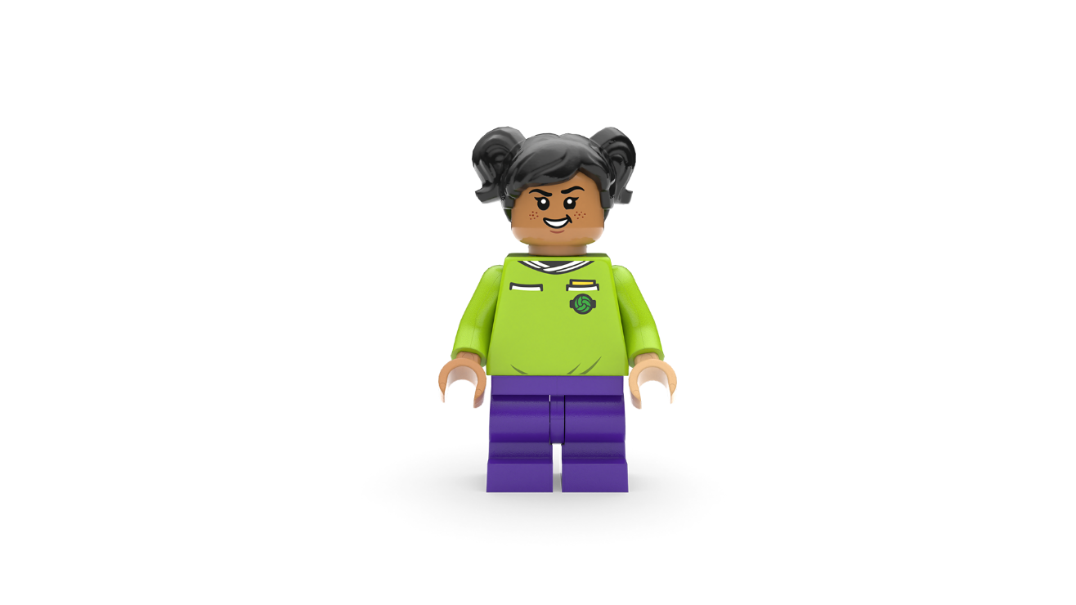
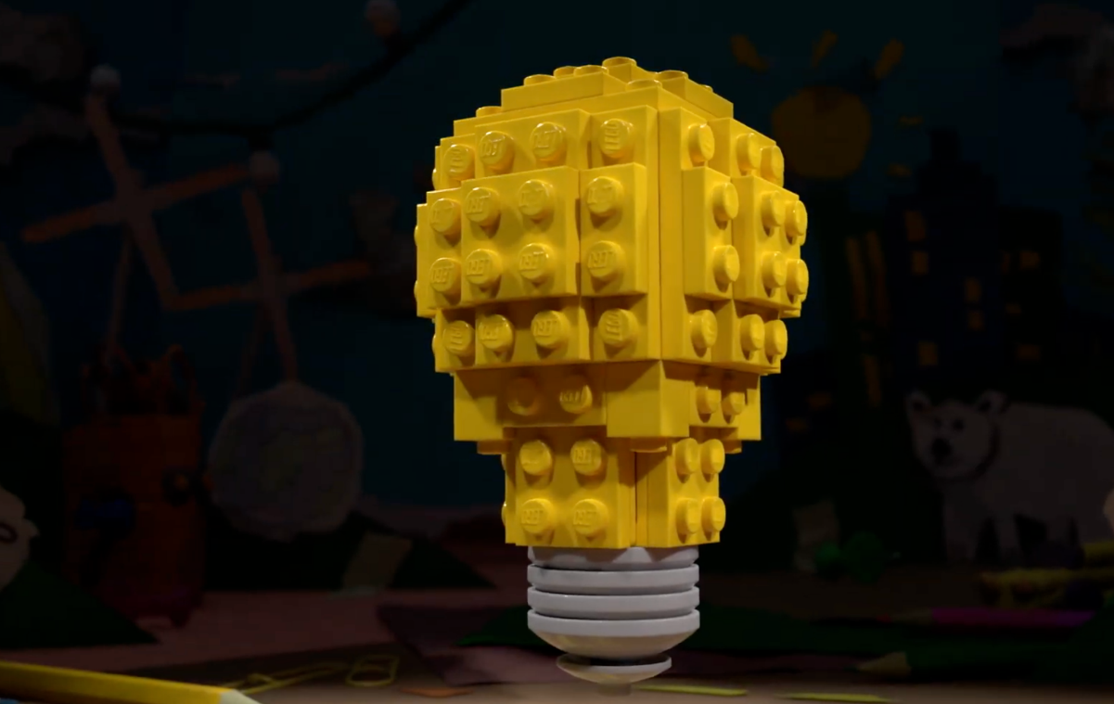
The Planet People Podcast Part 3
Notes:
Play part 3 (from 11.16) of the Planet People Podcast, (7 mins). (if you need the link to the podcast again it’s https://www.youtube.com/watch?v=fRagpiO6IF8).
In this part, students will:
Recap on the conversation
Be introduced to the Build the Change design challenge
Record any inspiring ideas on their Competition Worksheet.
Understand how they can enter their ideas into our competition.

Slide 20
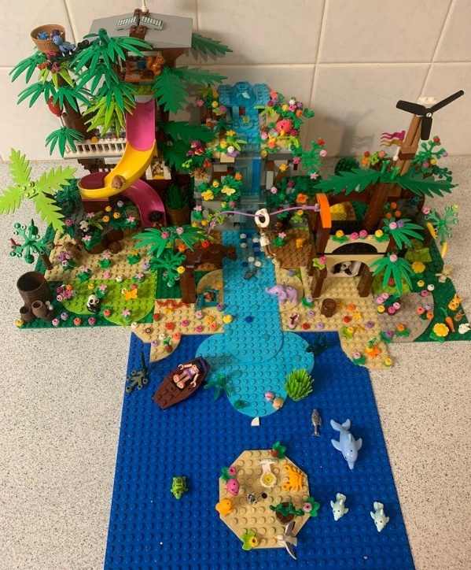
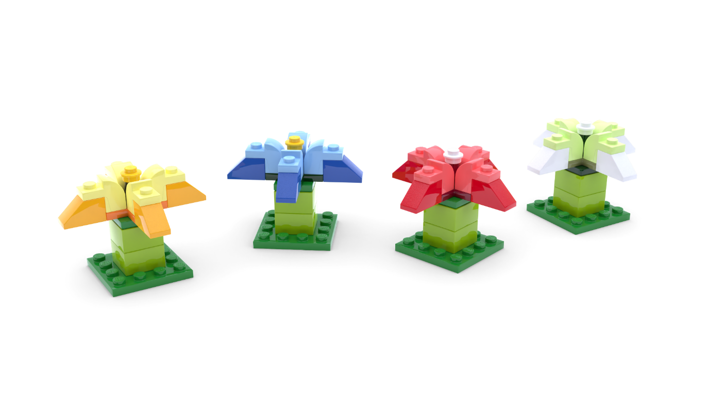
The Build for Belonging Design Challenge
Use your imagination to create something green, awe-some and completely unexpected for your community!
Notes:
Time - 2 mins
Remind students that: when people spend time around trees, flowers, and wildlife, they feel happier and healthier. But many people struggle to find time to reconnect with the magic of nature. What if you could surprise your community with an idea that brings the wonders of nature into busy, everyday life?
Set the Build the Change challenge using the slide:
Create something green, awe-some and completely unexpected for your community!
Check for understanding.

Slide 21
Reflection
What inspired you?
What intrigued you?
Notes:
Time - 5 mins
Think about the topic, the design challenge and anything else you’ve learned today. Allow students time to add final thoughts and ideas to their Mind Map.
You could ask them to:
Draw one thing that has interested or inspired them today
Write down one question they still have about the topic.
You may wish to seek answers to these questions together, or set this as research challenge to be completed at home.

Slide 22
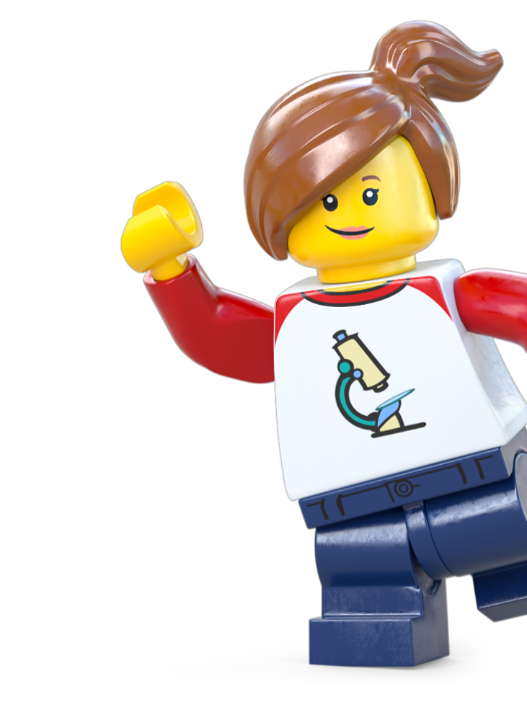
Extension Activity
Take Action!
Notes:
Take Action! Extension activities
The activities in this session are completely optional. You can spend however long you like on these, therefore we haven’t included timings. These activities are designed to be delivered outside. You can deliver some around your school but if possible, consider taking the learning out of school and into the community.

Slide 23
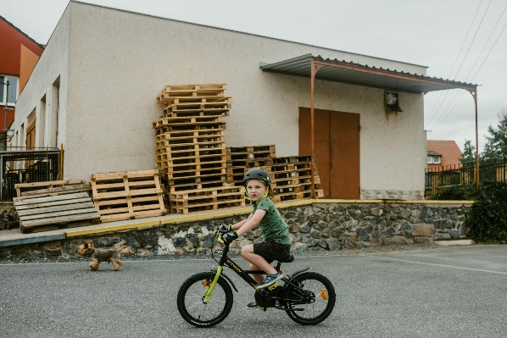
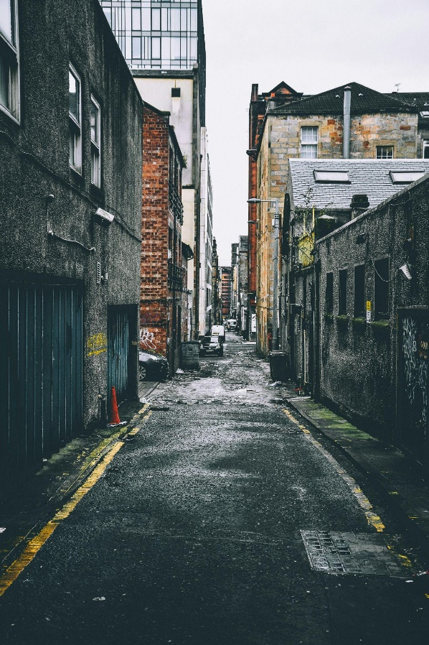
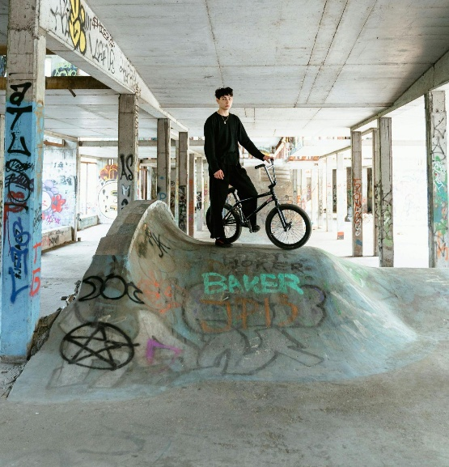
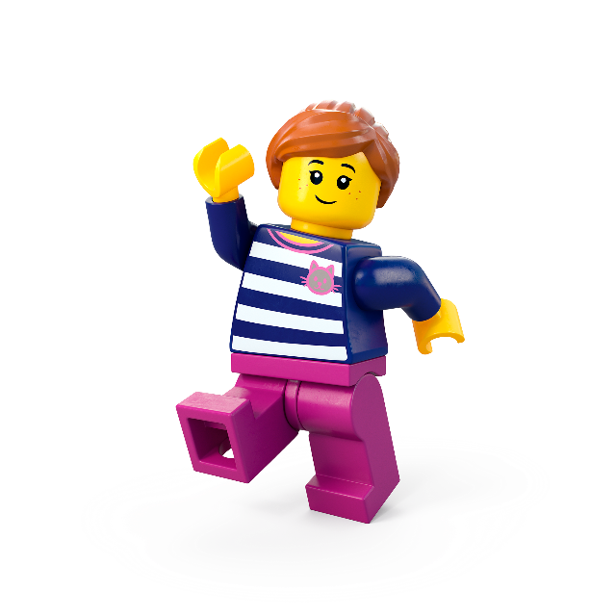
Activity 1:
Where is Green Space Missing?
c Pexels
Notes:
Objective: This activity helps students investigate the distribution of green spaces in urban areas and consider how these spaces could be improved or expanded.
Before the Fieldwork:
Introduce the activity – Discuss the importance of green spaces in cities and how they benefit the environment and people.
Where do we typically see green spaces in cities? Why might some areas have more than others?
Set predictions – Ask students to predict where they think green spaces will be most and least common in your local area.
Prepare materials – Provide students with clipboards, simple maps, or digital tools to record data.
During the Fieldwork:
Visit your local area or school grounds:
Students should observe and record green spaces such as parks, planters, trees, or even weeds growing in unexpected places.
Students record:
Map green spaces and take photos of any unexpected nature (e.g. wildflowers or plants growing in pavement cracks).
Rate areas for greenery, scoring from 1 (little green) to 5 (very green).
After the Fieldwork:
Back in class, analyse findings:
Where is green space missing in the local area?
How might factors like pollution, affluence, or foot traffic affect the amount of greenery?
Discuss solutions:
Where could new green spaces be added to improve the area?
How would this impact the local environment and community?
Link to the Design Challenge:
Use the data to guide design ideas that address where green spaces are most needed.
Encourage students to think about how they could add nature in unexpected places.
This activity encourages students to explore real-world issues and come up with practical, nature-based solutions for their communities.

Slide 24
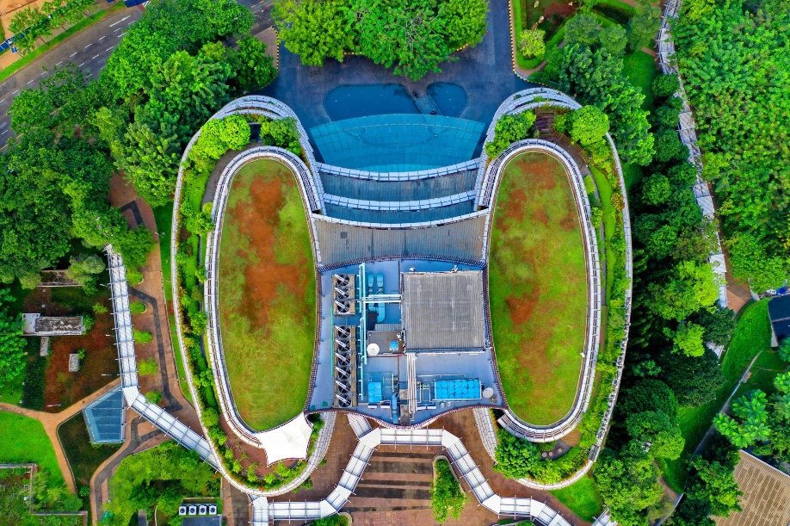
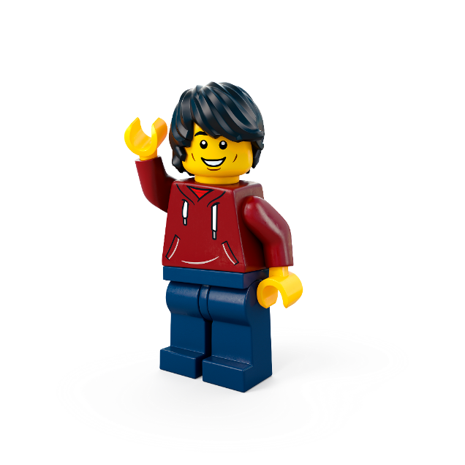
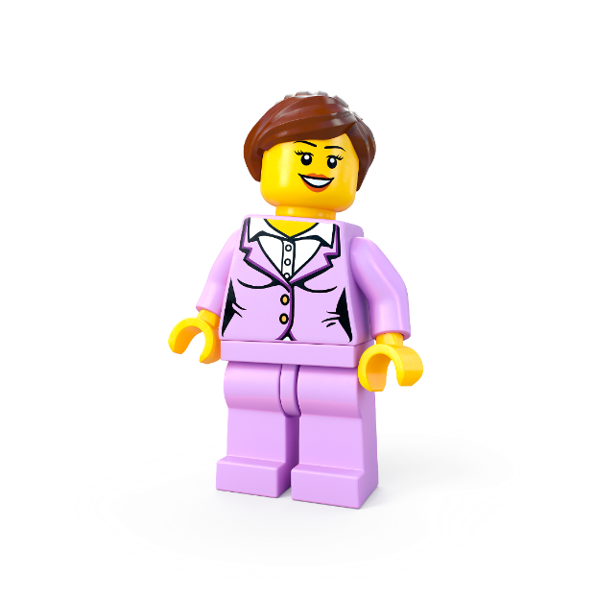
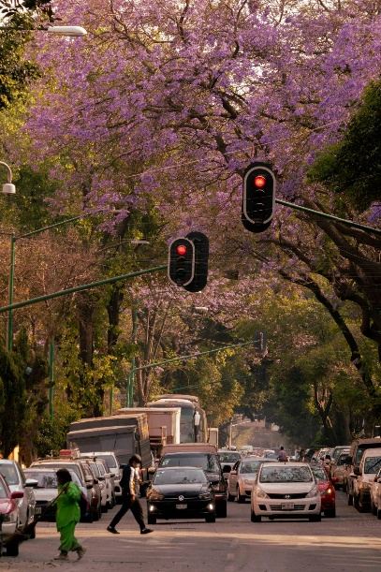
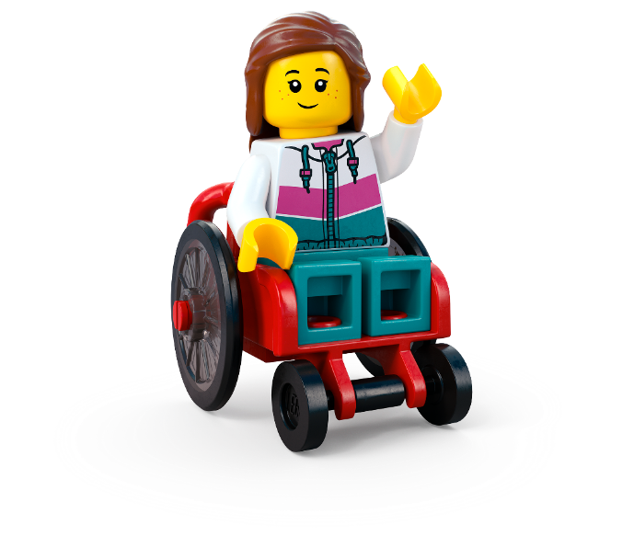
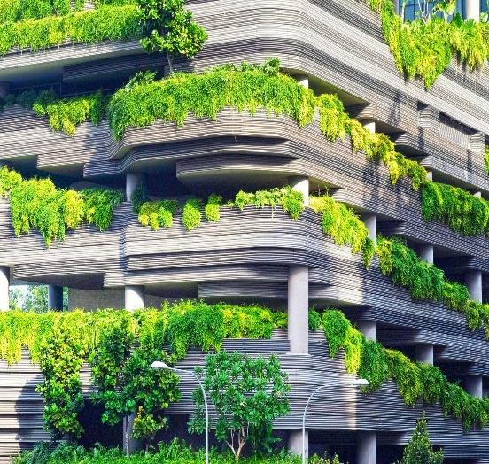
Activity 2:
How Green Spaces Shape Climate
c Pexels/Danist Soh/Unsplash
Notes:
Objective: This activity helps students investigate how green spaces influence urban temperature, air quality, and comfort, linking physical geography concepts to real-world urban environments.
Before the Fieldwork:
Introduce the activity – Discuss the role of trees and plants in cities:
How do they provide shade and cool down urban areas?
How do they improve air quality?
Set up predictions – Ask students where they think will be hotter, windier, or more polluted: green vs. built-up spaces.
Prepare materials – Provide thermometers, lightweight flags (or bubbles), and sticky tape with white paper for dust collection.
During the Fieldwork:
Visit two locations:
A shaded green space (e.g. a park or tree-lined street).
A built-up area (e.g. a tarmac car park or busy road).
Students record:
Temperature: Measure and compare in both locations.
Wind speed: Observe how wind moves using bubbles or small flags.
Air quality: Press sticky tape onto surfaces in both locations, then compare dust levels.
After the Fieldwork:
Back in class, analyse findings:
Which space was cooler? Why?
Did wind move differently in green vs. built-up areas?
Which area seemed more polluted?
Discuss impacts on climate:
How do trees and plants help reduce urban heat and improve air quality?
Could more green spaces make cities more comfortable and healthier?
Link to the Design Challenge:
How can students design greener cities to tackle urban heat and pollution?
What features would make a city more climate-friendly?
This activity encourages students to apply fieldwork data to real-world environmental challenges and urban planning solutions.

Slide 25
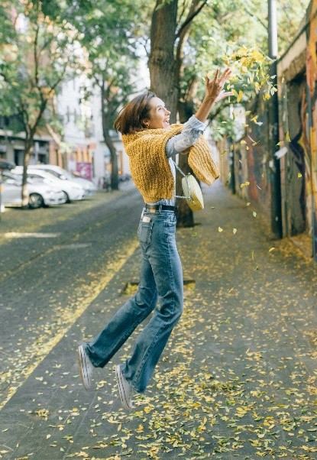
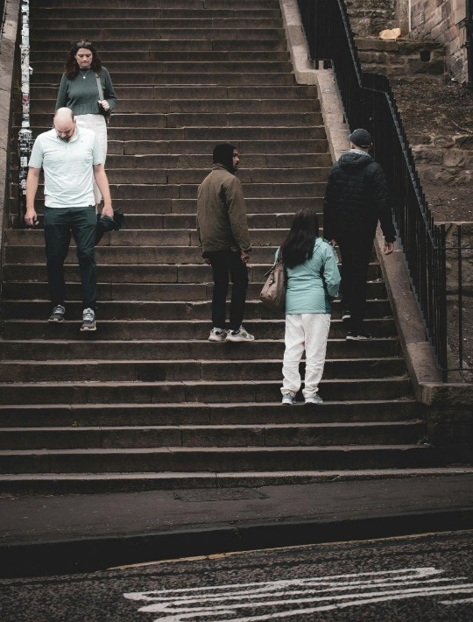
Activity 3: Green Spaces vs. Built Up Spaces
c Pexels
Notes:
Objective: This activity helps students compare how people behave in natural vs. urban environments, linking human and physical geography.
Before the Fieldwork:
Introduce the activity – Discuss how green spaces and built-up areas might affect people's behaviour, mood, and activities.
Set expectations – Students should observe quietly, record data accurately, and be respectful when asking questions.
Prepare materials – Provide tally sheets, clipboards, or digital devices for recording observations.
During the Fieldwork:
Visit two locations:
One natural space (e.g. a park, tree-lined street, or green square).
One built-up area (e.g. a busy high street, plaza, or car park).
Students record:
Number of people stopping vs. passing through.
Types of activities (sitting, playing, exercising, talking, shopping, etc.).
Age groups and how they use the space.
Optional: Interview a few people with simple questions:
"Do you prefer spending time here or in a greener space?"
"What would make this place better for you?"
After the Fieldwork:
Back in class, analyse findings:
Compare differences in behaviour between locations.
Discuss why people might use spaces differently (comfort, noise, accessibility).
Consider how greenery affects mood, social interaction, and well-being.
Link to the Design Challenge:
How could built-up spaces be redesigned to include more nature?
What features encourage people to stop, relax, and interact with their surroundings?
This activity encourages students to think critically about urban design and how geography impacts daily life.

Slide 26
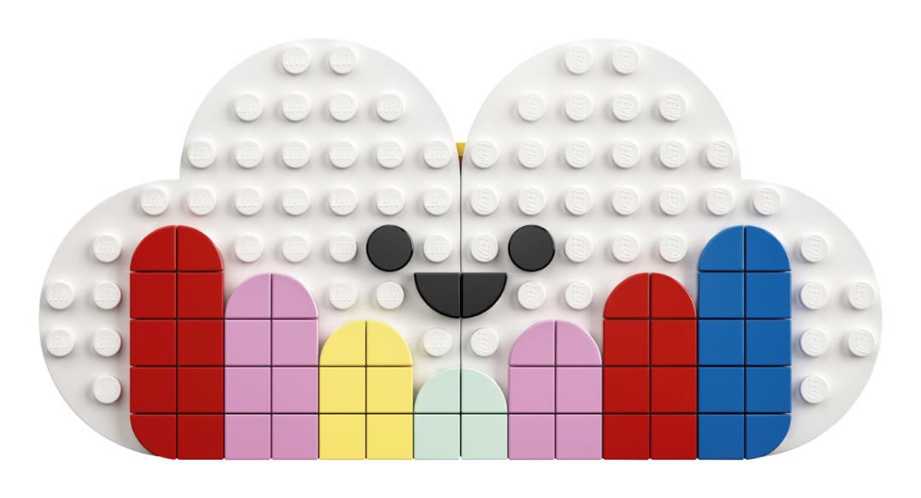
Lesson 2
Create and Share!

Slide 27
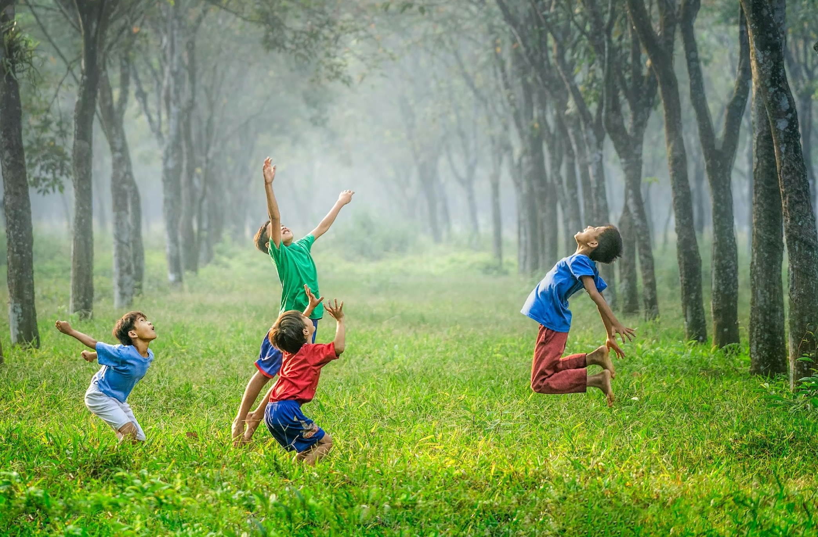
Super Nature
Remember all the reasons why nature is good for people?
Write down as many reasons as you can remember.
Notes:
Time - 1 min
Think, pair, share: Why Should We Spend Time in Nature? Put students in pairs and list as many reasons as they can, recalling what they learned in the previous lesson(s).
What did they come up with? Who came up with the most? Share ideas as a class. Compare with the list on the next slide.

Slide 28
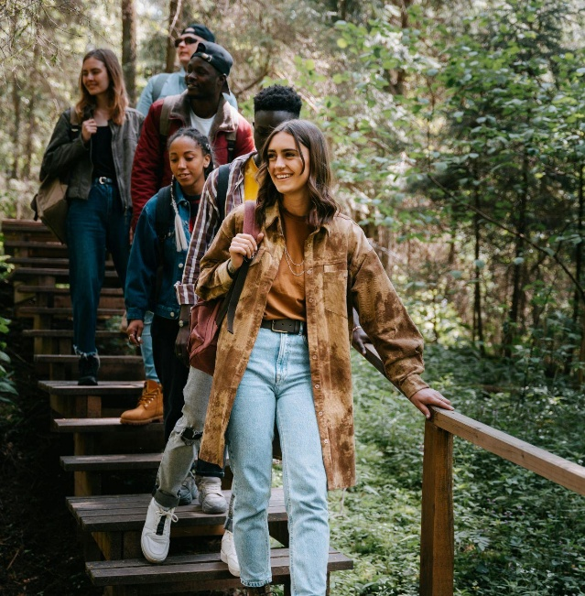
Nature...
Turns us into explorers Helps us sleep Brings people together Needs our help Is exciting!
Boosts our mood Is the best gym Cleans our air Is full of wildlife Helps us learn
© Artem Kniaz/Unsplash
Notes:
Boosts our mood Fresh air and green spaces help us feel calm and cheerful.
The best gym Running, climbing, and playing outside keeps us strong and healthy.
Cleans our air Trees act like giant air filters, giving us fresh oxygen to breathe.
Full of wildlife Nature is home to birds, butterflies, and so many amazing creatures.
Helps us learn The outdoors is a giant classroom, full of things to discover!
Turns us into explorers Build dens, follow animal tracks, or go on an adventure!
Helps us sleep Sunshine resets our body clock, helping us rest better at night.
Brings people together Parks and forests are perfect for fun with family and friends.
Needs our help The more we love nature, the more we want to protect it!
Is exciting! Splash, climb, roll, and explore - every day outside is an adventure!

Slide 29
Campaign for Nature
Notes:
Time - 8 mins
For this activity, students should work in pairs or smalls groups. Use the script below to introduce the activity:
Mission: You work for the Institute of Nature Connection, and it is your job is to help busy people notice nature.
Your Challenge:
Look at your audience card (see slide 40 and 41 in the appendix) to understand who you're designing for.
Think about how to help them reconnect with nature—it could be an advert, a fun experience, a digital billboard, or a social media post.
Your idea needs to grab their attention and make them realise how amazing nature is!
Draw or build your idea using the materials provided.
Tips:
Who is your audience? Look at your audience card.
What type of nature do they enjoy or need more of?
What would make them stop and pay attention?
Let's inspire people to see the magic of nature again! 🌿
Give each pair or group a different audience card (see slides 40 and 41). What could they create that would help promote one or all of the benefits of nature to that person. Give them time to come up with an idea, draw, build or make something related to their idea, and then share as a class.

Slide 30
Work together. Create together.
Teamwork = Success
No Idea’s Too Wild
Level It Up
Lead by Listening
Kindness is Key
All In, All Together
Differences = Strength
Mistakes Make Us Better
Notes:
Time - 1 min
Use this slide as a checklist to help students reflect on the previous team or paired activity. What did they do well? Where could they have improved? Remind them that when we work well together in teams and include everyone, we feel a sense of belonging. If you are completing the main design challenge in pairs or team, you could read through this teamwork manifesto together:
Teamwork = Success Stick together, support each other, and enjoy the ride - we win as a team!
No Idea’s Too Wild Every thought counts, whether it’s simple, creative, or completely out there.
Level It Up Build on each other’s ideas to create something even better.
Lead by Listening Respect everyone’s voice - great ideas start with paying attention.
Kindness is Key Use positive words and build each other up - we’ve got each other’s backs.
All In, All Together Make sure everyone’s part of the action - no one’s left behind.
Differences = Strength Our unique ideas and perspectives make the team unstoppable.
Mistakes Make Us Better Every mistake is a step forward - learn, grow, and keep going strong.
If you are running this challenge as a pair or team activity, these rules will help students build a sense of belonging as they tackle the creative challenge. If you have more time, you could pass a copy round for everyone to sign or even create your own.

Slide 31
The Build for Belonging Design Challenge
Use your imagination to create something green, awe-some and completely unexpected for your community!
Notes:
Time - 2 mins (for next 2 slides)
Bring students back to the design challenge that was introduced in lesson 1: Use your imagination to create something green, awe-some and completely unexpected for your community!
Remind them that when people spend time around trees, flowers, and wildlife, they feel happier and healthier. But many people struggle to find time to reconnect with the magic of nature. Imagine: What if you could surprise your community with an amazing idea that brings the wonders of nature into busy, everyday life?
Check for understanding.

Slide 32
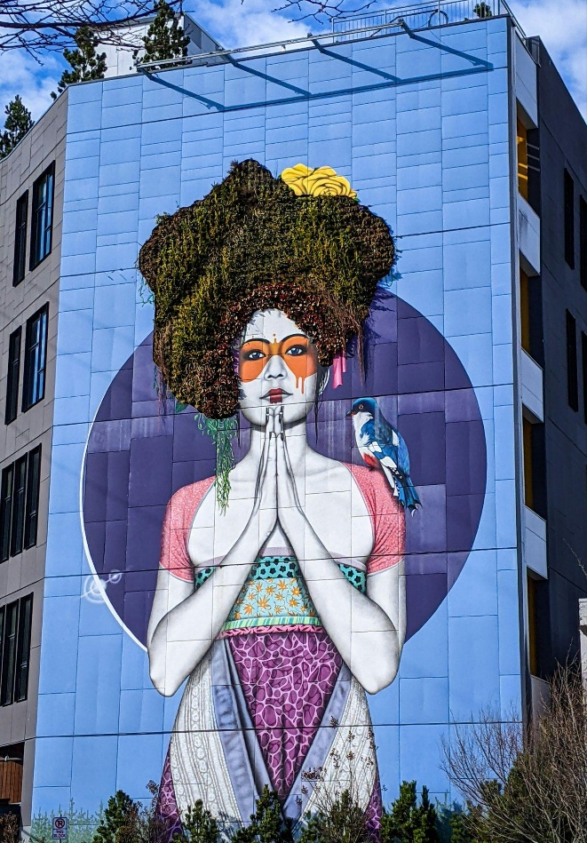
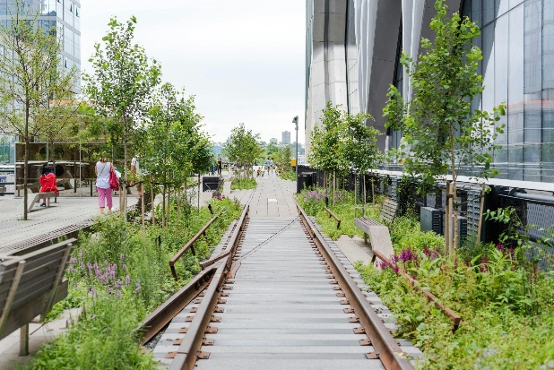
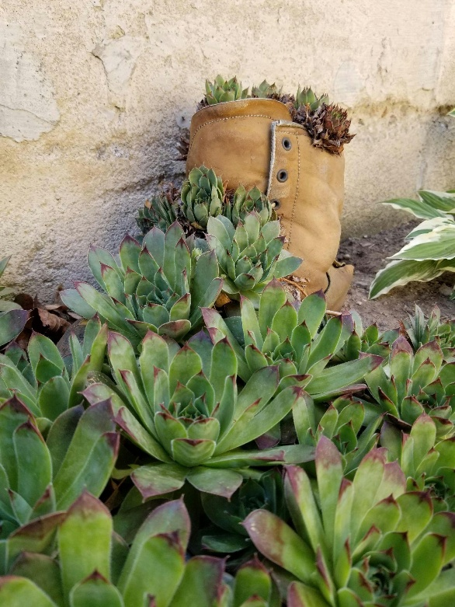
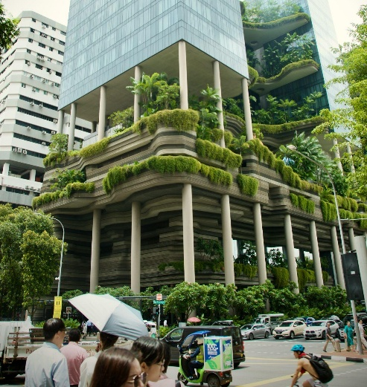
What if?
c Li-Ling Chang, Victor Ballesteros, Elizabeth Vilallta, Jackie Watt/Unsplash
Notes:
Share some of these images and prompts to inspire students ideas before getting them working on the challenge. Encourage them to write all ideas on their Mind Maps.
What if your street had tiny pocket forests, buzzing with wildlife and hidden homes for animals?
What if your high street had a magical trail of flowers and plants, leading people on exciting adventures?
What if you could borrow books from a treehouse library, a cosy reading nook nestled in the treetops?
What if your bus stop was a wild nature haven, where you could listen to birds and smell fresh flowers while you wait?

Slide 33
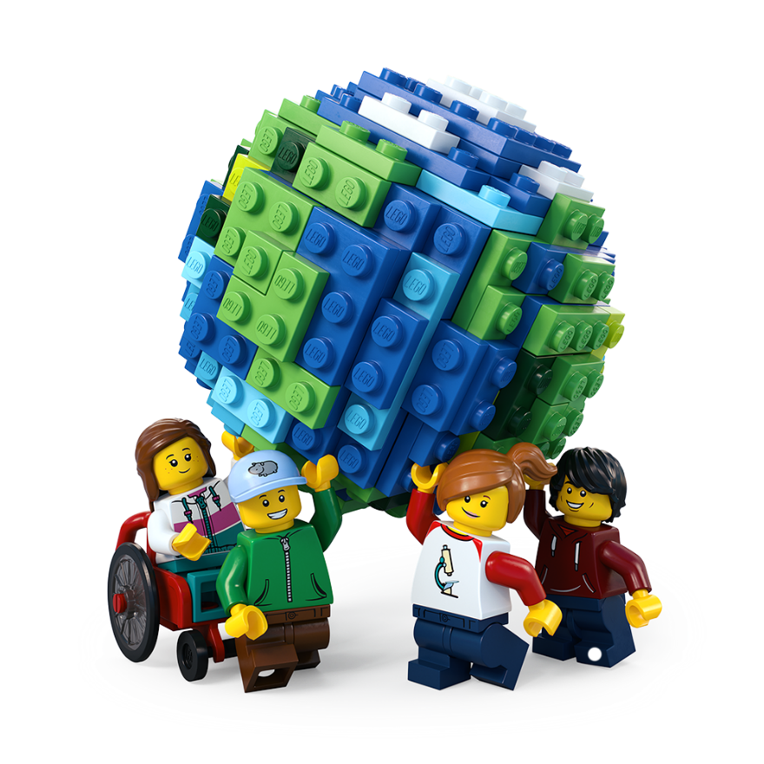
Let’s Build the Change!
Brainstorm ideas
Design your space
Create a model
Write a description
Share your solution
Enter our competition
Notes:
Time - 20 mins
Use this slide to explain all the jobs that need to be done before setting students off on their own.
Brainstorm ideas Look at your mind maps. As a team, write down as many ideas as possible – the sillier, the better! Choose two or three of the best ideas to make even better. Decide on one idea as your solution.
Design your space Draw your brilliant solution in the Competition Worksheet.
Build a model Create a model of your solution using all the cool materials available.
Present your solution Share your ideas with the rest of the class
Enter the Build for Belonging competition
Make sure your ideas, designs and descriptions are included in your Competition Worksheet. Teams should submit one worksheet per team to the competition. Teachers can take a photo of the build to enter it into our competition.
Remember: You can run the challenge as an individual challenge, in pairs or small groups of up to 4. You can allocate team roles using the Team Roles on slide 42, in the appendix.

Slide 34
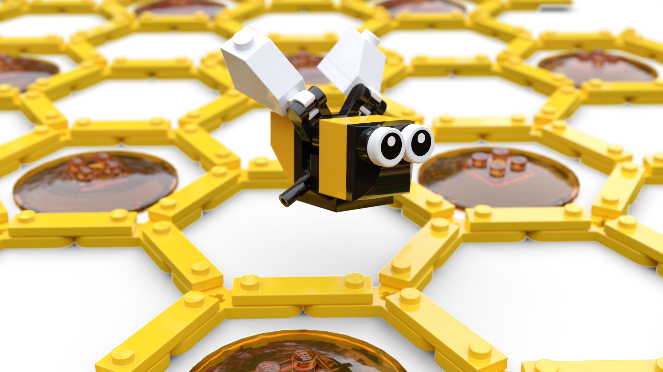
Iterate
Join up
Share ideas
Give feedback
Make improvements!
Notes:
Time - 8 mins
This is optional. It is recommended but can be removed if time is short. Or, the teacher(s) could visit each group and give feedback.
Pair up two individuals, pairs or teams for peer assessment.

Slide 35
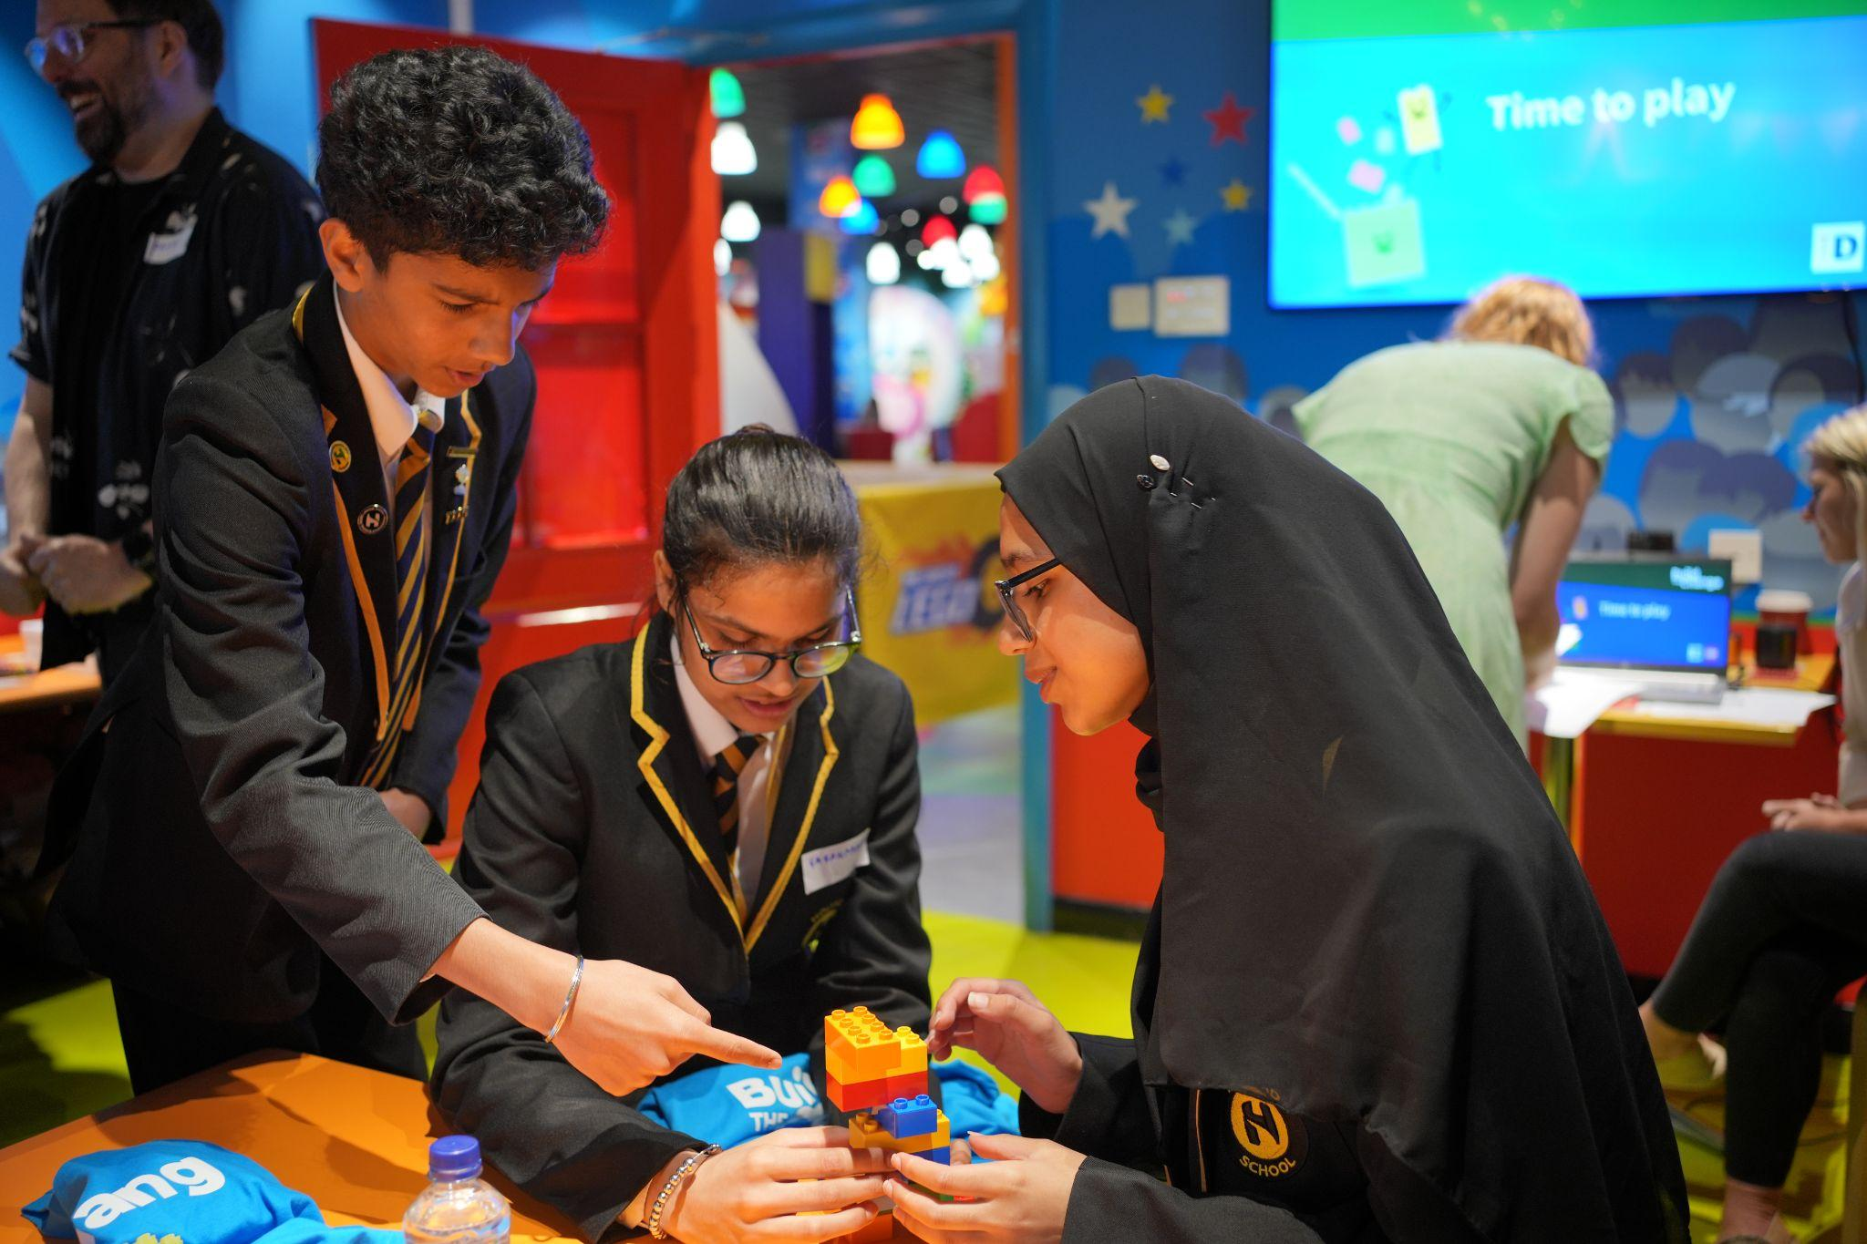
Final Checklist
Have you:
Labelled your final design?
Written a description of your solution
Got your model ready for its photo?
Prepared your presentation?
Notes:
Time - 10 mins
Give time to wrap up.
If you’re running the challenge with pairs or teams, use this list to remind each team member what they are responsible for:
Creative Designer: Time to show off your artistic skills! Label your final drawing to highlight all the awesome features of your design.
Copywriter: Get your writing hat on! Write a cool description of your amazing solution so everyone knows how it works.
Architect: Your job is to get our model ready for its close-up! Make sure it's looking perfect for its big moment in the spotlight.
Head of Communications: You’re the star presenter! Get ready to wow the class with your awesome solution and explain how it works.

Slide 36
buildthechange.theday.co.uk/competition
Notes:
Ask pupils to stop working and place their models around the room for everyone to see.
If you are entering your class’ ideas into our Build for Belonging Competition, show this slide to get pupils excited!
Enter by 30th June at www.buildthechange.theday.co.uk/competition

Slide 37
Share your ideas
Notes:
Time - 10 mins
Ask students to take it in turns to present their solution to the class. Encourage others to give positive and constructive feedback.
You could ask them: What went well? What could be even better?
Celebrate all their awesome ideas!

Slide 38
Share it with the world
Missed the competition deadline?
Don’t worry, your students’ awesome ideas can also be published on the LEGO.com website! Simply upload photos with a 200 character max description of your young person’s creations to our Build the Change photo gallery, for the whole world to see!
They might even be our next Builder of the Week!
Scan the QR code with a camera to start uploading.
Notes:
Don’t forget to upload your learner’s awesome ideas to help us show everyone how awesome kids’ ideas are!
You can upload photos and descriptions of your children’s creations to our Build the Change Tuesday gallery. They might even be our next Builder of the Week! Scan the QR code with a camera to start uploading or visit: https://www.lego.com/en-gb/sustainability/buildthechange/challenges/theday/upload?CMP=EMC-LCE.

Slide 39
Appendix

Slide 40
Notes:
Use these audience cards for the Campaign for Nature activity.

Slide 41
Notes:
Use these audience cards for the Campaign for Nature activity.

Slide 42
Team roles
Head of Communications The presenter gets to show off the team's amazing work to the class.
Copywriter The writer explains the team's ideas in the best words possible.
Creative Designer The designer creates and improves the team's awesome drawings.
Architect The builder brings the design to life with a cool model.
Notes:
Use this slide if you are asking students to work in groups. Please note: Students can enter the competition individually, in pairs or in teams of up to 4 people.
Explain the roles. Ask students to take on team roles according to their strengths.
Head of Communications Presents the final design to the class. Useful skills: Enthusiastic, confident, and loves speaking in front of people.
Copywriter Writes the description of the design and explains how it works. Useful skills: Enjoys writing and is great at turning ideas into words.
Creative Designer Draws and improves the designs on paper. Useful skills: Creative, loves to draw, and gets excited about bring ideas to life.
Architect Builds a model of the final design. Useful skills: Patient, creative, and has steady hands for building under pressure.

