Slide 1
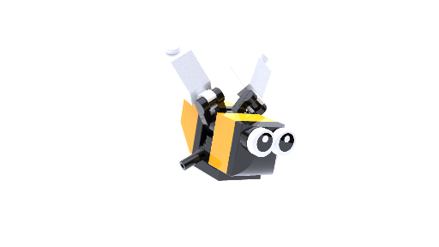
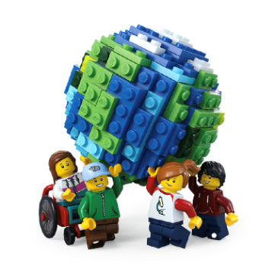
Build for Belonging
BUILD FOR COMMUNITY
WORKSHOP
Ages 11-14
Build the Change is supported by the LEGO Foundation. LEGO, the LEGO logo, the Minifigure and the Brick and Knob configuration are trademarks and copyrights of the LEGO Group. ©2025 The LEGO Group. All rights reserved.

Slide 2
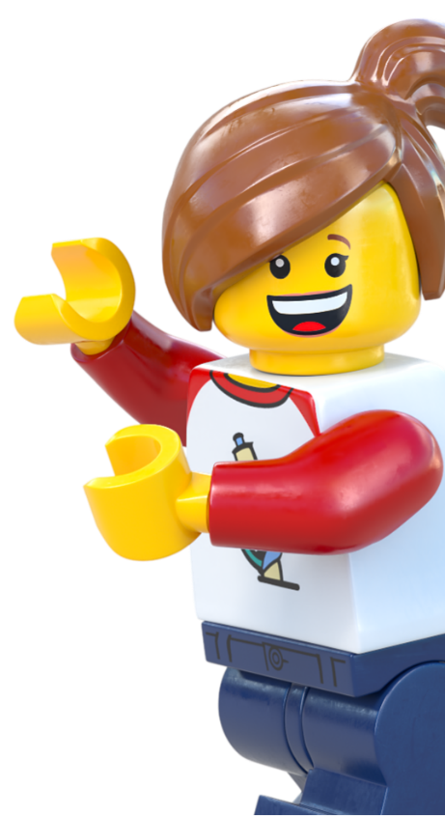
Contents
Workshop 1 Immerse – Slides 3-20
News Detectives Article – Slide 10-12
Planet People Podcast – Slides 13-18
Build for Belonging Design Brief – Slide 19-20
Take Action! Optional Extension – Slides 21-25
Workshop2 Create & Share – Slides 26-37
Design brief – Slide 30
Challenge checklist – Slide 32
Competition Information– Slide 35
Appendix – Slides 38-39
Team roles – Slide 39

Slide 3
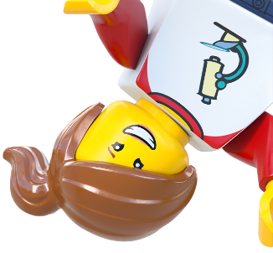
Lesson 1
Immerse

Slide 4
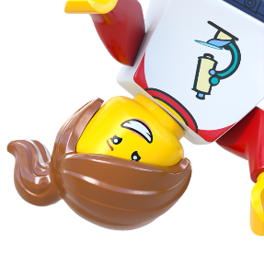
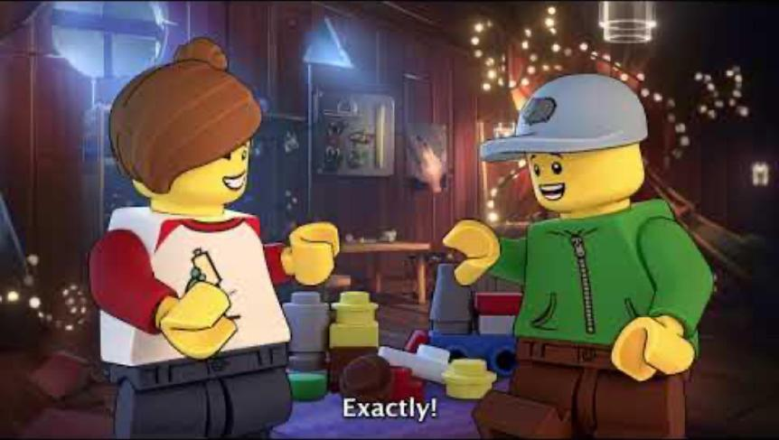
Notes:
Time - 1 min
Play the video to introduce students to the LEGO Group’s Build the Change programme.
https://www.youtube.com/watch?v=D7z8iXqjIkE&t=1s

Slide 5
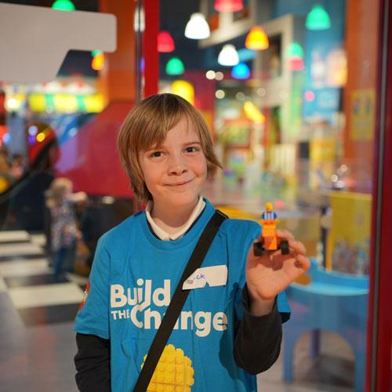
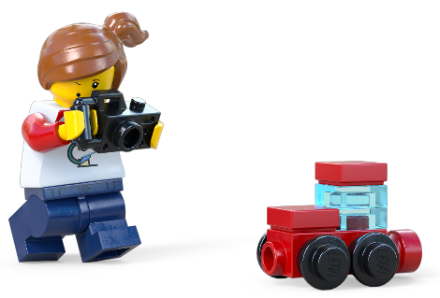
Create the Feeling...
Loneliness
Notes:
Time - 2 mins
Use our hands-on activity to introduce the topic of loneliness and belonging. Ask students to create a visual representation of the opposite concepts loneliness and belonging. Start with loneliness. They can be as creative, symbolic or literal as they like. There’s no right or wrong way of doing this. Give them a short amount of time. We’re not looking for perfection, just quick ideas.

Slide 6
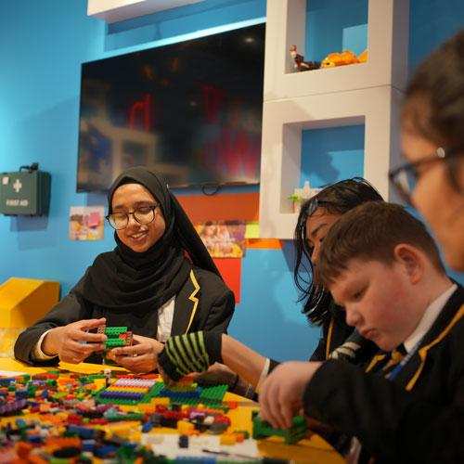
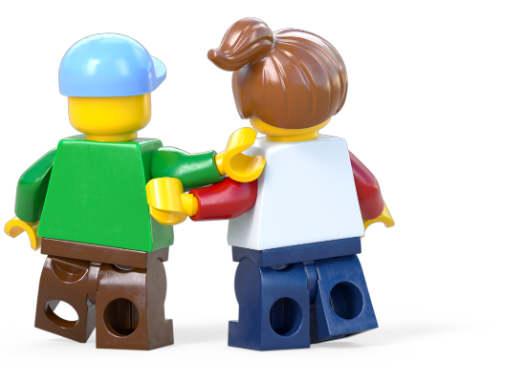
Create the Feeling...
Belonging
Notes:
Time - 2 mins
Use our hands-on activity to introduce the topic of loneliness and belonging. Ask students to create a visual representation of the opposite concepts loneliness and belonging. They can be as creative, symbolic or literal as they like. There’s no right or wrong way of doing this. Give them a short amount of time. We’re not looking for perfection, just quick ideas.

Slide 7
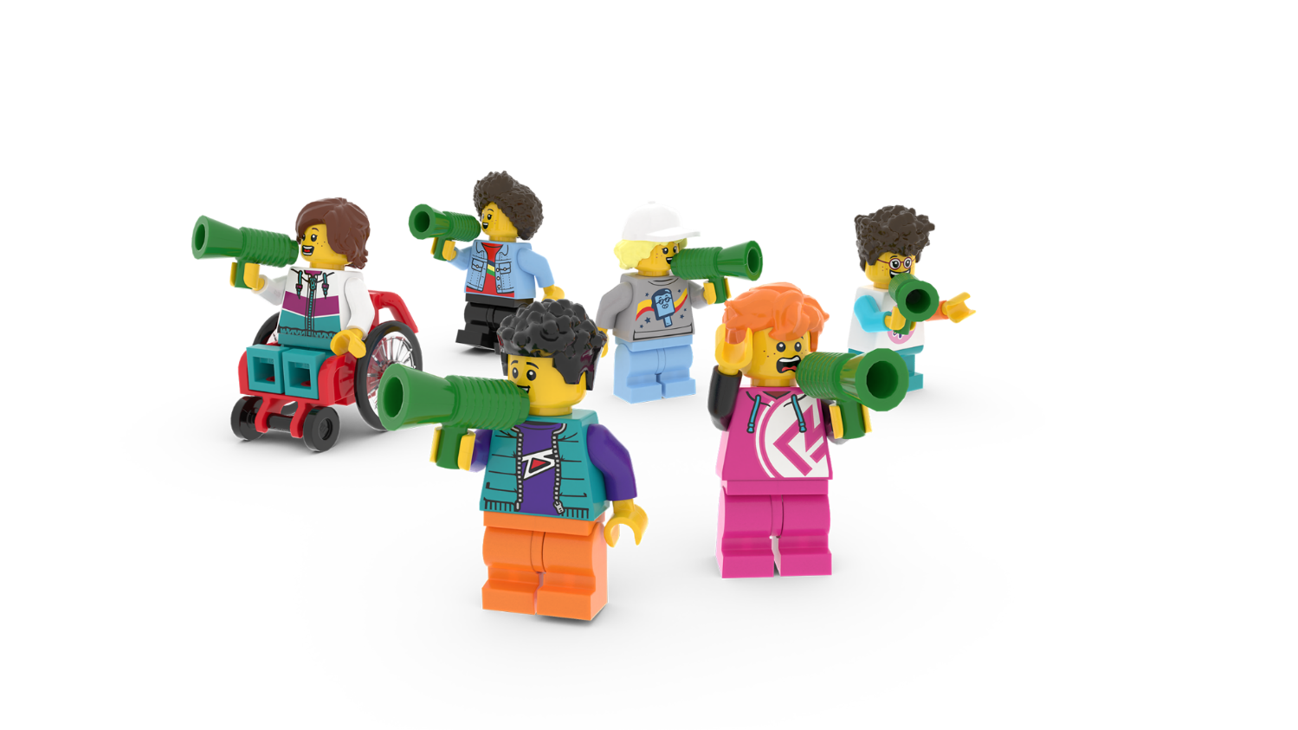
Share the feeling
Share your ideas.
Notes:
Time - 2 mins
Ask students to share their interpretations. Compile a class list of any words or feelings that crop up relating to loneliness and belonging. Which words crop up more than once?

Slide 8
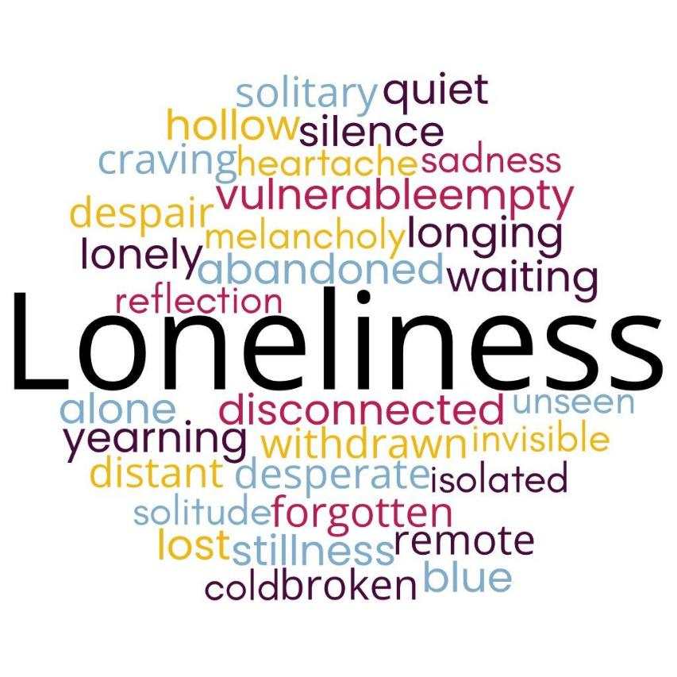
What is loneliness?
A feeling of being unhappy because you have no friends or people to talk to
Notes:
Time - 2 mins
Ask students to write their own definition of the word loneliness. Can they use some of the words compiled on the board? Take a couple of suggestions.
Click to reveal the Oxford Learner's’ Dictionary definition: a feeling of being unhappy because you have no friends or people to talk to
You can use this script to explain loneliness in a way they will understand:
Loneliness is like being on the playground and not having anyone to hang out with or chat to. It’s that feeling of being on your own, even if there are loads of people around, and it can feel a bit sad or empty.
Loneliness is a normal part of being human. This is because long ago, people lived in groups to stay safe and share food. If someone wandered off or got left out, they might be in danger, like from wild animals. So, their brain would make them feel lonely, like a little alarm saying, 'Hey, you need to go back to your friends!'
Even today, when we don’t have enough people to talk to or play with, that same alarm makes us feel lonely. It’s like our heart saying, 'I need some company!' It’s a reminder to spend time with others who care about us.
Make sure students understand that loneliness is a natural feeling that can guide us toward finding connection and friendship.

Slide 9
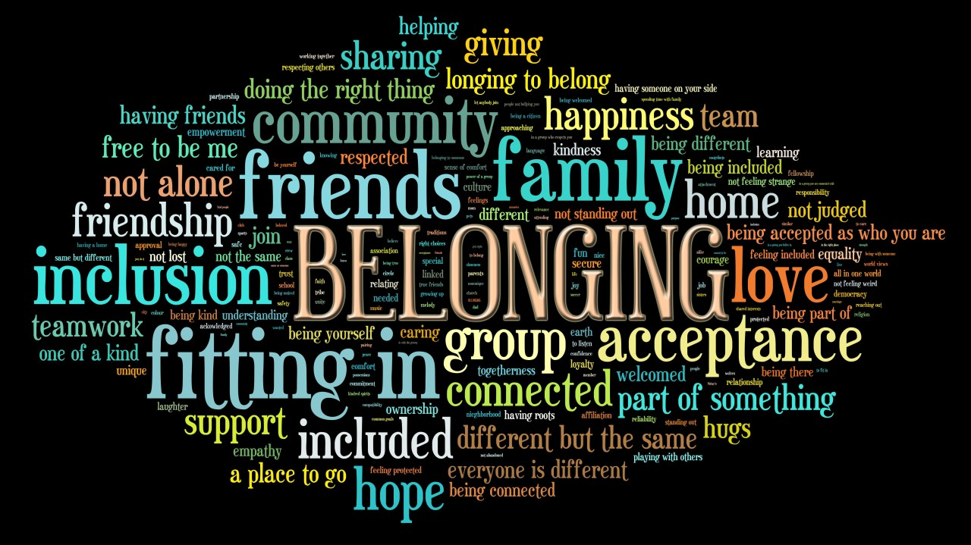
What is belonging?
The feeling of being comfortable and happy in a particular situation or with a particular group of people, and being treated as a full member of the group.
Notes:
Time - 2 mins
Explain that today they will be creating a solution to loneliness, something that brings people a sense of belonging.
Can students write a definition for the word belonging? Ask students to look at the class list of words, to write their own definition of belonging.
Click to reveal the Oxford Learner's’ Dictionary definition: the feeling of being comfortable and happy in a particular situation or with a particular group of people, and being treated as a full member of the group.
You can use this script to explain the concept of belonging in more detail:
Belonging means feeling like you’re part of something, whether it’s a group of friends, a team, or your community.
Belonging is like when you find a group of friends who get you. You feel relaxed, included and happy, like you’re part of a team where everyone is glad you’re there.
Belonging is important because, as we’ve just learned, humans are social creatures—we thrive when we connect with others. When we feel like we belong, it makes us happier, healthier, and more confident. We don’t just survive, we thrive.
Ask students to think of a special time when they’ve felt a sense of belonging. How was the moment better because it was shared with others? Would it have been as special if it was experienced alone?

Slide 10
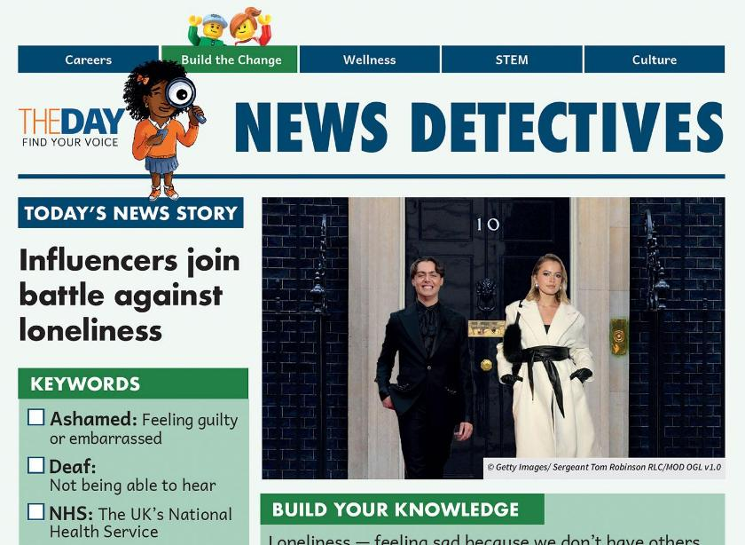
Read all about it!
Read all about it!
Influencers join battle against loneliness.
Click to read the news story.
Notes:
Time - 3 mins
Read the News Detectives article:
Read TODAY’S NEWS STORY independently, or as a class, depending on your class’ reading ability.
You could read the article on page 3 if you would like to increase the challenge for your class.
https://buildthechange.theday.co.uk/resources/influencers-join-battle-against-loneliness/

Slide 11
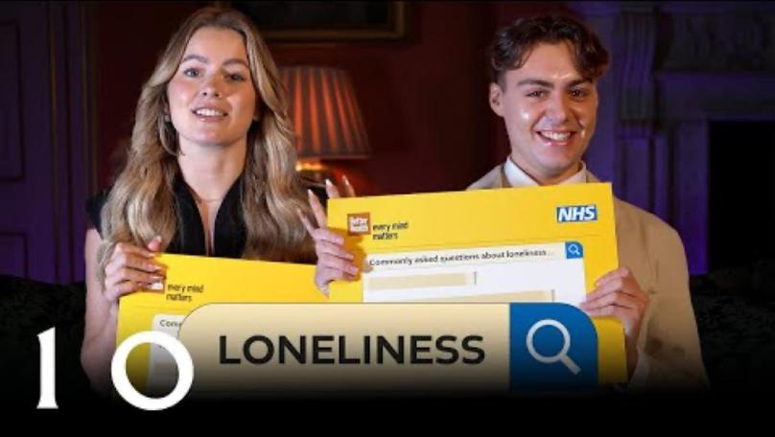
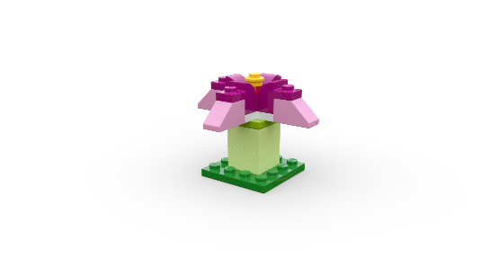
Solutions to loneliness
Talking Loneliness in Downing Street' video from 10 Downing Street's Youtube channel
Notes:
Time - 5 mins
Watch the video as a class: https://www.youtube.com/watch?v=nS-mVlBZzQ0
While students watch the video, ask them to listen out for solutions to loneliness and add them to their Mind Map, on their Competition Worksheet.

Slide 12
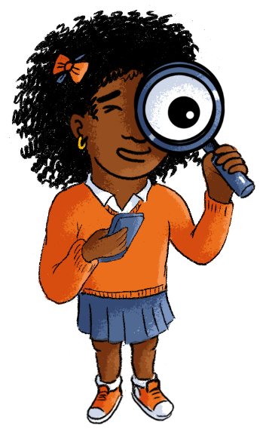
News Detectives
Connect
Wonder
Investigate
Construct
Express
Reflect
Notes:
Time - 9 mins
Put students into teams of 4 students. Give them some time to discuss these questions:
Connect - - - How do you feel about this story? Have you ever experienced loneliness? Would you judge a friend who admitted they felt lonely?
Wonder - - What questions do you have about this story? For example: What causes loneliness?
Investigate - - What are the facts? What are the opinions?
Construct - - Can you think of other ways to stop young people feeling embarrassed or ashamed about feeling lonely?
Express - - Is feeling lonely embarrassing or not?
Reflect - - Imagine your best friend has admitted they’re lonely. What could you say to them in that moment?
You could give them 5 minutes to discuss the questions and then spend some time reviewing and sharing responses when they’ve worked through all six.
Alternatively, you could give each group a question to focus on in more detail and then share ideas as a class.
Encourage them to add any interesting ideas or useful information to their Mind Map, in their Competition Worksheet.

Slide 13
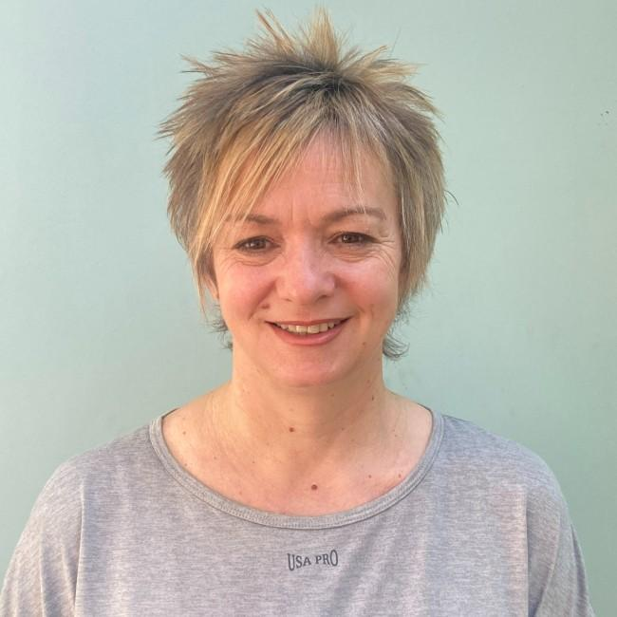
The Planet People Podcast
Meet Andrea Wigfield, a leading researcher on loneliness and social isolation at Sheffield Hallam University!
You’ll hear from her on the Build for Community podcast episode, up next!
Notes:
Time - 1 min
Seat students around creative materials. This can be for drawing, building or making.
Each student should have a Competition Worksheet in front of them.
Explain that they are going to listen to the LEGO Build the Change Planet People Podcast, which will explore why belonging so important for people and the planet, with an expert on the subject.
Inform them that they will be able to build or draw while they listen. They will be quizzed too so they should listen while they create.
They should also remember to keep adding useful information or ideas to the topic Mind Map they started in their Competition Worksheet.

Slide 14
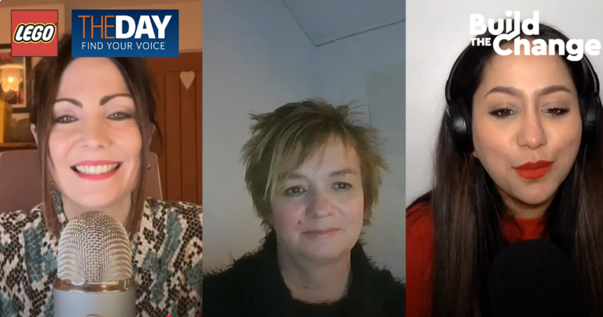
The Planet People Podcast Part 1
Notes:
Time - 25 mins to listen to the podcast, with pauses.
https://www.youtube.com/watch?v=4r0TgO6pFC8
Play part 1 of the Planet People Podcast (5 mins), pause at 5:10
In this part, students will:
Be introduced to the topic: loneliness and belonging
Complete a mini-build challenge: Create an object or place that brings people together
Understand a bit about our guest, their job and how they help people and the planet.
2. Pause the podcast at 5:10, (see Podcast Pause 1 Slide 15)

Slide 15
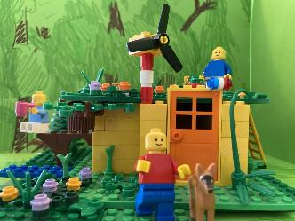
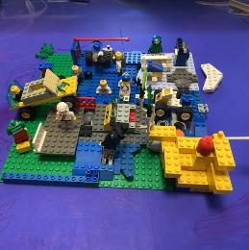
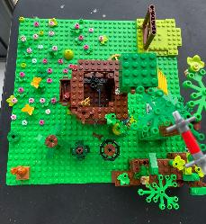
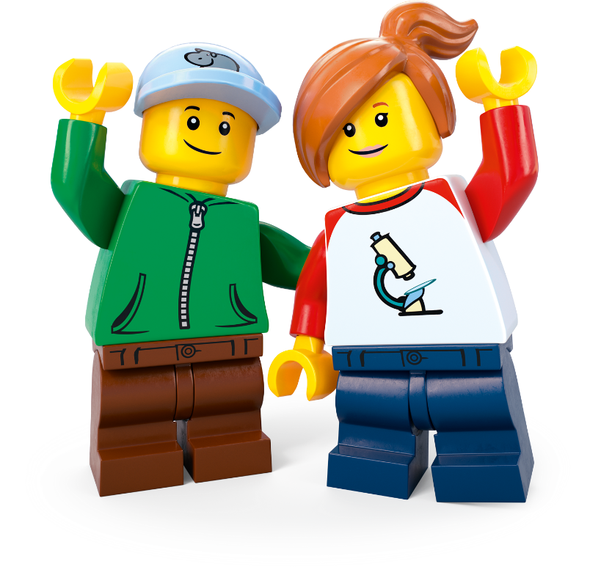
Podcast Pause 1: Mini Design Challenge
Create an object or place that brings people together. What did you make?
Notes:
Time - 4 mins for this pause
Allow students to finish their mini-build challenge: Create an object or place that brings people together
Share some ideas.
Direct students to their Competition Worksheet.
As they listen to Part 2, next, remind them to add to their topic Mind Map by drawing or writing down interesting or inspiring words or ideas.

Slide 16
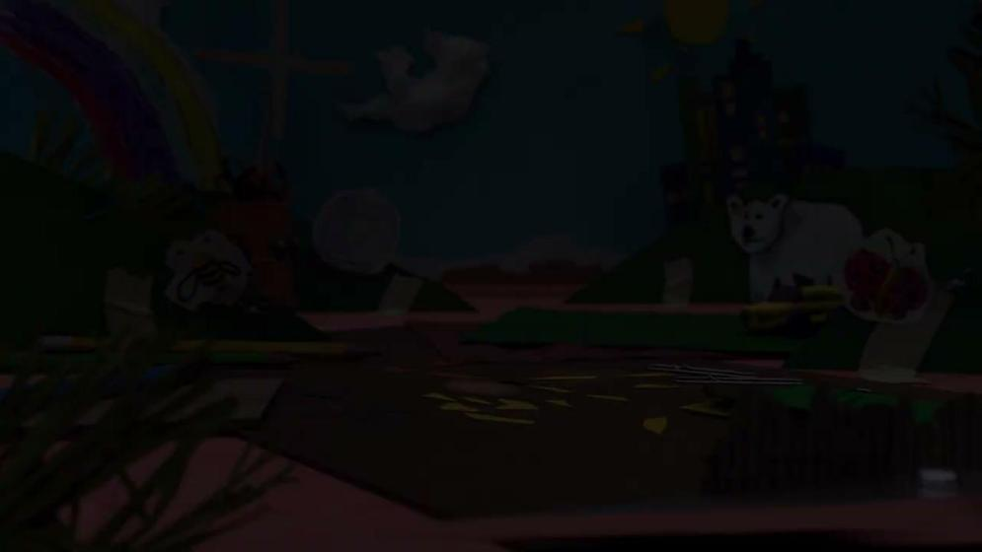
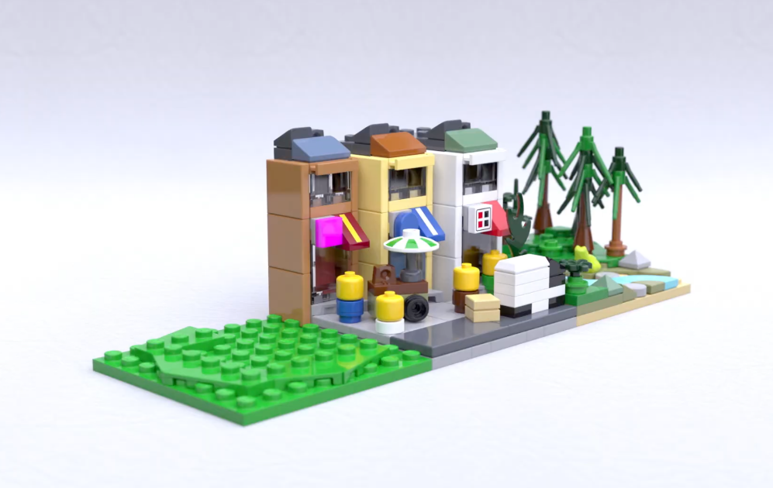
The Planet People Podcast Part 2
.
Notes:
Play part 2 (from 5:10) of the Planet People Podcast (6 mins), pause at 11.08 (if you need the link to the podcast again it’s https://www.youtube.com/watch?v=4r0TgO6pFC8).
In this part, students will:
Listen to the hosts interview the guest expert using the Investigation of the Day question: Why belonging so important for people and the planet?
Pupils create a Mind Map in their Competition Worksheet to record ideas as they listen.
2. Pause the podcast at 11.08, (see Podcast Pause 2 Slide 17)

Slide 17
Podcast Pause 2: What have
we learned?
Notes:
Time - 2 mins for this pause
Take a moment to encourage students to share what they have written down on their worksheet. Use these comprehension questions to check for understanding:
What is the Centre for Loneliness Studies and what does it do? Can they recall three ways they study loneliness? It’s part of Sheffield Hallum University and they research all kind of things around loneliness, how it affects people and what we can do about it. This includes:
Why do people feel lonely?
What kinds of people are more likely to feel lonely and why?
What events in our lives make us feel lonelier?
How does where we live either make us feel lonely or connected.
How can we help people feel less lonely and more connected?
What are some good examples of projects successfully tackling loneliness? Why are these effective? Can they think of any of their own examples of projects or activities they’ve seen or experienced that might help with loneliness?
Intergenerational living – where young people and older people live side-by-side
Intergenerational creative projects like making music, songwriting and art together
Social robots are like pets or friends that can help a lonely person with companionship, daily support and connect them to the outside world.
Friendly benches surrounded by nature which provide spaces where people in a communities can rest, get to know each other and connect with nature all at once.
We live in a world full of people. Why do we still feel lonely? Often this is because we don’t have meaningful relationships. These are the types of relationships where we share the same interests, think similar things or want similar things out of life. We all feel lonely sometimes – its part of being human. Some people are more likely to feel lonely. Age can cause us to feel lonely as well big life events like losing someone or something you love (grief), changing school, works or moving house. These are usually temporary and go away as we make new connections.
You may wish to ask students to consider what a meaningful relationship might look like. Can they describe them? What would the features be? Maybe they could reflect quietly on the meaningful relationships in their own lives and ways they could find even more of these. You could ask them to imagine they are helping a friend who is feeling lonely. What advice would they give them, based on what they’ve heard so far.
5. Ask students to consider the Investigation of the Day question: Why is belonging so important for people and our planet? Invite students to share their thoughts based on what they’ve learned so far.

Slide 18
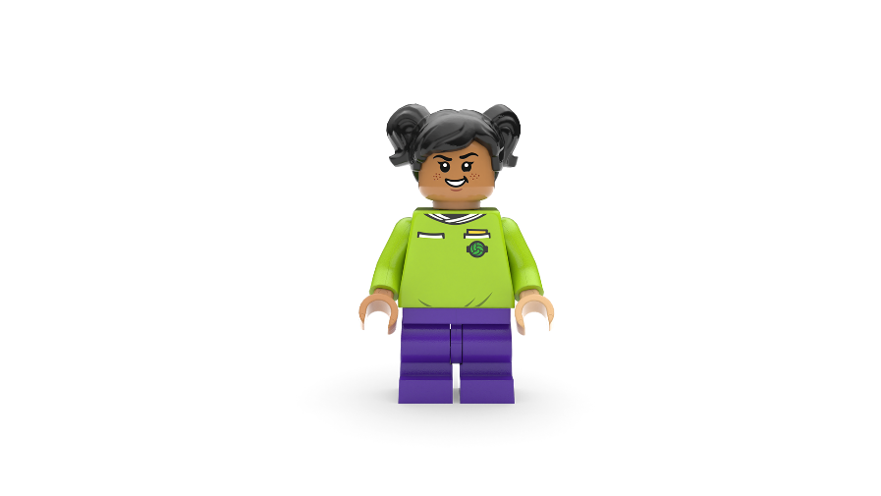
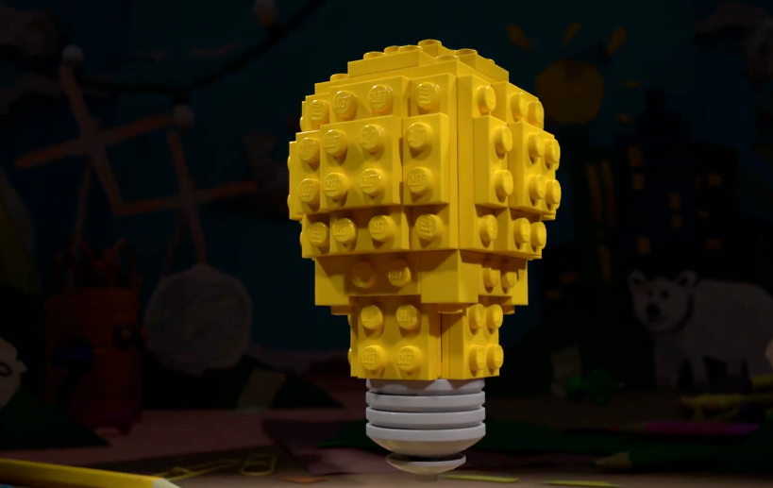
The Planet People Podcast Part 3
Notes:
Play part 3 (from 11:08) of the Planet People Podcast, to the end (8 mins). (if you need the link to the podcast again it’s https://www.youtube.com/watch?v=4r0TgO6pFC8).
In this part, students will:
Recap on the conversation
Be introduced to the Build the Change design challenge
Record any inspiring ideas on their Competition Worksheet.
Understand how they can enter their ideas into our competition.

Slide 19
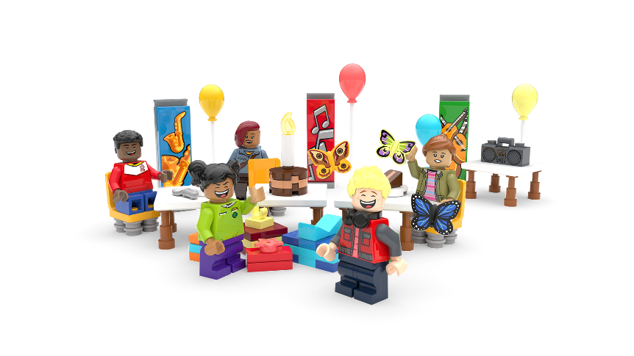
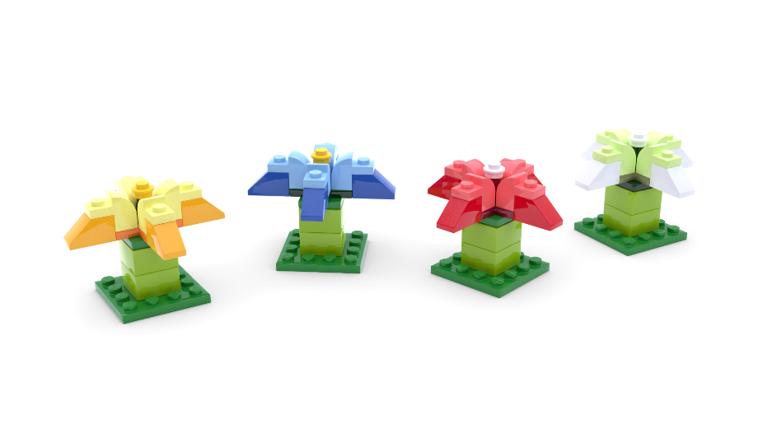
The Build for Belonging Design Challenge
Create something that tackles loneliness and helps local people feel connected.
Notes:
Time - 2 mins
Remind students that: Feeling lonely sometimes is part of being human. All humans want to feel like they belong and feel connected to others. What if you could create something amazing to help everyone in your community feel happier and more connected to others? This is your chance to design a brilliant solution to bring people together!
Set the Build the Change challenge using the slide:
Create something that tackles loneliness and helps local people feel connected.
Check for understanding.

Slide 20
Reflection
What inspired you?
What intrigued you?
Notes:
Time - 4 mins
Think about the topic, the design challenge and anything else you’ve learned today. Allow students time to add final thoughts and ideas to their Mind Map.
You could ask them to:
Draw one thing that has interested or inspired them today
Write down one question they still have about the topic.
You may wish to seek answers to these questions together, or set this as research challenge to be completed at home.

Slide 21
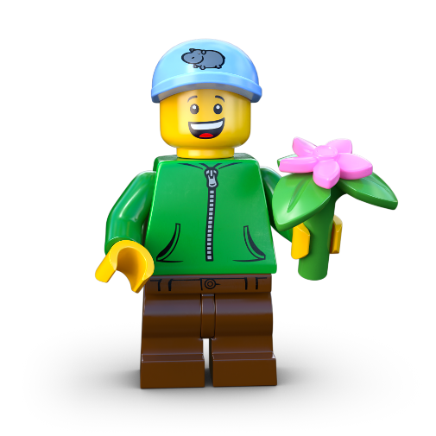
Take Action!
Extension Activity
Notes:
Take Action! Extension Activity
The activities in this session are completely optional. You can spend however long you like on these, therefore we haven’t included timings. You may even wish to take the learning out of school and into the community.

Slide 22
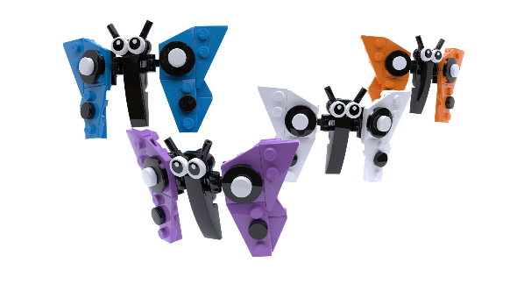
What is a community?
Notes:
Community: A community is a group of people who care about each other and work together. It can be big or small, like your family, your class at school, your neighborhood, or even a sports team you play on.
In a community:
People help each other, like neighbours sharing tools or classmates helping with homework.
They include everyone, so no one feels left out.
They share things, like information, advice, resources or support.
For example:
Your class is a community because you learn and play together.
A sports team is a community because everyone works together to score goals and win games.
A group of friends is a community because you care about and support each other.
Communities are special because they make people feel like they belong.

Slide 23
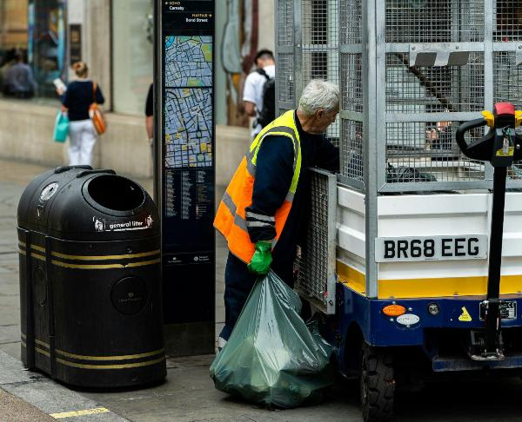
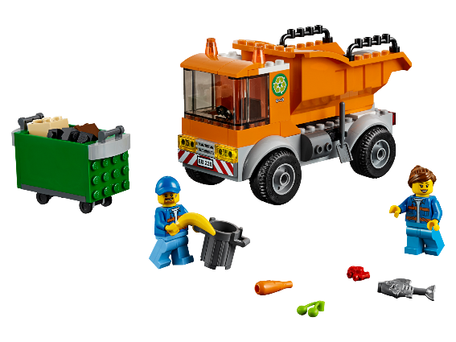
Activity 1: Community Exploration
c Krzysztof Hepner/Unsplash
Notes:
Encourage students to think about your wider local community. You could take your class out into the community to observe people and get ideas.
Use this script to get students started:
Research the different groups in our community (age, culture, jobs, interests, etc.). Don’t forget behind-the-scenes workers like waste collectors or council members.
Task:
Create something visual to represent these groups.
Share with the class. When listening to others, make sure you update your list with any missing groups.
By the end of this workshop you will have compiled a list of the different groups of people that make up your community. Encourage them to think creatively about how they could visually represent the data. Could they build something, draw a community map or create a digital infographic?
Objective: Students will explore and identify different groups that make up their local community and create a visual representation of their findings.
Materials:
Paper, markers, or digital tools for visual creation
Workshop Steps:
Introduction (10 mins)
Discuss what makes up a community (age, culture, jobs, interests, etc.).
Highlight often-overlooked roles (e.g., waste collectors, council members).
Exploration & Research (20 mins)
If possible, take students outside to observe the community.
Have them take notes on different groups they see or know about.
Task: Visual Representation (20 mins)
Students create a visual (map, collage, infographic, model, etc.) to represent the groups they identified.
Sharing & Discussion (10 mins)
Students present their work and add any missing groups to their lists.
Discuss why all these groups are important to a functioning community.
Assessment:
Completed visual representation
Participation in discussion and reflection
Extension Idea:
Have students interview a community member to learn more about their role. Do they feel that they contribute to the community?

Slide 24
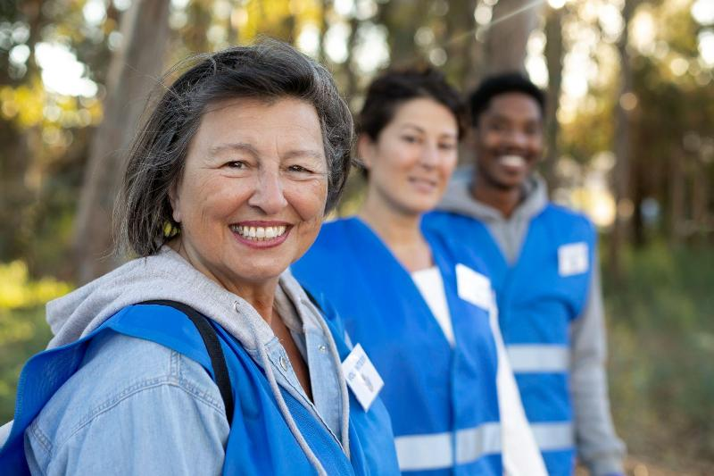
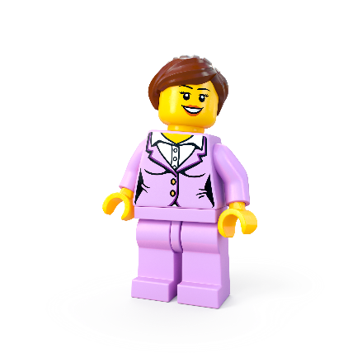
Activity 2: Empathise
c Freepik
Notes:
Objective: Students will develop empathy and critical thinking by analysing the role, challenges, and societal perceptions of a specific community group.
Materials:
Question prompts (displayed or printed)
Paper or digital tools for note-taking and presentations
Workshop Steps:
Introduction (10 mins)
Recap the previous lesson on identifying different groups in the community.
Explain the task: Each group will focus on one specific community group and analyse their role and experiences.
Group Selection & Analysis (20 mins)
Assign or let students choose a group (e.g., teachers, waste collectors, healthcare workers, shopkeepers, etc.).
Guide students through the reflection questions:
How do they contribute to the community?
Are they appreciated or overlooked?
What if they were missing?
What stereotypes exist, and how might they be harmful?
How connected do they feel to the community? Could they feel isolated?
Empathy Exercise & Creative Response (20 mins)
Students present their findings in a creative format:
A short role-play or skit
A written reflection or diary entry from the perspective of the group
A poster or infographic highlighting key insights
Class Discussion (10 mins)
Groups share their presentations.
Discuss how this perspective-taking exercise changes their understanding of community roles.
Assessment:
Depth of analysis in responses
Engagement in the discussion and creative presentation
Extension Idea:
Have students research real-life stories or interview a person in the group they studied.

Slide 25
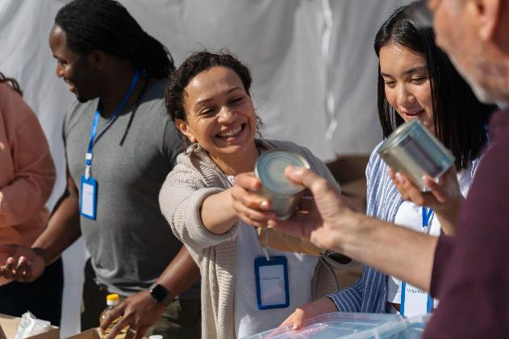
Activity 3: Community Connections
c Freepik
Notes:
Objective: Students will research local opportunities that support a specific community group, evaluate their effectiveness, and propose improvements to foster a greater sense of belonging.
Materials:
Internet access or community resource guides
Paper or digital tools for compiling research (PowerPoint, posters, reports)
Workshop Steps:
Introduction (10 mins)
Recap the previous lesson on analysing a community group’s role and challenges.
Introduce today’s task: Research local clubs, services, or projects that support this group and assess their impact.
Research & Analysis (20–30 mins, in class or as homework)
Students investigate what’s available locally for their assigned group.
Guide them with key questions:
What programs, clubs, or services exist?
Are they easily accessible and well-known?
How could they be improved to better meet needs?
Are there gaps, and what new initiatives could be created?
Presentation Preparation (20 mins)
Students compile their findings into a creative format:
PowerPoint presentation
Infographic or poster
Report or community proposal
Class Presentations & Discussion (20 mins)
Each group presents their research and suggestions.
Discuss recurring gaps and brainstorm possible student-led initiatives.
Assessment:
Quality and depth of research
Creativity in presentation
Thoughtfulness in proposed solutions
Extension Idea:
Invite a local community leader to discuss real-world initiatives and opportunities for student involvement.

Slide 26
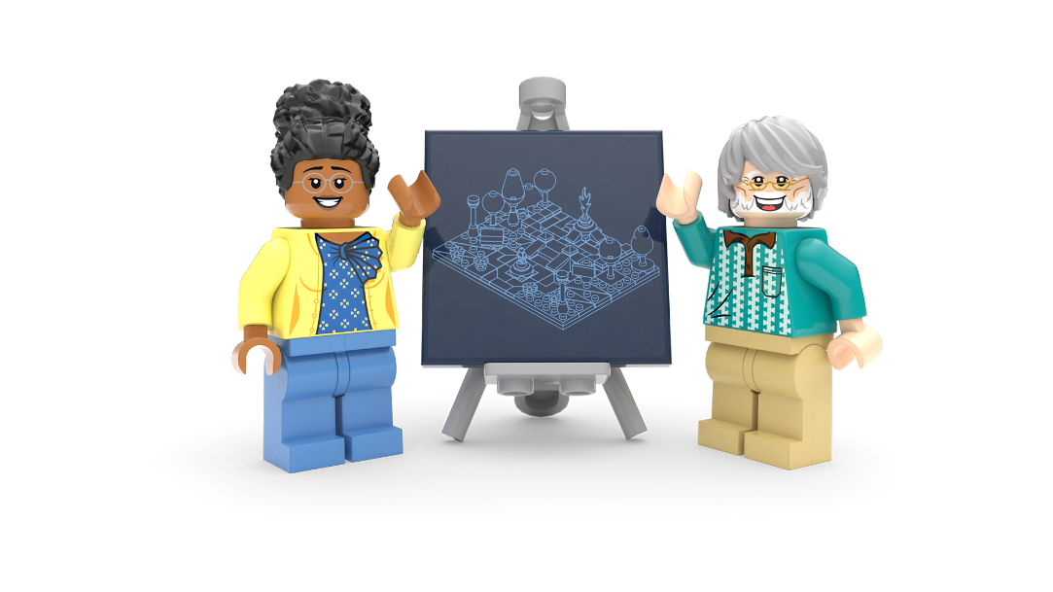
Lesson 2
Create and Share!

Slide 27
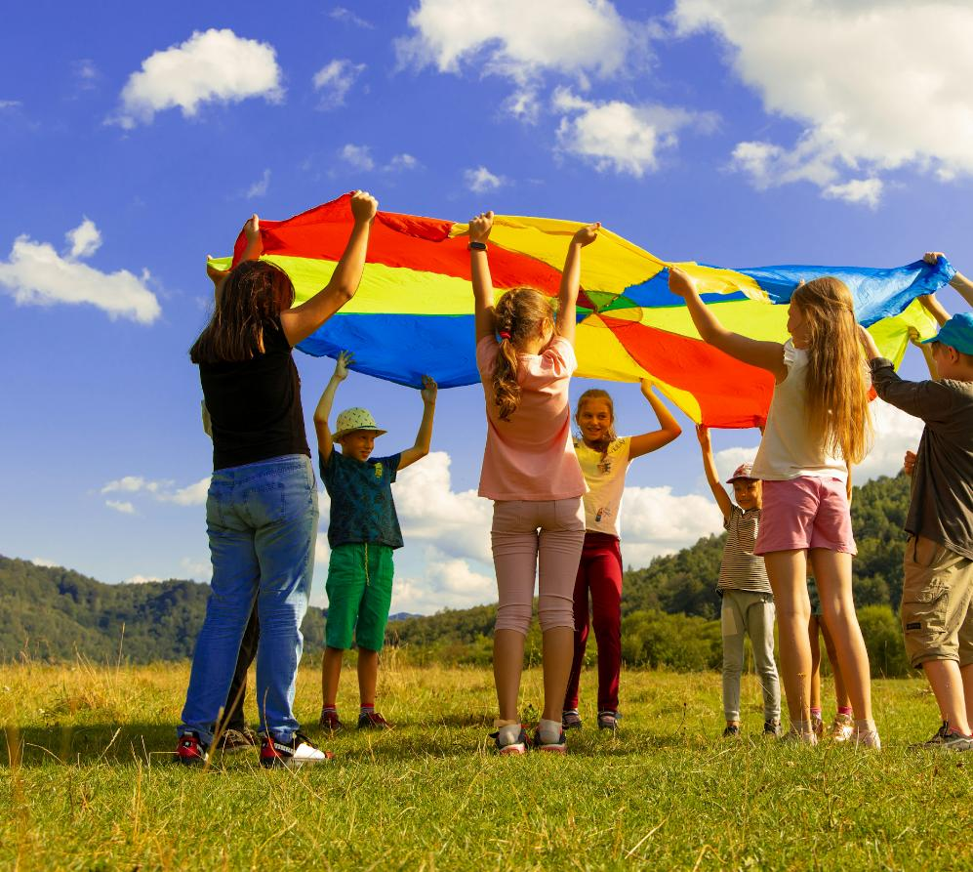
Power Teams
Notes:
Time - 2 min
Put students into teams of 4 around creative materials of your choice.
Use this script to introduce the challenge:
Tell your team about something that makes you you! It could be a skill, strength, interest, or talent. Maybe it’s an unusual hobby, a positive personality trait you have, or something special from your background or family. Whatever it is, share what makes you unique!
Give them 2 mins to identify and share one of their strengths.

Slide 28
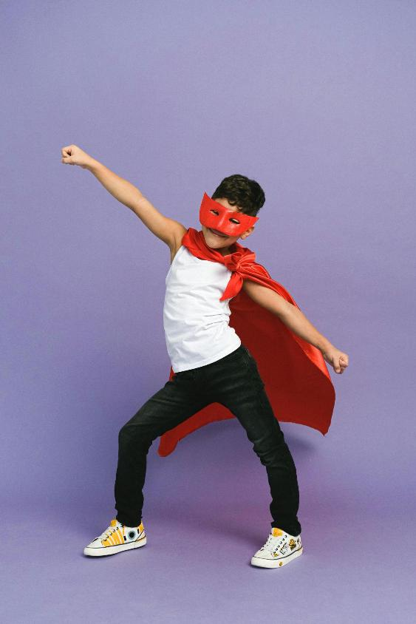
Power Teams
c Anna Shvets/Pexels
Notes:
Time - 5 mins
Next, challenge teams create a super character (this can be anything!) that combines their special qualities. They can draw or build this, depending on time, resources and your class. Encourage them to give their super character a name. This is their team name.
Use this script to explain the challenge:
Use your creativity and the materials around you to design a super character that combines all your unique individual qualities. Think about how your skills, strengths, and interests can make your character unstoppable! Once you're done, give your character a name – this will be your team’s name for today.

Slide 29
Work together. Create together.
Teamwork = Success
No Idea’s Too Wild
Level It Up
Lead by Listening
Kindness is Key
All In, All Together
Differences = Strength
Mistakes Make Us Better
Notes:
Time - 1 min
Use this slide as a checklist to help students reflect on the previous team or paired activity. What did they do well? Where could they have improved? Remind them that when we work well together in teams and include everyone, we feel a sense of belonging. If you are completing the main design challenge in pairs or team, you could read through this teamwork manifesto together:
Teamwork = Success Stick together, support each other, and enjoy the ride - we win as a team!
No Idea’s Too Wild Every thought counts, whether it’s simple, creative, or completely out there.
Level It Up Build on each other’s ideas to create something even better.
Lead by Listening Respect everyone’s voice - great ideas start with paying attention.
Kindness is Key Use positive words and build each other up - we’ve got each other’s backs.
All In, All Together Make sure everyone’s part of the action - no one’s left behind.
Differences = Strength Our unique ideas and perspectives make the team unstoppable.
Mistakes Make Us Better Every mistake is a step forward - learn, grow, and keep going strong.
If you are running this challenge as a pair or team activity, these rules will help students build a sense of belonging as they tackle the creative challenge. If you have more time, you could pass a copy round for everyone to sign or even create your own.

Slide 30
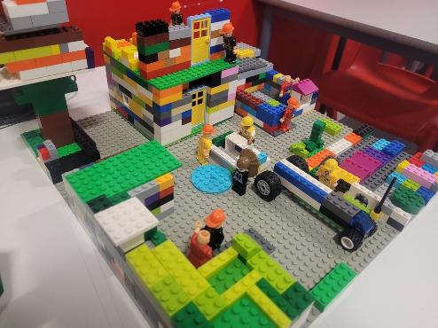
The Build for Belonging Design Challenge
Create something that tackles loneliness and helps local people feel connected.
Notes:
Time - 3 mins
Bring students back to the design challenge that was introduced in lesson 1: Create something that tackles loneliness and helps local people feel connected.
Remind students that: Feeling lonely sometimes is part of being human. All humans want to feel like they belong and feel connected to others. What if you could create something amazing to help everyone in your community feel happier and more connected to others? This is your chance to design a brilliant solution to bring people together!
Use the next slide to spark their thinking with solutions we’ve already covered in the lessons.
Check for understanding.

Slide 31
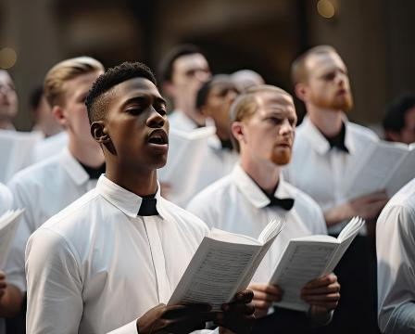
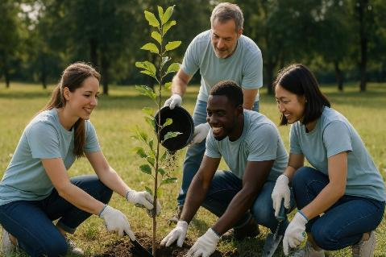
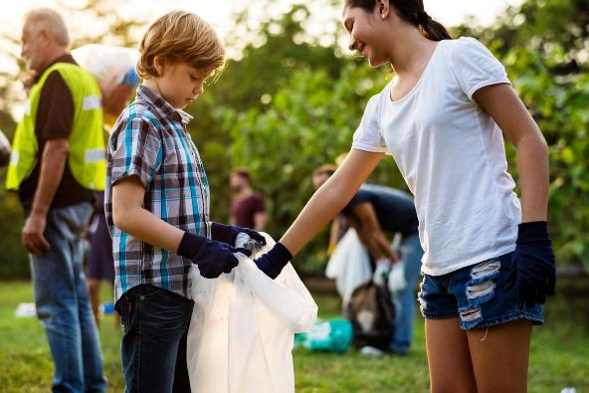
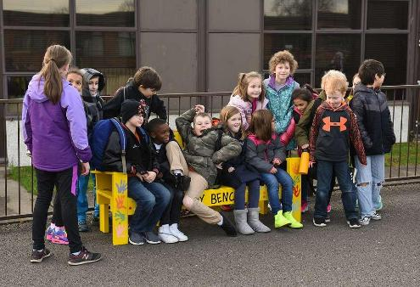
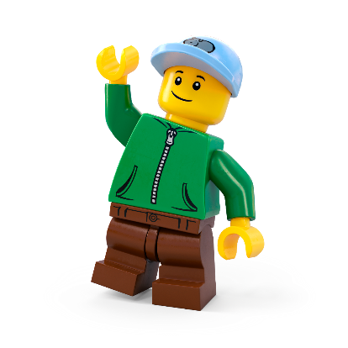
Design Challenge Inspiration

Slide 32
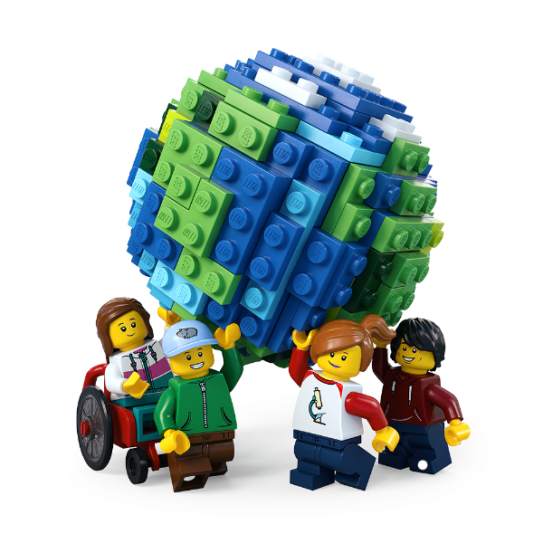
Let’s Build the Change!
Brainstorm ideas
Design your space
Create a model
Write a description
Share your solution
Enter our competition
Notes:
Time - 20 mins
Use this slide to explain all the jobs that need to be done before setting students off on their own.
Brainstorm ideas Look at your mind maps. As a team, write down as many ideas as possible – the sillier, the better! Choose two or three of the best ideas to make even better. Decide on one idea as your solution.
Design your space Draw your brilliant solution in the Competition Worksheet.
Build a model Create a model of your solution using all the cool materials available.
Present your solution Share your ideas with the rest of the class
Enter the Build for Belonging competition
Make sure your ideas, designs and descriptions are included in your Competition Worksheet. Teams should submit one worksheet per team to the competition. Teachers can take a photo of the build to enter it into our competition.
Remember: You can run the challenge as an individual challenge, in pairs or small groups of up to 4. You can allocate team roles using the Team Roles on slide 39, in the appendix.

Slide 33
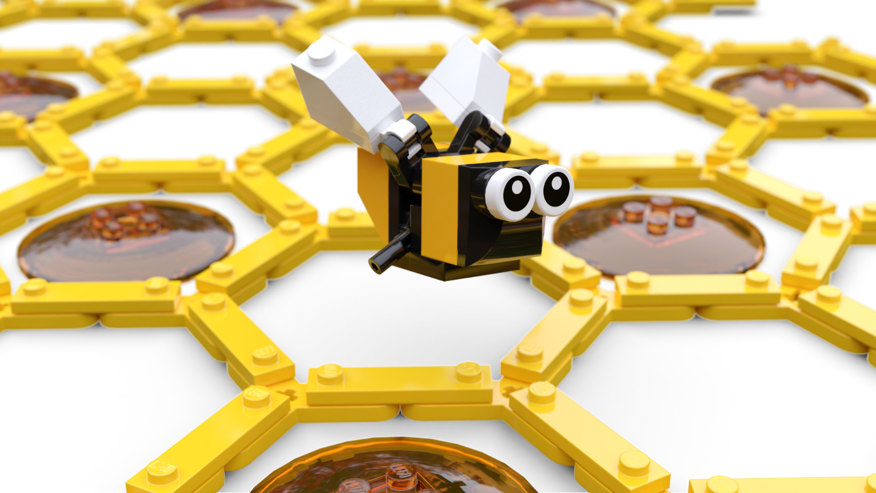
Iterate
Join up
Share ideas
Give feedback
Make improvements!
Notes:
Time - 9 mins
This is optional. It is recommended but can be removed if time is short. Or, the teacher(s) could visit each group and give feedback.
Pair up two individuals, pairs or teams for peer assessment.

Slide 34
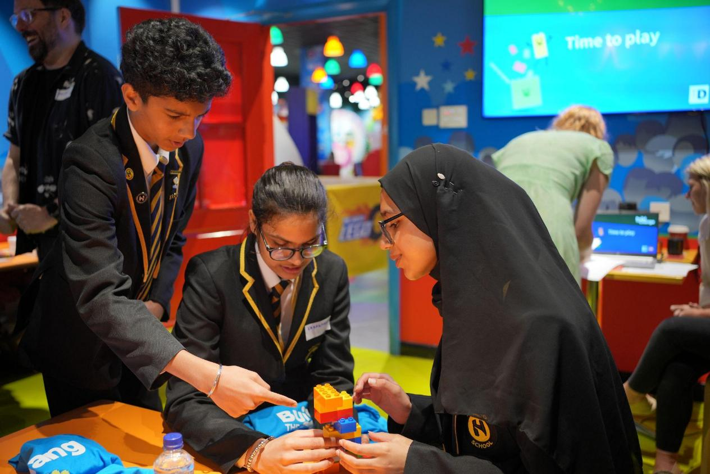
Final Checklist
Have you:
Labelled your final design?
Written a description of your solution
Got your model ready for its photo?
Prepared your presentation?
Notes:
Time - 10 mins
Give time to wrap up.
If you’re running the challenge with pairs or teams, use this list to remind each team member what they are responsible for:
Creative Designer: Time to show off your artistic skills! Label your final drawing to highlight all the awesome features of your design.
Copywriter: Get your writing hat on! Write a cool description of your amazing solution so everyone knows how it works.
Architect: Your job is to get our model ready for its close-up! Make sure it's looking perfect for its big moment in the spotlight.
Head of Communications: You’re the star presenter! Get ready to wow the class with your awesome solution and explain how it works.

Slide 35
buildthechange.theday.co.uk/competition
Notes:
Ask pupils to stop working and place their models around the room for everyone to see.
If you are entering your class’ ideas into our Build for Belonging Competition, show this slide to get pupils excited!
Enter by 30th June at www.buildthechange.theday.co.uk/competition

Slide 36
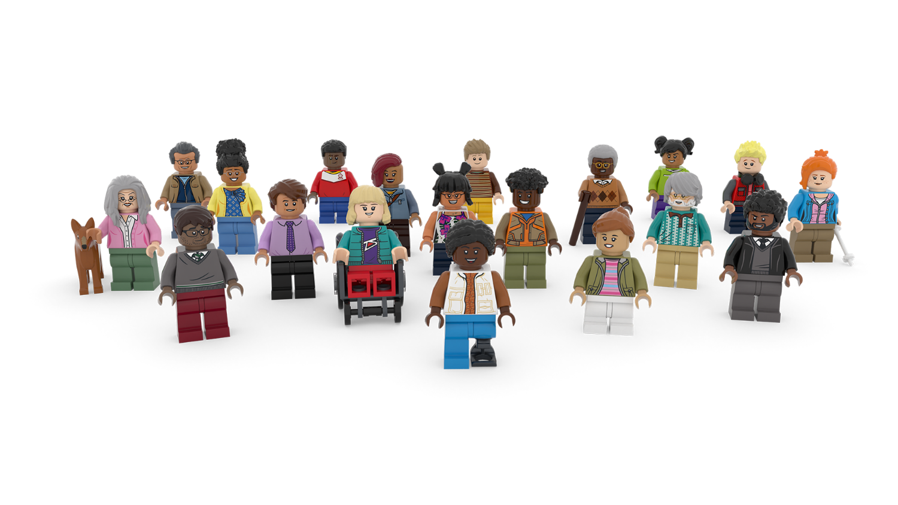
Share your ideas
Notes:
Time - 10 mins
Ask students to take it in turns to present their solution to the class. Encourage others to give positive and constructive feedback.
You could ask them: What went well? What could be even better?
Celebrate all their awesome ideas!

Slide 37
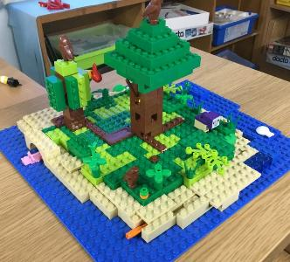
Share it with the world
Missed the competition deadline?
Don’t worry, your students’ awesome ideas can also be published on the LEGO.com website! Simply upload photos with a 200-character max description of your young person’s creations to our Build the Change photo gallery, for the whole world to see!
They might even be our next Builder of the Week!
Scan the QR code with a camera to start uploading.
Notes:
Don’t forget to upload your learner’s awesome ideas to help us show everyone how awesome kids’ ideas are!
You can upload photos and descriptions of your children’s creations to our Build the Change Tuesday gallery. They might even be our next Builder of the Week! Scan the QR code with a camera to start uploading, or visit: https://www.lego.com/en-gb/sustainability/buildthechange/challenges/theday/upload?CMP=EMC-LCE.

Slide 38
Appendix

Slide 39
Team roles
Head of Communications The presenter gets to show off the team's amazing work to the class.
Copywriter The writer explains the team's ideas in the best words possible.
Creative Designer The designer creates and improves the team's awesome drawings.
Architect The builder brings the design to life with a cool model.
Notes:
Use this slide if you are asking students to work in groups. Please note: Students can enter the competition individually, in pairs or in teams of up to 4 people.
Explain the roles. Ask students to take on team roles according to their strengths.
Head of Communications Presents the final design to the class. Useful skills: Enthusiastic, confident, and loves speaking in front of people.
Copywriter Writes the description of the design and explains how it works. Useful skills: Enjoys writing and is great at turning ideas into words.
Creative Designer Draws and improves the designs on paper. Useful skills: Creative, loves to draw, and gets excited about bring ideas to life.
Architect Builds a model of the final design. Useful skills: Patient, creative, and has steady hands for building under pressure.

